Slide 1
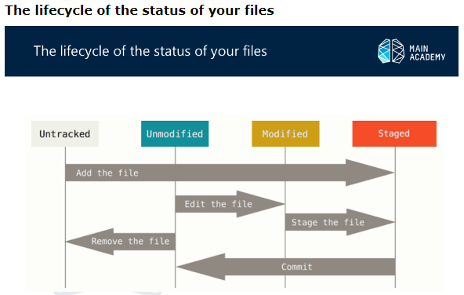

Slide 2
Comments: Remember that each file in your working directory can be in one of two states: tracked or untracked. Tracked files are files that were in the last snapshot; they can be unmodified, modified, or staged. Untracked files are everything else – any files in your working directory that were not in your last snapshot and are not in your staging area. When you first clone a repository, all of your files will be tracked and unmodified because Git just checked them out and you haven’t edited anything.
Addition information: https://git-scm.com/book/en/v2/Git-Basics-Recording-Changes-to-the-Repository

