Slide 1

Where are slides & code?
https://goo.gl/xZoYjj

Slide 2
Advance Web Technologies
Umer Farooq Mughal
Muzzammil Hussain
Workshop at UMT Lahore, March 2018

Slide 3
About Us
# Principle Software Engineers at Arbisoft.
# More than 8 years of industry experience.
# Arbisoft is one of the most high tech software house in Pakistan.
# 300+ engineers works at Arbisoft for some of the best tech names.
# Arbisoft arranged Pakistan’s first ever PyCon in 2017.

Slide 4
Before We Start...
# This is a guide to web development technologies and your options.
# Based on fact and opinion.
# It will also gives you idea how things are working in industry.

Slide 5
Common Question from Students
# I want to become a Full-Stack/Front-End /Back-End developer, what should I need to do?

Slide 6
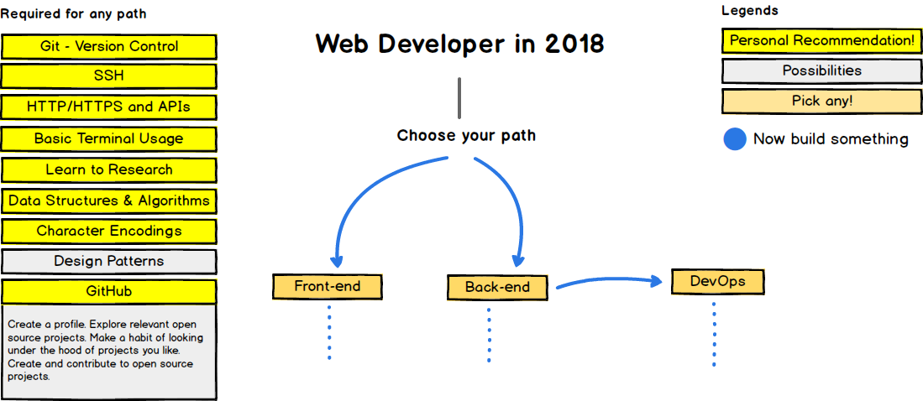
Roadmap to Becoming a Web Developer

Slide 7
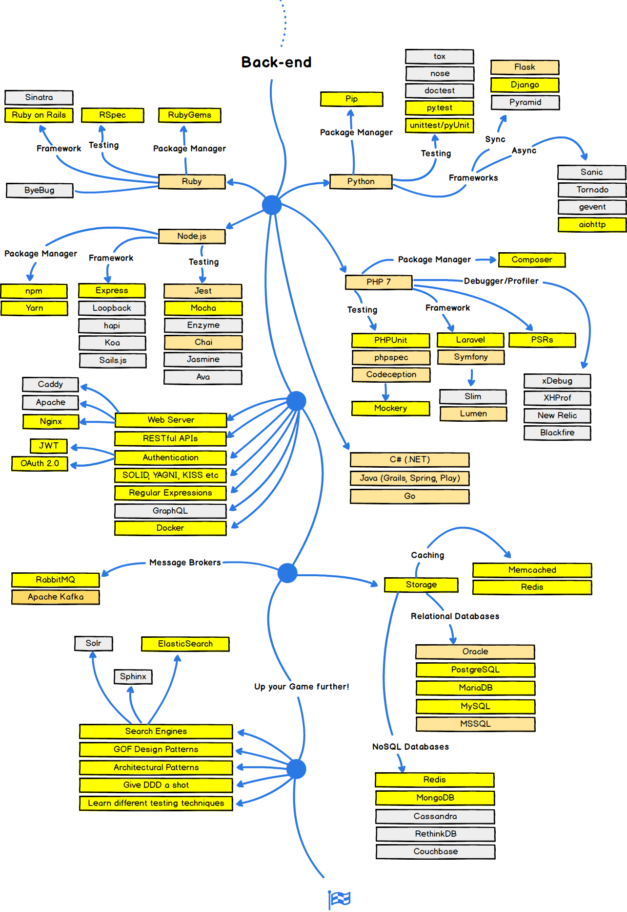

Slide 8
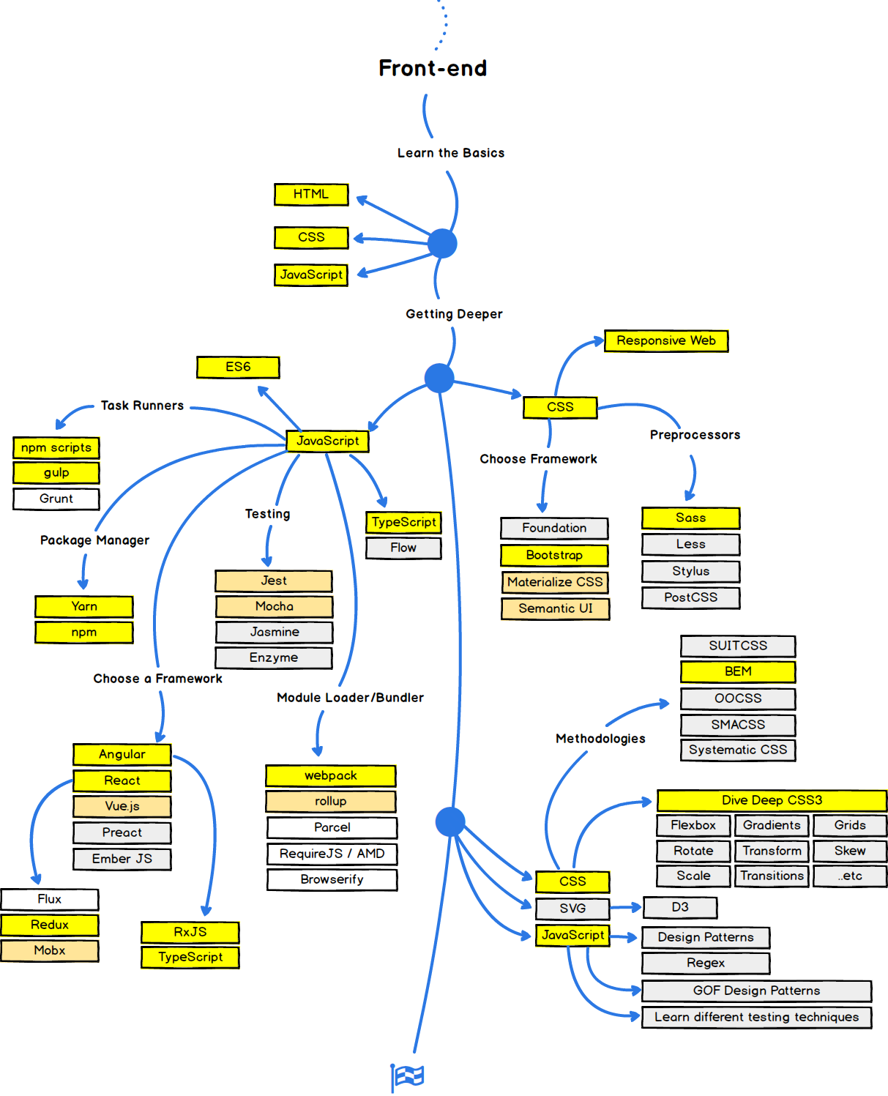

Slide 9
What makes Python special?

Slide 10
Python Has a Supportive and Active Community
# It’s been around for quite some time, so there’s plenty of documentation, guides, tutorials and more.
# The developer community is incredibly active. That means any time someone needs help or support, they can get it in a timely manner.
# When you run into development issues in the middle of crunch time, support can either make or break you.

Slide 11
Python Is Reliable and Efficient
# You can work with and deploy Python applications in nearly any environment, and there’s little to no performance loss no matter what platform you work with.
# Again, because it’s versatile, this also means you can work across several domains including but not limited to web development, desktop applications, mobile applications, hardware and more.
# You’re not bound to a single platform or domain, and it offers the same experience everywhere.

Slide 12
Python Has Some Great Corporate Sponsors
# It helps big time when a programming language has a corporate sponsor. C# has Microsoft, Java has Oracle and PHP is used by Facebook.
# Google adopted Python heavily back in 2006, and they’ve used it for many platforms and applications since.
# Why does this matter? Because if companies like Google want their team and future developers to work with their systems and apps, they need to provide resources. In Google’s case, they created a vast quantity of guides and tutorials for working with Python.

Slide 13
Python Has Big Data
# The use of big data and cloud computing solutions in the enterprise world has also helped skyrocket Python to success.
# It is one of the most popular languages used in data science, second only to R.
# It’s also being used for machine learning and AI systems and various modern technologies.

Slide 14
Python Has Amazing Libraries
# When you’re working on bigger projects, libraries can really help you save time and cut down on the initial development cycle.
# Python has an excellent selection of libraries, from NumPy and SciPy for scientific computing to Django/Flask for web development.
# There are even a few libraries with a more specific focus, like scikit-learn for machine learning applications and nltk for natural language processing.

Slide 15
Python Is Accessible
# For newcomers and beginners, Python is incredibly easy to learn and use.
# Part of the reason is the simplified syntax with an emphasis on natural language.
# You can write Python code and execute it much faster.

Slide 16
Python Is Popular
# Python is second most popular language on Github with 1 Million PRs in 2017.
# As of Dec 2017, Python is second most in-demand programming language with 2nd highest job share in programming. Thanks to Machine Learning and Big Data.

Slide 17
Why Node.js is Important too?

Slide 18
Language re-use
// Technologies like ASP.NET, Django or Spring requires developers to know yet another language to write code on the server-side; be it C#, Python, Java or any other.
// On the other hand, Node.js uses JavaScript.
// Developers only have to talk in a single language across all layers.

Slide 19
It is lightweight
// Node.js uses an event-driven architecture which means everything done on it, every single call and operation, is a chain of asynchronous callbacks.
// This allows Node.js to run on a single thread.
// This is the very foundation of the non-blocking I/O nature you may have heard that is Node.js main feature.

Slide 20
Node.js wins with Database Queries
// The database queries for new NoSQL databases like MongoDB, CouchDB are written in JavaScript.
// Developers need no gear-shifting in remembering the syntax differences when combining Node.js and NoSQL databases.
// JSON is modern form of data and its native to Node.js

Slide 21
World is Heterogeneous now
// There is no single answer to complex modern world problems.
// Node.js and Python are used side by side.
// NPM is the biggest 3rd party module repository, take advantage of that.
// Node.js is most commonly used as “Proxy” to other micro-services.

Slide 22
Flask

Slide 23
Main contrasts (vs Django)
// Flask provides simplicity, flexibility and fine-grained control. It is un-opinionated (it lets you decide how you want to implement things). It’s more “pythonic” because it’s explicit .
// Django provides an all-inclusive experience: you get an admin panel, database interfaces, an ORM, and directory structure for your apps and projects out of the box.

Slide 24
You should probably choose
// Flask, if you're focused on the experience and learning opportunities, or if you want more control about which components to use (such as what databases you want to use and how you want to interact with them).
// Django, if you're focused on the final product. Especially if you're working on a straight-forward application such as a news site, an e-store, or blog, and you want there to always be a single, obvious way of doing things.

Slide 25
React JS

Slide 26
What is React JS?
# ReactJS is declarative, efficient, and flexible JavaScript open-source library which is used for building user interfaces specifically for single page applications.
# It’s used for handling view layer for web and mobile apps.
# V in MVC

Slide 27
ReactJS Features
JSX:
Instead of using regular JavaScript for templating, it uses JSX. JSX is simple JavaScript which allows HTML quoting and uses these HTML tag syntax to render subcomponents
React Native:
Provides the react architecture to native applications like IOS, Android and UPD
Single-Way data flow:
A set of immutable values are passed to the components renderer as properties in its HTML tags.
Virtual Document Object Model:
React creates an in-memory data structure cache which computes the changes made and then updates the browser.

Slide 28
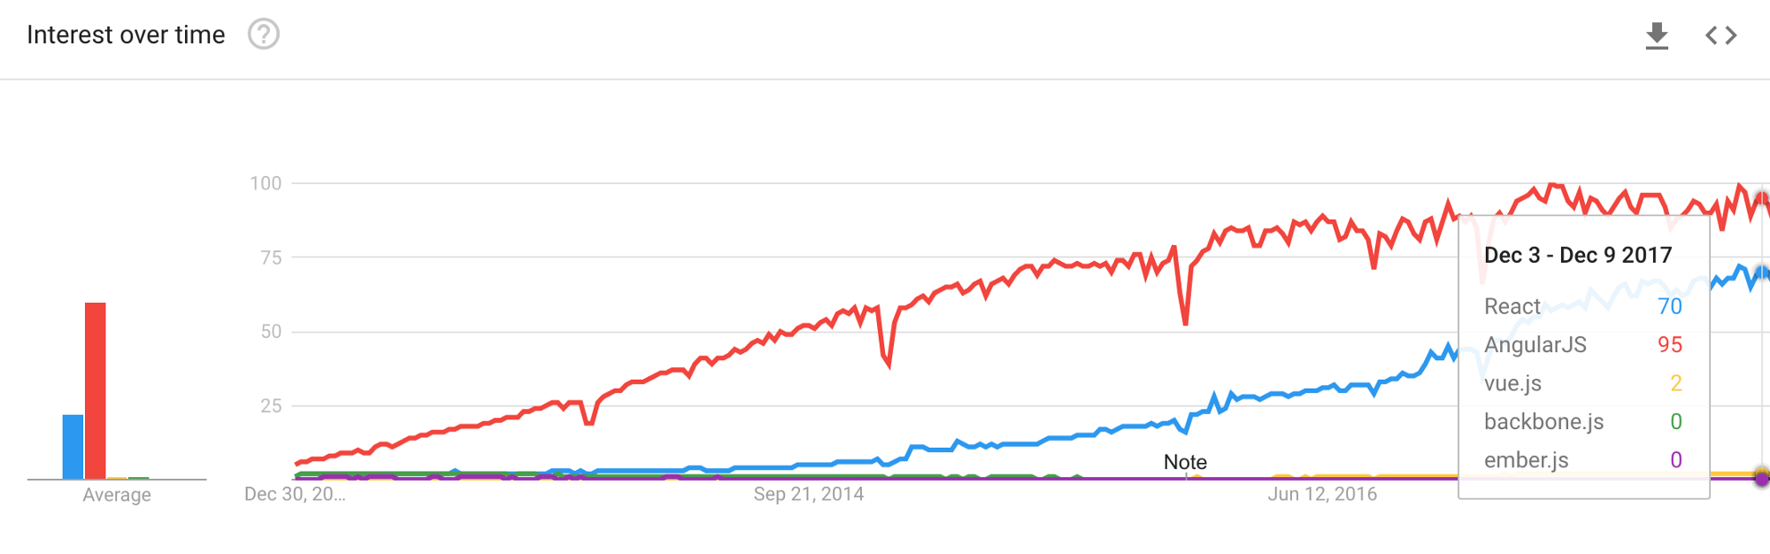
Why React Js?
# Because of Simplicity, Easy to learn, One way data binding and Performance
# One thing that really attracts me “It’s a Javascript”
# It’s trending(Google trends)

Slide 29
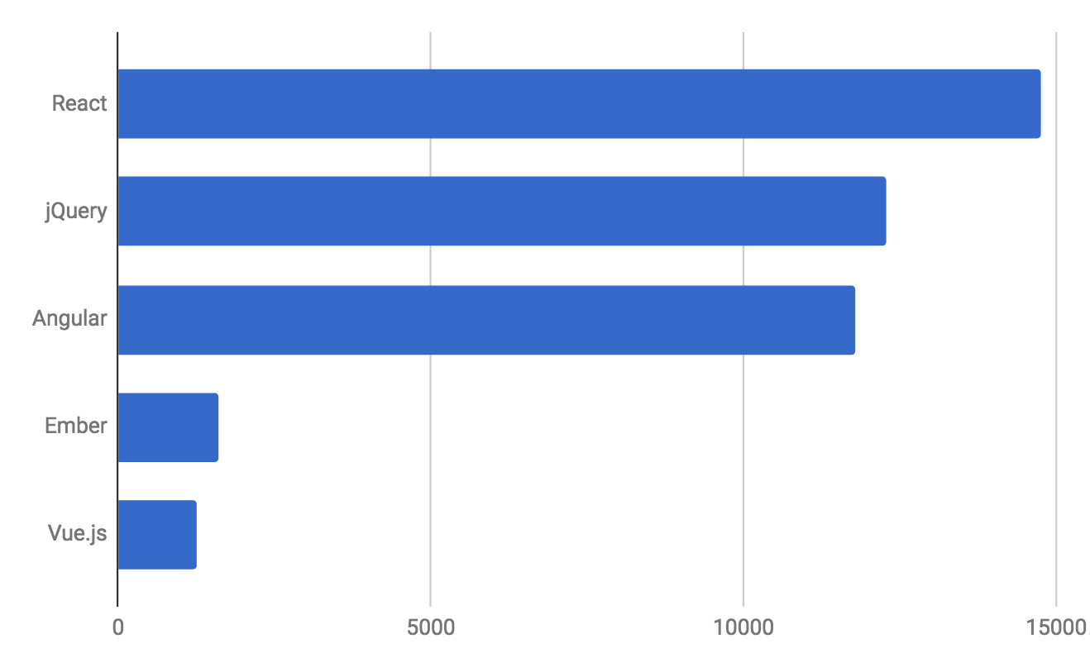
Why React Js?
(source: Indeed.com)

Slide 31
You can Contact Us
// muzzammil.hussain@arbisoft.com
// umer.farooq@arbisoft.com

