Slide 1
FACE RECOGNITIONS PROJECT

Slide 2
GROUP MEMBERS
Muhammad Hammad 11456
M Rashid Shafique 11446

Slide 3
PROJECT LIBERARIES
Pip Install Numpy For Creating matrix
Pip Install SVD For Calculation Covariance Matrix
Pip Install CV2 (Opencv-Python) For Read Images From Data Set
Pip Install OS For Traversing Directory For Getting Image Folders

Slide 4
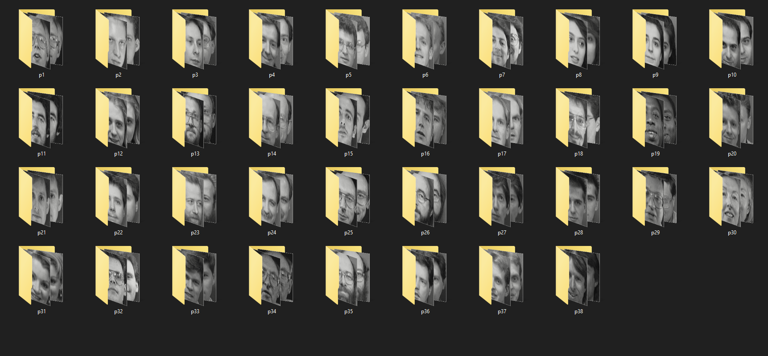
This is For Our Data Set

Slide 5
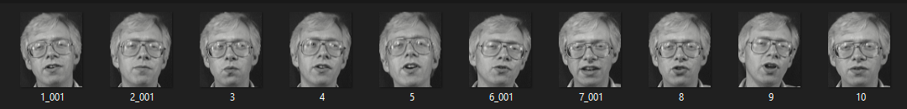
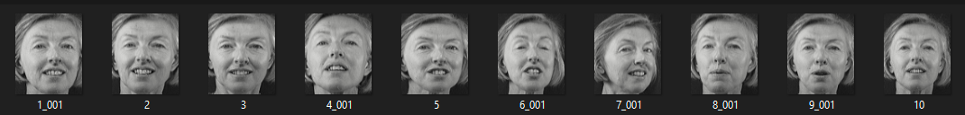
Protocol Dataset
Label Array
Person1
Person2
ADD TRAINING IMAGES ARRAY
ADD TESTING ARRAY

Slide 6
Image To Vector Matrix
Read Images In to Matrix Which Size Is N x N
And Convert Into Vector Form Which Size is N ² x 1
N ² x 1
N x N Size
pixel | pixel | pixel
pixel | pixel | pixel
pixel | pixel | pixel
pix | pix | pix | pix | pix | pix | pix | pix | pix

Slide 7
IMAGE 1
IMAGE 2
IMAGE 10
………………..
……….
N² x total Images

Slide 8
Vector Matrix
……….
N² x total Images

Slide 9
FIND MEAN FOR EACH IMAGE
Mean i1
Mean i2
Mean i3
Mean i4
Mean i5
Mean i6
Mean i7
Mean i8
……….
N² x total Images
Mean Array Size N ² x T

Slide 10
MEAN ARRAY
Mean i1
Mean i2
Mean i3
Mean i4
Mean i5
Mean i6
Mean i7
Mean i8
Mean Array Size N^2 x T

Slide 11
Subtract Of Each Row Cell For Each Image By mean And Save In to Mean Difference Array
-
Mean i1
Mean i2
Mean i3
Mean i4
Mean i5
Mean i6
Mean i7
Mean i8
……….

Slide 12
MEAN DIFFERNCE ARRAY
……….
N² x N²

