Slide 1
Software Engineering
Critical Estimation Concepts

Slide 2
Overview
Most massive cost overrun of recent times was Boston’s big dig highway.
Original estimated at $2.6 billion
Eventually cost $15 billion.
An estimation error of more than 400%

Slide 3
Four Generic sources of Estimation Error
Inaccurate information about project being estimated
Inaccurate information about organization that will perform the project
Too much confusion in project to support accurate estimation
Inaccuracies arising from the estimation process itself

Slide 4
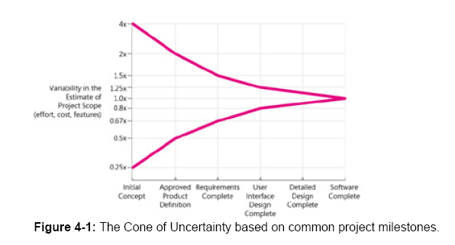
The Cone of Uncertainty
The cone shows how estimates become more accurate
As project progresses.

Slide 5
The Cone of Uncertainty
The reason that estimate contains
variability is that the software project
contains variability
The only way to reduce variability in the
estimate is to reduce the variability in the
Project
One misleading implication is that the cone
takes forever to narrow
See the diagram on the next slide

Slide 6
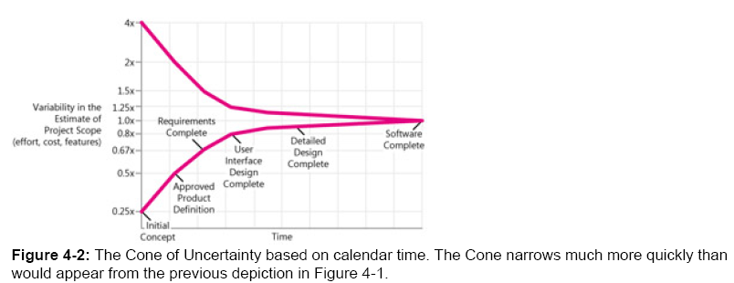
The cone of Uncertainty

Slide 7
Tip Regarding the cone
Tip: Consider the effect of the cone of uncertainty on the accuracy of your estimate. Your estimate cannot have more accuracy than is possible at your project’s current position within the cone.

Slide 8
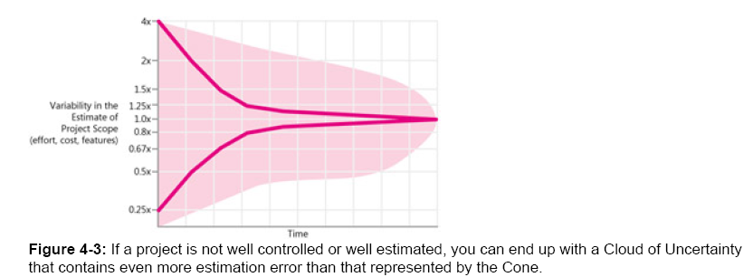
The Cone doesn’t narrow itself

Slide 9
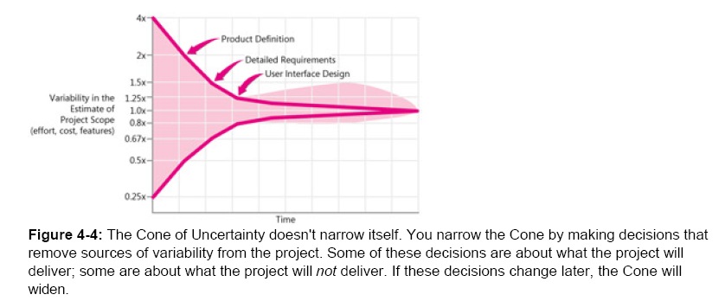
The cone doesn’t narrow itself

Slide 10
Another Tip
Tip: Don’t assume that the cone of uncertainty will narrow itself. You must force the cone to narrow by removing the sources of variability from your project

Slide 11
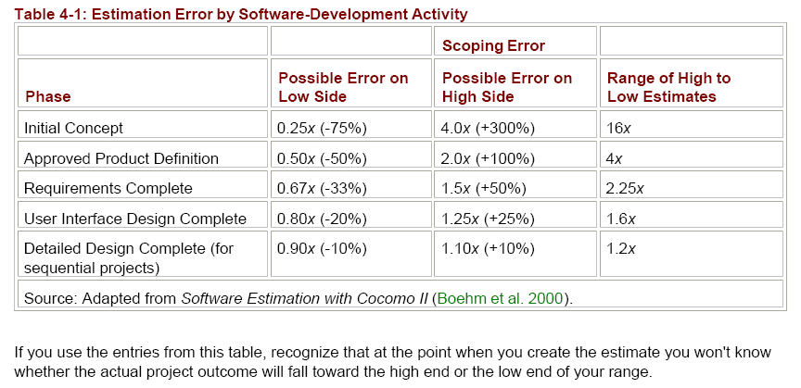
Accounting for the cone of
Uncertainty in software estimates

Slide 12
Two important tips
Tip: Account for cone of uncertainty by using predefined uncertainty ranges in your estimates
Tip: Account for cone of uncertainty by having one person create the “how much” part of the estimate and a different person create the “how certain” part of the estimate

Slide 13
Relationship between cone of uncertainty and commitment
Effective organizations delay their commitments until they have done the work to force the cone to narrow. Meaningful commitments in the early-middle part of the project (about 30% of the way in) are possible and appropriate.

Slide 14
Chaotic Development Processes
The cone represents uncertainty that is inherent even in well-run projects. Additional variability can arise from poorly run projects- that is from avoidable chaos
Common examples of chaos are:
Requirements that were not investigated
Lack of end user involvement in requirements validation
Poor designs that lead to errors in code
Poor coding practices
Inexperienced personnel
Incomplete or unskilled project management
Abandoning planning under pressure
Developer gold-plating
Lack of automated source code control

Slide 15
Tip for chaotic process
Tip: Don’t expect better estimation process alone to provide more accurate estimates for chaotic projects. You cant accurately estimate an out-of-control process. As a first step, fixing the chaos is more important than improving the estimates.

Slide 16
Unstable Requirements
Requirement changes has often been
reported as a common source of estimation
problem. Unstable requirements present
two specific estimation challenges.
The first challenge is that unstable requirements
represent one specific flavor of project chaos. If
requirements cannot be stabilized, the cone of
uncertainty can’t be narrowed and estimation
variability will remain high till the end of the project.
The second challenge is that requirements changes
are often not tracked and the project is often not
re estimated when it should be

Slide 17
Tip for Unstable Requirements
Tip: To deal with unstable requirements, consider project control strategies instead of or in addition to estimation strategies.

Slide 18
Requirements Growth
In order to estimate the effect of unstable requirements, you might consider simply incorporating an allowance for requirements growth, requirements changes or both in your estimate. A cone of uncertainty that accounts for requirements growth will also be different than the previous cone.

Slide 19
Requirements Growth
NASA’s software engineering laboratory uses the concept of requirements growth which plans on a 40% increase in requirements.
A similar concept is used by COCOMO II estimation model, which includes the notion of requirements “breakage”.

Slide 20
Omitted Activities
This is an example of error arising from the estimation practices.
We forget to include necessary task in the project estimates.
Studies show that developers overlook 20% to 30% of necessary task that brings about a 20% to 30% estimation error.

Slide 21
Omitted Activities
Omitted works falls into three major
categories:
Missing Requirements
Missing Software Development activities
Missing non software development activities

Slide 22
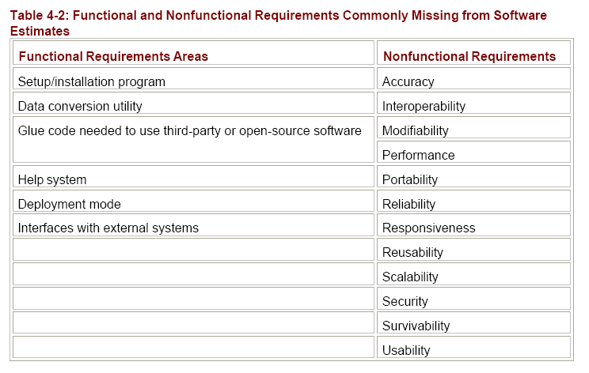
Requirements generally missed

Slide 23
Tip for omitted requirements
Tip: Include time in your estimates for all requirements. Nothing could be built for free and your estimates should not imply that it can.

Slide 24
Common software development activities missing from estimates
Ramp up time for new team members
Mentoring of new team members
Installation
Customization
Participation in review
Coordination with stake holders
Defect correction
Maintaining the revision control system
Coordinating with sub contractors

Slide 25
Tip for missing software development activities
Tip: Include all necessary software development activities in your estimates, not just coding and testing.

Slide 26
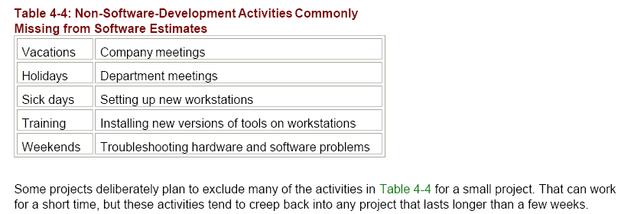
Non software development activities commonly missed

Slide 27
Tip for missing non software development activities
Tip: On projects that last longer than a few weeks, include allowances for overhead activities such as vacations, sick days, training days and company meetings.

Slide 28
Unfounded Optimism
Microsoft Vice President Christ Peter observed that “You never have to fear that estimates created by developer will be too pessimistic, because developers will always generate a too optimistic schedule”
Tip: Don’t reduce developer’s estimate- they are probably too optimistic already.

Slide 29
Unfounded Optimism
Common reasons for being optimistic are:
We will be more productive on this project than we were on the last project.
A lot of things went wrong on the last project. Not so many things will go wrong for this project.
We have learned a lot of lessons that will allow us to finish this project much faster.

Slide 30
Subjectivity and Bias
Subjectivity creeps into estimates in the form of optimism, conscious bias and unconscious bias.
Estimation Bias: Intent to fudge an estimate in one direction or another
Estimation Subjectivity: Human judgment is influenced by human experience, both consciously and unconsciously.

Slide 31
Subjectivity and Bias
Bias occurs when estimates are not aligned with the targets and pressure is applied to the estimate, project and project team. It is said that excessive schedule pressure occurs in 75% to 100% of large projects.
Subjectivity occurs when we feel when considering different estimation techniques that the more control knobs we have the better estimate we will get. The reality is opposite the more control knobs we have the more chances of subjectivity to creep in.

Slide 32
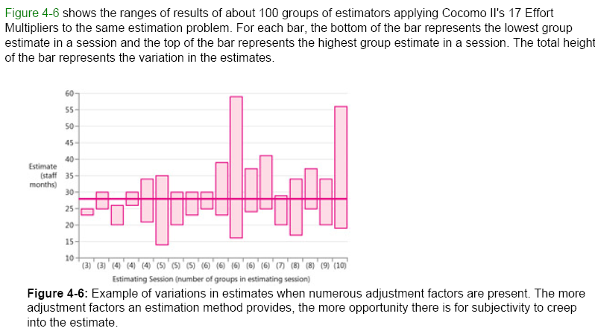
Subjectivity creeping in COCOMO II

Slide 33
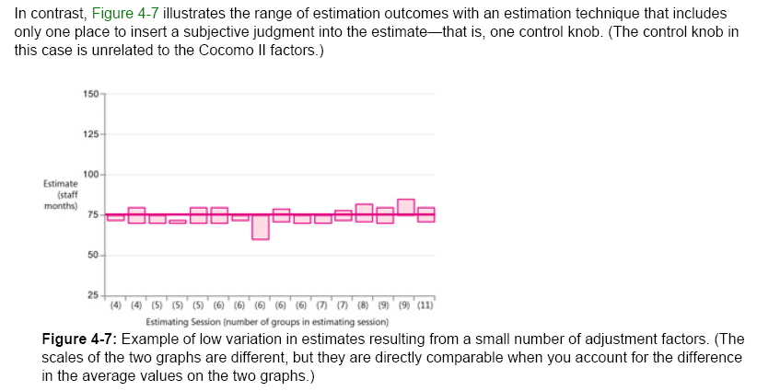
Subjectivity improves if we have less control knobs

Slide 34
Tip for subjectivity
Tip: Avoid having “control knobs” on your estimates. While control knobs might give you a feeling of accuracy, they usually introduce subjectivity and degrade actual accuracy.

Slide 35
Off-The-Cuff Estimates
Intuition and guess in software cost estimates are both correlated with cost and schedule overruns.
Tip: Don’t give off-the-cuff estimates. Even a 15 minutes estimate will be more accurate.

Slide 36
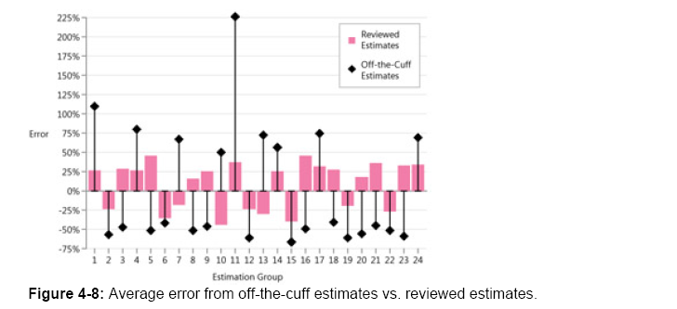
Off-The-Cuff Vs Reviewed estimates

Slide 37
Other sources of error
Some other sources of estimation error are:
Unfamiliar business area
Unfamiliar technology area
Incorrect conversion from estimated time to project time

