Slide 1
An Introduction to Software Engineering

Slide 2
Reference Books
3
Software Engineering, Ian Sommerville 7th Edition, Addison Wesley, 2004
Bruegge & Dutoit: Object-Oriented Software Engineering: Using UML, Patterns and Java, Third Edition, Prentice Hall, 2010. | ISBN 0-13-6061257
Miles & Hamilton: Learning UML 2.0, O’Reilly Media,
2006. ISBN: 0-596-00982-8

Slide 3

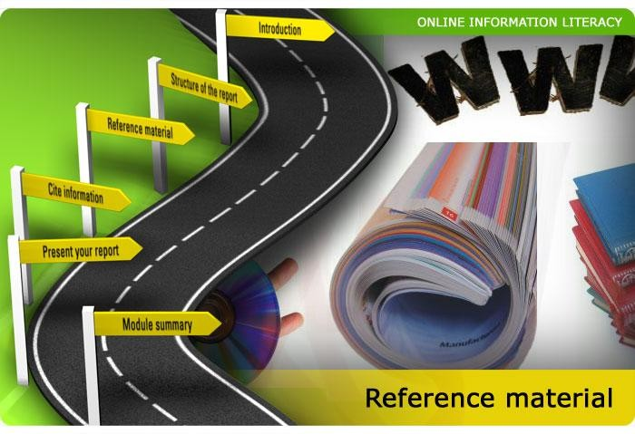
Links and Reference Material
4
http://en.wikipedia.org/wiki/Software_engineering
http://www.yacoset.com/Home/glossary

Slide 4

Grading Criteria
5

Slide 5



Quizzes and Assignments
6

Slide 6
Objectives
7
To introduce software engineering and to explain its importance
To set out the answers to key questions about software engineering
To introduce ethical and professional issues and to explain why they are of concern to software engineers

Slide 7
Topics covered
8
Software Engineering
Software Costs
Role Of Software Engineer
FAQs about software engineering

Slide 8
FAQs about software engineering
9
What is software?
What is software engineering?
What is the difference between software engineering and computer science?
What is the difference between software engineering and system engineering?
What is a software process?
What is a software process model?

Slide 9
FAQs about software engineering
10
What are the costs of software engineering?
What are software engineering methods?
What is CASE (Computer-Aided Software Engineering)
What are the attributes of good software?
What are the key challenges facing software engineering?

Slide 10
What is Software Engineering?
Software
▫ programs that provide function & performance
▫ data structures for information manipulation
▫ documents that describe the operations and use of the programs
Engineering
▫ A discipline that applies scientific and technical methods in the design and production of a product.

Slide 11
What is software?
12
Software products may be developed for a particular customer or may be developed for a general market.
Software products may be
▫ Generic - developed to be sold to a range of different customers e.g. PC software such as Excel or Word.
▫ Bespoke (custom) - developed for a single customer according to their specification.
New software can be created by developing new programs, configuring generic software systems or reusing existing software.

Slide 12
Definition of Software Engineering
IEEE Definition:
The application of a systematic, disciplined, quantifiable approach to the development, operation, and maintenance of software.

Slide 13
Definition of Software Engineering
The practical application of scientific knowledge in the design and construction of computer programs and the associated documentation required to develop, operate, and maintain them.
(Boehm)

Slide 14
Objectives of Software Engineering
To improve quality of software products
To increase customer satisfaction
To increase productivity
To increase job satisfaction
“This is not just a programming course”

Slide 15
Historical Background
Early days of computing, programs were written to make hardware work
Programming was not a discipline, more like a hobby or “art form”
However, computer developments require larger programs to be developed e.g. compilers and operating systems
Programming becomes a profession
Now a days we cant do any thing without programming

Slide 16



Computer Expenditure Survey Report 2009
100%
Software Maintenance
Expenditure
Software Development
Hardware Maintenance
1955
Years
2010

Slide 17
Software Engineering
18
The economies of ALL developed nations are dependent on software.
More and more systems are software controlled
Software engineering is concerned with theories, methods and tools for professional software development.
Expenditure on software represents a
significant fraction of Gross national product
GNP in all developed countries.

Slide 18
Software costs
19
Software costs often dominate computer system costs. The costs of software on a PC are often greater than the hardware cost.
Software costs more to maintain than it does to develop. For systems with a long life, maintenance costs may be several times development costs.
Software engineering is concerned with cost-effective software development.

Slide 19
What is the difference between software engineering and computer science?
20
Computer science is concerned with theory and fundamentals; software engineering is concerned with the practicalities of developing and delivering useful software.
Computer science theories are still insufficient to act as a complete underpinning for software engineering (unlike e.g. physics and electrical engineering).

Slide 20
What is the difference between software engineering and system engineering?
21
System engineering is concerned with all aspects of computer-based systems development including hardware, software and process engineering. Software engineering is part of this process concerned with developing the software infrastructure, control, applications and databases in the system.
System engineers are involved in system specification, architectural design, integration and deployment.

Slide 21
Software is Complex
22
Complex ≠ complicated
Complex = composed of many simple part related to one another
Complicated = not well understood, or explained

Slide 22




Complexity Example:
23
Scheduling Fence Construction Tasks
Setting posts [ 3 time units ]
Cutting wood [ 2 time units ]
Nailing
[ 2 time units for unpainted; 3 time units otherwise ]
Painting
[ 5 time units for uncut wood; 4 time units otherwise ]
Setting posts < Nailing, Painting Cutting < Nailing
…shortest possible completion time = ?
[ ⇒ “simple” problem, but hard to solve without a pen and paper ]

Slide 23

More Complexity
24
Suppose today is Tuesday, November 29
What day will be on January 3?
[ To answer, we need to bring the day names and the day numbers into coordination, and for that we may need again a pen and paper ]

Slide 24




The Role of Software Engg. (1)
25
A bridge from customer needs to programming implementation
Customer
Programmer
First law of software engineering
Software engineer is willing to learn the problem domain
(problem cannot be solved without understanding it first)

Slide 25




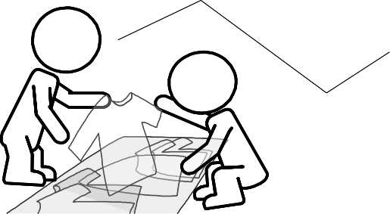
The Role of Software Engg. (2)
26
Customer:
Requires a computer system to achieve some business goals
by user interaction or interaction with the environment in a specified manner
System-to-be
Software-to-be
Environment
User
Software Engineer’s task:
To understand how the system-to-be needs to interact with
the user or the environment so that customer’s requirement is met and design the software-to-be
May be the same person
Programmer’s task:
To implement the software-to-be designed by the software engineer

Slide 26
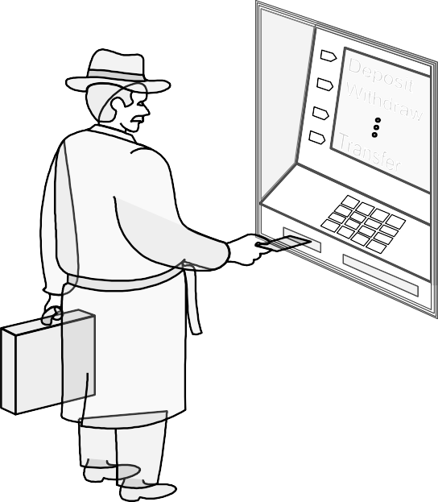
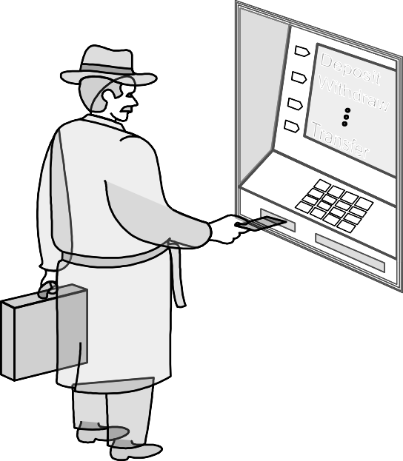
Example: ATM Machine
27
Understanding the money-machine problem:
1
2
Communication link
7
4
5
6
3
0
8 9
Bank’s remote datacenter
ATM machine
Bank customer

Slide 27

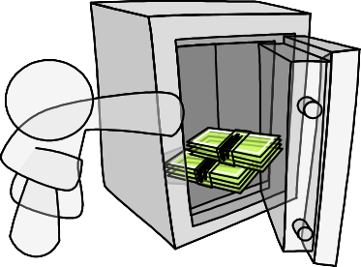






How ATM Machine Might Work
28
Domain model created with help of domain expert
Domain Model
Transaction record
How may I help you?
Cash
Speakerphone
Bookkeeper
Safe
Safe keeper
Phone
Window clerk
Datacenter liaison
Dispenser
Bank’s remote datacenter
Customer

Slide 28











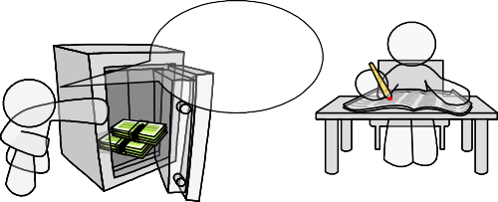
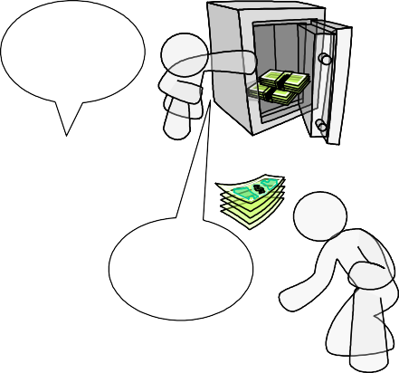









Cartoon Strip: How ATM Machine Works
29
A
Enter your PIN
B
Verify this account
C
Verify account XYZ
D
Account valid. Balance:
$100
Typing in PIN number
…
XYZ valid. Balance:
$100
E
How may I help you?
F
G
Record
$60 less
Release
$60
H
Dispensing!
Withdraw
$60
Dispense
$60
Please take your cash

Slide 29
Software Engineering Blueprints
30
Specifying software problems and solutions is like cartoon strip writing
Unfortunately, most of us are not artists, so we will use something less exciting:
UML symbols
The first law is willing to learn the problem domain

Slide 30
Second Law of Software Engineering
31
Software should be written for people first
▫ ( Computers run software, but hardware quickly becomes outdated )
▫ Useful + good software lives long
▫ To nurture software, people must be able to understand it

Slide 31
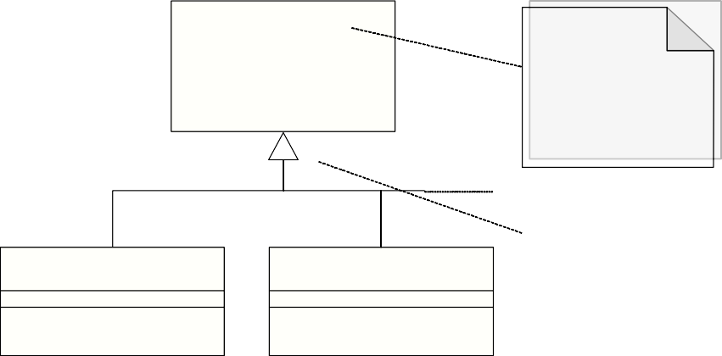
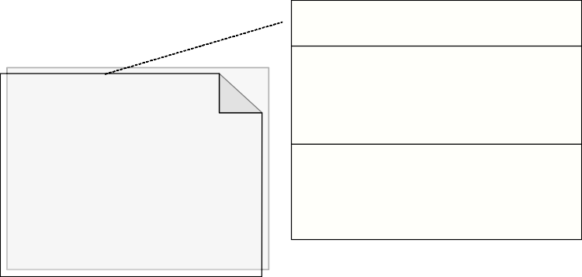
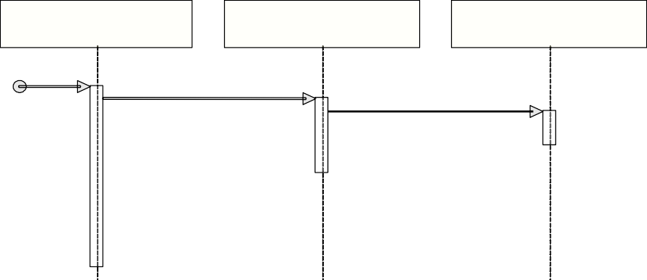
UML – Language of Symbols
32
«interface» BaseInterface
Stereotype
«⋅⋅⋅» provides additional info/ annotation/ explanation
ClassName
+ operation()
# attribute_1 : int
# attribute_2 : boolean # attribute_3 : String
Three common compartments:
Classifier name
Attributes
Operations
+ operation_1() : void
+ operation_2() : String
+ operation_3(arg1 : int)
Inheritance
Class1Implement
Class2Implement
relationship: BaseInterface is implemented by two classes
+ operation()
+ operation()
Software Class
Actor
Comment
Software Interface Implementation
instance1 : Class1 instance5 : Class2
instance8 : Class3
doSomething()
doSomethingElse()
Interaction Diagram
doSomethingYetElse()

Slide 32

For any query Feel Free to ask
33

