Slide 1
Software Engineering Lecture # 3

Slide 2
Software Development Fundamentals
3
SDLC (Software Development Life Cycle)
Software Development Phases
▫ Concept Elaboration
▫ Requirements
▫ Analysis and Design
▫ Development
▫ Integration & Test
▫ Deployment & Maintenance
▫ Tracking
•

Slide 3
Software Development Lifecycle
4
Software development, just like most other activities, has a beginning, middle and an end.
The end of one development activity is sometimes perceived as being linked to the beginning of a new development activity thus producing a cycle of beginning-middle-end, link, and so forth.
Deliverables from the preceding phase are usually approved before work starts on the next phase.
This view of software development is referred to as the software development life cycle.

Slide 4
Lifecycle Planning
5
a.k.a. Lifecycle Management or SDLC
Greatly influences your chance of success
Not choosing a lifecycle is a bad option
Different Software projects require different approaches
You do not need to know all models by name
You should know how that if given a certain scenario what sort of SDLC would be appropriate

Slide 5



Planning
6
Characteristics leads to Poor Planning
▫ Inexperienced management
▫ Ineffective change control
▫ Political Pressures
▫ Unrealistic Deadlines

Slide 6
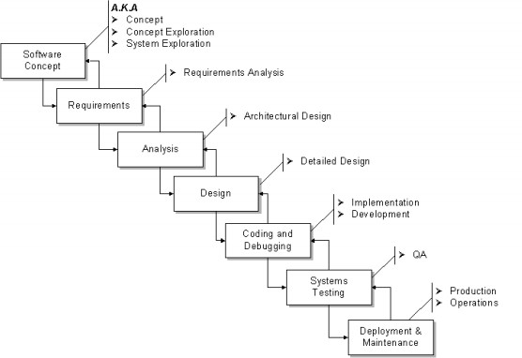
Software Development Phases
7

Slide 7
Concept Elaboration
8
The “Why” phase
Not a “mandatory formal” phase
▫ Sometimes called the “pre-project” phase
Collecting project ideas
▫ Then the “funneling” process
Project Justification
Initially rough Estimations

Slide 8
Concept Elaboration
9
Possibly includes Procurement Management:
▫ Request for Proposal RFP Process [4]
▫ Vendor selection
▫ Contract management[6]
▫ Gathering the initial team
▫ Primary contact for approval and decision making
▫ Potential Phase Outputs:
🞄 Concept Document, Product Description, Project Charter
,SOW (Statement of work) [5]

Slide 9
Requirements
10
The “What” phase
Inputs: SOW, Proposal
Outputs:
▫ Requirements Document (RD)
🞄 a.k.a. Requirements Specification Document (RSD), Software Requirements Specification (SRS)
▫ 1st Project Baseline
▫ Software Management Plan (SMP)
▫ Requirements Approval & Sign-Off
🞄 Your most difficult task in this phase

Slide 10
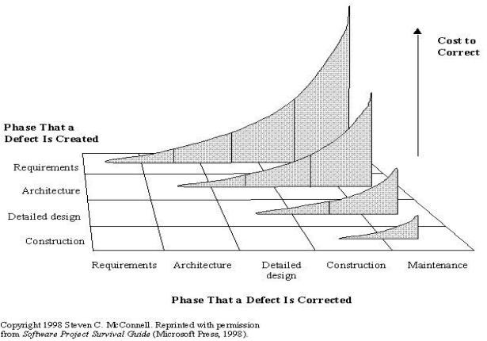
Why are Requirements so Important?
11

Slide 11
Requirements
12
Characteristics & Issues
▫ Conflict of interest: developer vs. customer
▫ Potential tug-of-war:
🞄 Disagreement on Features & Estimates especially in fixed- price contracts
▫ Frequent requirements changes
▫ Achieving sign-off

Slide 12
Requirement Types
13
Functional (behavioral)
▫ Features and capabilities
Non-functional (a.k.a. “technical”) (everything else)
▫ Usability
▫ Human factors, help, documentation
▫ Reliability
▫ Failure rates, recoverability, availability
▫ Performance
▫ Response times, throughput, resource usage
▫ Supportability
▫ Maintainability, portability
▫ Operations: systems management, installation
▫ Interface: integration with other systems

Slide 13
Requirements
14
Backward-looking vs. Forward-looking
▫ Backward: address issues with previous version
▫ Forward: Anticipating future needs of customers
Must be prioritized
▫ Must-have
▫ Should-have
▫ Could-have (Nice-to-have: NTH)
Must be approved

Slide 14
Analysis & Design
15
The “How” Phases
a.k.a. Top-level design & detailed design
Inputs: Requirements Document
Outputs:
▫ Functional Specification (Abstract level design specification)
▫ E-R Diagrams
▫ Data Flow Diagrams
▫ Detailed Design Document
▫ Object Diagrams
▫ Data Model
▫ Updated Plan (improved estimates; new baseline)
Approval & Sign-off

Slide 15

Development
16
The “Do It” phase
Coding & Unit testing
Often overlaps Design & Integration phases
To shorten the overall schedule
Other concurrent activities
▫ Design completion
▫ Integration begins
▫ Unit testing of individual components
▫ Test bed setup (environment and tools)
▫ Project plans updated
▫ Scope and Risk Management conducted

Slide 16

Development
17
Characteristics & Issues
▫ Pressure increases
▫ Last-minute changes
▫ Team coordination (esp. in large projects)
▫ Communication overhead

Slide 17

Integration & Test
18
Evolves from Development Phase
Often done as 2 parallel phases
Partial integration & initial test
Starts with integration of modules
Progressively add more components
Integration primarily a programmer task
Test primarily a QA team task

Slide 18
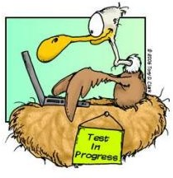
Integration & Test
19
Integration:
▫ Top-down: Core functionality first, empty shells for incomplete routines (stubs)
▫ Bottom up: gradually bind low-level modules
▫ Prefer top-down generally
Tests
▫ Integration testing
▫ Black & White-box testing
▫ Load & Stress testing
▫ Alpha & Beta testing
▫ Acceptance testing

Slide 19
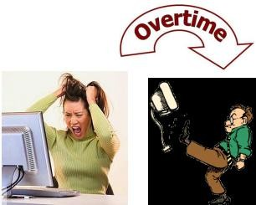
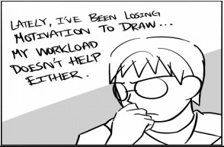

Integration & Test
20
Characteristics & Issues
▫ Increased pressure
▫ Overtime
▫ Customer conflicts over features
▫ Frustration over last-minute failures
▫ Budget overruns
▫ Motivation problems (such as burnout)
▫ Difficulty in customer acceptance

Slide 20

Deployment & Maintenance
21
Installation depends on system type
Maintenance
▫ Fix defects
▫ Add new features
▫ Improve performance
Configuration control is very important here
Documents need to be maintained also
Sometimes a single team maintains multiple products
Deployment typically in your project plan, maintenance not

Slide 21
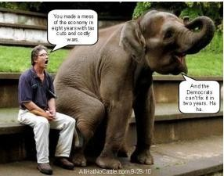


Deployment & Maintenance
22
Characteristics & Issues
▫ Lack of enthusiasm
▫ Pressure for quick fixes
▫ Insufficient budget
▫ Too many patches
▫ Personnel turnover
▫ Regression testing is critical

Slide 22



Tracking
23
Management Level
▫ Tasks Lists
▫ Status meetings and Reports
▫ Milestones
▫ Reviews
▫ Budget Reports
▫ Management by Walking Around

Slide 23
Umbrella Activities
Software project tracking and control
Formal technical reviews (FTR)
Software quality assurance (SQA)
Software configuration management
Document preparation and production
Reusability management
Risk management

Slide 24

Rule of Thumb
25
Most software projects (something like 80 percent) are delivered late, substantially over budget, and incomplete . The more effort you put into managing your project, the more you increase your chances of success.

Slide 25
References
26
Software Engineering by Roger Pressman
Software Engineering by Ian Sommerville
Accumulated Notes (Engr. Ali Javed, UET Taxila)
http://forum.onestoptesting.com/forum_posts.asp?TID=2766
http://en.wikipedia.org/wiki/Request_for_proposal
http://en.wikipedia.org/wiki/Statement_of_work
http://en.wikipedia.org/wiki/Contract_management
http://en.wikipedia.org/wiki/Kickoff_meeting

Slide 26

For any query Feel Free to ask
27

