Slide 1
Software Management
(Introduction of Software Engineering and management terms)

Slide 2
Organization of this Lecture:
What is Software Engineering?
Programs vs. Software Products
Evolution of Software Engineering
Notable Changes In Software Development Practices
Introduction to Life Cycle Models
Summary

Slide 3


What is Software Engineering?
Engineering approach to develop software.
  Building Construction Analogy.
Systematic collection of past experience:
  techniques,
  methodologies,
  guidelines.

Slide 4
Engineering Practice
Heavy use of past experience:
  Past experience is systematically arranged.
Theoretical basis and quantitative techniques provided.
Many are just thumb rules.
Tradeoff between alternatives
Pragmatic approach to cost-effectiveness

Slide 5
Why Study Software Engineering? (1)
To acquire skills to develop large programs.
  Exponential growth in complexity and difficulty level with size.
  The ad hoc approach breaks down when size of software increases: ---

Slide 6
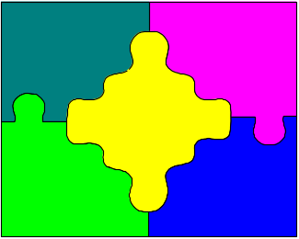
Why Study Software Engineering? (2)
Ability to solve complex programming problems:
  How to break large projects into smaller and manageable parts?
Learn techniques of:
  specification, design, interface development, testing, project management, etc.

Slide 7
Why Study Software Engineering? (3)
To acquire skills to be a better programmer:
    Higher Productivity
    Better Quality Programs

Slide 8
Software Crisis
Software products:
  fail to meet user requirements.
  frequently crash.
  expensive.
  difficult to alter, debug, and enhance.
  often delivered late.
  use resources non-optimally.

Slide 9
Factors Contributing to the Software Crisis
Larger problems,
Lack of adequate training in software engineering,
Increasing skill shortage,
Low productivity improvements.

Slide 10

Software Myths
(Management Perspectives)
As long as there are good standards and clear procedures in my company, I shouldn’t be too concerned.
But the proof of the pudding
is in the eating;
not in the Recipe !

Slide 11
Software Myths
(Management Perspectives)
As long as my software engineers(!) have access to the fastest and the most sophisticated computer environments and state-of-the-art software tools, I shouldn’t be too concerned.
The environment is
only one of the several factors
that determine the quality
of the end software product!

Slide 12
Software Myths
(Management Perspectives)
When my schedule slips, what I have to do is to start a fire-fighting operation: add more software specialists, those with higher skills and longer experience - they will bring the schedule back on the rails!
Unfortunately,
software business does not
entertain schedule compaction
beyond a limit!

Slide 13
Software Myths
(Customer Perspectives)
A general statement of objectives is sufficient to get started with the development of software. Missing/vague requirements can easily be incorporated/detailed out as they get concretized.
Application requirements can never be stable; software can be and has to be made flexible enough to allow changes to be incorporated as they happen.

Slide 14
Software Myths
(Developer Perspectives)
Once the software is demonstrated, the job is done.
Usually, the problems just begin!

Slide 15
Software Myths
(Developer Perspectives)
Until the software is coded and is available for testing, there is no way for assessing its quality.
Usually, there are too many
tiny bugs inserted at every stage
that grow in size and complexity
as they progress thru further stages!

Slide 16
Software Myths
(Developer Perspectives)
The only deliverable for a software development project is the tested code.
The code is only
the externally visible component
of the entire software complement!

Slide 17
Software Product
is a product designated for delivery to the user
source
codes
documents
reports
manuals
object
codes
plans
data
test results
test suites
prototypes

Slide 18
Boehm’s
Top Ten
Industrial Software Metrics

Slide 19
Boehm’s Top Ten
Industrial Software Metrics
Finding and fixing a software problem after delivery of the product is 100 times more expensive than defect removal during requirements and early design phases.
1

Slide 20
Software Myths
(Customer Perspectives)
A general statement of objectives is sufficient to get started with the development of software. Missing/vague requirements can easily be incorporated/detailed out as they get concretized.
Application requirements can never be stable; software can be and has to be made flexible enough to allow changes to be incorporated as they happen.

Slide 21
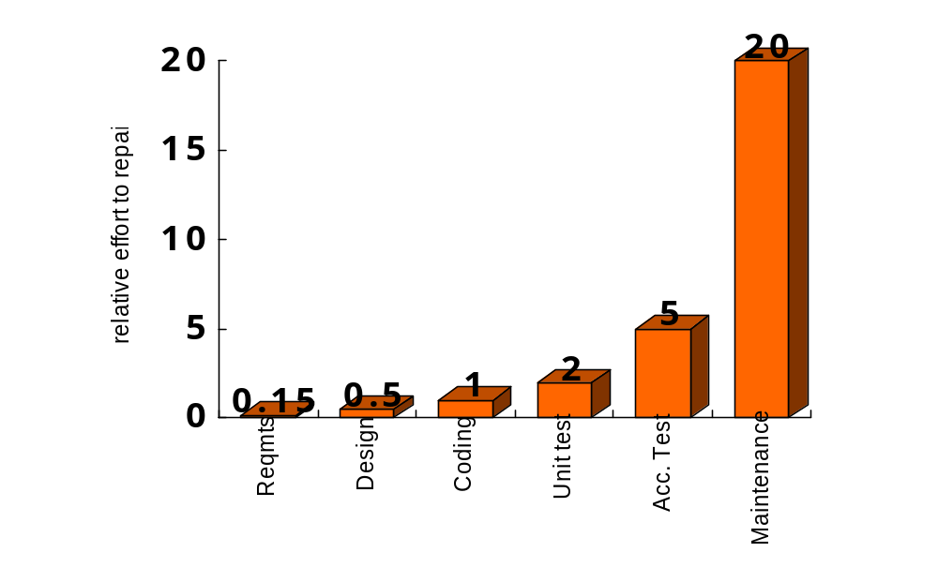
Effort to Repair Software
(when defects are detected at different stages)

Slide 22
Boehm’s Top Ten
Industrial Software Metrics
Nominal software development schedules can be compressed up to 25% (by adding people, money, etc.) but no more.
2

Slide 23
Software Myths
(Management Perspectives)
When my schedule slips, what I have to do is to start a fire-fighting operation: add more software specialists, those with higher skills and longer experience - they will bring the schedule back on the rails!

Slide 24
Boehm’s Top Ten
Industrial Software Metrics
Maintenance costs twice what the development costs.
3

Slide 25
Boehm’s Top Ten
Industrial Software Metrics
Development and maintenance costs are primarily a function of the size.
4

Slide 26
Boehm’s Top Ten
Industrial Software Metrics
Variations in humans account for the greatest variations in productivity.
5

Slide 27

Software Myths
(Management Perspectives)
As long as my software engineers(!) have access to the fastest and the most sophisticated computer environments and state-of-the-art software tools, I shouldn’t be too concerned.

Slide 28
Boehm’s Top Ten
Industrial Software Metrics
The ratio of software to hardware costs has gone from 15:85 in 1985 and continues to grow in favor of software as the dominant cost.
6

Slide 29
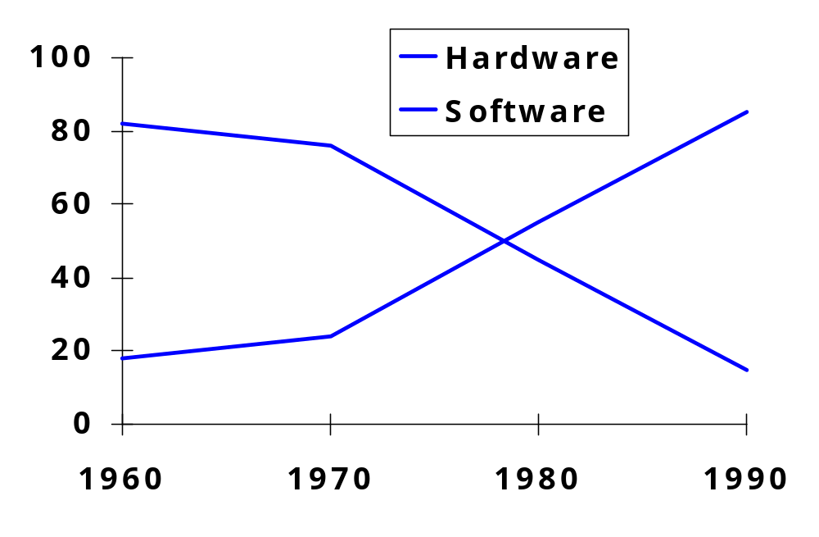
Hardware Vs Software Costs

Slide 30
Boehm’s Top Ten
Industrial Software Metrics
Only about 15% of the development effort is in coding.
7

Slide 31
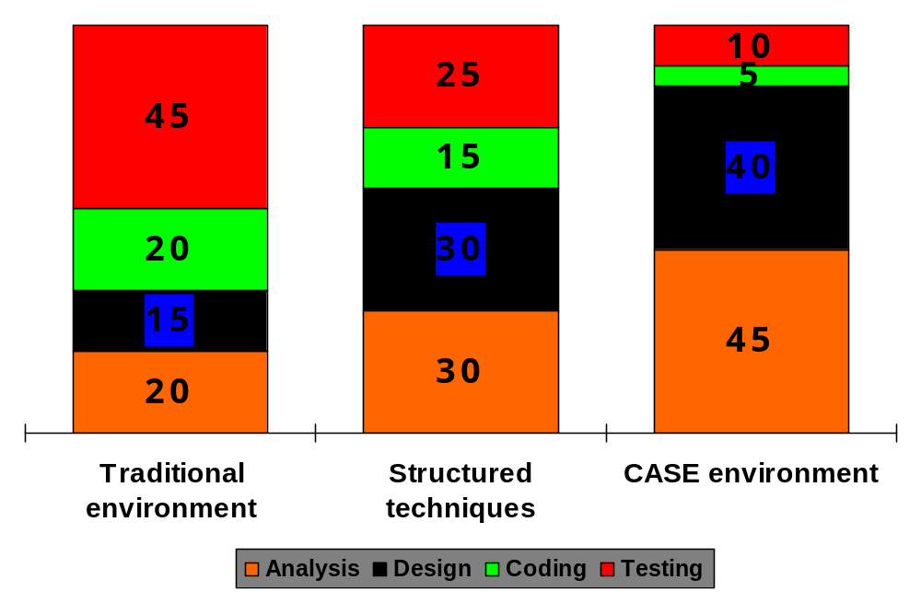
Distribution of Effort
Across Phases
Testing
Coding
Design
Analysis

Slide 32
Boehm’s Top Ten
Industrial Software Metrics
Applications products cost three times as much per instruction as individual programs; system software products cost nine times as much.
8

Slide 33
Boehm’s Top Ten
Industrial Software Metrics
9
Walkthroughs catch 60% of the errors.

Slide 34
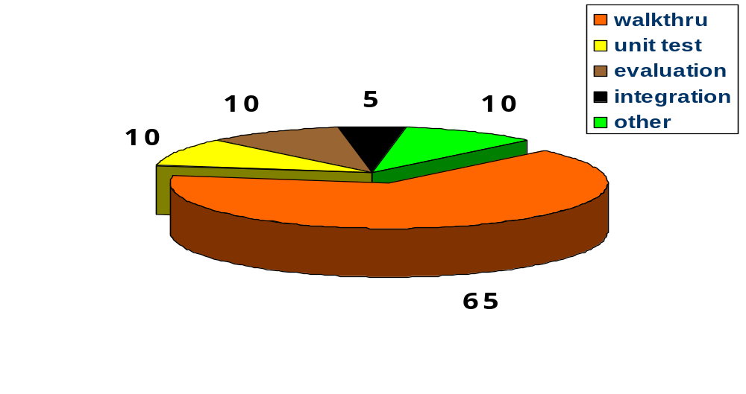
Distribution of Activities in Defect Removal

Slide 35
Software Myths
(Developer Perspectives)
Until the software is coded and is available for testing, there is no way for assessing its quality.

Slide 36

Boehm’s Top Ten
Industrial Software Metrics
10
Many software processes obey a Pareto distribution.
20%
modules
80%
cost

Slide 37
Boehm’s Top Ten
Industrial Software Metrics
10
Many software processes obey a Pareto distribution.
20%
modules
80%
errors

Slide 38

Boehm’s Top Ten
Industrial Software Metrics
10
Many software processes obey a Pareto distribution.
80%
cost
to fix
20%
modules

Slide 39
Boehm’s Top Ten
Industrial Software Metrics
10
Many software processes obey a Pareto distribution.
20%
modules
80%
exec time

Slide 40

Boehm’s Top Ten
Industrial Software Metrics
10
Many software processes obey a Pareto distribution.
20%
tools
80%
use

Slide 41
Symptom of Software Crisis
about US$250 billion spent per year in the US on application development
of this, about US$140 billion wasted due to the projects getting abandoned or reworked; this in turn because of not following best practices and standards
Ref: Standish Group, 1996

Slide 42
Symptom of Software Crisis
10% of client/server apps are abandoned or restarted from scratch
20% of apps are significantly altered to avoid disaster
40% of apps are delivered significantly late
Source: 3 year study of 70 large c/s apps 30 European firms.
Compuware (12/95)

Slide 43
Programs versus Software Products
Usually small in size
Author himself is sole user
Single developer
Lacks proper user interface
Lacks proper documentation
Ad hoc development.
Large
Large number of users
Team of developers
Well-designed interface
Well documented & user-manual prepared
Systematic development

Slide 44
Computer Systems Engineering
Computer systems engineering:
  encompasses software engineering.
Many products require development of software as well as specific hardware to run it:
  a coffee vending machine,
  a mobile communication product, etc.

Slide 45
Computer Systems Engineering
The high-level problem:
  deciding which tasks are to be solved by software
  which ones by hardware.

Slide 46
Computer Systems Engineering (CONT.)
Often, hardware and software are developed together:
  Hardware simulator is used during software development.
Integration of hardware and software.
Final system testing

Slide 47
Computer Systems Engineering (CONT.)
Feasibility
Study
Requirements Analysis and Specification
Hardware Development
Hardware Software Partitioning
Software Development
Integration
and Testing
Project Management

Slide 48
Emergence of Software Engineering
Early Computer Programming (1950s):
  Programs were being written in assembly language.
  Programs were limited to about a few hundreds of lines of assembly code.

Slide 49
Early Computer Programming (50s)
Every programmer developed his own style of writing programs:
  according to his intuition (exploratory programming).

Slide 50
High-Level Language Programming (Early 60s)
High-level languages such as FORTRAN, ALGOL, and COBOL were introduced:
  This reduced software development efforts greatly.

Slide 51
High-Level Language Programming (Early 60s)
Software development style was still exploratory.
  Typical program sizes were limited to a few thousands of lines of source code.

Slide 52
Control Flow-Based Design (late 60s)
Size and complexity of programs increased further:
  exploratory programming style proved to be insufficient.
Programmers found:
  very difficult to write cost-effective and correct programs.

Slide 53
Control Flow-Based Design (late 60s)
Programmers found:
  programs written by others very difficult to understand and maintain.
To cope up with this problem, experienced programmers advised: ``Pay particular attention to the design of the program's control structure.'’

Slide 54
Control Flow-Based Design (late 60s)
A program's control structure indicates:
  the sequence in which the program's instructions are executed.
To help design programs having good control structure:
  flow charting technique was developed.

Slide 55
Control Flow-Based Design (late 60s)
Using flow charting technique:
  one can represent and design a program's control structure.
  Usually one understands a program:
    by mentally simulating the program's execution sequence.

Slide 56
Control Flow-Based Design
(Late 60s)
A program having a messy flow chart representation:
  difficult to understand and debug.
111

Slide 57
Control Flow-Based Design (Late 60s)
It was found:
  GO TO statements makes control structure of a program messy
  GO TO statements alter the flow of control arbitrarily.
  The need to restrict use of GO TO statements was recognized.

Slide 58
Control Flow-Based Design (Late 60s)
Many programmers had extensively used assembly languages.
  JUMP instructions are frequently used for program branching in assembly languages,
  programmers considered use of GO TO statements inevitable.

Slide 59
Control-flow Based Design (Late 60s)
At that time, Dijkstra published his article:
  “Goto Statement Considered Harmful” Comm. of ACM, 1969.
Many programmers were unhappy to read his article.

Slide 60
Control Flow-Based Design (Late 60s)
They published several counter articles:
  highlighting the advantages and inevitability of GO TO statements.

Slide 61
Control Flow-Based Design (Late 60s)
Soon it was conclusively proved:
  only three programming constructs are sufficient to express any programming logic:
    sequence (e.g. a=0;b=5;)
    selection (e.g.if(c=true) k=5 else m=5;)
    iteration (e.g. while(k>0) k=j-k;)

Slide 62
Control-flow Based Design (Late 60s)
Everyone accepted:
  it is possible to solve any programming problem without using GO TO statements.
  This formed the basis of Structured Programming methodology.

Slide 63
Structured Programming
A program is called structured
  when it uses only the following types of constructs:
    sequence,
    selection,
    iteration

Slide 64
Structured programs
Unstructured control flows are avoided.
Consist of a neat set of modules.
Use single-entry, single-exit program constructs.

Slide 65
Structured programs
Structured programs are:
  Easier to read and understand,
  easier to maintain,
  require less effort and time for development.

Slide 66
Structured Programming
Research experience shows:
  programmers commit less number of errors
    while using structured if-then-else and do-while statements

Slide 67
Data Structure-Oriented Design (Early 70s)
Soon it was discovered:
  it is important to pay more attention to the design of data structures of a program
    than to the design of its control structure.

Slide 68
Data Flow-Oriented Design (Late 70s)
Data flow-oriented techniques advocate:
  the data items input to a system must first be identified,
  processing required on the data items to produce the required outputs should be determined.

Slide 69
Data Flow-Oriented Design (Late 70s)
Data flow technique identifies:
  different processing stations (functions) in a system
  the items (data) that flow between processing stations.

Slide 70
Data Flow-Oriented Design (Late 70s)
Data flow technique is a generic technique:
  can be used to model the working of any system
    not just software systems.
A major advantage of the data flow technique is its simplicity.

Slide 71

Data Flow Model of a Car Assembly Unit
Engine Store
Door Store
Car
Chassis with Engine
Partly Assembled Car
Fit
Engine
Fit
Doors
Fit
Wheels
Paint and
Test
Assembled Car
Chassis Store
Wheel Store

Slide 72
Object-Oriented Design (80s)
Object-oriented technique:
  an intuitively appealing design approach:
  natural objects (such as employees, pay-roll-register, etc.) occurring in a problem are first identified.

Slide 73
Object-Oriented Design (80s)
Relationships among objects:
  such as composition, reference, and inheritance are determined.
Each object essentially acts as
  a data hiding (or data abstraction) entity.

Slide 74
Object-Oriented Design (80s)
Object-Oriented Techniques have gained wide acceptance:
  Simplicity
  Reuse possibilities
  Lower development time and cost
  More robust code
  Easy maintenance

Slide 75
Evolution of Design Techniques
Object-Oriented
Data flow-based
Data structure-based
Control flow-based
Ad hoc

Slide 76
Evolution of Other Software Engineering Techniques
The improvements to the software design methodologies
  are indeed very conspicuous.
In additions to the software design techniques:
  several other techniques evolved.

Slide 77
Evolution of Other Software Engineering Techniques
  life cycle models,
  specification techniques,
  project management techniques,
  testing techniques,
  debugging techniques,
  quality assurance techniques,
  software measurement techniques,
  CASE tools, etc.

Slide 78
Differences Between the Exploratory Style and Modern Software Development Practices
Use of Life Cycle Models
Software is developed through several well-defined stages:
  requirements analysis and specification,
  design,
  coding,
  testing, etc.

Slide 79
Differences Between the Exploratory Style and Modern Software Development Practices
Emphasis has shifted
  from error correction to error prevention.
Modern practices emphasize:
  detection of errors as close to their point of introduction as possible.

Slide 80
Differences Between the Exploratory Style and Modern Software Development Practices (CONT.)
In exploratory style,
  errors are detected only during testing,
Now,
  focus is on detecting as many errors as possible in each phase of development.

Slide 81
Differences Between the Exploratory Style and Modern Software Development Practices (CONT.)
In exploratory style,
  coding is synonymous with program development.
Now,
  coding is considered only a small part of program development effort.

Slide 82
Differences Between the Exploratory Style and Modern Software Development Practices (CONT.)
A lot of effort and attention is now being paid to:
  requirements specification.
Also, now there is a distinct design phase:
  standard design techniques are being used.

Slide 83
Differences Between the Exploratory Style and Modern Software Development Practices (CONT.)
During all stages of development process:
  Periodic reviews are being carried out
Software testing has become systematic:
  standard testing techniques are available.

Slide 84
Differences Between the Exploratory Style and Modern Software Development Practices (CONT.)
There is better visibility of design and code:
  visibility means production of good quality, consistent and standard documents.
  In the past, very little attention was being given to producing good quality and consistent documents.
  We will see later that increased visibility makes software project management easier.

Slide 85
Differences between the exploratory style and modern software development practices (CONT.)
Because of good documentation:
  fault diagnosis and maintenance are smoother now.
Several metrics are being used:
  help in software project management, quality assurance, etc.

Slide 86
Differences between the exploratory style and modern software development practices (CONT.)
Projects are being thoroughly planned:
  estimation,
  scheduling,
  monitoring mechanisms.
Use of CASE tools.

Slide 87
Software Life Cycle
Software life cycle (or software process):
  series of identifiable stages that a software product undergoes during its life time:
    Feasibility study
    requirements analysis and specification,
    design,
    coding,
    testing
    maintenance.

Slide 88
Common Symptoms of Failed Software Development Projects
Inaccurate understanding of end-user-needs
Inability to deal with changing requirements
Modules that do not fit together
Software that is too hard to maintain or extend
Late discovery of serious flaws
Poor software quality
Unacceptable software performance

Slide 89
Some Root Causes for Failure
Ad hoc requirements management
Ambiguous and imprecise communication
Brittle software architectures
Overwhelming complexity
Undetected inconsistencies in requirements, design and implementations
Insufficient testing
Subjective project status assessment
Failure to attack risk
uncontrolled change propagation
Insufficient use of automation tools

Slide 90
Misplaced Assumptions
All requirements can be pre specified.
Users are expert at specification of their needs.
Users and developers are both good at visualization.
The project team is capable of unambiguous communication.
Ref: Larry Vaughn

Slide 91
Life Cycle Model
A software life cycle model (or process model):
  a descriptive and diagrammatic model of software life cycle:
  identifies all the activities required for product development,
  establishes a precedence ordering among the different activities,
  Divides life cycle into phases.

Slide 92
Life Cycle Model (CONT.)
Several different activities may be carried out in each life cycle phase.
  For example, the design stage might consist of:
    structured analysis activity followed by
    structured design activity.

Slide 93
Why Model Life Cycle ?
A written description:
  forms a common understanding of activities among the software developers.
  helps in identifying inconsistencies, redundancies, and omissions in the development process.
  Helps in tailoring a process model for specific projects.

Slide 94
Why Model Life Cycle ?
Processes are tailored for special projects.
  A documented process model
    helps to identify where the tailoring is to occur.

Slide 95
Life Cycle Model (CONT.)
The development team must identify a suitable life cycle model:
  and then adhere to it.
  Primary advantage of adhering to a life cycle model:
    helps development of software in a systematic and disciplined manner.

Slide 96
Life Cycle Model (CONT.)
When a program is developed by a single programmer ---
  he has the freedom to decide his exact steps.

Slide 97
Life Cycle Model (CONT.)
When a software product is being developed by a team:
  there must be a precise understanding among team members as to when to do what,
  otherwise it would lead to chaos and project failure.

Slide 98
Life Cycle Model (CONT.)
A software project will never succeed if:
  one engineer starts writing code,
  another concentrates on writing the test document first,
  yet another engineer first defines the file structure
  another defines the I/O for his portion first.

Slide 99
Life Cycle Model (CONT.)
A life cycle model:
  defines entry and exit criteria for every phase.
  A phase is considered to be complete:
    only when all its exit criteria are satisfied.

Slide 100
Life Cycle Model (CONT.)
The phase exit criteria for the software requirements specification phase:
  Software Requirements Specification (SRS) document is complete, reviewed, and approved by the customer.
A phase can start:
  only if its phase-entry criteria have been satisfied.

Slide 101
Life Cycle Model (CONT.)
It becomes easier for software project managers:
  to monitor the progress of the project.

Slide 102
Life Cycle Model (CONT.)
When a life cycle model is adhered to,
  the project manager can at any time fairly accurately tell,
    at which stage (e.g., design, code, test, etc. ) of the project is.
  Otherwise, it becomes very difficult to track the progress of the project
    the project manager would have to depend on the guesses of the team members.

Slide 103
Life Cycle Model (CONT.)
This usually leads to a problem:
  known as the 99% complete syndrome.

Slide 104
Life Cycle Model (CONT.)
Many life cycle models have been proposed.
We will confine our attention to a few important and commonly used models.
  classical waterfall model
  iterative waterfall,
  evolutionary,
  prototyping, and
  spiral model

