Slide 1
Understanding Server Performance With Orca
Richard Grevis
UBS European Wealth Management
London, 24nd March, 2004
Comments or corrections? Please mail richard.grevis@ubs.com

Slide 2

Orca Design
Copy of each host’s kernel statistics.
RRD database data.
HTML pages and graphs.
Orca Server
Web Interface
Holy meltdown Batman!!
The server is going to blow!!
Clients are polled from the server using rsync and ssh.
SE toolkit daemon installed on each host.
Monitors and saves kernel statistics to local disk.

Slide 3
Client Components
RICHPse and EWMorca packages are installed to /opt.
  Thank Richard Pettit and Adrian Cockroft.
  EWMorca applies a custom SE configuration and Orca ssh keys.
The SE toolkit daemon runs as root.
The client daemon is a lightweight and small process.
It writes data to /var/log/orca every 5 minutes.
Other tools are installed to allow real-time inspection of a host.
  Located in /opt/RICHPse
  E.g. “/opt/RICHPse/bin/se /opt/RICHPse/examples/net.se”
  Or “cd /opt/RICHPse; bin/se examples/zoom.se” (X application).
  Read all about it in the SE Toolkit documentation.

Slide 4
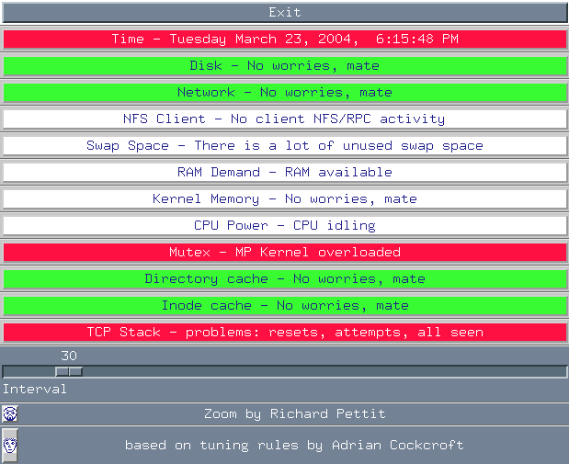
SE examples/zoom.se

Slide 5
Client Components
se net.se
Name Ipkts Ierrs Opkts Oerrs Colls Coll-Rate
hme0 19278594 0 2541442 0 0 0.00 %
hme1 0 0 0 0 0 0.00 %
fjge0 2442308200 1 3555904996 0 0 0.00 %
fjge1 12920004 1 4955589 0 0 0.00 %
se cpg.se
Gathering information.....…ok
Checking paging/swapping...
Checking disk saturation...
Total reads/second = 2 total writes/second = 148
Checking DNLC hit rate...
DNLC hit rate is only 43.74 %. Should be at least 80 %.
Try increasing ncsize in /etc/system. (See Appendix A of
"Administering Security, Performance and Accounting).“
Checking CPU times...
Checking network condition...
Errors on interface: fjge0 (ierrors = 1 oerrors = 0)
Errors on interface: fjge1 (ierrors = 1 oerrors = 0)
There have been 393 UDP input overruns.
Re-evaluate the number of nfsd threads.
Do you have NC400 and/or PrestoServe installed?

Slide 6
Orca Server Components
Client data gathering Daemon
  Rsync via ssh to each monitored host in turn
  Gathers contents of /var/log/orca from each host.
Orca Server Daemon
  Thank Blair Zajac.
  1 (or more) Perl processes.
  Uses a Round Robin Database (RRD) to save and aggregate daily, monthly and yearly data.
  Generates the HTML framework and uses RRD to generate performance graphs (in .png format).
  Operation/Appearance is administrator customisable.
The client records more parameters than the server currently displays. At any time, other graphs may be configured and generated from data already gathered.

Slide 7
Orca – The CPU
CPU load is usually the easiest to measure and easiest to manage and plan for.
As I/O performance is much harder to properly measure and diagnose, administrators often ignore all load aspects except for CPU. Don’t!
  In particular, business application mixes are often more I/O intensive than processor intensive.
  But Java business applications consume ALL resource types!
Sun has invested a great deal of effort in making Solaris efficient for multiple CPUs. They implement a re-entrant kernel and have efficient in I/O despite Sparc processors being really slow.
A consequence is “more than expected” subtlety in process scheduling and control.

Slide 8
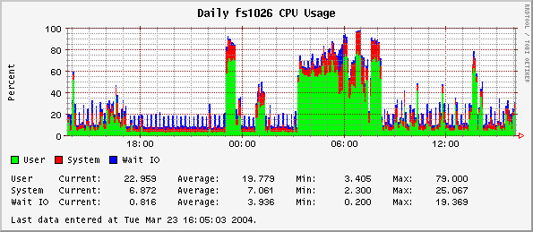
Orca – CPU Usage
Be aware of multi-cpu hosts – load measure is averaged across the CPUs.
  1 process using 100% of a single CPU, or 5 processes using 20% ?
Wait I/O may not mean what you think on multiple cpu machines.
  Solaris may report that all (idle) cpu’s are waiting on I/O when only 1 thread (and hence 1 cpu) really is.
  Remember about hosts with tape drives! In their case long waits on I/O are quite normal.
Solaris 8 does not measure hardware interrupts as part of load. Load may be underestimated in interrupt “rich” environments (e.g. very active gigabit ethernet).

Slide 9
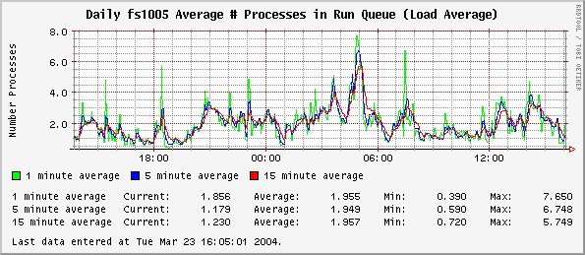
Orca – Run Queue Length
Run queue length is a “good” but basic guide to CPU load.
Must be measured relative to the number of CPUs in the host.
  But it is true that the greater the excess of the run queue length over CPUs, the more processor time will be spent on switching/scheduling instead of your jobs.
The relationship between run queue and subjective load –
  Depends on scheduling.
  On processor speed and relationship to I/O bandwidth.
  On the job mix (interactive/batch).

Slide 10
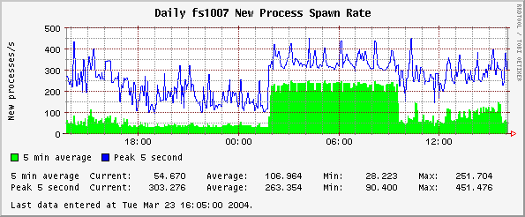
Orca – New Process Spawn Rate
Can reveal problems that are otherwise hard to identify.
  E.g. Large numbers of processes being invoked, each consuming little time.
  Such as the way Ensign monitoring is sometimes configured (invoking many processes each time a line is written to a log file).
  E.g. Poor developer code which polls for files, directories, or processes by shell programmed polling. (ps, grep, sh, invoked 300,000 times a day).
Another graph is available - “Total Processes”.
  Can be useful to notice inetd or httpd processes accumulating erroneously.

Slide 11
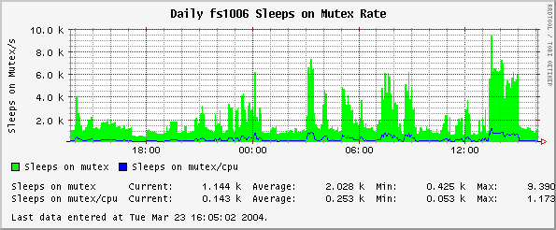
Orca – Sleep on Mutex
Mutex’s coordinate multiple CPUs fighting over certain shared resources.
  Mutex’s are efficient when the expected delay/block is very short.
  Solaris uses mutex’s to manage critical kernel code segments and data resources in the face of multiple CPUs wanting to get at something.
  Too high a value means the CPU resources are being wasted. % System time consumed increases.
Bad database application programming or configurations can trigger high mutex sleep rates.
  More CPUs may make the problem WORSE.
  Faster CPUs may help.
  Maybe it’s too many requests for the same database data resources, or too many database threads configured for the available CPUs etc.

Slide 12
Orca – The Networks
Modern network fabric is switched.
  Aggregated datacentre bandwidth is much more than interface bandwidth. Perhaps a total of tens of gigabytes per second, depending on the core switches.
Historical guidelines for ethernet loading no longer apply.
  Hosts only see traffic destined for the host, not all datacentre traffic.
  Full duplex communication increases ultimate bandwidth, eliminates ethernet collisions, and eliminates transmission backoff (a major cause of the sharp performance degradation of older ethernets under load).
However be aware:
  That switch/host mismatches of duplex configurations during auto-negotiate are a common cause of severe network performance problems.
  High speed LANs enable users to saturate WAN links more easily.
  TCP kernel parameters may require tuning if maximum performance is required for high bandwidth, high latency networks (e.g. intercity ATM links).
NFS call graphs are available but not activated in our instance.

Slide 13
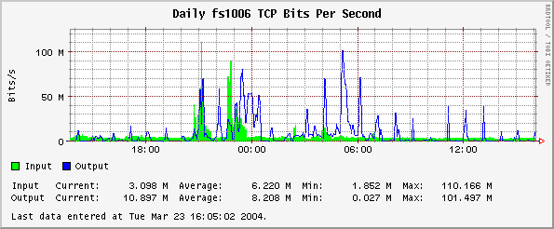
Orca – TCP Transfer Rate
Remember that EWMI has:
  Both gigabit and 100 Meg interfaces.
  A switched network (bandwidth limits depend on endpoint traffic. There is no datacentre-wide aggregate limit within reason).
  Full duplex means no collisions, no ethernet transmission backoff, and input and output use bandwidth separately.
  Network zones are separated by firewalls which may affect traffic.
Sustained rates of greater than 50-60% of capacity is a bit high.

Slide 14
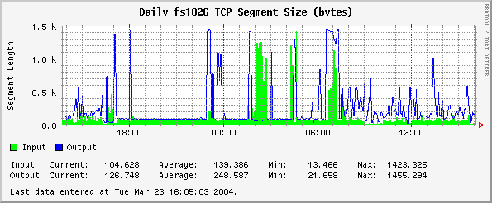
Orca – TCP Packet Size
Helps characterize traffic more than revealing problems.
Sustained packet sizes near 1500 bytes:
  Network backup in progress.
  Bulk File transfers are in progress.
Smaller packets:
  Interactive or query/response traffic.

Slide 15
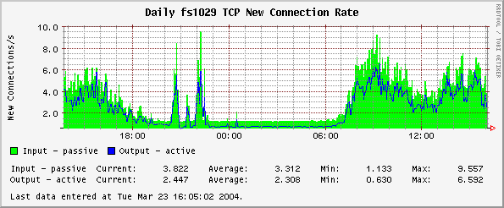
Orca – TCP New Connection Rate
Can indicate patterns of user access to web/other applications.
Unusual spikes or connection patterns may indicate configuration issues not easy to notice by other means.
In extremis, may indicate when tcp device tuning is warranted.

Slide 16
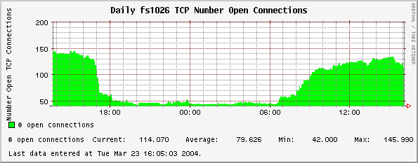
Orca – TCP Open Connections
Can indicate useful patterns of user or network access.
If open connections slowly rise in time, this may indicate local or remote processes not releasing/closing connections.
In extremis, may indicate when tcp device tuning is warranted.
Many other network related graphs are available (described later).

Slide 17
Orca - Memory
Solaris kernel’s paging ain’t what it used to be!
  I will describe what I understand to be Solaris 8 paging behaviour. Many people describe Solaris <=7 behaviour and incorrectly apply some or all of it to 8.
Historical Note for Solaris 7 and before.
  Programs, files, I/O buffers – everything is paged together.
  System/application I/O would slowly fill memory with I/O buffers that were thrown away and forgotten about. (A separate process find them and adds them to the free list).
  So lack of reported free memory did not indicate a memory problem, nor how much memory programs were using.
  Page scan rate had to be further inspected to see if there was a real memory deficit. Non-zero page scan rates were needed just to reclaim discarded I/O buffers.
  Warning. Books and articles written some years ago, before Solaris 8, will not point out they only apply to Solaris 7 and before, obviously. You may get suckered by this. I know I did.

Slide 18
Orca – Solaris 8 Memory and Paging
Solaris 8 Implements a “Cyclical Page Cache”
  A specific “file system free list” now exists dedicated to caching filesystem data only.
  Another one is used for pages related to applications, their uninitialised data, the kernel and shared libraries.
  Freed pages get explicitly placed in a cache list then migrate to a free list.
Effects:
  Filesystem I/O reclaims pages from its own free list, so heavy I/O does not force pages for processes out of memory to disk.
  The Orca (or vmstat) free memory figure really is your free memory.
  A non-zero scan rate really does mean some program/kernel related memory pressure, not merely that lots of filesystem I/O is taking place.
  Higher page reclaim rates are considered normal during heavy filesystem activity.
Vmstat –p 5
  Read the manual page and try it.
  You get separate statistics for executable, anonymous, and filesystem page rates (in, out, and freed).
  Guess I should update Orca and SE to display this.

Slide 19
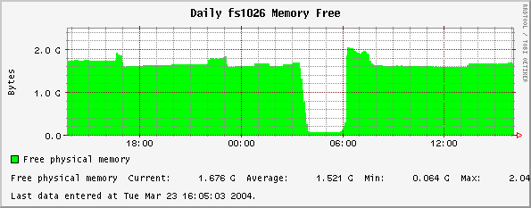
Orca – Free Memory
As normal filesystem I/O no longer reduces the reported free memory, the above loss of memory may indicate a problem.
In this case, the way free memory plunges may indicate some poor programming, or else too much is started all at once.

Slide 20
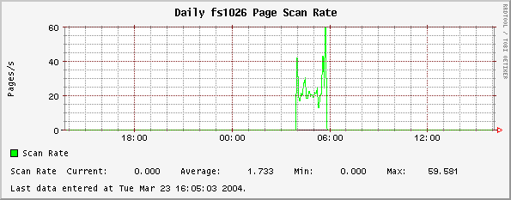
Orca – Page Scan Rate
For Solaris 8, a high value for page scan rate really can indicate a memory problem.
  In the above example, which corresponds to the slide before, the scan rate is not too bad – perhaps job job tuning is sufficient in this case.
  Consistently high values (200?) indicate more memory is needed.
Remember about memory leaks, but leakage consumes memory without always prompting high scan rates.

Slide 21
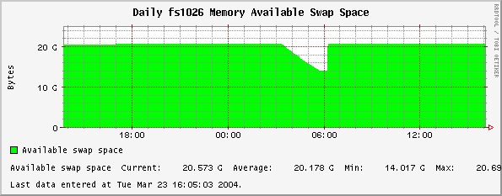
Orca – Swap Space Available
Remember that /tmp is a swapfs, hence files in /tmp can fill swap.
Remember that swapfs filesystems like /tmp can be limited in size to guarantee minimum swap available for processes.
Remember that more swap space can be added dynamically.
More memory graphs are available – page residence time, kernel/other page breakdown, I/O or locked, etc.

Slide 22
Orca – The Magical World of I/O
Analysing and optimising I/O performance is hard and opaque.
  Disk are extremely slow compared to processor and memory, so the impact of performance problems can be large.
  Disks are globally shared resources and disk request queues are global in Solaris. Questions such as “which processes are loading my disk?”, “why is the service time so long?”, and in our case, even “Which filesystem does this disk belong to?” can be difficult to determine.
Datacentre environments can be harder again.
  My database lives in Solaris files,
  Mounted on a Veritas filesystem volume,
  Which is a striped group of sub-disks (plexes),
  And those disks are really SAN disks, not local disks,
  Which can fail over to another host via VCS,
  Because the disks live somewhere else entirely
  (in a Hitachi Data Systems SAN disk array),
  And yet in the HDS the “SAN physical disks”,
  Are virtual disks,
  Which are cached, redundant RAID groups of actual disks.
  Which by the way, are replicated to another county for DR.

Slide 23
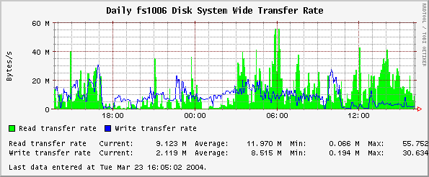
Orca – Disk System Wide Transer Rate
There is no right and wrong, and there is no fixed answer of what the right or maximum transfer rates should be.
A picture can be built of what is “normal”, so at least administrators can be aware if transfer patterns change abruptly.
Note: SAN disk transfer rates can be much greater than local disk transfer capacity. Do not assume local disks are faster.

Slide 24
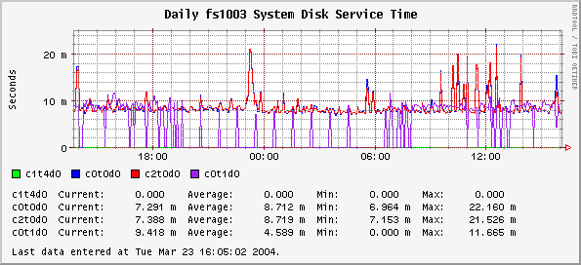
Orca – Disk Service Time
Long service times for disk I/O can be a good indicator of high disk load (usually excessive head movement).
  The local disk service times (shown above) are fine. (5-40ms is OK).
  Sustained 300ms+ service times are probably not fine.
  Simultaneous short and long service times on related disks (e.g. in a disk set for a single filesystem) indicates bad I/O distribution which warrants correcting.
Remember that a SAN disk is not actually a single physical disk.
  As they often cache writes, write service time can be extremely short (until some SAN device cache limit is hit!).
  Performance analysis may require data from the SAN array itself.
  Inter-site SAN replication bottlenecks may suddenly affect service time.

Slide 25
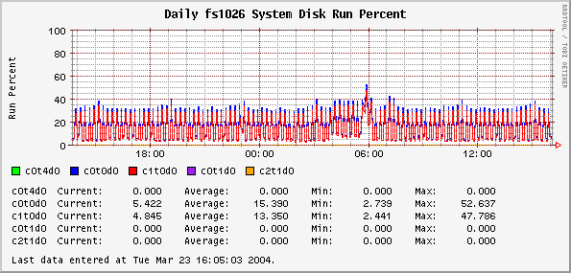
Orca – Disk Run Percentage
Means the percentage of time a request is queued for this disk.
There is no problem with a high disk run %, as such.
But if some disks are running constantly and others not at all, it may indicate incorrect I/O load distribution or disk organisation.
If you are striped but only 1 disk of the stripe is busy, then eek!

Slide 26
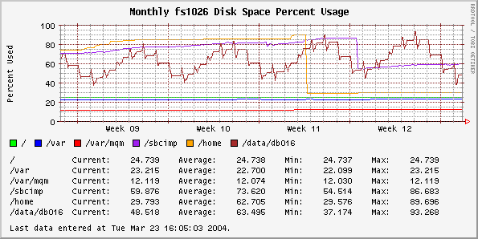
Orca – Disk Space
Beware! Orca aggregates daily -> weekly -> monthly figures by averaging.
  Disk usage spikes (while important to know about), may not be revealed by graphs such as the above. It show averages.
  Someone has extended Orca to enable “maximum” style consolidation. Integration with our system is pending.
An inode usage graph is available, which can indicate excessive file creation on a filesystem. Generally inode usage needs little monitoring.

Slide 27
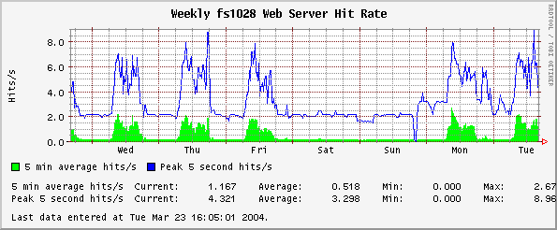
Orca – Web Servers
Yes, Orca can look at web server logs via the RICHPse client.
Other graphs are available.
  Web server data transfer rate.
  Web server error rate.
  Web server transfer size breakdown.
There are other specific web log tools that can reveal more information than Orca does.

Slide 28
Orca – Analysing CPU Problems
When run queue length is much higher than # processors.
  Remember that process may have multiple threads, each each thread can run on a separate CPU. (Ummm…. I think so).
Excessive proportion of system (kernel) time being used?
  Process(es) in tight system call loops (e.g. continuous file stat(), open/close().
  Database resource contention problems that trigger mutex/spin locks.
  Excessive context switching due to load.
  Excessive process invocation rate.
  Actions:
    Inspect runq, mutex, and context switches graphs. There are many other kernel graphs (dnlc hit rate, cache steal rate, system calls etc), but excessive values can be difficult to judge.
    Top(1), prstat(1), and truss(1) to inspect processes of course. Prstat has options to inspect individual threads.
    Turn process accounting on /etc/init.d/acct start, then acctcom and acctcms can reveal cumulative process times for fleeting but frequent commands.
    Locking guru? Look at lockstat(1M).

Slide 29
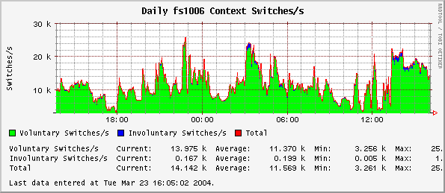
Orca – Analysing CPU Problems
Significant involuntary switches on multi-cpu hosts is probably bad.
  It is when a process is switched out, not because it needs to sleep on a resource, but rather because the kernel needs to give the CPU to someone else… well it’s not great.

Slide 30
Orca – Analysing Memory Problems
Free memory, page scan rate, page residence time – look at all of them together.
Graphs are available to detail the memory page break-up between the kernel and user processes, and whether they are locked.
Lots of free memory may indicate that kernel and application tuning is can be done too.
  In large memory configurations, the kernel flush rates and page scan rates are not appropriate. Tune fsflushr, tune_t_fsflushr, and autoup to reduce fflush() CPU load and increase page residency time. Reference: http://docs.sun.com/db/doc/806-6779/6jfmsfr7a?a=view
  Database applications can be configured to use more memory.
  You can create swapfs filesystems as places for temporary table spaces, where oracle places its temporary sorting files, or any application’s scratch files.
  But remember, reclaimable I/O buffers are included the the free list value. It is not quite as unused as it may seem.
  Solaris 8 better sets and tunes kernel performance variables. Are you sure you need to tune?

Slide 31
Orca – Analysing Network Problems
Network “problems” can occur at several levels.
Problems with the network itself, as indicated by low bandwidth, packet collisions, interface errors, etc.
Problems with an application’s use of the network, which may be manifested by high connection rates, high connection drop rates, etc.
You need to be aware of:
  The network topology.
  The location and characteristics of firewalls.
  The bandwidth and characteristics of WAN links.
  Be generally aware of your traffic routing (is there asymmetric routing? Does that matter?)
  Be aware of how the switch ports for your hosts are configured.

Slide 32
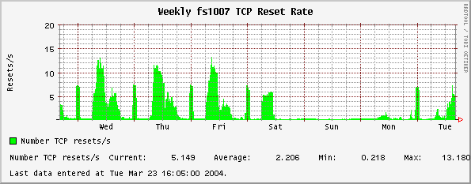
Orca – TCP Reset Rate
A TCP reset is when an inbound connection is refused.
Possible reasons:
  A host daemon is no longer listening on some port or is mis-configured.
  A remote host is mis-configured (trying to access the wrong port or the wrong host).
  Security. You are being port scanned?
Actions: netstat(1), snoop(1). Also lsof(1) can reveal a process’es listen ports.

Slide 33
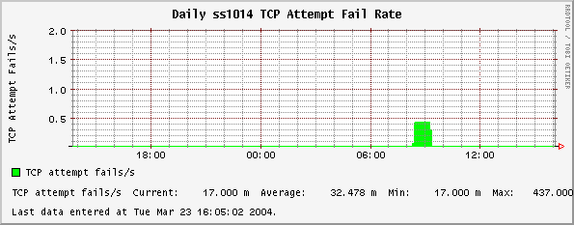
Orca – TCP Attempt Fail Rate
This is the client end of TCP connect fails. An attempt was made on this host to open a remote connection, and this failed.
The same reasons as TCP connect failure apply here.

Slide 34
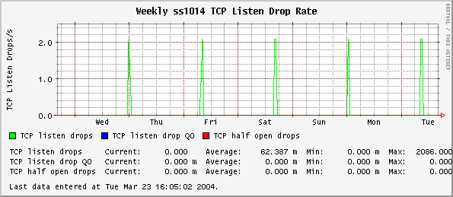
Orca – TCP Listen Drop Rate
The rate of new connection attempts to this host that are being dropped.
Usually indicates too high a connection rate for the available listening processes and the host processing resources.
Actions:
  Increase number of listening daemons (such as apache).
  Reduce peak incoming connection rate (if possible).
  Denial of service attacks may cause listen/drop rates to spike.
  Ultimately a faster host or clustering may be required.

Slide 35
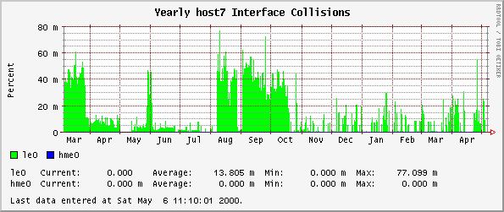
Orca – Interface Collisions
Interface collisions should never occur with switched full duplex networks.
Duplex configuration mismatches.
  If collisions rates are high, check duplex configuration of both the host and switch. If switch inspection is not possible, try forcing host link duplex each way and check for problems. (ndd /dev/hme etc to set network link parameters).
  Another symptom is that the network connection seems OK when the link traffic is light and with small packets (e.g. telnet), but hangs or gums up when file transfer is attempted.

Slide 36
Orca – Analysing I/O Problems
In EWMI, the relationship between database activity in a filesystem and disk I/O inside the HDS SAN is not currently understood or measured.
So far, the Orca disk I/O statistics at the host visible SAN disk level has generally indicated:
  Good overall request service time (often 10ms).
  Some occasional spikes, not sustained for long periods.
  But conversely the I/O appears highly out of balance. Many hosts have 95% of their I/O traffic occurring on 3 out of 150 disk slices.
  But is this bad? It does indicate possible VxVM configuration errors, because striping is done at the host VxVM level, and hence we should expect that any disk I/O will equally load 4 UNIX visible disks, not 1 or 2.
  But each disk that UNIX sees is ultimately just a communication channel to the SAN hardware. It does not say anything about how many physical disks are being activated and used.
  Thus the ultimate answers require raw internal HDS disk statistics, and a map of relationships between HDS disks and host filesystems.
There are better texts on I/O tuning than I could create, but beware that few of them talk about a VxVm/VxFS/SAN world.

Slide 37
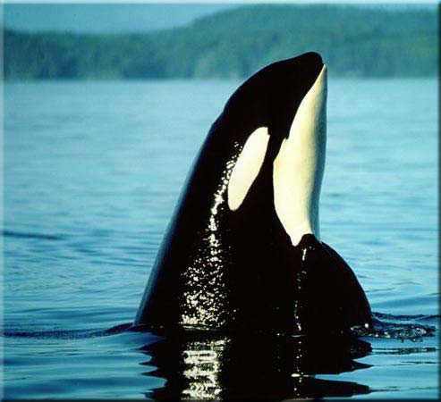
Orca – The end.
BURP

