Slide 1
Mathematical fundamentals for ISS
Honza Černocký, ÚPGM FIT VUT
Please open Python notebooks matika and cos_jexp.

Slide 2
Functions and sequences
Signals with continuous time (analog, real world) are defined for all times t. Signály se spojitým časem, spojité signály.
From math point of view, they are functions x(t) ← round brackets
Signals with discrete time (computer, digital world), sampled signals are defined only for integer times (sample numbers) n. Signály s diskrétním časem, diskrétní signály, vzorkované signály.
From math point of view, they are sequences x[n] ← square brackets.

Slide 3
How is it done in Python ? Just 4 steps …
Generate the independent variable - 1 line of Python code
Generate or read the signal - 1 line of Python code
Do something with the signal - 1 line of Python code
Show the result - 1 line of Python code (or more if you want to have it nice)

Slide 4



Operations with functions
As you know them from primary school, just do it for all times:
Addition
Subtraction
Multiplication
Mind the “masking effect” of zeros
#basicops

Slide 5



Operations with sequences
As you know them from primary school, just do it for all times.
Addition
Subtraction
Multiplication
Mind the “masking effect” of zeros
When plotting in Python, use stem rather than plot to show that we have discrete values.
But remember this is a lecture example, in normal life, we’ll be happily using plot also with discrete signals ☺
#basicops_seq

Slide 6

Linear function
Parameter a – slope (směrnice, sklon)
Parameter b – offset, bias (posun).
#linear

Slide 7



Derivations and integrals
Example on a simple quadratic function:
Derivation done analytically
Primitive function (antiderivative, primitivní funkce) done analytically
#deriv_int_anal

Slide 8

Derivation done numerically
Analytical form of derivation might not exist, or we are given an input signal, or just too lazy …
Make use of the definition of derivation
and just estimate the derivative from 2 points close to each other …
#deriv_num
Notes:
U ploteni tecen neysvetlovat, jak se to odvodilo, sikovni studenti na to muizou prijit sami.

Slide 9
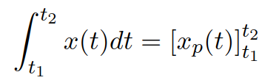

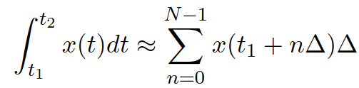
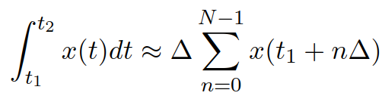
Finite integral from t₁ to t₂
Analytically using the primitive function:
But we will rather meet the numerical approximation of integral:
Finite integral is the surface under the function (plocha pod křivkou)
Define a time step ∆, filling the interval t₁ to t₂ N times.
Approximate the integral as the sum of surfaces of “noodles”, and simplify as the width of all noodles is the same:
#int_anal_num

Slide 10

Cosine function (cosínusovka) – continuous time
Basic cosine
has
Period (perioda) 2π rad – we are measuring angles in radians.
Magnitude (amplituda) 1
Phase shift (fázové posunutí, fáze) 0
#cosine_basic

Slide 11


Cosine with more interesting parameters
Setting the number of periods per second: frequency (frekvence, kmitočet) f₁ in Hertz.
The period (in seconds) then becomes
Making the cosine do f₁ periods in second: multiply its argument by
This value is called angular or circular frequency or velocity (kruhová / úhlová frekvence / rychost) and is measured in rad/s

Slide 12

Cosine with more interesting parameters II
Changing the magnitude - just multiply the cosine by constant C₁.
Changing the phase – add angle Φ₁ to the argument
Positive – shift to the left - advancing the signal (předběhnutí)
Negative – shift to the right – delaying the signal (zpoždění)
After adding / subtracting 2π, we obtain the same, as the periodicity of cosine is 2π.
Full cosine:
#cosine_full
Notes:
V cem je pocatecni faze ?
V cem muze byt amplitude ?

Slide 13

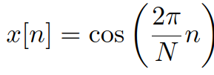
Cosine sequence – discrete time
Sequence
Not very interesting - something like 6.28 samples per period ???
Enforcing the number of samples in one period to be N:
2π/N is called normalized angular frequency (normovaná kruhová frekvence) – also denoted as ω₁.
Similarly as for the continuous one, we can change the magnitude and phase
#cosine_disc

Slide 14


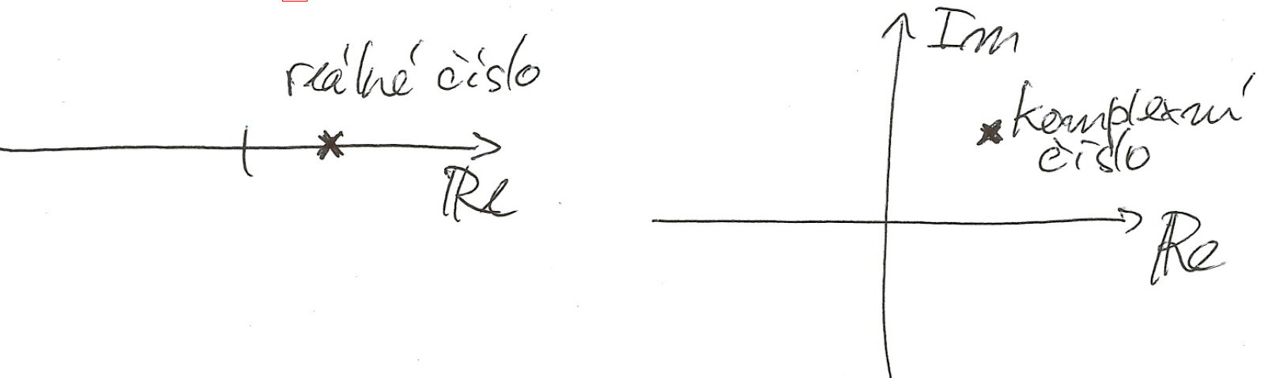
Complex numbers – basics
The real numbers are 1D – real axis
Complex numbers are 2D – lay in the complex plane (komplexní rovina) with two dimensions – the real one and the imaginary one
Mathematicians use i, electrical (and IT) engineers use j

Slide 15

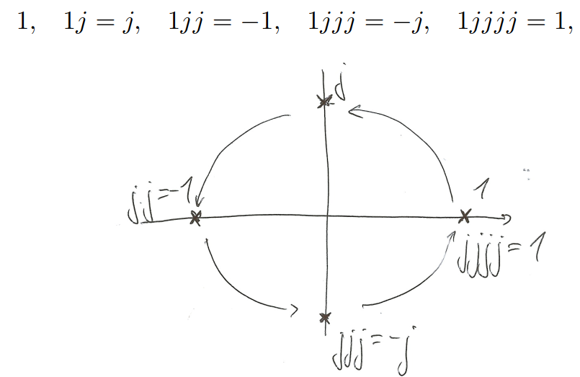
Complex unit
Is defined as
Has “circular property”

Slide 16

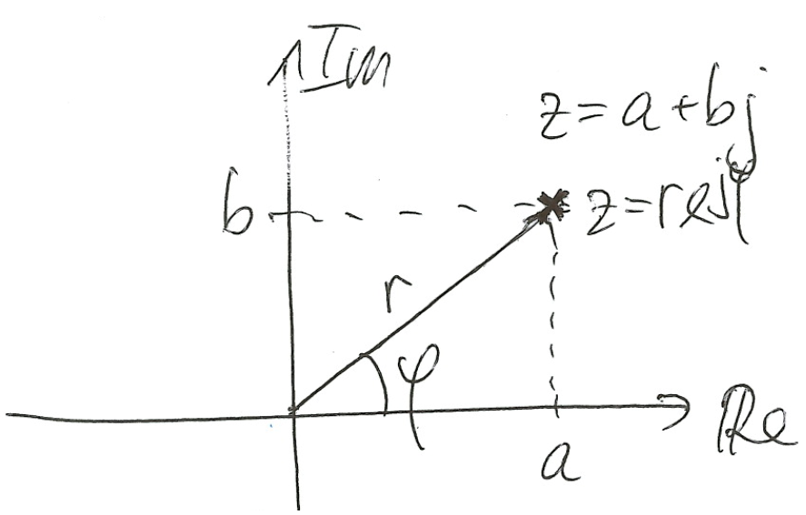
Complex number as a vector and its two forms
It is convenient to imagine complex numbers as vectors starting in 0+0j and going to the given complex number.
Component form (složkový tvar) of a complex number
a is real component
b is imaginary component
Polar form (polární nebo goniometrický tvar)
r is magnitude or absolute value (modul, absolutní hodnota, magnituda)
φ is phase (fáze, úhel, argument)

Slide 17



Conversion of forms using basic geometry
From polar to component
… so the component form can be written as
From component to polar
Be careful about the inverse tangens and always check that you have got the result correctly.
See the 1st numercical exercise.
Python (and all other languages supporting math) have appropriate functions
np.abs(), np.angle()

Slide 18



Exponential form of complex number
or (if lazy to type in LaTeX) or (el. engineers)

Slide 19
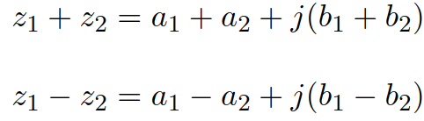
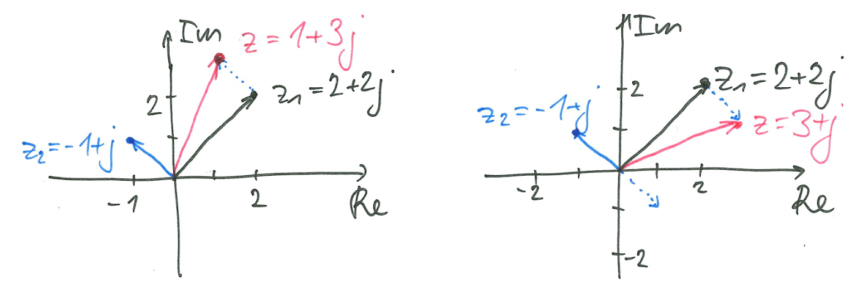
Operations with complex numbers
Addition and subtraction in composite form
Easy to imagine as vectors in the complex plane !

Slide 20

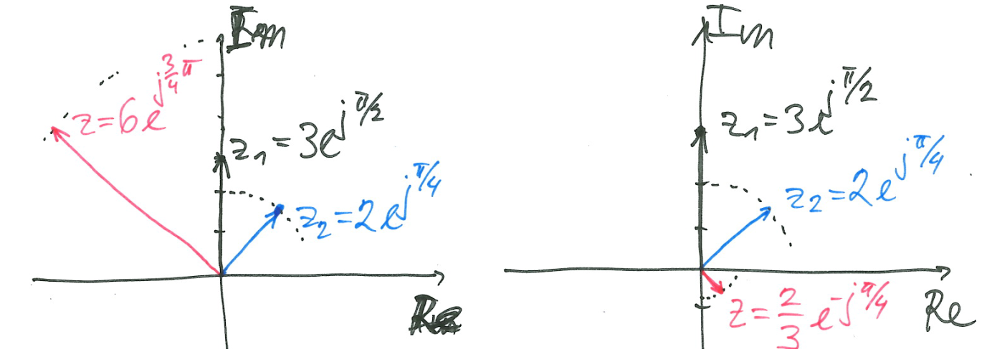

Operations with complex numbers II
Multiplication
Possible in component form, but too complicated …
Much more convenient in the exponential form: multiply the magnitudes and sum the phases !
Division: similar

Slide 21

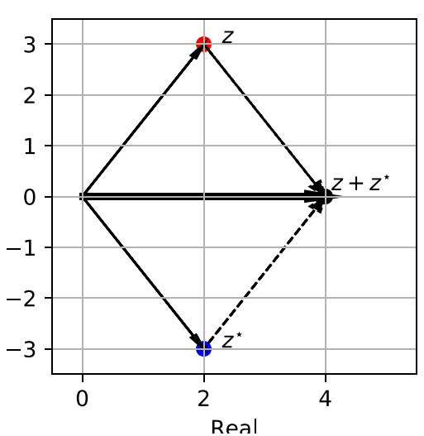
Operations with complex numbers III
Complex conjugation (komplexní sdružení)
Component form: imaginary part swapped
Exponential form: phase swapped
Sum of complex-conjugated complex numbers is a real number
Product of complex-conjugated complex numbers is the square of their magnitude
Will be handy in determing powers and energies
np.conj(x) * x is faster to write and to compute than np.power(np.abs(x), 2.0)

Slide 22

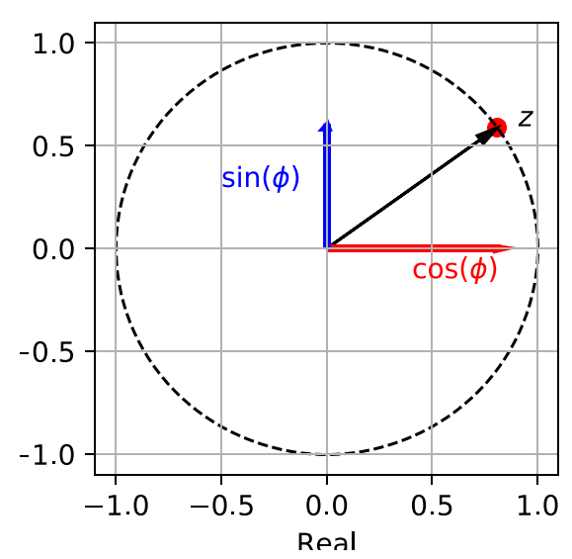
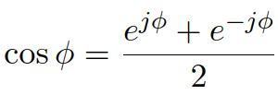
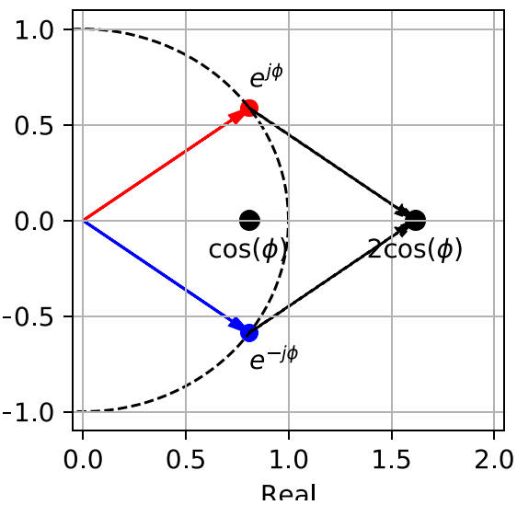
Unit circle (jednotková kružnice) r = 1
Useful to derive some formulas in case you forget them …

Slide 23


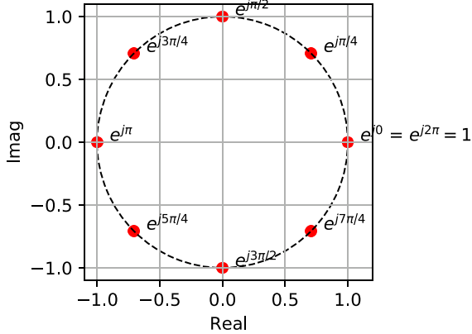
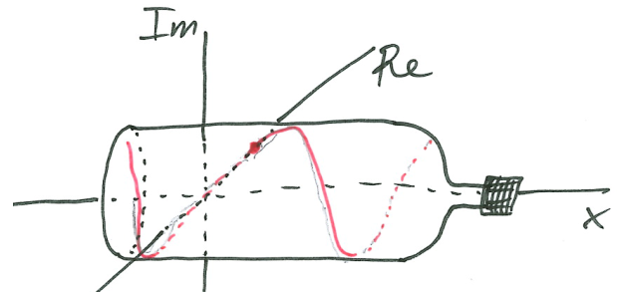
Complex exponential
For zero phase:
The point then starts moving counter-clock-wise (proti směru hodinových ručiček)
Much better to see it on a physical model the „complex bottle“
and visualize it in Python
#complex_exp

Slide 24

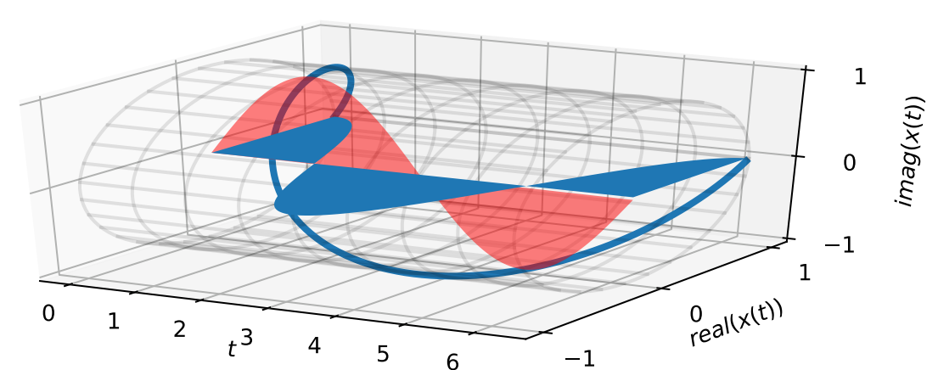


Operations with complex exponential
Showing that it can be really decomposed into cos and sin …
turning in opposite direction:
instead of
#complex_exp_minus

Slide 25


Operations with complex exponential II
Changing the magnitude – just multiply with a constant
#complex_exp_magnitude
Changing the phase – just multiply with a complex number laying on the unit circle with the desired phase
the complex exponential will acquire the desired phase
#complex_exp_phase
Changing both – multiply with a complex number of which the magnitude will be the desired magnitude change, and phase will be the desired phase change
#complex_exp_magnitude_phase

Slide 26



Complex exponential with period different from 2π
Exactly the same as for the cosine: multiply time by angular frequency so that
the angular frequency can be even negative, in this case, the complex exponential will “turn” in the opposite direction
#complex_exponential_ang_freq

Slide 27
Complex exponential – the whole thing
the complex coefficient c₁
Its magnitude determines the magnitude of resulting complex exponential.
Its phase determines the phase of resulting complex exponential.
the angular frequency ω₁ determines the number of revolutions of the complex exponential per second.

Slide 28





Breaking a cosine into two complex exponentials
Using the well known formula
The cosine without initial phase can be decomposed as
Don’t be scared by the negative angular frequency !
#cos_decomposition
And the full one similarly making use of
and are complex constants.
#cos_decomposition_full

Slide 29


Complex exponential - discrete-time
Very similar to discrete cosine … for 1 period in N samples
k periods in N samples:
#complex_exp_discrete
#complex_exp_discrete_2

Slide 30

General complex exponential with discrete time
Similarly as for the continuous-time one,
magnitude of c determines the magnitude of resulting complex exponential.
phase of c determines the phase of resulting complex exponential.
k determines the number of periods (“turns”) in N samples
#complex_exp_discrete_general

Slide 31





Decomposing a discrete cosine into two complex exponentials
Again using the well known formula
Complex numbers and are again complex coefficients.
The example is for
#discrete_cos_decomposition

Slide 32
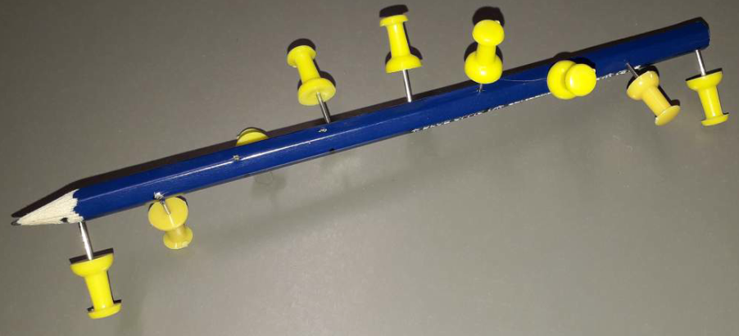

Physical model for discrete complex exponential
Use whatever long object and put something into it …

Slide 33
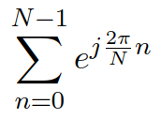
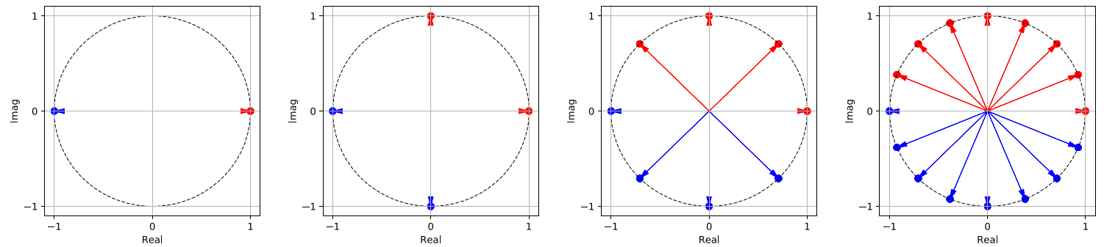
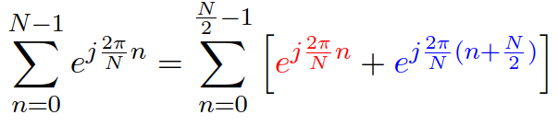
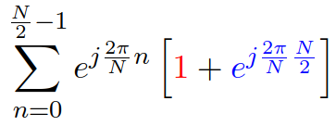
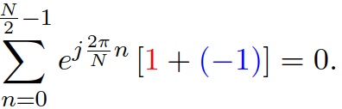

Sum of discrete complex exponential over one period
Examples for N = 2, 4, 8, and 16.
Obvious that the blue parts will cancel out with the red ones => zero
It generalizes also for other N’s. In case more math needed, here it is !

Slide 34

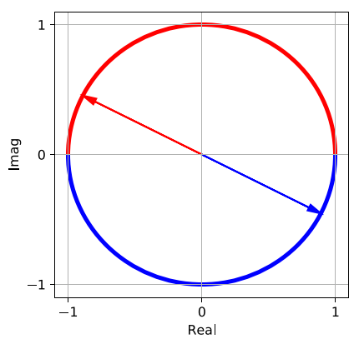
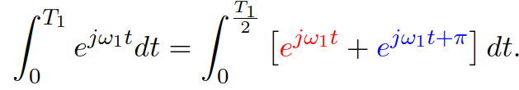
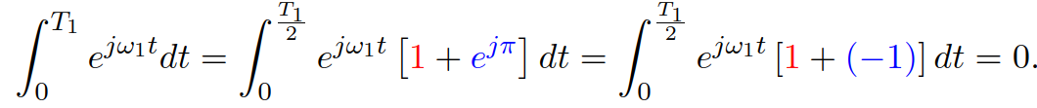
Sum of a continuous complex exponential over one period
Red and blue parts cancel out (integral is nothing but a sum …)
If you really want a proof, here it is:

Slide 35
Summary
ISS is actually an applied math course (sometimes also dubbed “Fourier hell” …)
Cosines, sines and complex exponentials are the very basis of spectral analysis.
It is good to write equations but writing 2 lines of Python code, and visualizing the result, helps understanding the math!
Funny TODO: Impress your friends in a pub by creating a physical model of a complex exponential (and send me photos).
Serious TODO: think about the relations of regular and normalized frequencies when one samples a continuous signal with sampling frequency F_{s}.
Consider both standard and angular ones.
What are their units ?
How to convert one to another ?

