Slide 1
Introduction to spectral analysis
Honza Černocký, ÚPGM
Please open Python notebook 02_spectral.

Slide 2
The goal of spectral analysis
Take a complicated signal and try to see how it is composed from frequency components
What do we want to know about them
  At which frequencies they are
  How strong they are
  How they are shifted in time
We can perform it for a single segment of a signal -> spectrum
Or we can see the evaluation of spectrum during the time -> spectrogram

Slide 3

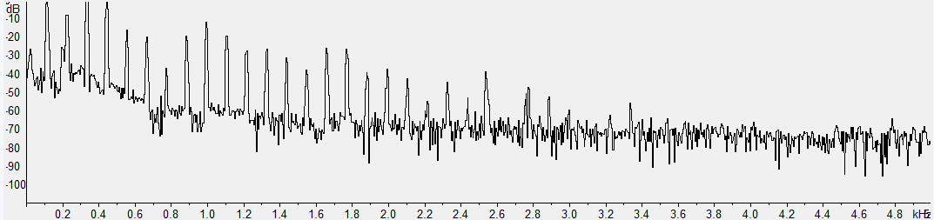
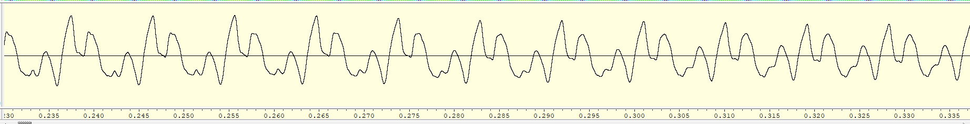
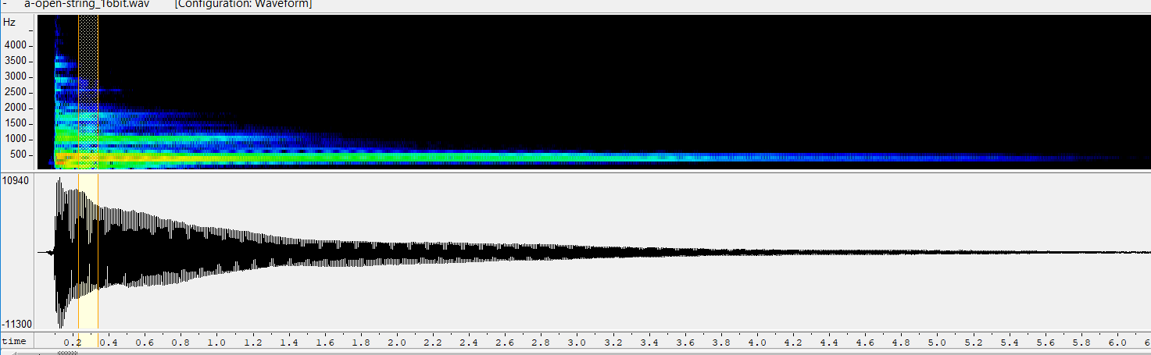
Guitar
Piece of signal and its spectrum
Whole signal and its spectrogram

Slide 4
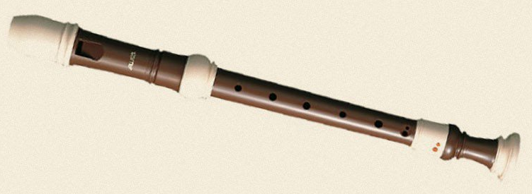
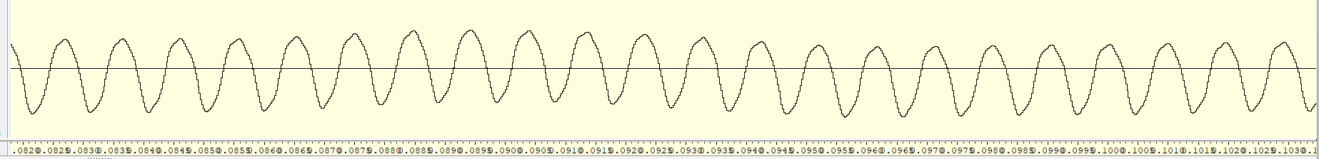

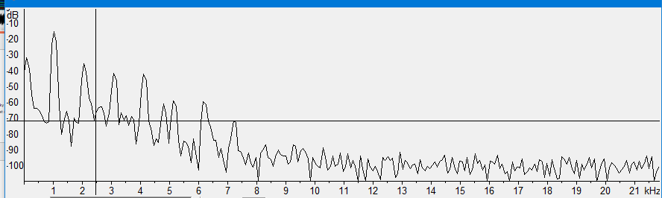
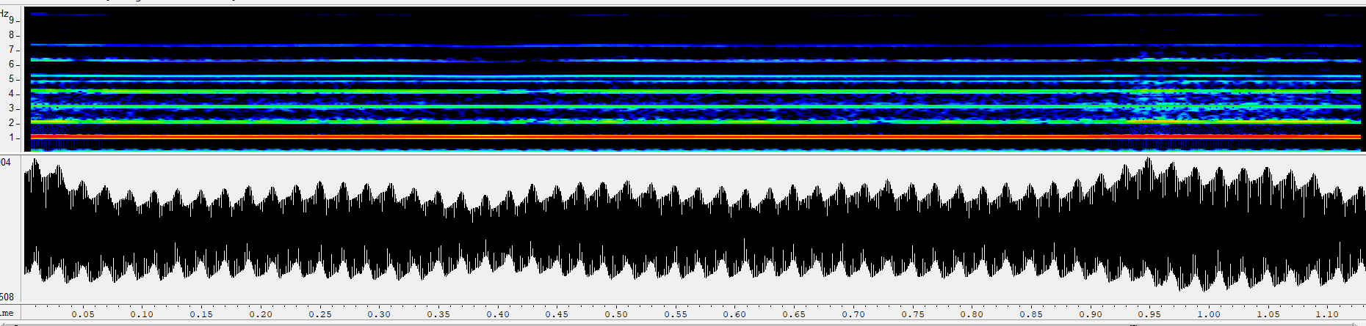
Recorder (zobcová flétna)

Slide 5

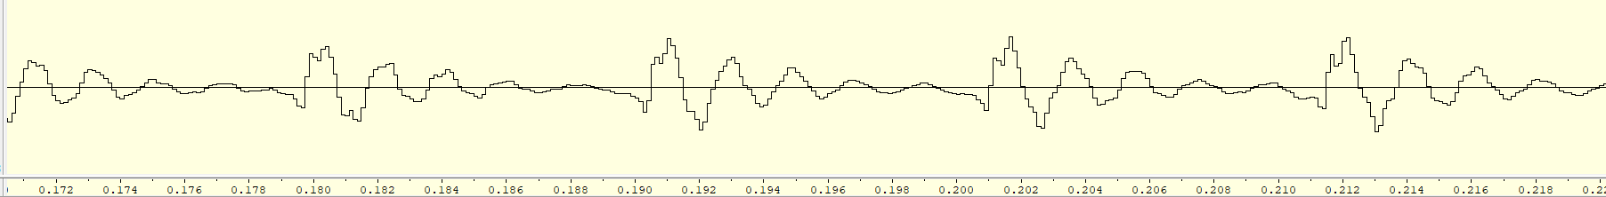
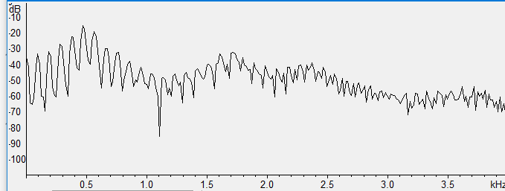
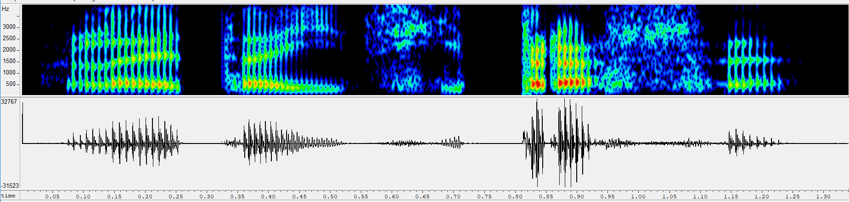
Human voice (lidský hlas)

Slide 6
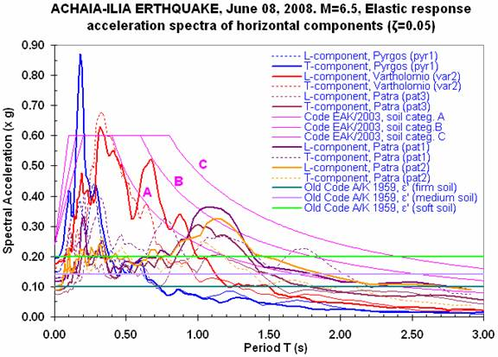
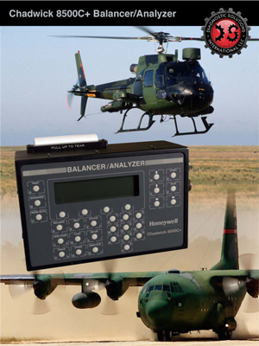
Not just audio … seismology, vibration analysis

Slide 7
Why are the signals around us complex ?
Because they are created by complicated physical processes, not by a cosine generator !
Strings: several vibration modes together, see for example https://www.youtube.com/watch?v=BSIw5SgUirg
Flutes (tubes): dtto, https://www.youtube.com/watch?v=KZ7intMz2Y4
Human voice: vocal chords (hlasivky) do everything but smooth movements, and this creates lots of frequencies: https://www.youtube.com/watch?v=y2okeYVclQo

Slide 8
Harmonically related signals
Most of frequency analysis involves a fundamental frequency (základní frekvence, fundamentální frekvence)
and its multiples – harmonically related frequencies (harmonicky vztažené frekvence) or simply harmonics (harmonické).
  Musicians might have heard about it in the music theory classes – aliquots (alikvotní tóny)
Our spectral analysis will follow the same principles – fundamental frequency and its mutliples.

Slide 9
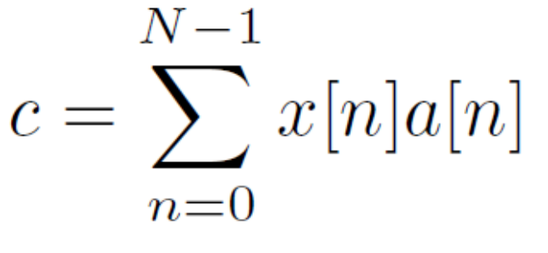
Spectral analysis
}
Correlation
Determination of similarity
Projection to bases
Notation
  x[n] is the unknown signal
  a[n] is a known (generated) analysis signal
  c is the resulting coefficient quantifying correlation / similarity / strength of projection
The same !

Slide 10

Implementation of this simple equation
x[n] and a[n] are stored in row vectors.
np.sum(a * x) – straightforward implementation
np.dot(a, x.T) – dot product (skalární součin) of 2 vectors (the 2nd one must be column)
np.matmul(a, x.T) – the same using a function for matrix multiplication
np.matmul(A, x.T)
  more bases stored in the rows of matrix A
  we’ll get whole vector of coefficients
  we’ll see this all the time !
#computing_projection

Slide 11
Examples of analysis – use also your intuition !
“Unknown” signal has N=128 samples, let’s begin with a D.C. signal …
We’ll always show the product x[n] a[n]
Analysis signals will be
  another DC signal big similarity
  Cosine – 1 period in N samples no similarity
  Cosine – 2 periods in N samples no similarity
#dc_signal_analysis

Slide 12
“Unknown” signal is 1 period of cosine
Analysis signals will be
  another DC signal no similarity
  Cosine – 1 period in N samples big similarity
  Cosine – 2 periods in N samples no similarity
#1cos_analysis

Slide 13
“Unknown” signal are 2 periods of cosine
Analysis signals will be
  another DC signal no similarity
  Cosine – 1 period in N samples no similarity
  Cosine – 2 periods in N samples big similarity
#2cos_analysis

Slide 14
“Unknown” signal are 2 periods of cosine + some D.C. component
Analysis signals will be
  another DC signal some similarity
  Cosine – 1 period in N samples no similarity
  Cosine – 2 periods in N samples some similarity
Wow, the projection manages to separate the “strengths” of D.C. and cosine !
#2cos_dc_analysis

Slide 15
“Unknown” signal are 2 periods of cosine + some noise
Analysis signals will be
  another DC signal not showing - no similarity
  Cosine – 1 period in N samples not showing - no similarity
  Cosine – 2 periods in N samples some similarity – same as for clean one !
Wow, analysis by cosines seems to be robust !
#2cos_noise_analysis

Slide 16
Cosines seem to work !
Big positive – correlation, similarity, this frequency IS in the analyzed signal.
Big negative – anti-correlation, similar, but in the inverse sense, the frequency IS in the analyzed signal with minus sign.
Small / zero – no correlation, no similarity, the frequency is not there or just a little.

Slide 17
Massive spectral analysis with cosines !
Working with cosines seems to work perfectly, let’s run a massive spectral analysis with many of them.
We’ll get many cosines cos(2π k n / N ) … but how many ?
  k = 0 is the D.C. : cos(2π k n / N ) = cos(0) = 1
  k = 1 is one period in N samples
  k = 2 are two periods in N samples
  …
  k = N/2 is the fastest cosine we can generate: cos(2π (N/2) n / N ) = cos(π n) generates +1, -1, +1, -1 … changing polarity every sample.
#show_range_of_cosines

Slide 18
The input signal and reference spectrum …
256 samples from sound ‘e’ from my favorite test signal “Létající prase”.
the reference spectrum should look like this
#prase_signal

Slide 19
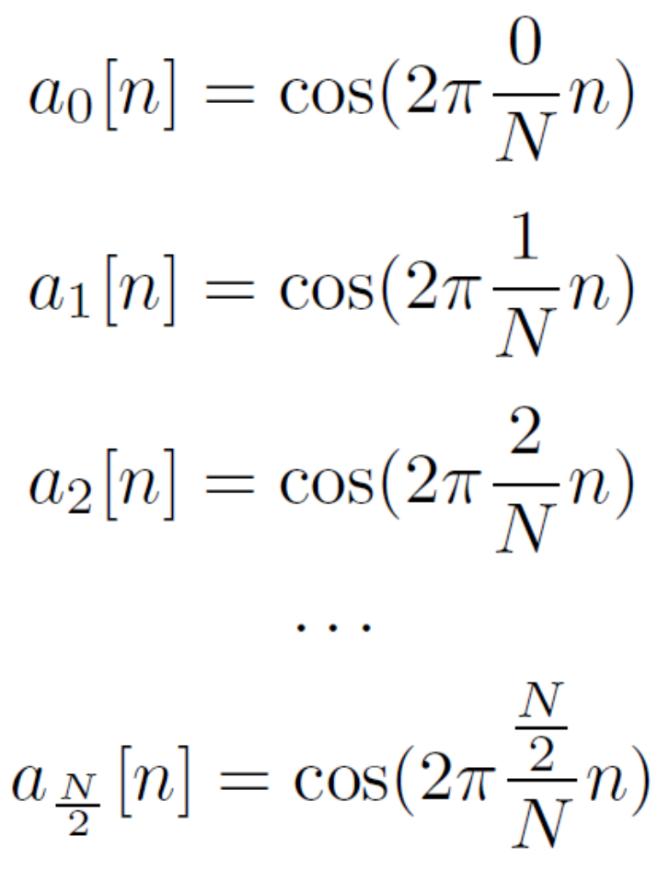
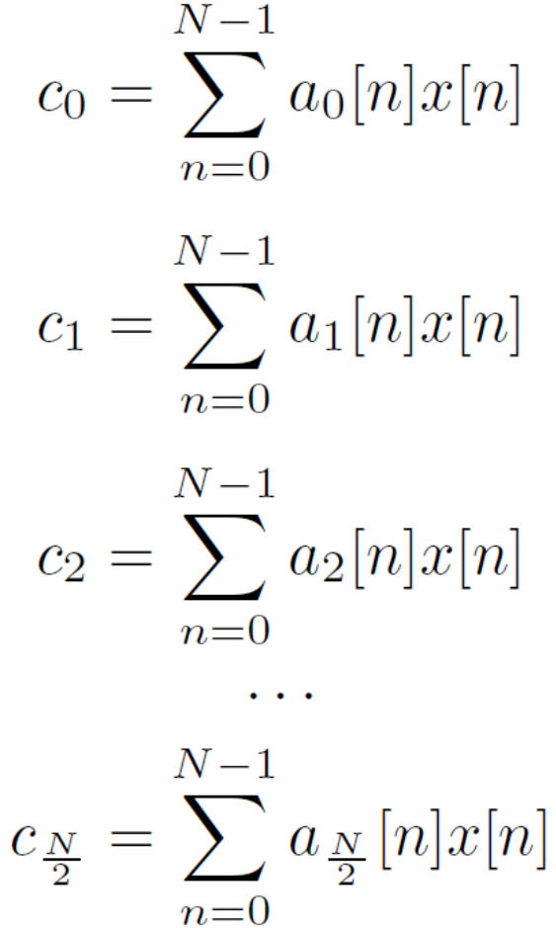

Prepare the battery of cosines and run the show!
#full_cos_anal

Slide 20
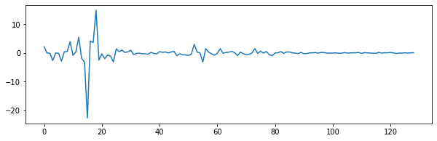
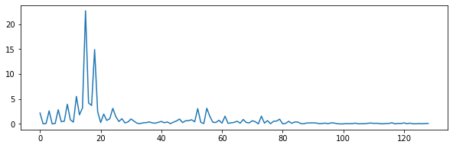
Result of analysis
Coefficients c_{k}
Coefficients c_{k}
in absolute values |c_{k}|
Is this OK ???

Slide 21
Let’s try to re-synthesize the signal …
Multiply each basis by the respective coefficient and sum it all
For our cosines
Also nicely doable as vector-matrix multiplication: x_{s} = c^{T} A
#full_cos_synt
Failure – WHY ???

Slide 22
Phase is the problem !
“Unknown” signal are 2 periods of a sine
Analysis signals will be
  Cosine – 2 periods in N samples zero, that’s bad !!!
#2sin_analysis
we’ll need to analyze the signals by both cosine and sine !
#2cos_sin_analysis

Slide 23
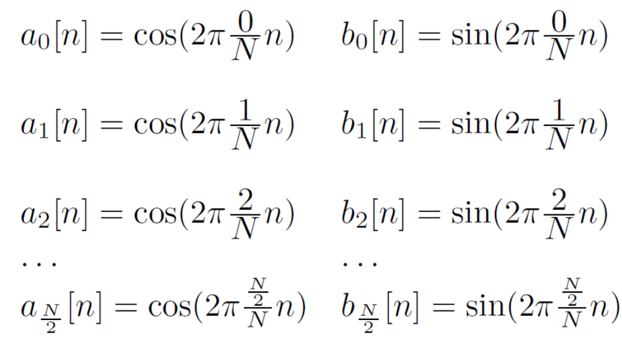
Analysis with whole groups of cosines and sines
How will the analysis signals for limit values look like ?
Notes:
Especially sin for 0/N and N/2/N – actually both of them zero, so not really relevant.

Slide 24
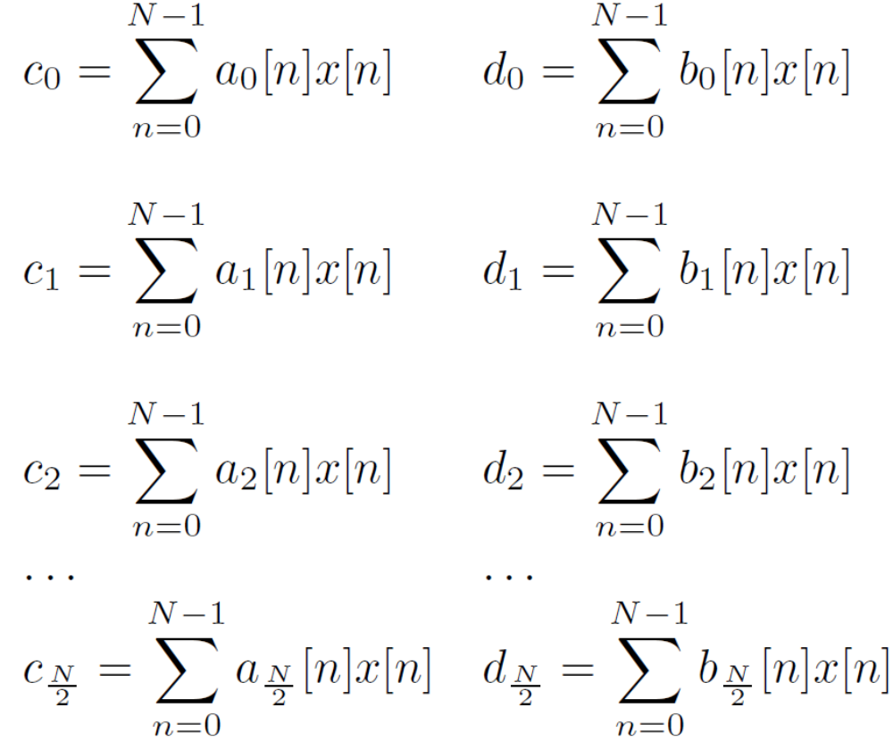
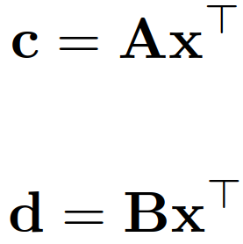
Let’s go
#full_cos_sin_anal

Slide 25
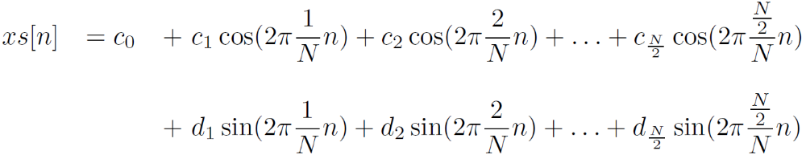
Looks pretty good, how about re-synthesis ?
Again, multiply each basis by the respective coefficient and sum it all
Also nicely doable as vector-matrix multiplication: x_{s} = c^{T} A + d^{T} B
#full_cos_sin_synt
Works ! However, keeping track of cosines and sines is a bit complicated …

Slide 26
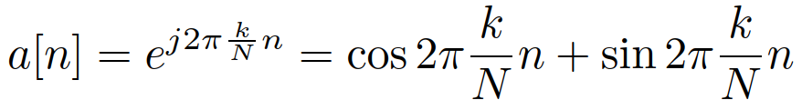
The ultimate basis for spectral analysis – a complex exponential
Complex exponential contains both cosine and sine in one function
Complex exponentials are also harmonically related: the first has normalized frequency 1/N, the next 2/N, etc …
#complex_exp
Special cases
  k = 0 – analysis of the D.C. component (always 1)
  k = N/2 – analysis of the fastest function – each sample changes polarity
  Both are real !

Slide 27
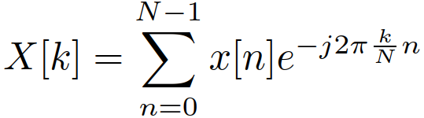


Analysis by complex exponentials
Why the minus ???
Projection to real numbers: in case |a| = 1, it is enough to multiply with the base and we obtain a good coefficient for reconstruction:
x = 3, b = 1: projection c = xb = 3, reconstruction: cb = 3 . 1 = 3 OK
Projection to a complex number: x = 3,
projection:
reconstruction: not OK

Slide 28


Analysis involves conjugating the complex basis
Fixing this problem - take a complex conjugate (komplexní sdružení) of the basis:
More generally: for analysis signal a[n], that is complex, take it’s complex conjugate a*[n]. For our bases
The same complex exponential, but turning in opposite direction
#plus_minus_complex_exp

Slide 29
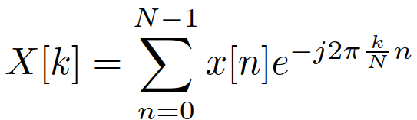
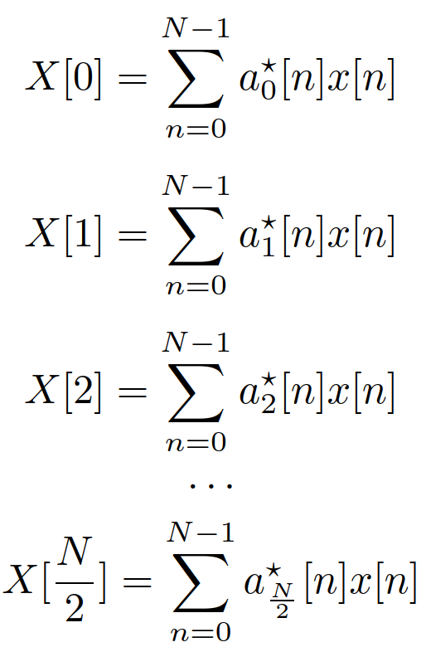
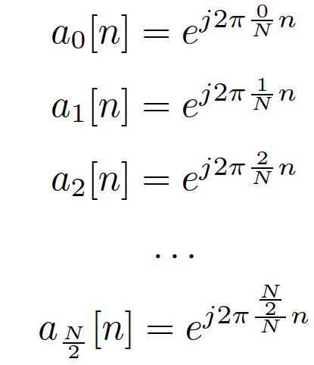

Discrete Fourier transform (Diskrétní Fourierova transformace) (DFT)
What does it tell us ?
  Index k tells us which frequency
  Magnitude (absolutní hodnota, modul) |X[k]| tells us how much
  Phase (fáze, úhel, argument, fázový posuv) arg X[k] tells us how shifted
#dft_anal

Slide 30
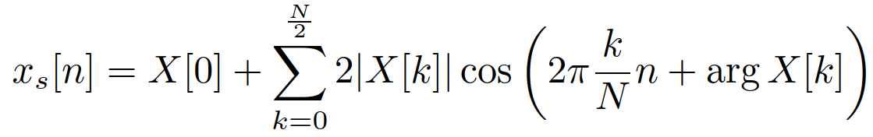
Synthesis from all this …
We have done synthesis as
So here it should be
Ooops, we’d get something complex ☹
We could extract the magnitudes and phases from complex coefficients and do something like this
But it would be complicated as a hell, and we love our complex exponentials, so …

Slide 31
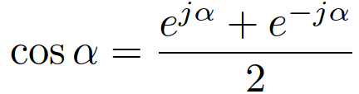
Complex exponentials only …
We use the old trick with a conjugate complex exponential turning in the opposite direction
  Definition:
  Our case
#discrete_cos_decomposition (reproduced from the last lecture)
But we absolutely want to stay in positive indices k, a bit of math will help us to go from –k (negative) to N-k (positive):

Slide 32
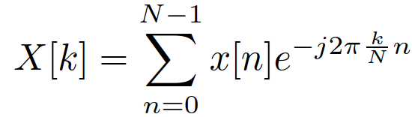
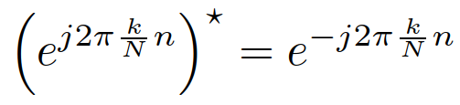
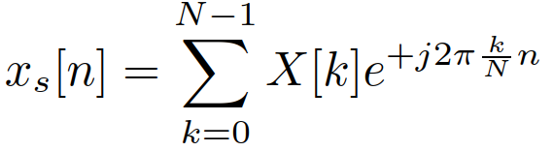
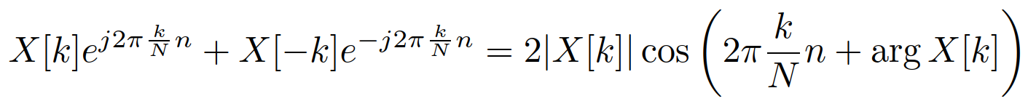
DFT with all N output coefficients
We perform the analysis for the full range
k = 0 … N-1 knowing that there will be symmetry between
  The coefficients: X[k] = X*[N-k], this means |X[k]| = |X[N-k]|
  and arg X[k] = - arg X[k]
  The complex exponentials:
We’ll perform the synthesis again with the full range of coefficients k = 0 … N-1 knowing that
  k = 0 will produce a D.C. value (real signal)
  k = N/2 will produce a real signal as well (+1,-1,+1,-1, …)
  For other k’s, pairs k and N-k will produce two complex exponentials running in the opposite direction, summing up to a cosine:

Slide 33
Full DFT spectrum and how many values do we have ?
#full_dft_anal
Let’s count the floats:
  X[0] – real, 1 float
  X[1 … N/2-1] – complex, 2 floats each: 2(N/2 – 1)
  X[N/2] – real, 1 float
  X[N/2+1 … N-1] – no floats needed, we already have them: X[k] = X*[N-k]
All together: 1 + 2(N/2 – 1) + 1 = N, OK, DFT preserves all the information

Slide 34
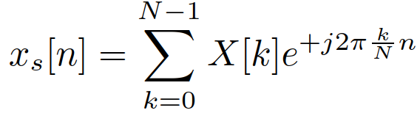
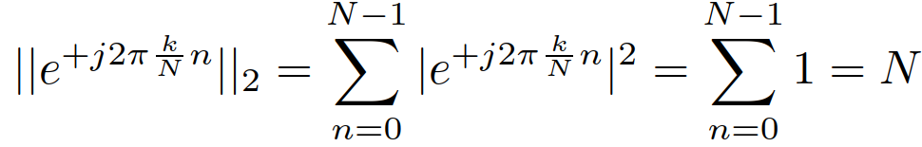
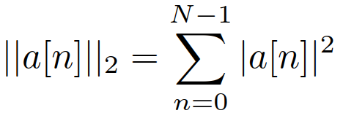
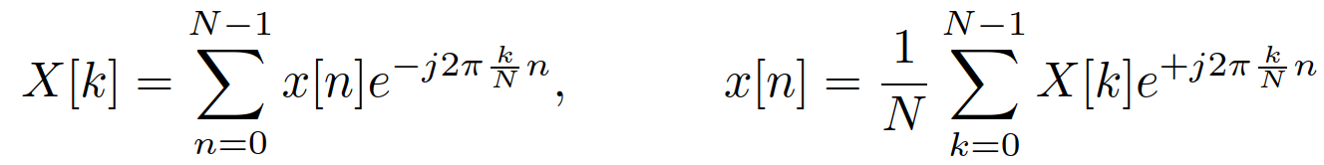
DFT synthesis – inverse Discrete Fourier Transform (inverzní diskrétní Fourierova transformace)
#full_dft_synt
Very nice, except for the dynamic range … max = 0.57 for the original signal and 147 for the synthesized one ☹
It should be correct with bases that are normal, so what’s the norm of our complex exponential ?
Aha, need to correct this, so the ultimate definition of DFT and IDFT is

Slide 35
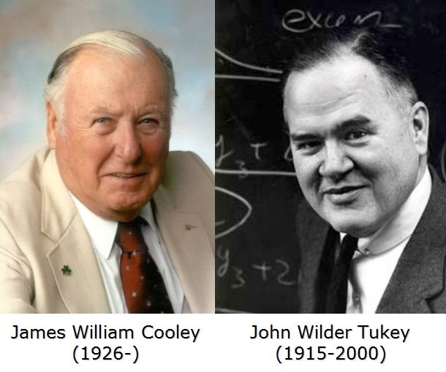
Using DFT in your code
DFT is computation hungry
  Computation of each output coefficient involves N complex mutliplications and N complex additions.
  And there are N output coefficients, co that the complexity is 2N²
  Quadratic complexity is bad even with modern
  computers with GPUs and was even worse
  in the 60’s where a computer occupying
  whole room had computing power
  smaller than your smart watch.
Developing FFT in the 60’s completely
revolutionized the signal processing
2016

Slide 36
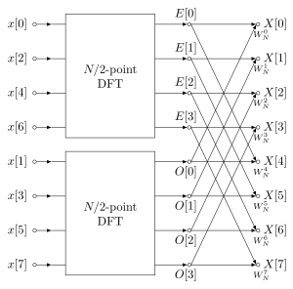
Fast Fourier transform (rychlá Fourierova transformace) - FFT
Works only for powers of 2: N = 2^{b}
Works in b stages and uses the symmetries
of complex numbers, each stage needs only
N operations, the graph looks like butterflies
=> butterly algorithm
The complexity goes from N² to N log₂ N
fft is part of all numerical libraries in all possible
languages.
Sorry, no time to derive it thoroughly, but look at one of many sources (incl. Wikipedia)
Remember FFT is not a new transform, it is a fast implementation of DFT !
#fft_anal_synt

Slide 37
Showing and interpreting the result of DFT - frequency
Your boss/colleague/customer won’t like you for just the index k on x-axis
Normalized frequency (normovaná frekvence) k / N is better
Regular frequency in Hertz is even better
  Need the sampling frequency (vzorkovací frekvence) F_{s} [Hz] – number of samples per second. Sampling period (vzorkovací perioda) T_{s} = 1 / F_{s} is in seconds.
many ways to derive the conversion but let’s do it this simple way:
  The period of a cos (or sine or complex exp.) with normalized frequency of 1/N is N samples.
  The period in time is N T_{s}. Therefore the frequency is 1/ (N T_{s}) = F_{s} / N.
Normalizing and de-normalizing frequencies involves just by division and multiplication by the sampling frequency F_{s.}
#dft_freq_axes

Slide 38
Showing and interpreting the result of DFT – going to F_{s} or just F_{s} /2 ?
We usually show only the left part of the DFT spectrum as the right one is not informative.
  indices 0 … N/2, attention, this is N/2+1 coefficients, not N/2 !!! For N=256, we’ll need to keep 129 values !!!
  normalized frequencies 0 … 1/2,
  regular frequencies 0 … F_{s}/2
#dft_final_visualization
Attention: the halves are symmetrical only for real input signals. Beware in case you have to process anything complex (digital radio, microphone arrays, …)

Slide 39
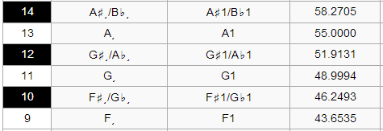
Frequency resolution of DFT
Interval 0 … F_{s} is divided into N samples, therefore the frequency resolution is F_{s} / N.
This is not much, consider an example:
  F_{s} = 48000 Hz.
  Trying to tune low tones on a piano
  Performing DFT with N = 256 samples.
  The resoluition is 48000 / 256 = 187 Hz – quite bad if we need units of Hz !

Slide 40
Increasing the resolution – option I.
Increase the number of samples, in case we have F_{s} = 48000 Hz, let’s take N = 65536 and run FFT
This will take lots of computation !
The missing samples can be either taken from the signal (if we have them) or filled by zeros – zero padding (doplňování nulami)
#zero_padding
With zero padding, the result looks nicer, but there is no new information !

Slide 41
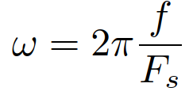
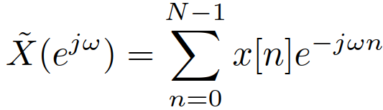
or … Discrete time Fourier Transform (Fourierova transformace s diskrétním časem) - DTFT
DFT sets the normalized frequency points to multiples of 1 / N
DTFT can work with anything – usually defined with normalized angular frequency
We can set the range of frequencies to anything we want.
However, needs to compute by definition and therefore much slower than FFT.
Let us show analysis of our speech spectrum with better precision around the maximum
#dtft study carefully, you might need it in the project ☺

Slide 42
SUMMARY
We analyze by multiplying and summing vectors
Difficult signals are analyzed by harmonically related functions
  Cosines – not enough
  Cosines and sines – too complicated
  Ultimate solution: complex exponentials => DFT
The original signal can be fully re-synthesized – IDFT (making use of properties of complex numbers to get a real signal)
The results are there for N discrete frequencies from 0 till almost F_{s}
  Of these, only N/2+1 are worth showing
  with a nice frequency axis !
Frequency resolution is limited but can be improved
  by zero padding
  By switching to DTFT

Slide 43
Next lecture
Use of DFT – some typical signals
  D.C.
  Pulse
  Rectangle
  Periodic signals – nice and ugly …
Properties of DFT – symmetry, linearity, shifts.
How about if we run k beyond the sampling frequency ?
Spectrogram for visualization
Spectrogram for filtering in the frequency domain
Why do we need spectral analysis even in the “AI” era

