Slide 1
快取行為模擬
計算機組織 Lab 5

Slide 2
Outline
Introduction of Cache
Cache Memory
Direct Mapped Cache
Associative Cache
Replace Policy
Homework

Slide 3
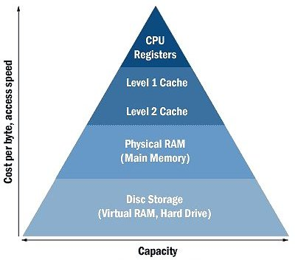
Cache Memory
Cache Memory
The level of the memory hierarchy closest to the CPU
Computer Memory Architecture
越往上層，記憶體的速度越快，容量越小。
資料只能在相鄰的階層中移動。
computer memory architecture
Notes:
Cache
This form of memory can be considered as an intermediary between the main physical RAM and the CPU. The cache makes any data frequently used by CPU instantly available. If the required information is not located in the cache, a fetch is made from the main memory.
There are two levels of cache: Level 1 Cache (primary cache) and Level 2 Cache (secondary cache).
Level 1 cache is built directly on the CPU, just like the registers. It is small in size, ranging anywhere between 2 kilobytes (KB) and 128KB. As this cache is closer to the CPU than level 2 cache, its transfer speeds are much faster as a result.
Level 2 cache is usually situated in close proximity to, but off, the CPU chip. However, there are certain systems where the cache is built directly onto the CPU itself as like the level 1 cache. The size of level 2 cache ranges from 256KB to 2 megabytes (MB). Both levels of cache use Static Random Access Memory (SRAM) to hold the data.

Slide 4
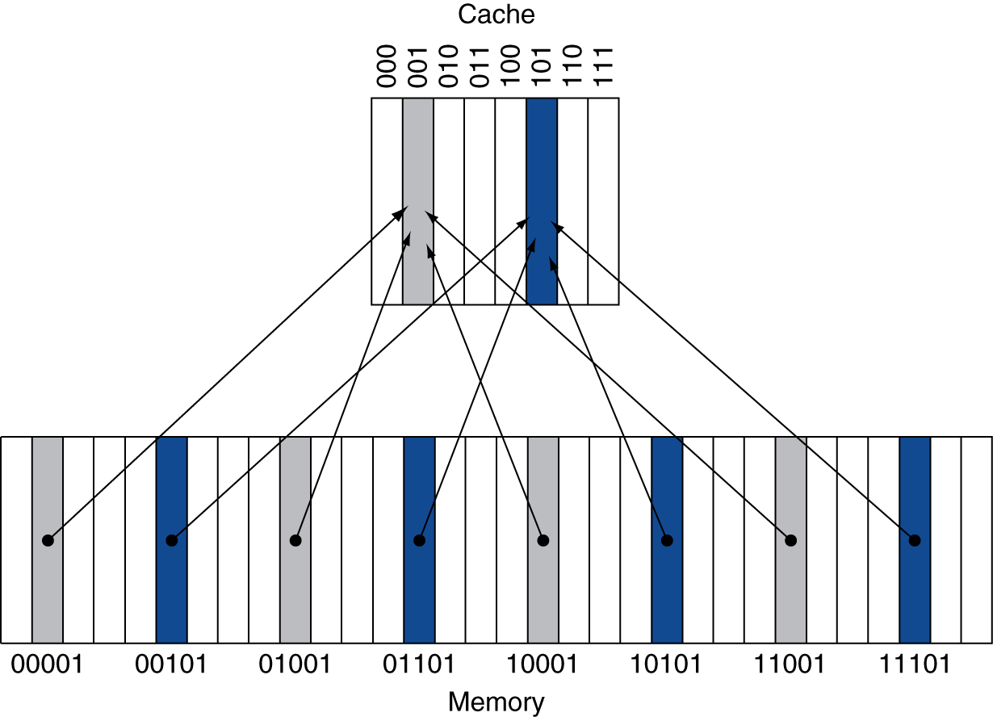
Direct Mapped Cache
根據Memory位置，把所有區塊分配給cache。
Cache block :is the basic mapping unit, which usually contains several words
Notes:
處理器怎麼知道data是否在cache中，並且正確的從cache抓出想要的資料？
我們把資料一次從記憶體下層轉移到記體上層的單位定作block。如果處理器要求讀取某個block的資料，剛好在上層的記憶體內，那就稱為hit。如果不在上層，那就稱為miss。hit rate就是你成功在上層記憶體就找到你要的資料的次數比例。
Cache block :is the basic mapping unit, which usually contains several words
direct-map顧名思義，就是直接根據記憶體位置，把所有區塊平均分配給cache。看圖應該就能理解配置的方法，cache內有000~111 8個block，memory內有00000~11111 32個block，memory內的block index結尾只要等於cache index，就代表該block可以被放到該cache的該位置。也就是灰色的部份（00001, 01001, 10001, 11001）都可以被放到cache 001 block內。

Slide 5
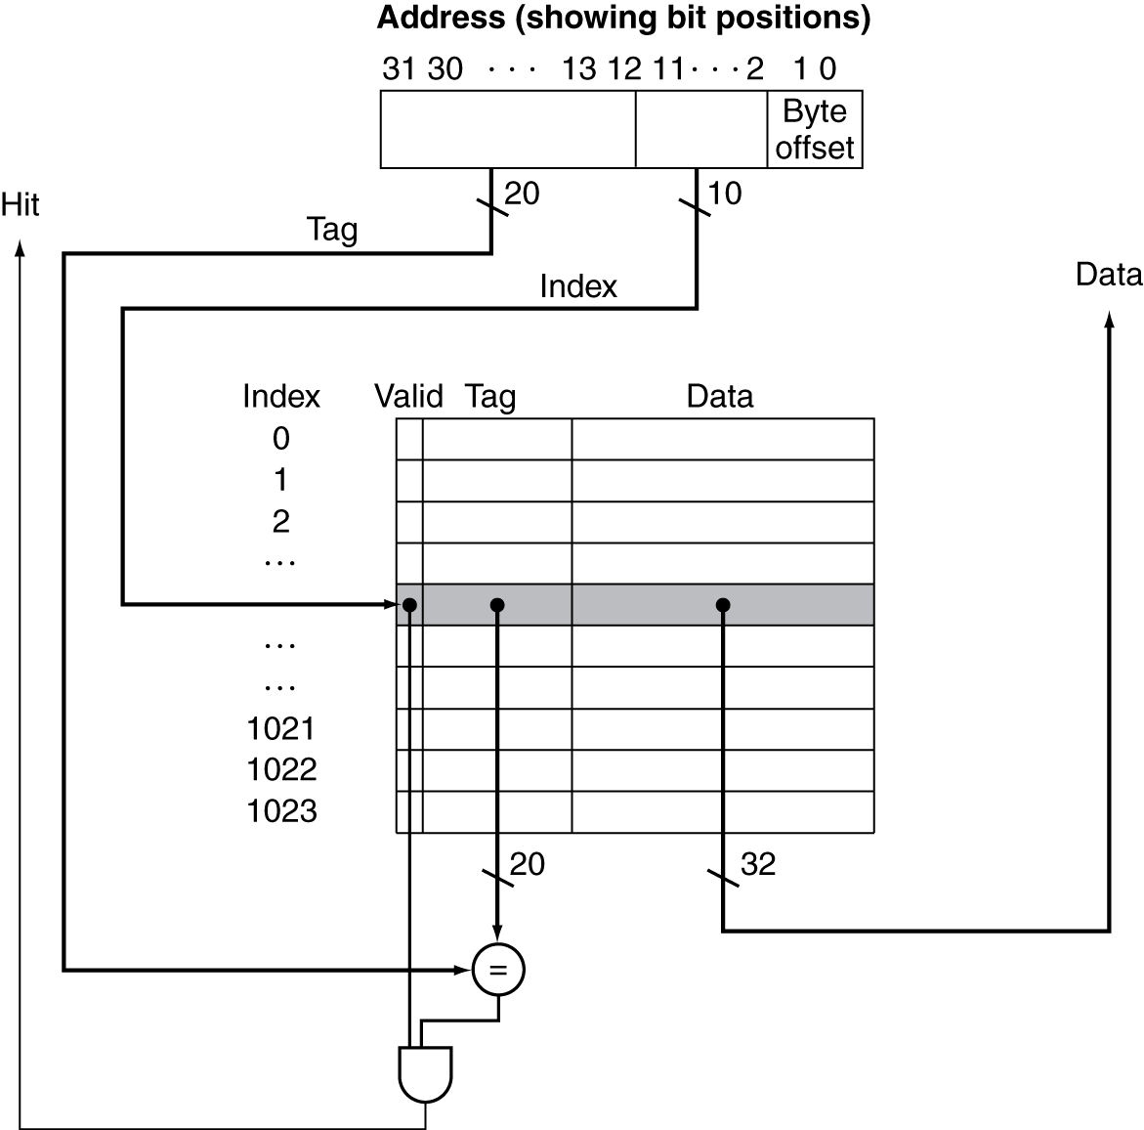
Address Subdivision
Tag
Store block address as well as the data
Vaild bit
Cache中資料是否有效
Block size
1 words
Cache size
4 KB (1024 blocks)
4KB =1Kwords = 1K blocks
Block size
Notes:
一個memory是以1 byte為單位，但是cache是以1word為單位 ，1word =4byte 所以需要byte offset
100 101 110 111
tag
但這樣設計的問題就是，我要怎麼知道我想要的記憶體資料剛好在cache內？ 答案是多設計一個tag欄位，讓tag紀錄該cache所紀錄的資料在原本記憶體中的位置。tag不需要完整紀錄該cache存放內容的記憶體位址，他只要紀錄前面幾個bit就好了。以上圖為例，我想知道cache index 001到底是存放（00001, 01001, 10001, 11001），只要額外紀錄前兩個bit就好。
Valid bit
另外cache還需要valid bit，來紀錄該cache是否包含有效資訊。例如處理器剛啟動時，cache內並沒有任何東西，此時cache內容全是無效的，要經過一段時間才會塞滿內容。

Slide 6
Direct-mapped Cache Example (1/6)
8-blocks, 1 word/block, direct mapped
Initial state
Index | V | Tag | Data
000 | N
001 | N
010 | N
011 | N
100 | N
101 | N
110 | N
111 | N

Slide 7
Direct-mapped Cache Example (2/6)
Word addr | Binary addr | Hit/miss | Cache block
22 | 10 110 | Miss | 110
Index | V | Tag | Data
000 | N
001 | N
010 | N
011 | N
100 | N
101 | N
110 | Y | 10 | Mem[10110]
111 | N

Slide 8
Direct-mapped Cache Example (3/6)
Word addr | Binary addr | Hit/miss | Cache block
26 | 11 010 | Miss | 010
Index | V | Tag | Data
000 | N
001 | N
010 | Y | 11 | Mem[11010]
011 | N
100 | N
101 | N
110 | Y | 10 | Mem[10110]
111 | N

Slide 9
Direct-mapped Cache Example (4/6)
Word addr | Binary addr | Hit/miss | Cache block
22 | 10 110 | Hit | 110
26 | 11 010 | Hit | 010
Index | V | Tag | Data
000 | N
001 | N
010 | Y | 11 | Mem[11010]
011 | N
100 | N
101 | N
110 | Y | 10 | Mem[10110]
111 | N

Slide 10
Direct-mapped Cache Example (5/6)
Word addr | Binary addr | Hit/miss | Cache block
16 | 10 000 | Miss | 000
3 | 00 011 | Miss | 011
16 | 10 000 | Hit | 000
Index | V | Tag | Data
000 | Y | 10 | Mem[10000]
001 | N
010 | Y | 11 | Mem[11010]
011 | Y | 00 | Mem[00011]
100 | N
101 | N
110 | Y | 10 | Mem[10110]
111 | N

Slide 11
Direct-mapped Cache Example (6/6)
Word addr | Binary addr | Hit/miss | Cache block
18 | 10 010 | Miss | 010
Index | V | Tag | Data
000 | Y | 10 | Mem[10000]
001 | N
010 | Y | 10 | Mem[10010]
011 | Y | 00 | Mem[00011]
100 | N
101 | N
110 | Y | 10 | Mem[10110]
111 | N

Slide 12
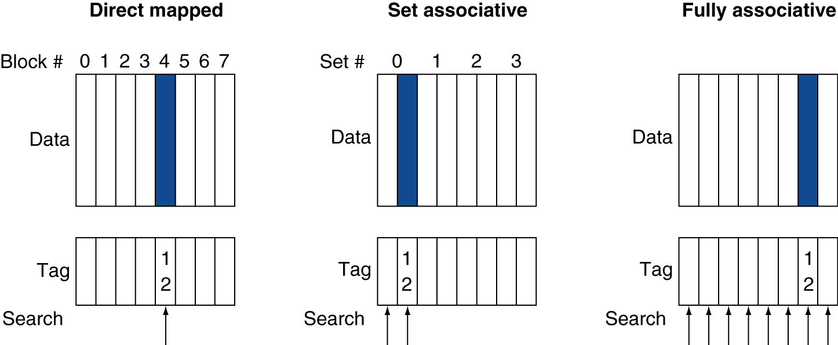
Associative Cache Example (1/3)
Notes:
一個block不在是單一個空間 容許index可以存更多筆資料

Slide 13
Associativity Example (2/3)
Compare 4-block caches
Direct mapped, 2-way set associative, fully associative
Block access sequence: 0, 8, 0, 6, 8
Direct mapped
Cache index = Block address % block numbers
Block address | Cache index | Hit/miss | Cache content after access
 |  |  | 0 | 1 | 2 | 3
0 | 0 | miss | Mem[0]
8 | 0 | miss | Mem[8]
0 | 0 | miss | Mem[0]
6 | 2 | miss | Mem[0] |  | Mem[6]
8 | 0 | miss | Mem[8] |  | Mem[6]
Cache index

Slide 14
Associativity Example (3/3)
2-way set associative
Block access sequence: 0, 8, 0, 6, 8
Block address | Cache index | Hit/miss | Cache content after access
 |  |  | Set 0 |  | Set 1
0 | 0 | miss | Mem[0]
8 | 0 | miss | Mem[0] | Mem[8]
0 | 0 | hit | Mem[0] | Mem[8]
6 | 0 | miss | Mem[0] | Mem[6]
8 | 0 | miss | Mem[8] | Mem[6]
LRU(least recently used)
Policy
Cache index = Block address % set numbers
Fully associative
Block access sequence: 0, 8, 0, 6, 8
Block address |  | Hit/miss | Cache content after access
0 |  | miss | Mem[0]
8 |  | miss | Mem[0] | Mem[8]
0 |  | hit | Mem[0] | Mem[8]
6 |  | miss | Mem[0] | Mem[8] | Mem[6]
8 |  | hit | Mem[0] | Mem[8] | Mem[6]

Slide 15
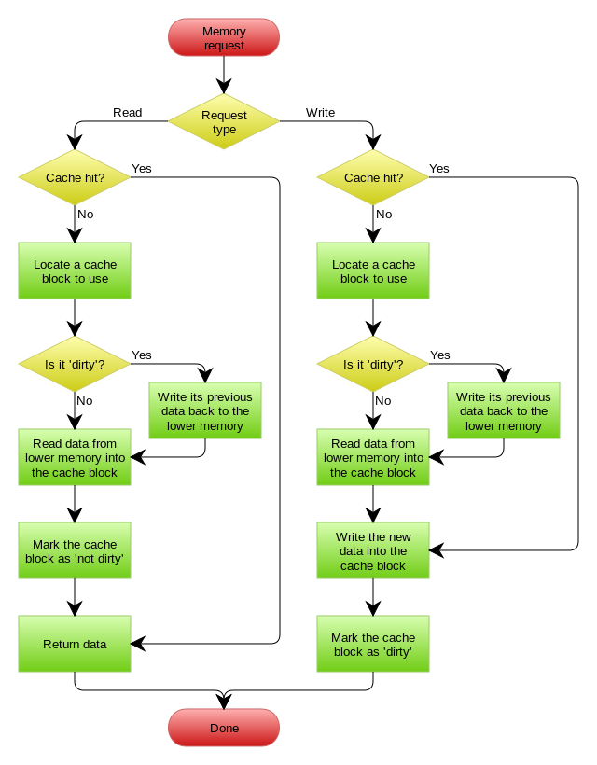
Flow Chart

Slide 16
Homework (Overview)
CO_Lab5壓縮包裡面有2個din檔
spice.din & gcc.din 各自內含約十萬筆資料
作業內容
依據前頁的流程圖寫一個程式讀取並處理din檔，完成有兩種替換法則(FIFO、LRU)的Write back Cache行為模擬
壓縮包
於E-Course2下載

Slide 17
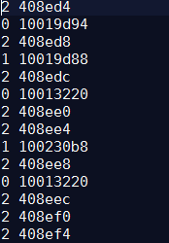
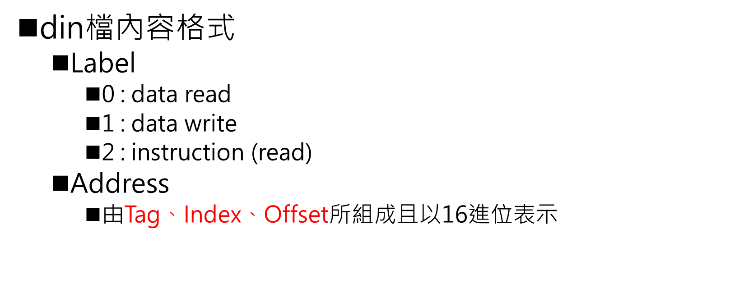
Homework (din檔內容)
din檔內容格式
Label
0 : data read
1 : data write
2 : instruction (read)
Address
由Tag、Index、Offset所組成且以16進位表示
Label
Addresses
Tag
Index
Offset

Slide 18
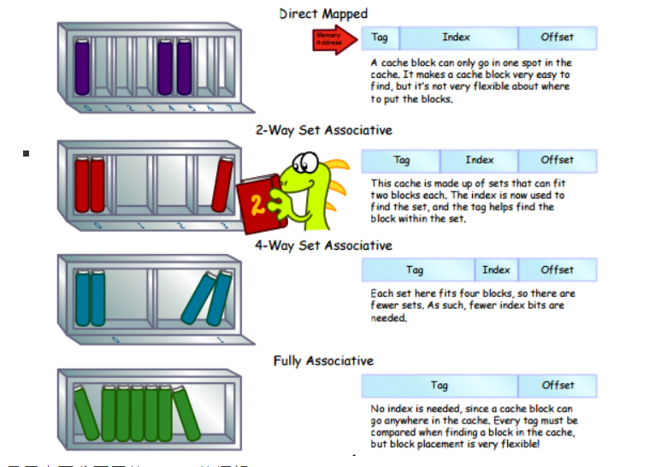

Slide 19
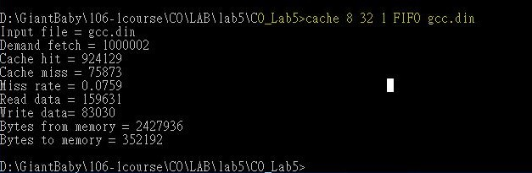
Homework (輸入格式)
把編譯完的執行檔命名為 cache
輸入語法
cache cache_size block_size associativity replace_policy file
cache_size: 8, 16, …, 256 (KB)
block_size :4, 8, 16, …, 128 (B)
associativity: 1 (direct-mapped), 2, 4, 8, f (fully associative)
replace-policy: FIFO, LRU
file: gcc.din, spice.din
輸入範例
cache 8 32 1 FIFO gcc.din

Slide 20
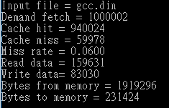
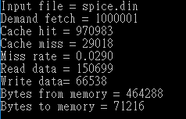
Homework (輸出格式)
cache 8 32 2 LRU gcc.din
輸出要有這些項目(紅字為評分項目)
Input file
Demand fetch
Cache hit
Cache miss
Miss rate
Read data
Write data
Bytes from Memory
Bytes to memory
cache 16 16 1 FIFO spice.din

Slide 21
Homework (評分標準)
作業總共100%
使用QA中沒有提供的參數組合做測試，檢查8個output項目個別是否正確(10%)
全對的話有另外有20分(20%)
QA中有附幾個組合以及其輸出結果。同學可以拿來測試程式執行結果是否與QA中附的執行結果一致。

Slide 22
Homework (繳交)
上傳包含執行檔及程式原始碼的壓縮檔到教學平台上
盡量使用C/C++，非C/C++/Python請附使用說明文件
Deadline = 12/16

