Slide 1
Data Structures
Programming Project #4

Slide 2
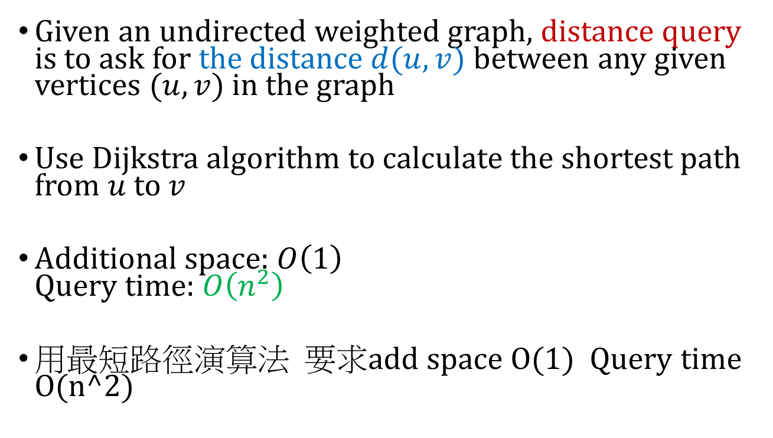
Exact Distance Query
Given an undirected weighted graph, distance query is to ask for the distance $d(u,v)$ between any given vertices $(u, v)$in the graph
Use Dijkstra algorithm to calculate the shortest path from $u$ to $v$
Additional space: $O\left(1\right)$ Query time: $O\left(n^{2}\right)$
用最短路徑演算法 要求add space O(1) Query time O(n^2)

Slide 3
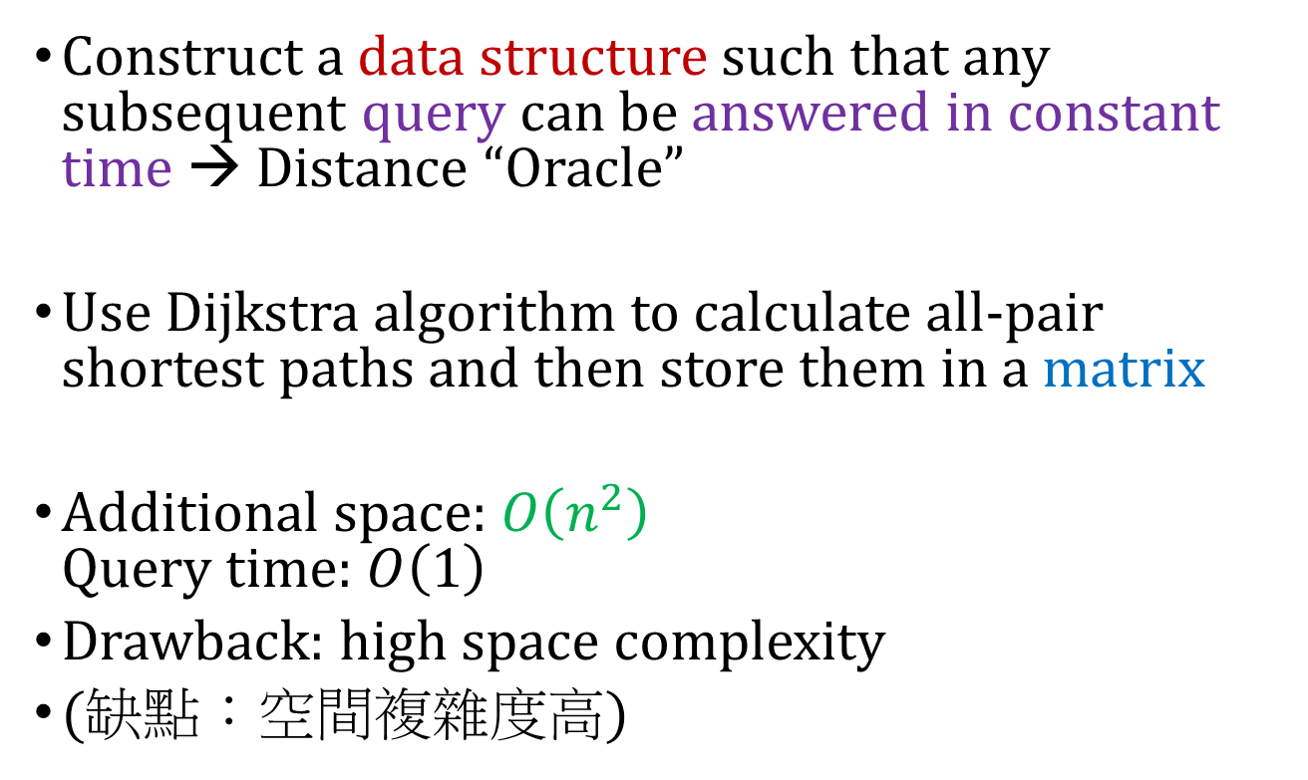
Exact Distance Query and Distance Oracle
Construct a data structure such that any subsequent query can be answered in constant time → Distance “Oracle”
Use Dijkstra algorithm to calculate all-pair shortest paths and then store them in a matrix
Additional space: $O\left(n^{2}\right)$ Query time: $O\left(1\right)$
Drawback: high space complexity
(缺點：空間複雜度高)
Distance Oracles beyond the Thorup–Zwick Bound, in IEEE FOCS 2010

Slide 4
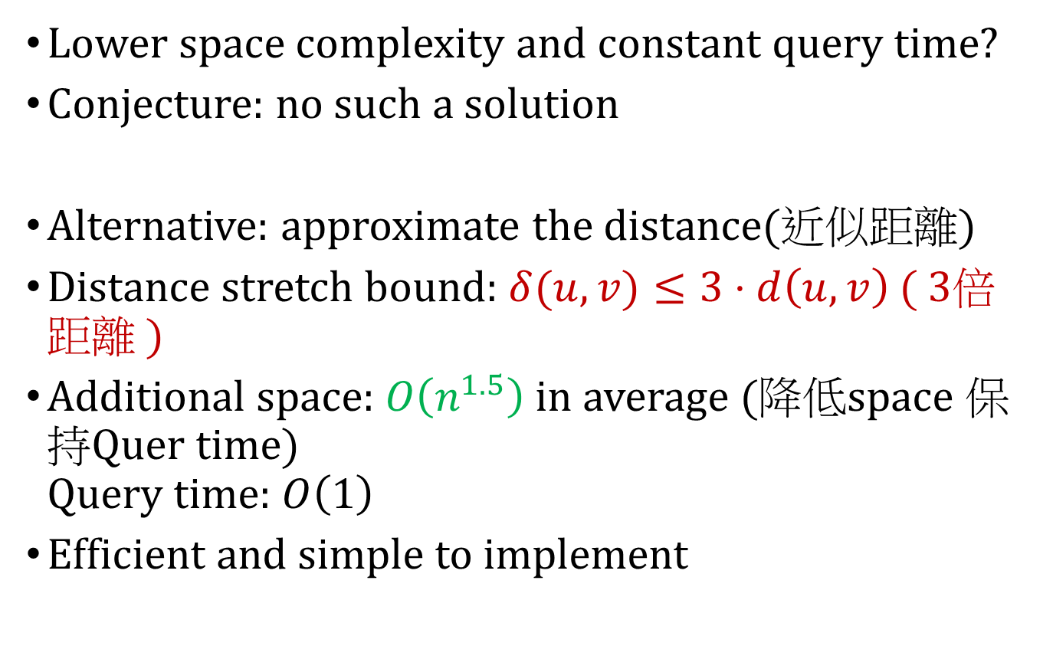
Approximate Distance Oracle
Lower space complexity and constant query time?
Conjecture: no such a solution
Alternative: approximate the distance(近似距離)
Distance stretch bound: $δ(u,v)≤3⋅d\left(u,v\right)$( 3倍距離 )
Additional space: $O\left(n^{1.5}\right)$ in average (降低space 保持Quer time) Query time: $O\left(1\right)$
Efficient and simple to implement
Approximate distance oracles, in Journal of ACM 2005

Slide 5
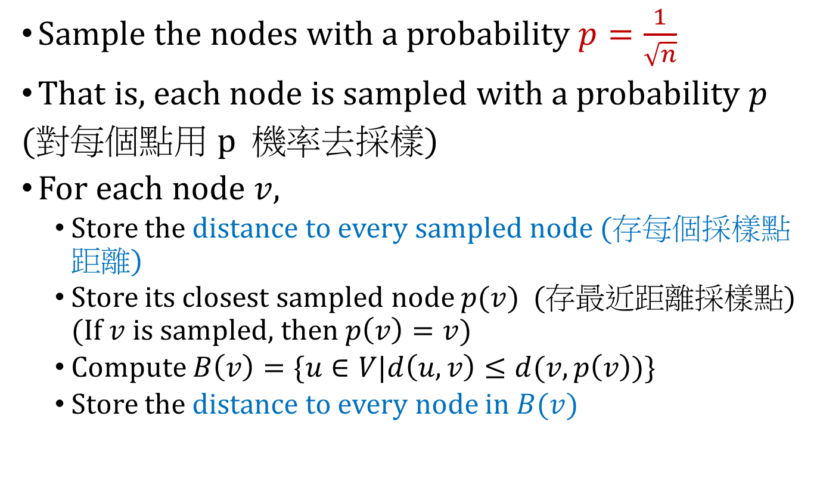
Data Structure for Approximate Distance Oracle (We don’t implement this oracle)
Sample the nodes with a probability $p=\frac{1}{\sqrt{n}}$
That is, each node is sampled with a probability $p$
(對每個點用 p 機率去採樣)
For each node $v$,
Store the distance to every sampled node (存每個採樣點距離)
Store its closest sampled node $p(v)$ (存最近距離採樣點) (If $v$ is sampled, then $p\left(v\right)=v$)
Compute $B\left(v\right)=\{u∈V|d\left(u,v\right)≤d(v,p\left(v\right))\}$
Store the distance to every node in $B(v)$
Approximate distance oracles, in Journal of ACM 2005

Slide 6
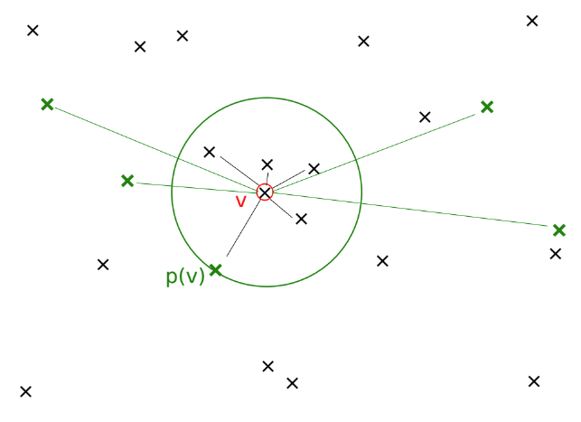


Data Structure for Approximate Distance Oracle (We don’t implement this oracle)
$$B\left(v\right)$$
$$p\left(v\right)$$
Approximate distance oracles, in Journal of ACM 2005

Slide 7
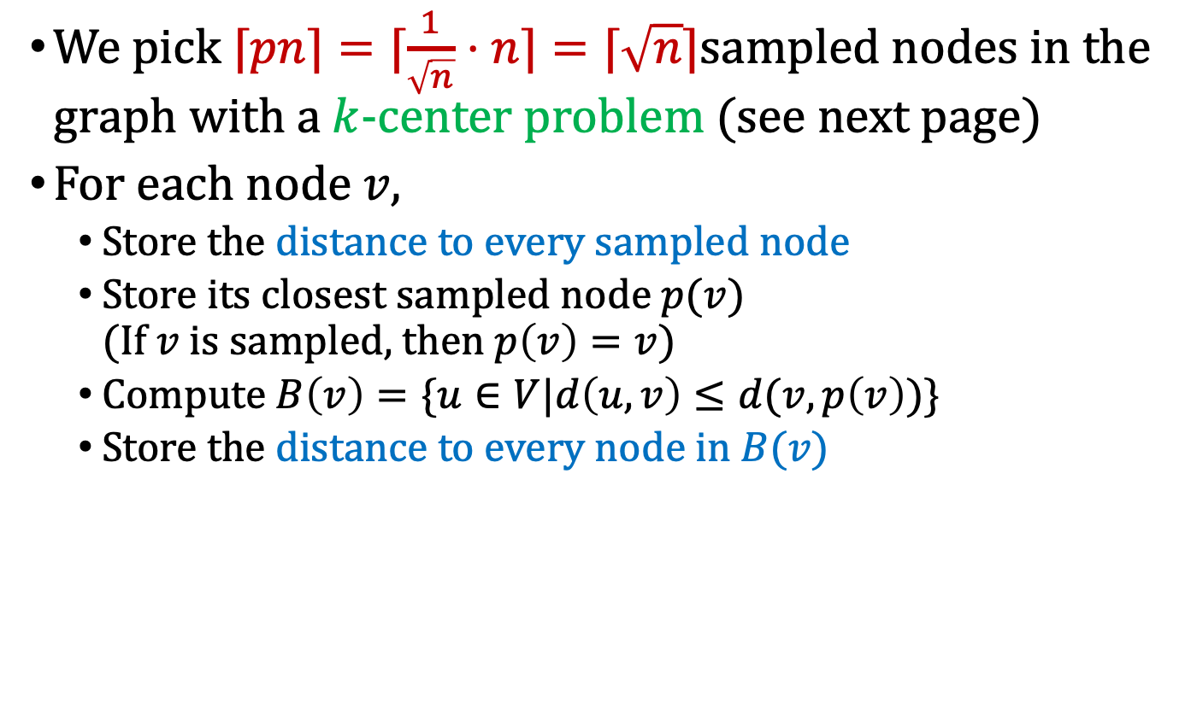
Modified Data Structure (We implement this modified oracle)
We pick $⌈pn⌉=⌈\frac{1}{\sqrt{n}}⋅n⌉=⌈\sqrt{n}⌉$sampled nodes in the graph with a $k$-center problem (see next page)
For each node $v$,
Store the distance to every sampled node
Store its closest sampled node $p(v)$ (If $v$ is sampled, then $p\left(v\right)=v$)
Compute $B\left(v\right)=\{u∈V|d\left(u,v\right)≤d(v,p\left(v\right))\}$
Store the distance to every node in $B(v)$

Slide 8
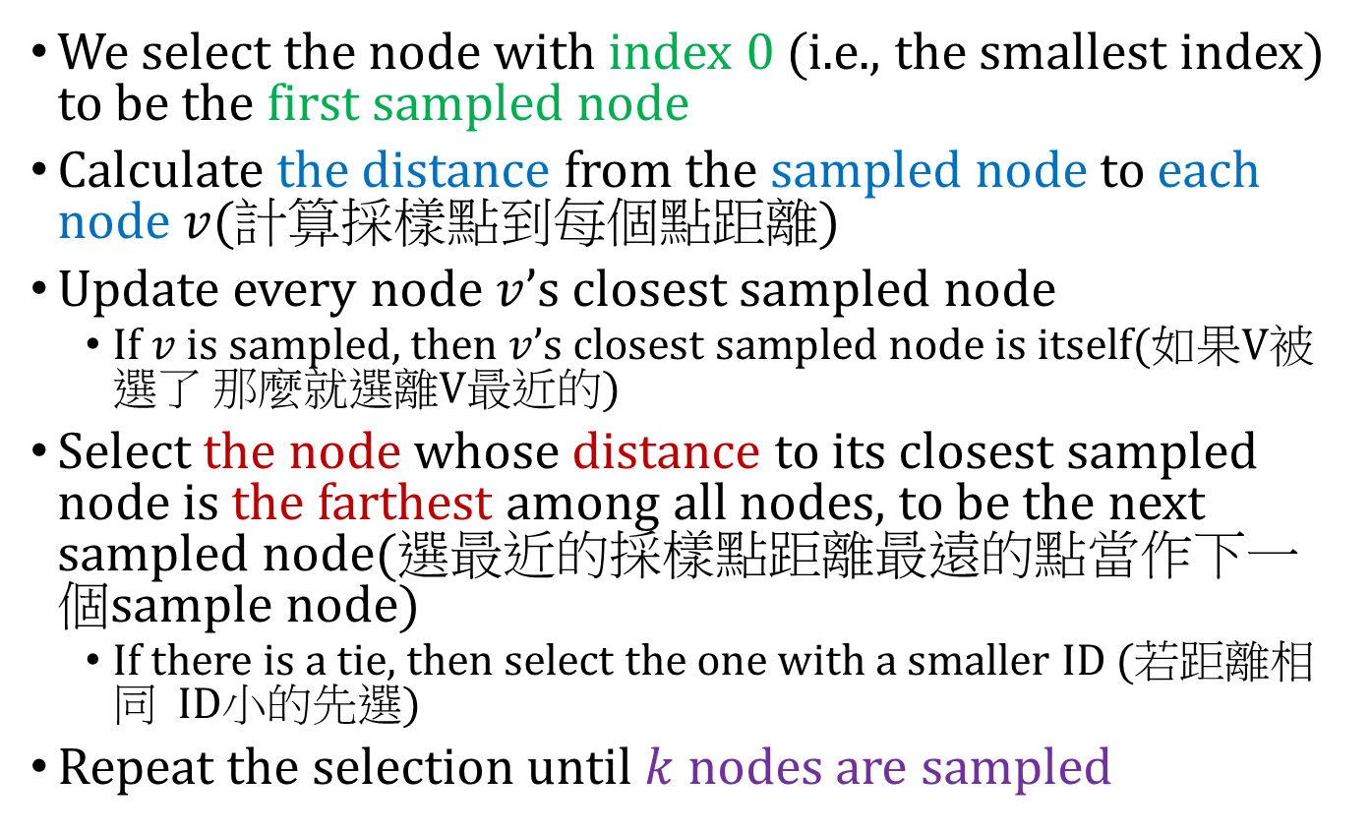

Greedy algorithm for $k$-center problem
We select the node with index 0 (i.e., the smallest index) to be the first sampled node
Calculate the distance from the sampled node to each node $v$(計算採樣點到每個點距離)
Update every node $v$’s closest sampled node
If $v$ is sampled, then $v$’s closest sampled node is itself(如果V被選了 那麼就選離V最近的)
Select the node whose distance to its closest sampled node is the farthest among all nodes, to be the next sampled node(選最近的採樣點距離最遠的點當作下一個sample node)
If there is a tie, then select the one with a smaller ID (若距離相同 ID小的先選)
Repeat the selection until $k$ nodes are sampled

Slide 9
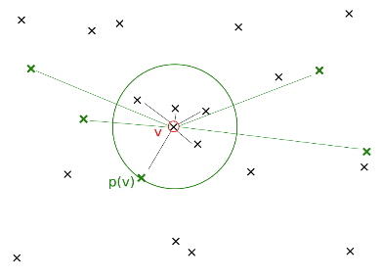







Method of Approximate Distance Query
Answer the subsequent query $d(u,v)$
If $u$ is in $B\left(v\right)$ or $v$ is in $B\left(u\right)$, then return $δ\left(u,v\right)=d\left(u,v\right)$ (note that $d\left(u,v\right)=d\left(v,u\right)$)
Otherwise, return $δ\left(u,v\right)=min\{d\left(v,p\left(v\right)\right)+d\left(p\left(v\right),u\right), d\left(u,p\left(u\right)\right)+d(p\left(u\right),v)\}$
$$B\left(v\right)$$
$$B\left(v\right)$$
$$u$$
$$p\left(v\right)$$
$$p\left(v\right)$$
$$u$$
Approximate distance oracles, in Journal of ACM 2005

Slide 10
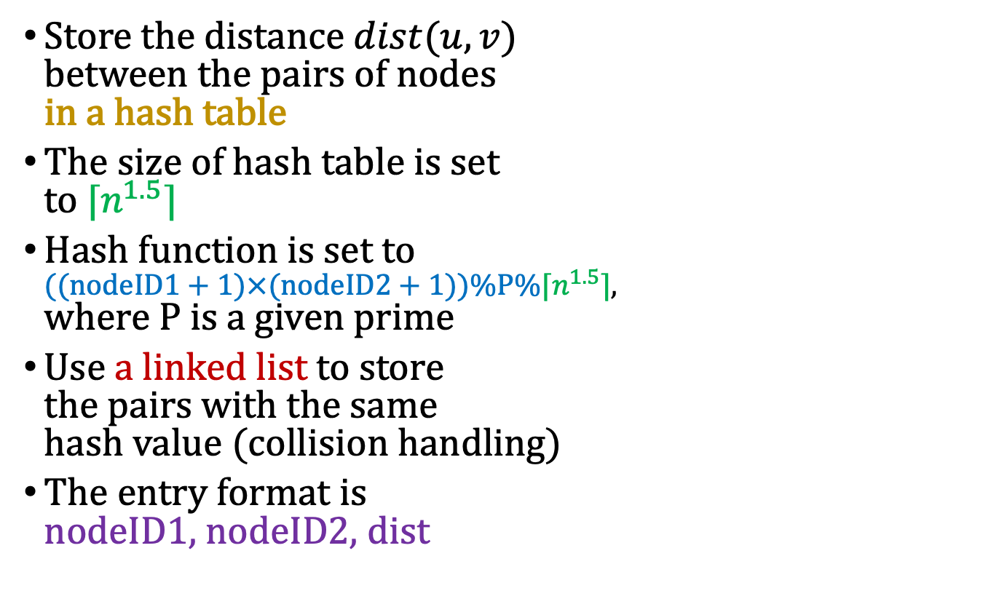

Implementation Rules
[0]
0,16, 4
Assume $P=17$ and $\left\lceil n^{1.5}\right\rceil =17$
$$\left(\left(0+1\right)×\left(16+1\right)\right)\%17\%17=0$$
[4]
Store the distance $dist(u,v)$ between the pairs of nodes in a hash table
The size of hash table is set to $⌈n^{1.5}⌉$
Hash function is set to $((nodeID1+1)×(nodeID2+1))\%P\%⌈n^{1.5}⌉$, where $P$ is a given prime
Use a linked list to store the pairs with the same hash value (collision handling)
The entry format is nodeID1, nodeID2, dist
$$\left(\left(3+1\right)×\left(9+1\right)\right)\%17\%17=6$$
3, 9, 8
7, 4, 9
$$\left(\left(7+1\right)×\left(4+1\right)\right)\%17\%17=6$$
[8]
Get the same position in the hash table → collision → linked list
[12]
[16]

Slide 11
一定要用hash table 和 linked list

Slide 12
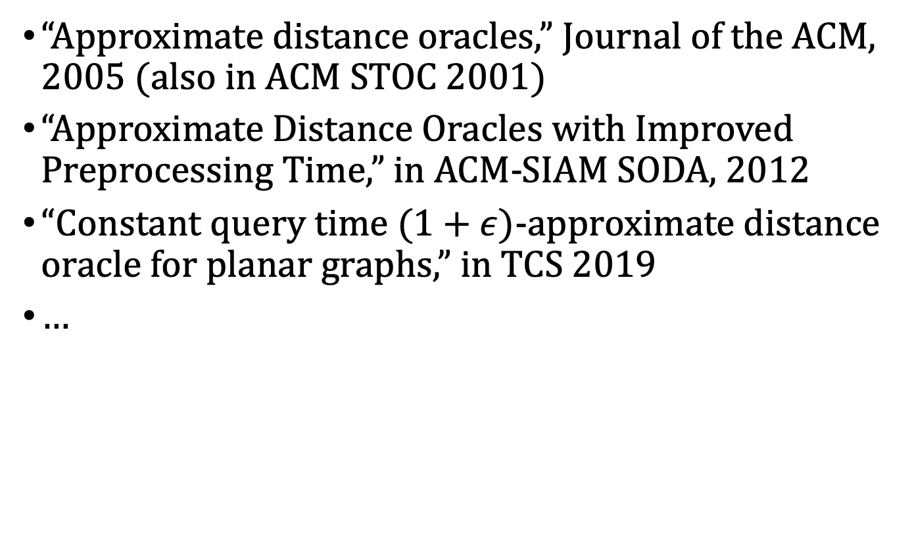
Reference and Reading Materials
“Approximate distance oracles,” Journal of the ACM, 2005 (also in ACM STOC 2001)
“Approximate Distance Oracles with Improved Preprocessing Time,” in ACM-SIAM SODA, 2012
“Constant query time $(1+ε)$-approximate distance oracle for planar graphs,” in TCS 2019
…

Slide 13
Input Sample: use scanf
Format:
#nodes #undirectedLinks prime
linkID nodeID1 nodeID2 distCost
…
#queriedPairs
pairID nodeID1 nodeID2
…

Slide 14
Input Sample: use scanf
A
4
3
G
B
10
12
Format:
7 10 3
0 0 1 3
1 0 3 12
2 0 6 4
3 1 2 7
4 1 4 6
5 2 3 5
6 2 6 10
7 3 4 4
8 4 5 7
9 5 6 1
3
0 1 4
1 6 5
2 1 5
1
6
7
F
C
7
5
E
D
4
Pairs:
(B, E)
(G, F)
(B, F)

Slide 15

Input Sample: use scanf
#sample nodes = $⌈\sqrt{7}⌉=3$
A
4
3
G
B
10
12
1
6
7
F
C
Pairs:
(B, E)
(G, F)
(B, F)
7
5
E
D
4

Slide 16
Input Sample: use scanf
#sample nodes = $⌈\sqrt{7}⌉=3$
0
A
4
4
3
G
B
3
10
12
1
6
7
5
F
C
10
Pairs:
(B, E)
(G, F)
(B, F)
7
5
E
D
4
9
12

Slide 17
Input Sample: use scanf
#sample nodes = $⌈\sqrt{7}⌉=3$
0, 12
A
4, 12
4
3
G
B
3, 10
10
12
1
6
7
5, 11
F
C
10, 5
Pairs:
(B, E)
(G, F)
(B, F)
7
5
E
D
4
9, 4
12, 0

Slide 18
Input Sample: use scanf
#sample nodes = $⌈\sqrt{7}⌉=3$
0, 12, 10
A
4, 12, 10
4
3
G
B
3, 10, 7
10
12
1
6
7
5, 11, 11
F
C
10, 5, 0
Pairs:
(B, E)
(G, F)
(B, F)
7
5
E
D
4
9, 4, 9
12, 0, 5

Slide 19
Input Sample: use scanf
10 + 4 = 14
#sample nodes = $⌈\sqrt{7}⌉=3$
9 + 3 = 12
0, 12, 10
A
4, 12, 10
4
3
G
B
3, 10, 7
10
12
1
6
7
5, 11, 11
F
C
10, 5, 0
Pairs:
(B, E)
(G, F)
(B, F)
7
5
12
E
D
4
9, 4, 9
12, 0, 5

Slide 20
Input Sample: use scanf
#sample nodes = $⌈\sqrt{7}⌉=3$
0, 12, 10
A
4, 12, 10
4
3
G
B
3, 10, 7
10
12
1
6
7
5, 11, 11
F
C
10, 5, 0
Pairs:
(B, E)
(G, F)
(B, F)
7
5
12
E
D
4
1
9, 4, 9
12, 0, 5

Slide 21
Input Sample: use scanf
3 + 5 = 8
#sample nodes = $⌈\sqrt{7}⌉=3$
5 + 3 = 8
0, 12, 10
A
4, 12, 10
4
3
G
B
3, 10, 7
10
12
1
6
7
5, 11, 11
F
C
10, 5, 0
Pairs:
(B, E)
(G, F)
(B, F)
7
5
12
E
D
4
1
9, 4, 9
8
12, 0, 5

Slide 22

Input Sample: use scanf
3 + 5 = 8
#sample nodes = $⌈\sqrt{7}⌉=3$
5 + 3 = 8
0, 12, 10
0.5
A
0.5, 12, 10
3
G
B
3, 10, 7
10
12
1
6
7
F
C
1.5, 11, 11
10, 5, 0
Pairs:
(B, E)
(G, F)
(B, F)
7
5
12
E
D
4
1
9, 4, 9
8
12, 0, 5

Slide 23
Output Sample: use printf
Format:
#storedDistances(存了多少pairs)
pairID nodeID1 nodeID2 approxDist
…

Slide 24
Output Sample: use printf
A
4
3
G
B
10
12
Format:
16
0 1 4 12
1 6 5 1
2 1 5 8
1
6
7
F
C
7
5
E
D
4
A, B
A, C
A, D
A, E
A, F
A, G
B, C
B, D
C, D
C, E
C, F
C, G
D, E
D, F
D, G
F, G
Pairs:
(B, E)
(G, F)
(B, F)

Slide 25
Note
Superb deadline: 12/19 Thu
Deadline: 12/26 Thu
Submit your code to E-course2
Demonstrate your code in 工院1館 401B
C Source code
Show a good programming style

Slide 26
Input Sample: use scanf
#sample nodes = $⌈\sqrt{7}⌉=3$
A
4
3
G
B
10
12
1
6
7
F
C
Pairs:
(B, E)
(G, F)
(B, F)
7
5
E
D
4

Slide 27
Input Sample: use scanf
#sample nodes = $⌈\sqrt{7}⌉=3$
0
A
4
4
3
G
B
3
10
12
1
6
7
5
F
C
10
Pairs:
(B, E)
(G, F)
(B, F)
7
5
E
D
4
9
12

Slide 28
Input Sample: use scanf
#sample nodes = $⌈\sqrt{7}⌉=3$
0, 12
A
4, 12
4
3
G
B
3, 10
10
12
1
6
7
5, 11
F
C
10, 5
Pairs:
(B, E)
(G, F)
(B, F)
7
5
E
D
4
9, 4
12, 0

Slide 29
Input Sample: use scanf
#sample nodes = $⌈\sqrt{7}⌉=3$
0, 12, 10
A
4, 12, 10
4
3
G
B
3, 10, 7
10
12
1
6
7
5, 11, 11
F
C
10, 5, 0
Pairs:
(B, E)
(G, F)
(B, F)
7
5
E
D
4
9, 4, 9
12, 0, 5

Slide 30
Input Sample: use scanf
#sample nodes = $⌈\sqrt{7}⌉=3$
0, 12, 10
A
4, 12, 10
4
3
G
B
3, 10, 7
10
12
1
6
7
5, 11, 11
F
C
10, 5, 0
Pairs:
(B, E)
(G, F)
(B, F)
7
5
E
D
4
9, 4, 9
12, 0, 5

Slide 31
Input Sample: use scanf
10 + 4 = 14
#sample nodes = $⌈\sqrt{7}⌉=3$
9 + 3 = 12
0, 12, 10
A
4, 12, 10
4
3
G
B
3, 10, 7
10
12
1
6
7
5, 11, 11
F
C
10, 5, 0
Pairs:
(B, E)
(G, F)
(B, F)
7
5
12
E
D
4
9, 4, 9
12, 0, 5

Slide 32
Input Sample: use scanf
#sample nodes = $⌈\sqrt{7}⌉=3$
0, 12, 10
A
4, 12, 10
4
3
G
B
3, 10, 7
10
12
1
6
7
5, 11, 11
F
C
10, 5, 0
Pairs:
(B, E)
(G, F)
(B, F)
7
5
12
E
D
4
1
9, 4, 9
12, 0, 5

Slide 33
Input Sample: use scanf
3 + 5 = 8
#sample nodes = $⌈\sqrt{7}⌉=3$
5 + 3 = 8
0, 12, 10
A
4, 12, 10
4
3
G
B
3, 10, 7
10
12
1
6
7
5, 11, 11
F
C
10, 5, 0
Pairs:
(B, E)
(G, F)
(B, F)
7
5
12
E
D
4
1
9, 4, 9
8
12, 0, 5

Slide 34
Sample input1
11 13 13
0 0 1 3
1 0 2 5
2 0 9 9
3 1 5 4
4 1 10 6
5 2 3 7
6 2 6 6
7 3 6 11
8 3 7 20
9 4 5 2
10 4 6 8
11 4 8 5
12 9 10 3
0
9
9
3
3
1
6
10
5
4
2
8
7
6
7
5
6
11
20
8
3
5
4
2

Slide 35
Sample input1
0
⌈√(11)⌉ = 4
Sample node : 0
0
序號 | 說明
1 | 將node_num 開根號取ceiling
2 | 選取A點做為smaple 計算到每一點距離
3 | 找到最遠的點做為第二個sample
4 | 紀錄到其他點的距離
5 | 找最近sample點 距離最遠的點當作下個sample
6 | 紀錄到其他點的距離
7 | 重複5-6 直到找到node_num 開根號取ceiling 為止
8 | 每個node選出sample node 的最短距離 當作代表
9 | 開始處理pairs
9.1 | 若pair在雙方半徑中 直接走線上最短路徑
9.2 | 將pair 的兩個點用代表值半徑中選出sample中繼點 比較距離短的勝出 若有距離相同 選取Index小的當作中繼點
9
9
9
3
3
3
1
6
9
10
5
5
4
2
8
14
7
6
7
5
32
6
11
11
20
8
3
5
7
12
4
2
9
1.離0最遠的點選為下一個sample node 為7

Slide 36
Sample input1
Sample node : 0,7
0,32
⌈√(11)⌉ = 4
9,41
0
序號 | 說明
1 | 將node_num 開根號取ceiling
2 | 選取A點做為smaple 計算到每一點距離
3 | 找到最遠的點做為第二個sample
4 | 紀錄到其他點的距離
5 | 找離最近sample點 距離最遠的點當作下個sample
6 | 紀錄到其他點的距離
7 | 重複5-6 直到找到node_num 開根號取ceiling 為止
8 | 每個node選出sample node 的最短距離 當作代表
9 | 開始處理pairs
9.1 | 若pair在雙方半徑中 直接走線上最短路徑
9.2 | 將pair 的兩個點用代表值半徑中選出sample中繼點 比較距離短的勝出 若有距離相同 選取Index小的當作中繼點
9
9
3
3,35
3
1
6
9,41
10
5
5,27
4
2
8
14,44
6
7
7
5
6
32,0
11
20
11,31
8
3
5
12,20
4
2
7,39
9,39
1.離最近sample node 最遠的點選為下一個sample node 為8

Slide 37
Sample input1
⌈√(11)⌉ = 4
Sample node : 0,7,8
0,32,14
9,41,20
0
序號 | 說明
1 | 將node_num 開根號取ceiling
2 | 選取A點做為smaple 計算到每一點距離
3 | 找到最遠的點做為第二個sample
4 | 紀錄到其他點的距離
5 | 找離最近sample點 距離最遠的點當作下個sample
6 | 紀錄到其他點的距離
7 | 重複5-6 直到找到node_num 開根號取ceiling 為止
8 | 每個node選出sample node 的最短距離 當作代表
9 | 開始處理pairs
9.1 | 若pair在雙方半徑中 直接走線上最短路徑
9.2 | 將pair 的兩個點用代表值半徑中選出sample中繼點 比較距離短的勝出 若有距離相同 選取Index小的當作中繼點
9
9
3
3,35,11
3
9,41,17
1
6
10
5
5,27,19
4
2
8
14,44,0
6
7
7
5
6
32,0,44
11
20
11,31,13
8
3
5
12,20,24
4
2
7,39,7
9,39,5
1.離最近sample node 最遠的點選為下一個sample node 為3

Slide 38
Sample input1
⌈√(11)⌉ = 4
Sample node : 0,7,8,3
0,32,14,12
9,41,20,21
0
序號 | 說明
1 | 將node_num 開根號取ceiling
2 | 選取A點做為smaple 計算到每一點距離
3 | 找到最遠的點做為第二個sample
4 | 紀錄到其他點的距離
5 | 找離最近sample點 距離最遠的點當作下個sample
6 | 紀錄到其他點的距離
7 | 重複5-6 直到找到node_num 開根號取ceiling 為止
8 | 每個node選出sample node 的最短距離 當作代表
9 | 開始處理pairs
9.1 | 若pair在雙方半徑中 直接走線上最短路徑
9.2 | 將pair 的兩個點用代表值半徑中選出sample中繼點 比較距離短的勝出 若有距離相同 選取Index小的當作中繼點
3,35,11,15
9
9
3
3
9,41,17,21
1
6
10
5
5,27,19,7
14,44,0,24
4
2
8
32,0,44,20
6
7
7
5
6
11
20
11,31,13,11
8
3
5
12,20,24,0
4
2
7,39,7,19
9,39,5,19

Slide 39
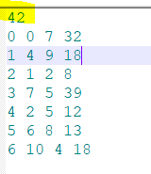
Sample output1
⌈√(11)⌉ = 4
Sample node : 0,7,8,3
0,32,14,12
輸出第一行為存多少pairs到hash table
( 重複的不存 例如(0,7)存過 不存(7,0) )
一、Sample node到所有點
7*4 + C(4,2)= 34 個
二、非Sample node最小半徑(紅色數字)內
的可走到的非Sample node
6:(6,2) (6,4) (6,5)
5:(5,1) (5,4)
9:(9,10) (9,1)
10:(1,10) 共8個
綜合一和二 34+8=42個，故第一行輸出為42
9,41,20,21
0
9
3
3,35,11,15
9
3
9,41,17,21
1
6
10
5
5,27,19,7
14,44,0,24
4
2
8
32,0,44,20
6
7
7
5
6
11
20
11,31,13,11
8
3
5
42
4
12,20,24,0
2
7,39,7,19
9,39,5,19

Slide 40
Sample output1
⌈√(11)⌉ = 4
Sample node : 0,7,8,3
0,32,14,12
Rule
Case | source | destination | Return
1 | 相同點 | 相同點 | 回傳0
2 | Sample | Sample | 直接查
3 | Sample | Not sample | 直接查 Sample 到 Not sample
4 | Not sample | Sample
5 | Not sample | Not sample | 1.Source到Destination (1)紅色數字半徑內直接查 (2)半徑外則source到最近Sample node+最近Sample node到des距離 2. Destination到Source (1)紅色數字半徑內直接查 (2)半徑外則des到最近Sample node +最近Sample node到source距離 1.2.比較取短的Return
9,41,20,21
0
9
3
3,35,11,15
9
3
9,41,17,21
1
6
10
5
5,27,19,7
14,44,0,24
4
2
8
32,0,44,20
6
7
7
5
6
11
42
0 0 7 32
1 4 9
2 1 2
3 7 5
4 2 5
5 6 8
6 10 4
20
11,31,13,11
8
3
5
32
12,20,24,0
4
2
0
7
7,39,7,19
9,39,5,19

Slide 41
Sample output1
⌈√(11)⌉ = 4
Sample node : 0,7,8,3
0,32,14,12
Rule
Case | source | destination | Return
1 | 相同點 | 相同點 | 回傳0
2 | Sample | Sample | 直接查
3 | Sample | Not sample | 直接查 Sample 到 Not sample
4 | Not sample | Sample
5 | Not sample | Not sample | 1.Source到Destination (1)紅色數字半徑內直接查 (2)半徑外則source到最近Sample node +最近Sample node到des距離 2. Destination到Source (1)紅色數字半徑內直接查 (2)半徑外則des到最近Sample node +最近Sample node到source距離 1.2.比較取短的Return
9,41,20,21
0
9
3
3,35,11,15
9
3
9,41,17,21
1
6
10
5
5,27,19,7
14,44,0,24
4
2
8
32,0,44,20
6
7
7
5
6
42
0 0 7 32
1 4 9 18
2 1 2
3 7 5
4 2 5
5 6 8
6 10 4
11
20
11,31,13,11
8
5
20
9
3
5
4
8
12,20,24,0
4
2
9
9
7,39,7,19
9
0
4
9,39,5,19
故取短為9+9=18

Slide 42
Sample output1
⌈√(11)⌉ = 4
Sample node : 0,7,8,3
0,32,14,12
Rule
Case | source | destination | Return
1 | 相同點 | 相同點 | 回傳0
2 | Sample | Sample | 直接查
3 | Sample | Not sample | 直接查 Sample 到 Not sample
4 | Not sample | Sample
5 | Not sample | Not sample | 1.Source到Destination (1)紅色數字半徑內直接查 (2)半徑外則source到最近Sample node +最近Sample node到des距離 2. Destination到Source (1)紅色數字半徑內直接查 (2)半徑外則des到最近Sample node +最近Sample node到source距離 1.2.比較取短的Return
9,41,20,21
0
9
3
3,35,11,15
9
3
9,41,17,21
1
6
10
5
5,27,19,7
14,44,0,24
4
2
8
32,0,44,20
6
7
7
5
6
42
0 0 7 32
1 4 9 18
2 1 2 8
3 7 5
4 2 5
5 6 8
6 10 4
11
20
11,31,13,11
8
3
5
2
3
5
1
0
12,20,24,0
4
2
5
3
7,39,7,19
2
0
1
9,39,5,19
故取短為3+5=8

Slide 43
Sample output1
⌈√(11)⌉ = 4
Sample node : 0,7,8,3
0,32,14,12
Rule
Case | source | destination | Return
1 | 相同點 | 相同點 | 回傳0
2 | Sample | Sample | 直接查
3 | Sample | Not sample | 直接查 Sample 到 Not sample
4 | Not sample | Sample
5 | Not sample | Not sample | 1.Source到Destination (1)紅色數字半徑內直接查 (2)半徑外則source到最近Sample node +最近Sample node到des距離 2. Destination到Source (1)紅色數字半徑內直接查 (2)半徑外則des到最近Sample node +最近Sample node到source距離 1.2.比較取短的Return
9,41,20,21
0
9
3
3,35,11,15
9
3
9,41,17,21
1
6
10
5
5,27,19,7
14,44,0,24
4
2
8
32,0,44,20
6
7
7
5
6
42
0 0 7 32
1 4 9 18
2 1 2 8
3 7 5 39
4 2 5
5 6 8
6 10 4
11
20
11,31,13,11
8
3
5
39
12,20,24,0
4
2
7
5
7,39,7,19
9,39,5,19
為39

Slide 44
Sample output1
⌈√(11)⌉ = 4
Sample node : 0,7,8,3
0,32,14,12
Rule
Case | source | destination | Return
1 | 相同點 | 相同點 | 回傳0
2 | Sample | Sample | 直接查
3 | Sample | Not sample | 直接查 Sample 到 Not sample
4 | Not sample | Sample
5 | Not sample | Not sample | 1.Source到Destination (1)紅色數字半徑內直接查 (2)半徑外則source到最近Sample node +最近Sample node到des距離 2. Destination到Source (1)紅色數字半徑內直接查 (2)半徑外則des到最近Sample node +最近Sample node到source距離 1.2.比較取短的Return
9,41,20,21
0
9
3
3,35,11,15
9
3
9,41,17,21
1
6
10
5
5,27,19,7
14,44,0,24
4
2
8
32,0,44,20
6
7
7
5
6
42
0 0 7 32
1 4 9 18
2 1 2 8
3 7 5 39
4 2 5 12
5 6 8
6 10 4
11
20
11,31,13,11
8
5
7
5
3
5
2
0
12,20,24,0
4
2
7
5
7,39,7,19
5
0
2
9,39,5,19
故取短為5+7=12

Slide 45
Sample output1
⌈√(11)⌉ = 4
Sample node : 0,7,8,3
0,32,14,12
Rule
Case | source | destination | Return
1 | 相同點 | 相同點 | 回傳0
2 | Sample | Sample | 直接查
3 | Sample | Not sample | 直接查 Sample 到 Not sample
4 | Not sample | Sample
5 | Not sample | Not sample | 1.Source到Destination (1)紅色數字半徑內直接查 (2)半徑外則source到最近Sample node +最近Sample node到des距離 2. Destination到Source (1)紅色數字半徑內直接查 (2)半徑外則des到最近Sample node +最近Sample node到source距離 1.2.比較取短的Return
9,41,20,21
0
9
3
3,35,11,15
9
3
9,41,17,21
1
6
10
5
5,27,19,7
14,44,0,24
4
2
8
32,0,44,20
6
7
7
5
6
42
0 0 7 32
1 4 9 18
2 1 2 8
3 7 5 39
4 2 5 12
5 6 8 13
6 10 4
11
20
11,31,13,11
8
3
5
13
12,20,24,0
4
2
6
8
7,39,7,19
9,39,5,19
為13

Slide 46
Sample output1
⌈√(11)⌉ = 4
Sample node : 0,7,8,3
0,32,14,12
Rule
Case | source | destination | Return
1 | 相同點 | 相同點 | 回傳0
2 | Sample | Sample | 直接查
3 | Sample | Not sample | 直接查 Sample 到 Not sample
4 | Not sample | Sample
5 | Not sample | Not sample | 1.Source到Destination (1)紅色數字半徑內直接查 (2)半徑外則source到最近Sample node +最近Sample node到des距離 2. Destination到Source (1)紅色數字半徑內直接查 (2)半徑外則des到最近Sample node +最近Sample node到source距離 1.2.比較取短的Return
9,41,20,21
0
9
3
3,35,11,15
9
3
9,41,17,21
1
6
10
5
5,27,19,7
14,44,0,24
4
2
8
32,0,44,20
6
7
7
5
6
42
0 0 7 32
1 4 9 18
2 1 2 8
3 7 5 39
4 2 5 12
5 6 8 13
6 10 4 18
11
20
11,31,13,11
8
9
9
4
3
5
10
0
12,20,24,0
4
2
5
17
7,39,7,19
4
8
10
9,39,5,19
故取短為9+9=18

Slide 47


