Slide 1
System Programming Lab 4 File Attributes
Lecturer：Professor Pao-Ann Hsiung
Teaching Assistant: Arthur & Koma
Embedded Systems Laboratory
National Chung Cheng University
Chiayi, Taiwan-62102

Slide 2
Outline
File Attributes
Demo & Requirements
Grading Policies
Turn In
Download

Slide 3
File Attributes

Slide 4
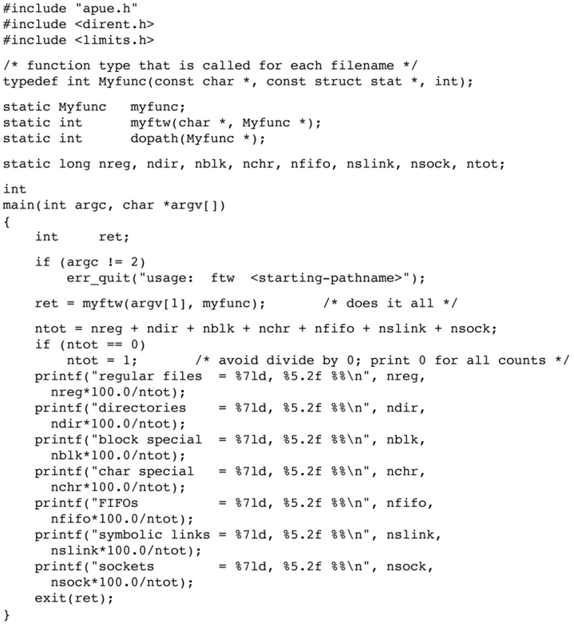
Figure 4.22 counting file types

Slide 5
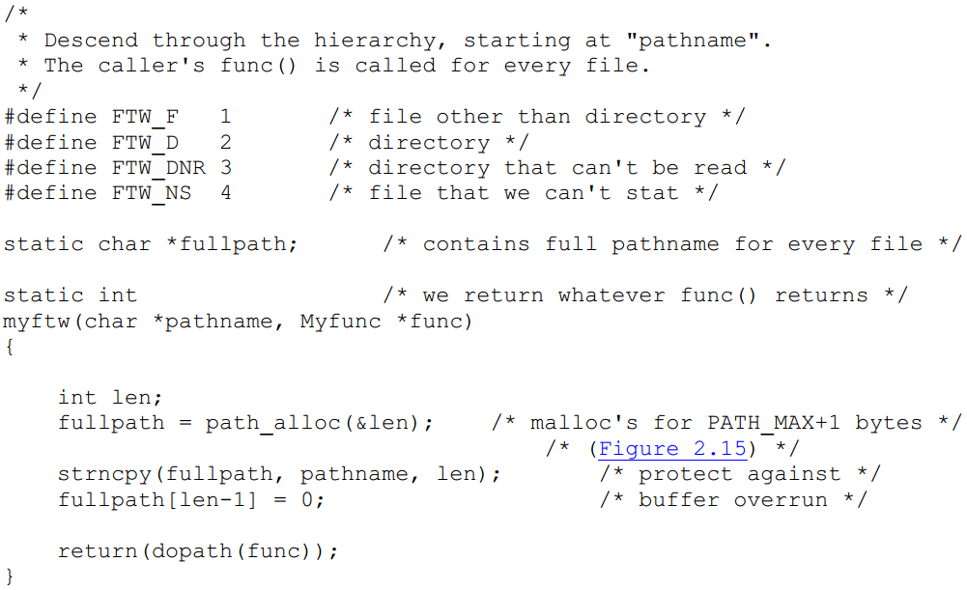
Figure 4.22 counting file types

Slide 6
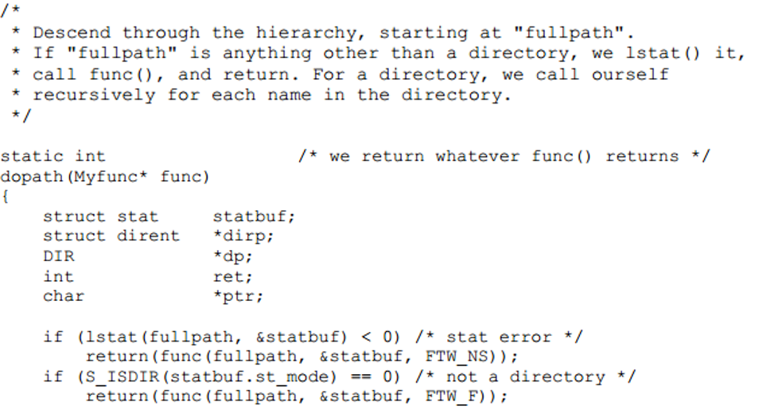
Figure 4.22 counting file types

Slide 7
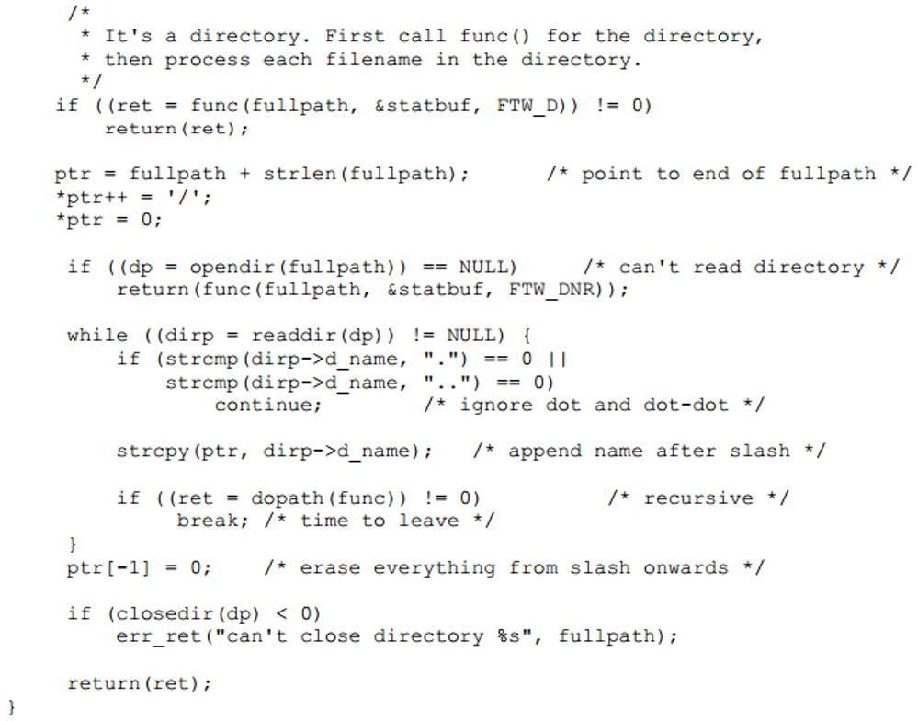
Figure 4.22 counting file types

Slide 8
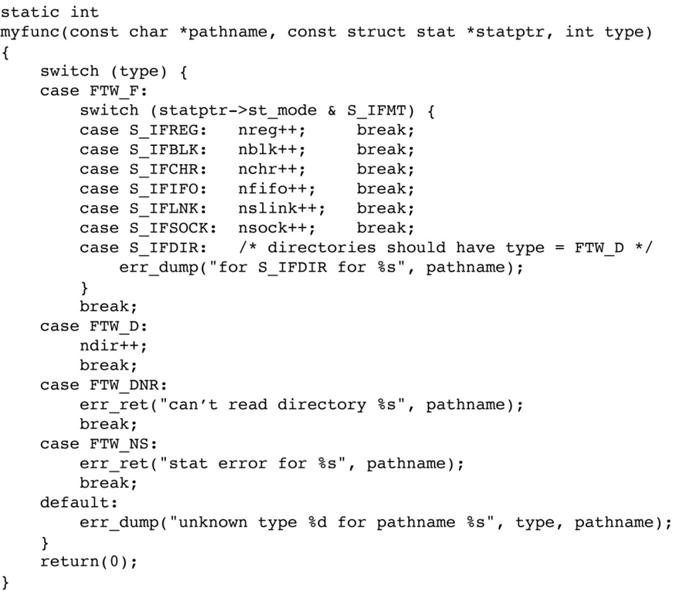
Figure 4.22 counting file types

Slide 9
Structure Information of File
struct stat {
mode_t st_mode; /* file type & mode */
ino_t st_ino; /* i-node # */
dev_t st_dev; /* device # */
dev_t st_rdev; /* device # of special files*/
nlink_t st_nlink; /* # of links */
uid_t st_uid; /* owner UID (user ID) */
gid_t st_gid; /* owner GID (group ID) */
off_t st_size; /* size in bytes of regular files */
struct timespec st_atim; /* time of last access */
struct timespec st_mtim; /* time of last modification*/
struct timespec st_ctim; /*time of last file status change*/
blksize_t st_blksize; /* best I/O block size */
blkcnt_t st_blocks; /* # disk blocks allocated */
};

Slide 10
File Type Macros
#define S_ISREG(st_mode) (((st_mode) & S_IFMT) == S_IFREG)
Macro | Type of file
S_ISREG() | Regular file
S_ISDIR() | Directory file
S_ISCHR() | Character special file
S_ISBLK() | Block special file
S_ISFIFO() | Pipe or FIFO
S_ISLNK() | Symbolic link
S_ISSOCK() | Socket

Slide 11
chmod
#include <sys/stat.h>
int chmod(const char *filename, mode_t mode);
change the permission bits of a file
Returns: 0 if OK, -1 on error
Ex: chmod(filename, S_IRUSR | S_IWUSR)
filename permission: rw-------

Slide 12
File Access Permission
Permission bits: rwxr--r--
st_mode mask | Meaning
S_IRUSR | user-read
S_IWUSR | user-write
S_IXUSR | user-execute
S_IRGRP | group-read
S_IWGRP | group-write
S_IXGRP | group-execute
S_IROTH | other-read
S_IWOTH | other-write
S_IXOTH | other-execute

Slide 13
readlink
#include <unistd.h>
ssize_t readlink(const char* restrict pathname, char *restrict buf, size_t bufsize);
Open the link and read the name in the link
Returns: number of bytes read if OK, -1 on error
Symbolic Link -> Target file

Slide 14
access
#include <unistd.h>
int access(const char *pathname, int mode);
Returns: 0 if OK, -1 on error
Ex: if(access(file, F_OK) == 0) // file exists
mode | Description
R_OK | test for read permission
W_OK | test for write permission
X_OK | test for execute permission
F_OK | test for existence of file

Slide 15
Requirements

Slide 16
Requirements
Use Makefile: make
Create the files in shell script (using createFile.sh)
Compile fig4_22.c
Run the executable file (fig_4_22)
There are some error messages, and you should modify your code.
Error message:
can’t read directory pathname: Permission denied
Hint: you can use the chmod() function to change the permissions of the directory.

Slide 17
Requirements (cont’d)
Count total size of all files
Hint: you can use st_size to get file size
#include <sys/types.h>
off_t total_size;
printf(“Total size = %lld\n”, total_size);

Slide 18
Requirements (cont’d)
Check if a symbolic link is valid.
Valid Link: The target file does exist.
Invalid Link: The target file doesn’t exist.
Hint: you can use the readlink() and access() functions to check if a line is valid

Slide 19
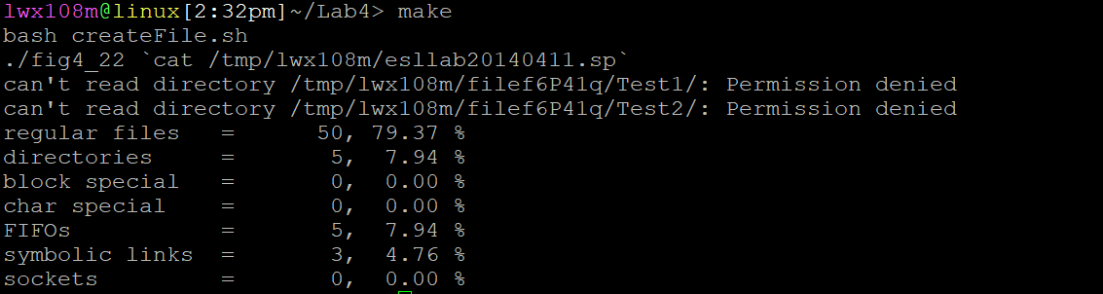
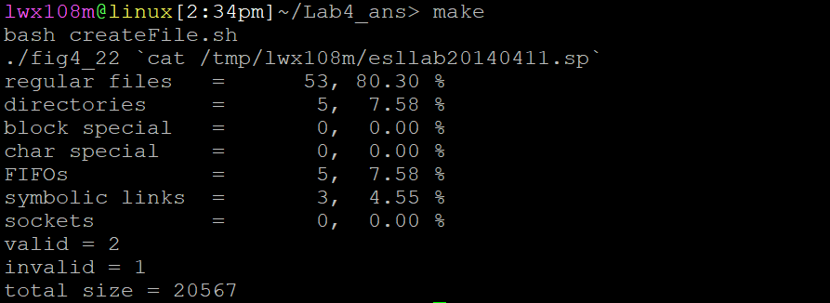
Requirements (cont’d)
Original
Requirements

Slide 20
Result of Requirements
Answer the following in table (Answers.doc):
How did you modify the code fig4_22.c?
Give the count of each type of files and the percentage.
File type = Count, Percentage
Give the total files size
Total size = Size
(Bonus) Give the counts of valid and invalid links
Valid link = Count
Invalid link = Count
Please see attached screenshots!

Slide 21
Turn In

Slide 22
Turn In
The E-course2
https://ecourse2.ccu.edu.tw//
Upload 學號.zip into “Lab_4”
Source files
Makefile
Due date
2020/05/05 23:59:59

Slide 23
Turn In (cont’d)
TA’s email:
spta@embedded.cs.ccu.edu.tw

Slide 24
Download

Slide 25
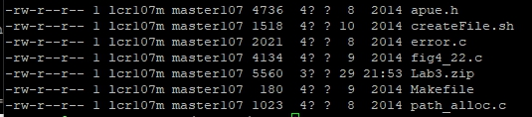
Download command
Code: $wget --no-check-certificate https://ecourse.ccu.edu.tw/29954/textbook/10/3/Lab3.zip

Slide 26
Download
Code: https://ecourse.ccu.edu.tw/29954/textbook/10/3/Lab3.zip
Answers.doc:
https://ecourse.ccu.edu.tw/29954/textbook/10/3/Answers.docx

