Slide 1

<Data Crew>
Machine Learning Code Gladiators 2021

Slide 2
Executive Summary
The model summaries to segregate the test data between genuine and false conversions by identifying the maximum possible leads generated by the malignant technique.

Slide 3
Conversion fraud in Digital Advertising
Digital Advertising is changing at a rapid pace with a huge increase in digital audience. At the same time, the digital advertising success metric is shifting from audience volume (eg . Impression count) to conversions (eg. lead submissions) as the success metric. This requires higher transparency and control on the conversions.
My task was to segregate the test data between genuine and false conversions by identifying the maximum possible leads generated by the malignant technique.

Slide 4
Solution
First Approach was to join all the necessary columns and form a single csv file which contains all the data in one file.
Second as the Dataset was imbalanced, so we have to balance the dataset by using undersampling ,oversampling or Smote.
After that it is the turn to perform Exploratory Data Analysis on the dataset, generating insights and facts
After that we check Transformations of the columns and try to fit the data in a Gaussian Distribution using Various Techniques,
After Transformations its time for Feature Selection followed by Model Building and Hyperparameter Tuning.
Last step is to work on metrics and then choose the appropriate model.

Slide 5
Approach
First shot was to join the data and form a single file containing all the data.
Second shot was to work on the transformations of Continous Features and select the best transformation , and also which encoding would be the best for handling the categorical features
After Selecting the best encoding type ,we will have to find for the outliers, identify them and select a best way to replace them ,as this is related to finance sector, we must be careful while dealing with the outliers
Then I moved on Model building and Hyperparameter Tuning and Evaluation of Metrics and then Rechecking them with the FAST AI Model.

Slide 6
Technology Stack
NumPy(For Numerical Computation),Pandas(For Panel Data)
Seaborn, Matplotlib(For Data Visualization and EDA)
for Model Building and Selection
FASTAI for Scikit-Learn, for verification of ROCAUC metric.
This was the Architecture which I followed.
RAW DATA
MERGING FILES
FEATURE
ENGINEERING
FEATURE
SELECTION
MODEL SELECTION
NO
NO
DEPLOYMENT
FAST AI CHECK
FINALISE MODEL
YES
METRIC CHECK
MODEL TUNING
SUCCESS
CHECK

Slide 7
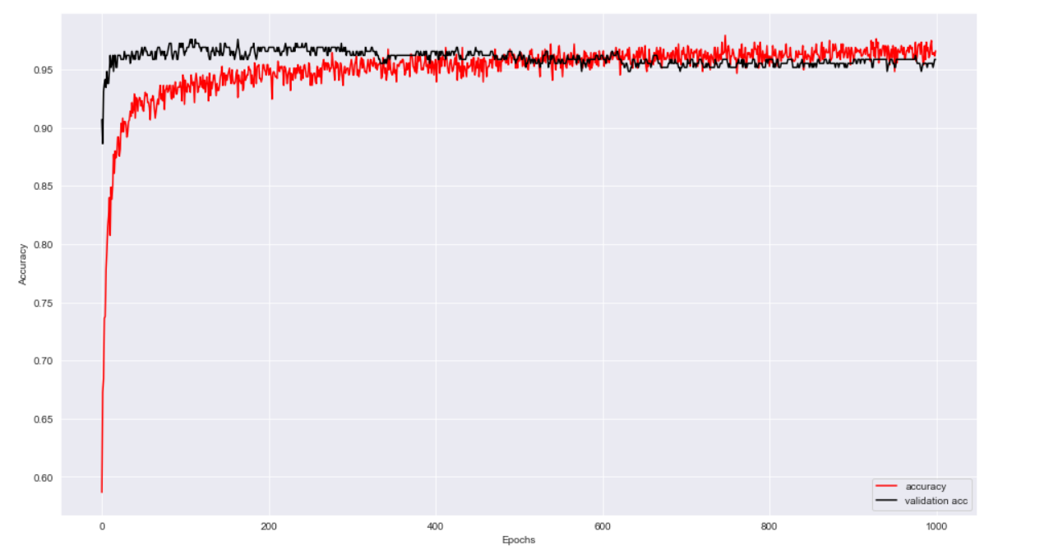
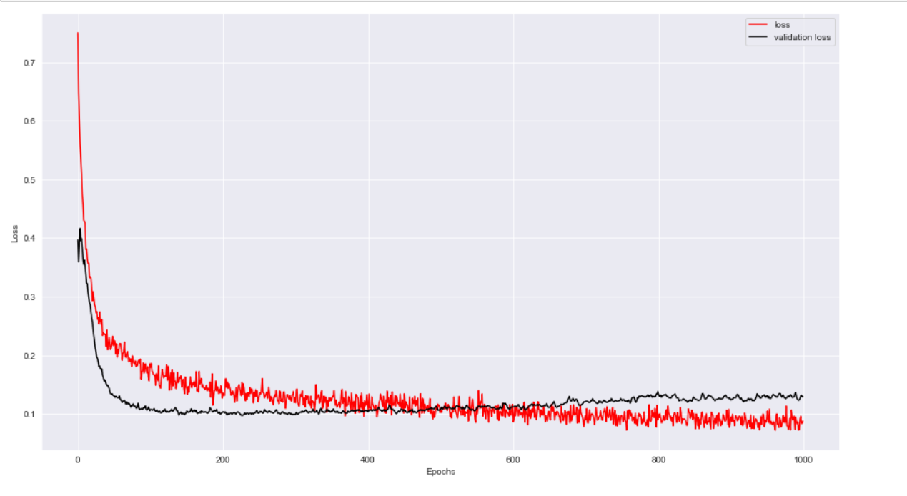
Model Architectures
First the dataset was trained with the Decision Tree Algorithm it received an Accuracy of 84% on the Testing Data,
Second I tried to use Artificial Neural Network which gave an accuracy of 88% on the Testing Data , here is the Glimpse of the loss and Accuracy curve for the ANN.
Accuracy vs Validation Curve Loss vs Validation Loss

Slide 8
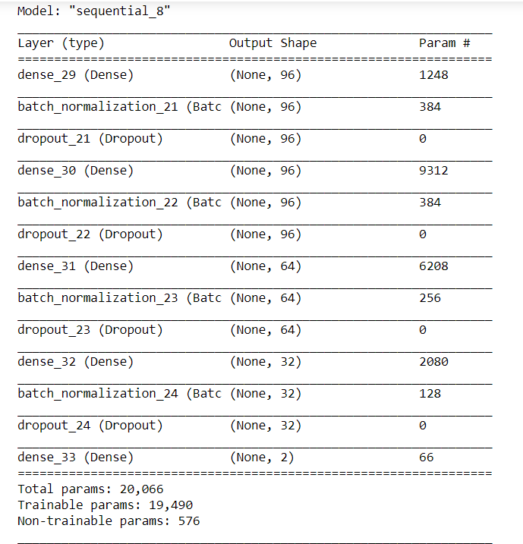
Neural Network Summary
Accuracy vs Val Accuracy Loss vs Validation Loss

Slide 9
Why our team is the best!
As the name of our team is Data Crew , the crew which works on Data, trying to figuring out new patterns in data, well we work on statistical tests and optimal model building , we try out different kinds of Statistical tests for Data Transformation and Feature Selection so that the generated insights might be used later in Model Building and Provide effective and valuable Results.

Slide 10
Associated attachments/ files
All the files are available at the GitHub Repository
Files to be Evaluated : Data Preprocessing Files (Training and Testing),Model Building File, where the model is build and the submission file for Results . After the Preprocessing of Training and Testing Data I have made 2 separate files as train and test, those are the preprocessed files.
GitHub Repo : https://github.com/mv1249/CodeGladiators

Slide 11
Thank you

