Slide 1
FINAL PROJECT · VIBE CODING CEDIA 2026
From syllabus to evidence
Training and researching Integral Personal Development
Martha Agila (UTPL) · Rodrigo Proaño (UTE)
Project guides 21 and 08
Narration generated with an AI voice (ElevenLabs) and reviewed by the authors.
Vibe Coding CEDIA 2026 · Universidad UTE · UTPL
1 / 10
Notes:
COVER
NARRATION · ≈15 s · 30–40 words in English
Introduce the tool by name, say who is in the subgroup and which universities, and in one sentence what it solves.
From syllabus to evidence. Training and researching Integral Personal Development. We are Martha Agila from UTPL and Rodrigo Proaño from UTE. Both are universities in Ecuador. We bring faculty training and research together in one tool.

Slide 2
FINAL PROJECT · VIBE CODING CEDIA 2026
The problem
The competency grows through training that needs support from research.
A CONCRETE EXAMPLE
Real pilot: ten sources, none uses the term.
Vibe Coding CEDIA 2026 · Universidad UTE · UTPL
2 / 10
Notes:
PART A · PRESENTATION (3 min in total)
THE PROBLEM · NARRATION · ≈35 s · 80–90 words
Describe the real task, who struggles with it and what it costs today. A concrete example beats a general figure.
Integral Personal Development is not taught as content. It grows through a training process that needs support from research. The syllabus should always be within reach and not only in a P D F. That is why we bring it to a mobile app. Reviewing the literature takes weeks. We lived it with ten real sources in three languages. None of them used the term Integral Personal Development. The sacral and cosmic domains were the least studied. Where should a teacher start?

Slide 3
FINAL PROJECT · VIBE CODING CEDIA 2026
The tool
WHO USES IT
WHAT GOES IN
WHAT COMES OUT
Teachers in training, facilitators
A syllabus or PDF sources
Website, app and traceable synthesis
Vibe Coding CEDIA 2026 · Universidad UTE · UTPL
3 / 10
Notes:
THE TOOL · NARRATION · ≈30 s · 70–80 words
Who uses it, what goes in and what comes out. Name the project guide it builds on.
The tool is used by university teachers in training and by the person who facilitates that training. It combines two course guides. With guide twenty one the teacher uploads a syllabus in Word. The result is a course website and a mobile app. With guide eight the teacher provides sources in P D F. They receive a synthesis where every claim has a source and a page. Both paths share one progress record.

Slide 4
FINAL PROJECT · VIBE CODING CEDIA 2026
How it works
1 · TRAINING
2 · CONVERSION
3 · RESEARCH
4 · DECISION
CHF syllabus or another one
Claude converts; teacher reviews
Cites passage and page
Reviewers approve
People always decide.
Vibe Coding CEDIA 2026 · Universidad UTE · UTPL
4 / 10
Notes:
HOW IT WORKS · NARRATION · ≈40 s · 95–105 words
Walk through the four steps. Make clear what the AI does and what a person always decides.
It works along two paths. Training and research. Teachers can start with either one and their progress is recorded. In the first step training begins. The teacher sees the Human Competencies for the Future syllabus or uploads another one. In the second step A I converts the syllabus and the teacher reviews the result. In the third step research begins. The assistant proposes in five stages and quotes the literal passage with its page. In the fourth step people decide. Two reviewers score separately and approve each stage. The A I proposes and people always decide.

Slide 5
FINAL PROJECT · VIBE CODING CEDIA 2026
Evidence that it works
26/26
0.70
60/60
contents match the syllabus
kappa between reviewers
passages on their page
Pilot with two syllabi and ten sources; real use pending.
Vibe Coding CEDIA 2026 · Universidad UTE · UTPL
5 / 10
Notes:
EVIDENCE · NARRATION · ≈35 s · 80–90 words
Figures from your own tests. Separate what was checked from what is still a proposal.
This is what we verified. In training we tested two real syllabi from UTE and UTPL. All twenty six course contents match the official syllabus word for word. In research the two reviewers reached a kappa of zero point seven zero before consensus. That counts as substantial agreement. All sixty quoted passages appear on their page. Human review also caught an overstated claim that the automatic check missed. We corrected it in version one point one. Use with real teachers is still a proposal.

Slide 6
FINAL PROJECT · VIBE CODING CEDIA 2026
Limits and responsible use
WHAT IT DOES NOT DO
DATA AND PRIVACY
NEXT STEP
Reviewers still decide
Claude only converts syllabi
Canvas with teachers
Vibe Coding CEDIA 2026 · Universidad UTE · UTPL
6 / 10
Notes:
LIMITS AND RESPONSIBLE USE · NARRATION · ≈25 s · 55–65 words
What it does not do, how it protects data and the next step (Moodle or another LMS, or the next AI-native level).
The syllabus is sent to Claude only to convert it. It contains only institutional data about the facilitator and the site does not store it. The tool does not replace the reviewers' judgment. Progress is self reported and complements the virtual classroom. Articles are processed on the computer. Our next step is to apply it in Canvas with teachers in training.

Slide 7
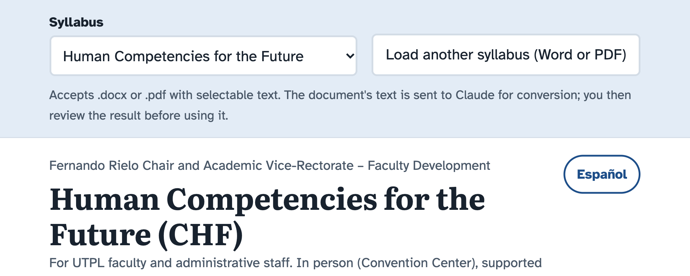
FINAL PROJECT · VIBE CODING CEDIA 2026
Demo · Input
Training path: the CHF syllabus, loading another one, English or Spanish
Vibe Coding CEDIA 2026 · Universidad UTE · UTPL
7 / 10
Notes:
PART B · DEMO (2 min in total)
NARRATION · ≈30 s · 70–80 words in English
Show the start or input screen. Say what the person enters and why.
Let us see the tool on screen. This is the entry point of the Training path. The teacher sees the Human Competencies for the Future syllabus and its schedule. At the top they can upload another syllabus in Word or P D F. A I converts it and the teacher reviews the result before using it. The site also works as an app on the phone. One button switches the page between English and Spanish.

Slide 8
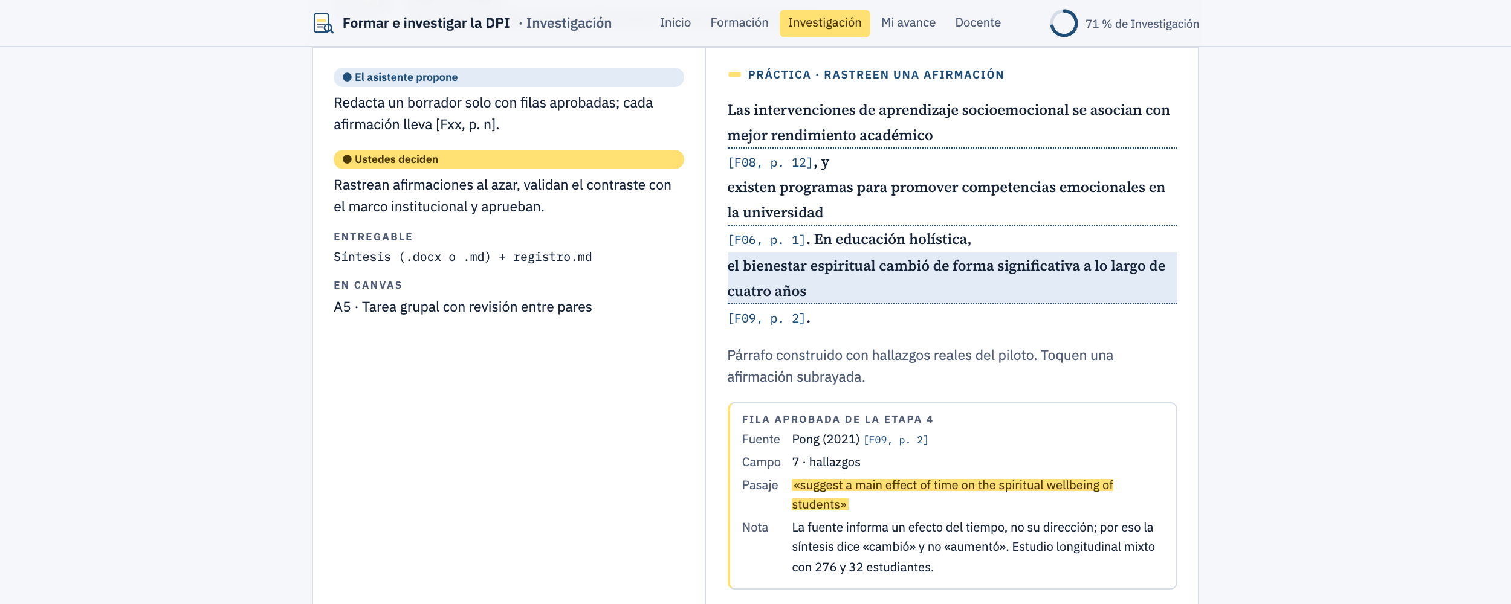
FINAL PROJECT · VIBE CODING CEDIA 2026
Demo · Result
Real case: a synthesis claim traced to its passage and page
Vibe Coding CEDIA 2026 · Universidad UTE · UTPL
8 / 10
Notes:
NARRATION · ≈35 s · 80–90 words in English
Show the main result. Point to where to look on the screenshot and what it means.
This is our real case in the Research path. The synthesis states that spiritual wellbeing changed over four years. Clicking the claim opens its approved row. It shows the source, page two and the literal passage. The assistant had first written increased and human review corrected it. The source does not report the direction of the change. Reviewers trace claims like this one at random. That is why every claim must be traceable and a person checks its meaning.

Slide 9
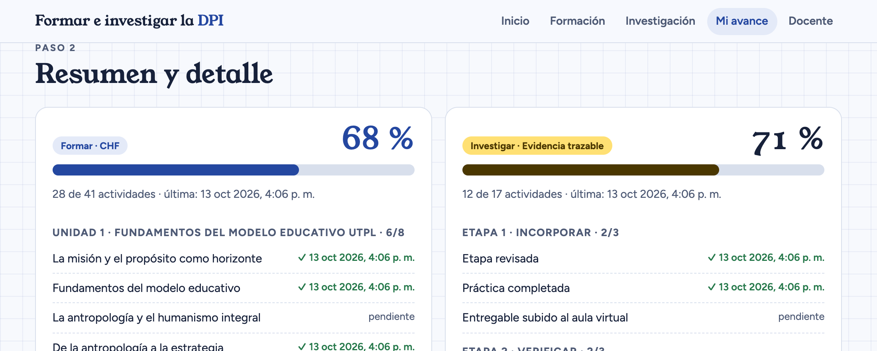
FINAL PROJECT · VIBE CODING CEDIA 2026
Demo · Review and delivery
My Progress: both paths with dates, ready to export to Canvas
Vibe Coding CEDIA 2026 · Universidad UTE · UTPL
9 / 10
Notes:
NARRATION · ≈30 s · 70–80 words in English
Show where the person reviews, approves or exports. Close the demo with the test that backs it.
Here is where work is reviewed and submitted. My Progress brings both paths together with the date of each activity. In this example with test data training is at sixty eight percent. Research is at seventy one percent. The teacher exports the file and uploads it to an assignment in Canvas. The teacher dashboard checks that nobody edited it by hand and flags any change. This screen is also in Spanish for now.

Slide 10
FINAL PROJECT · VIBE CODING CEDIA 2026
Training and research, one single path
Next step: Canvas with teachers in training.
mvagila.github.io/Deasarrollo_Personal_Integral
Martha Agila (UTPL) · Rodrigo Proaño (UTE)
Vibe Coding CEDIA 2026 · Universidad UTE · UTPL
10 / 10
Notes:
CLOSE · NARRATION · ≈25 s · 55–65 words
What changes in the subgroup's work, the next step and a short invitation. End on a complete sentence.
With this tool the micro project rests on traceable evidence. Training and research stop being separate paths and start supporting each other. Our next step is to apply it with teachers in training. We invite you to visit the site and try both paths. Then adapt it to the competency you teach. Thank you very much for your attention.

