Slide 1
PT-Symmetric Photonic Heterostructures
Conservation Relations and Anisotropic Transmission Resonances in
Group 13
Harshda Saxena
Mithil Vakde
Shyam Iyer
Vaishnav Rao

Slide 2
Overview
What is a 𝒫𝒯-Symmetric Photonic Heterostructure?
What are Anisotropic Transmission Resonances (ATRs)?
What are symmetry-breaking transitions and when do they occur?
Is the 𝒫𝒯 transition unique?
Where can such 𝒫𝒯-Symmetric structures be implemented?

Slide 3
Overview
What is a 𝒫𝒯-Symmetric Photonic Heterostructure?
What are Anisotropic Transmission Resonances (ATRs)?
What are symmetry-breaking transitions and when do they occur?
Is the 𝒫𝒯 transition unique?
Where can such 𝒫𝒯-Symmetric structures be implemented?

Slide 4


What is 𝒫𝒯-Symmetry?
The “𝒫” comes from the Parity operation, which flips the signs of momenta (p) and spatial coordinates ( r)
The “𝒯” comes from the Time reversal operation, which flips the sign of time and momenta, along with an overall complex conjugation
A Hamiltonian is called 𝒫𝒯 symmetric if it is invariant under the 𝒫𝒯 operation -
The relation between the potential in the Hamiltonian -
Observable ⇒ Eigenvalues of 𝒫𝒯 symmetric Hamiltonian to be real ⇔ Eigenvectors must be 𝒫𝒯 symmetric
Notes:
Split this into 2 slides

Slide 5

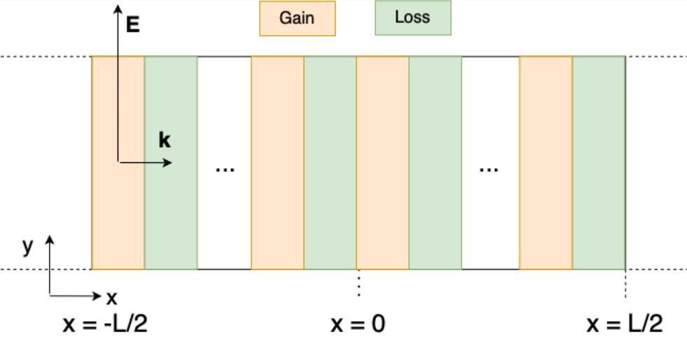
What are these structures?
The permittivity in optics behaves like the potential in QM!
Thus, the permittivity (ε) 1D 𝒫𝒯 symmetric heterostructure will satisfy the relation -
How does one achieve this?

Slide 6



The S - Matrix
In QM, S matrix is just the operator that relates the wavefunction at time t to that at t_{0.,}
In our case, the scattering matrix S relates the amplitudes of incident waves (ф_{k} ), and scattered and transmitted (ψ_{n}) waves.
What happens when we do a 𝒫𝒯 operation? Incident becomes scattering!
Before - After -
Manipulating these 2, gives a very important equation -

Slide 7
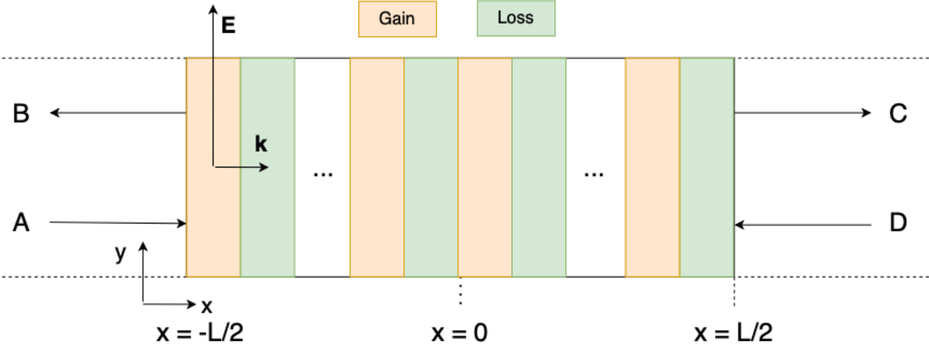
The Generalized Unitarity Relations
Recall the structure as we read before, but now lets see what happens when we have coherent beams incident from both sides

Slide 8
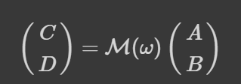




The Generalized Unitarity Relations - Contd
Recall the transfer matrix, which relates the amplitudes on the left and right of the structure -
From a similar logic after applying the 𝒫𝒯 operation we obtain , parameterizing ℳ as below, where b and c are real, and related by detℳ = |a|² - bc = 1
Using the S matrix as defined above, and relating it to ℳ gives us the following -

Slide 9
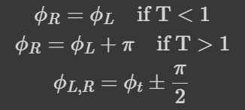



The Generalized Unitarity Relations - Contd
Using this, and the transmission coefficients (t), left/right reflection coefficients r_{L}/r_{R}
We finally get the relations -
Thus T<1 becomes - , and T>1 becomes
We finally plot these relations to get a feel for what is actually going on.
T=1 means that either R_{L} or R_{R} , giving rise to no reflection from that side, and what we call as Anisotropic Transmission Resonance (ATR)

Slide 10
What did we cover till now?
What is a 𝒫𝒯-Symmetric Photonic Heterostructure?
What is 𝒫𝒯-Symmetry?
What are these structures
What is the S matrix?
What are the Conservation Relations?
Notes:
Last point: CPA Laser points and Unidirectional invisibility.
{[]} implies to be removed when presentation has been made.
Add a master preview slide (2s, fast, repeat only at the conclusion). Each major point in its own slide with subpoints. (repeated many times)

Slide 11
Overview
What is a 𝒫𝒯-Symmetric Photonic Heterostructure?
What are Anisotropic Transmission Resonances (ATRs)?
What are symmetry-breaking transitions and when do they occur?
Is the 𝒫𝒯 transition unique?
Where can such 𝒫𝒯-Symmetric structures be implemented?

Slide 12
What are ATRs?
Why Anisotropic?
What are its Properties?
Are there different Types of ATRs?
Existence in different structures and scenarios
Notes:
Change to Shyam’s window change format

Slide 13
What are ATRs?
Recall:
Note that:
T = 1 ⇔ R_{L} = 0 or R_{R} = 0
Such a process is called an ATR.
Generalised Unitarity Relation
They are a generalisation of transmission resonances in unitary optical systems.

Slide 14
Why is it called Anisotropic?
In general only one of the refectances are zero.
So no reflection for light incident only on one side
Possible that both reflectances = 0 simultaneously
This requires precise control over two degree of freedom. Hard to do experimentally
3 variables, 1 equation ⇒ 2 DOF
Notes:
[accidentally]

Slide 15
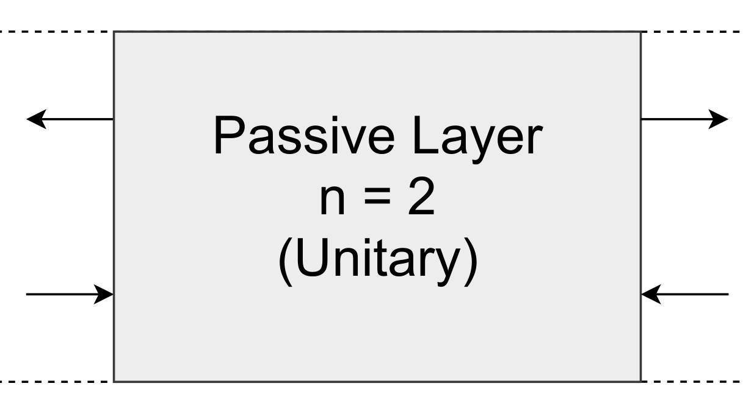
Introducing new structures
And plotting Transmittance and reflectance
Notes:
Change to Shyam’s window change format

Slide 16
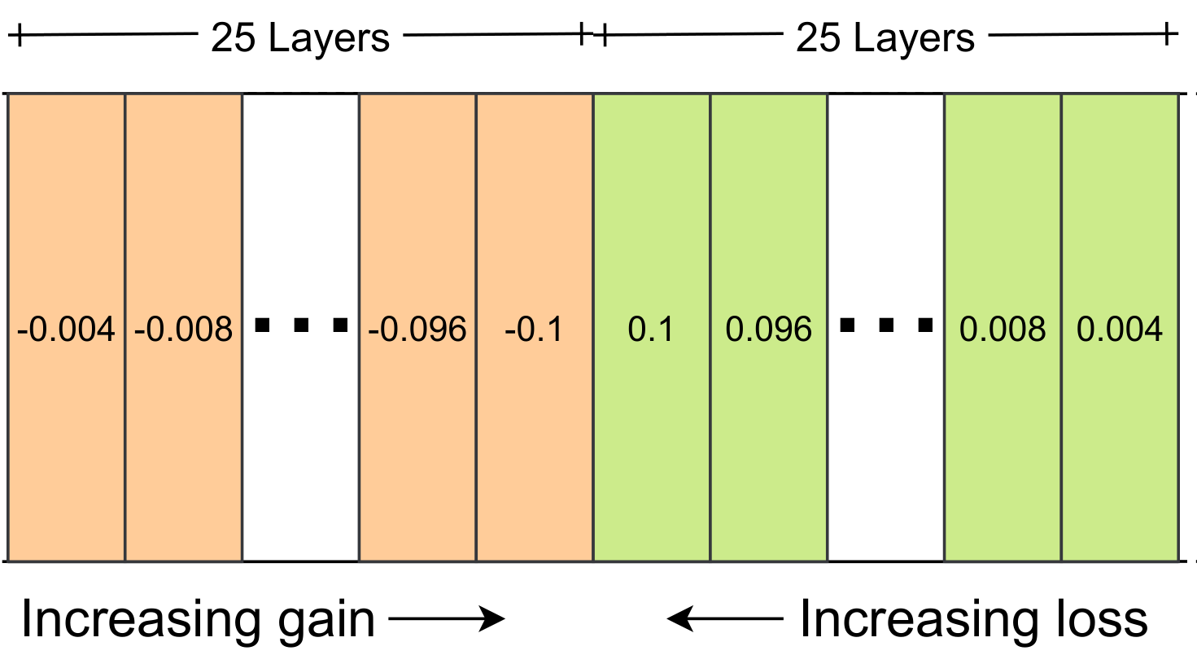
Introducing new structures
And plotting Transmittance and reflectance
Notes:
Change to Shyam’s window change format

Slide 17
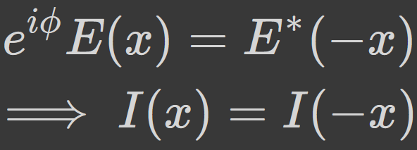
What are its properties?
Flux is conserved during this process
Intensity Profile is spatially symmetric about center during an ATRs
Generally asymmetric for non ATR frequencies
Relation between EM fields at ATRs due to PT symmetry gives symmetric intensities

Slide 18
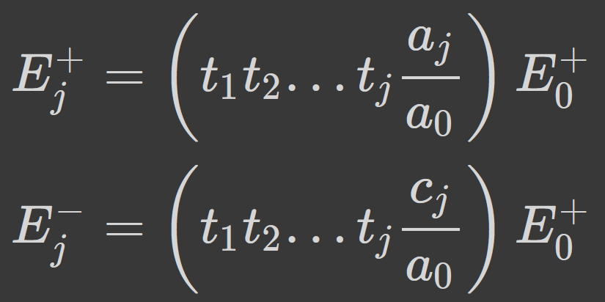
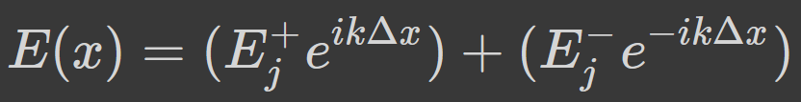
Abeles Matrix Formalism
*K. Ohta, H. Ishida - Matrix formalism for calculation of electric field intensity of light in stratified multilayered films
And plotting Intensities for same structures
We have used the method described by K. Ohta* to plot intensities
Calculating amplitudes at the boundaries
Then calculating amplitudes in the interiors
Notes:
Change to Shyam’s window change format

Slide 19
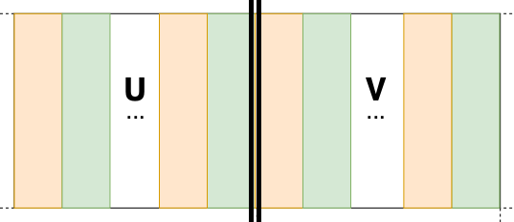
Are there different types of ATRs?
2 types: Trivial and Non-Trivial
Trivial ATRs:
Due to transmission resonances of 2 halves
Coefficients of the whole structure can be related to that of each halves. PT symmetry ensures a TR of left half implies one on the right half too.
Notes:
[accidentally]

Slide 20
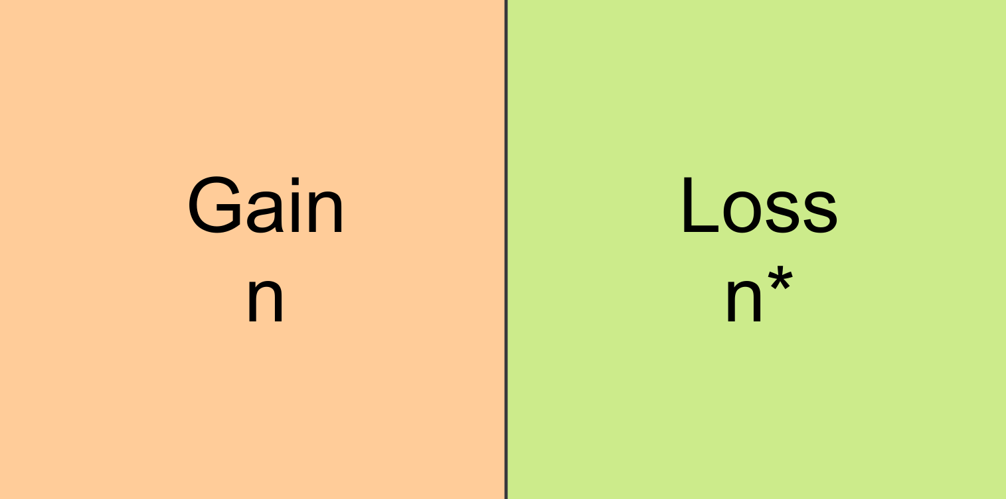
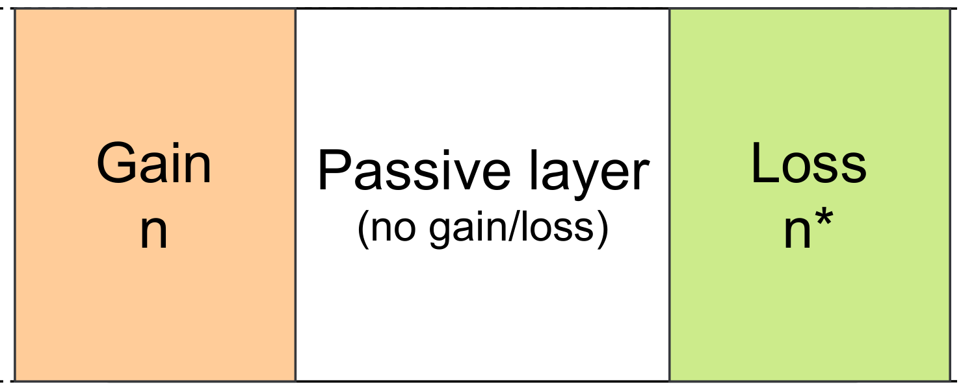
Existence of ATRs
We look at existence for the following 2 structures
We also look at specific scenarios such as certain asymptotic limits and broken symmetry phases
Same structures looked at in section 1 plots
Notes:
[accidentally]

Slide 21
What did we cover till now?
What are ATRs?
Why Anisotropic?
What are its Properties?
Are there different Types of ATRs?
Existence in different structures and scenarios
Notes:
Change to Shyam’s window change format

Slide 22
Overview
What is a 𝒫𝒯-Symmetric Photonic Heterostructure?
What are Anisotropic Transmission Resonances (ATRs)?
What are symmetry-breaking transitions and when do they occur?
Is the 𝒫𝒯 transition unique?
Where can such 𝒫𝒯-Symmetric structures be implemented?

Slide 23
3) Symmetry-breaking transitions
What are they?
How do we find conditions for them to occur?
When do they coincide with ATRs?

Slide 24
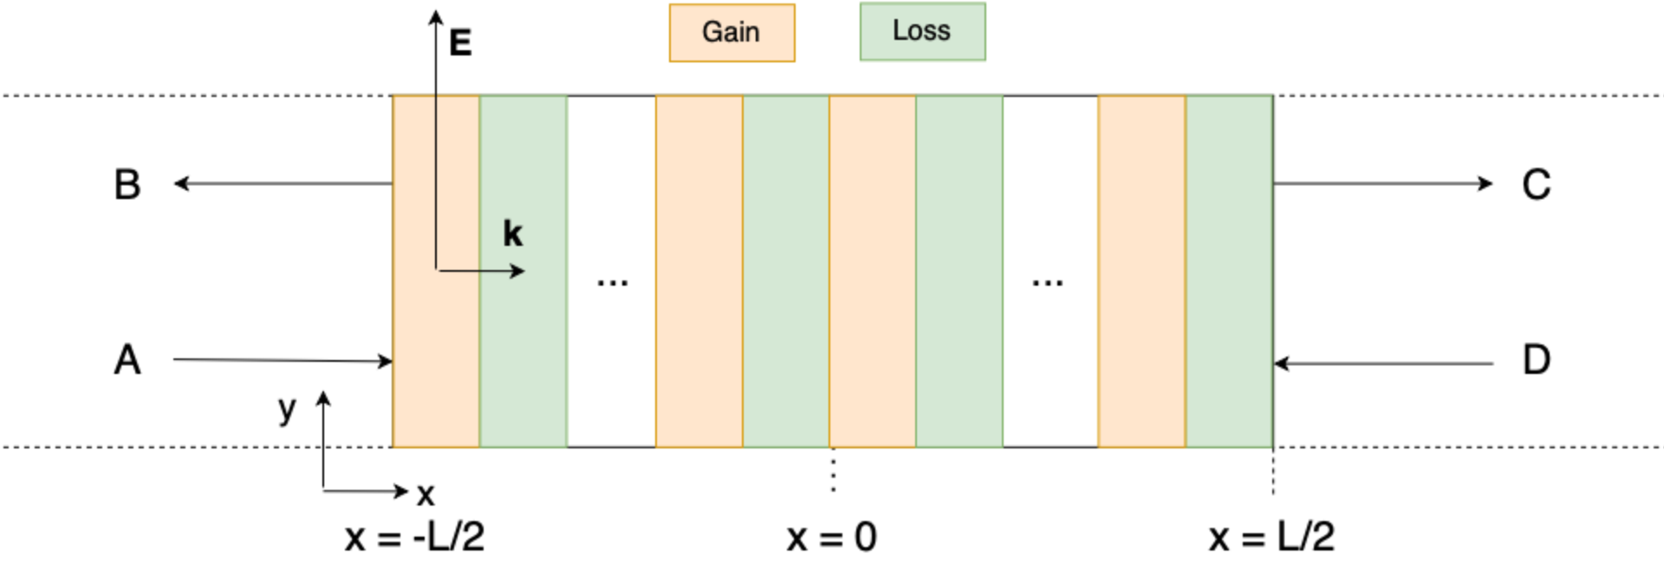
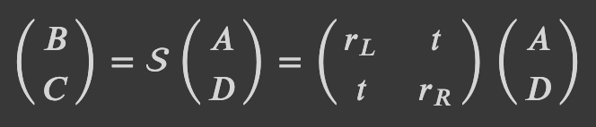
What are Symmetry-breaking transitions?
The PT- Symmetric heterostructure
The scattering matrix definition
As ω is varied or gain and loss are adjusted, the system may undergo a symmetry breaking transition.
Symmetric phase -> Eigenstates are themselves PT-Symmetric So the eigenvalues of S are unimodular, and eigenstates are mapped to themselves.
Broken symmetry phase -> Eigenstates are not PT- Symmetric Moduli of the eigenvalues of S are reciprocal to one another, eigenstates map onto each other under 𝒫𝒯-Symmetric operation.
At the symmetry-breaking transition or “phase boundary” we have a single eigenstate and eigenvalue.

Slide 25
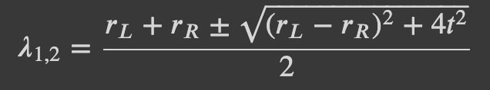

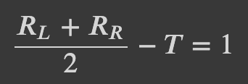
How do we find conditions for them to occur?
The scattering matrix definition
Eigenvalues of the scattering matrix
The symmetry breaking transition occurs when there exists one eigenvalue of the S matrix
This occurs at
Using the conservation relations, we get the condition for symmetry breaking in terms of R_{L}, R_{R} and T as
When the LHS<1 we have symmetric phase and when LHS>1, symmetry-broken phase.
This is a simple experimental criterion for ascertaining the 𝒫𝒯-breaking transition point.

Slide 26
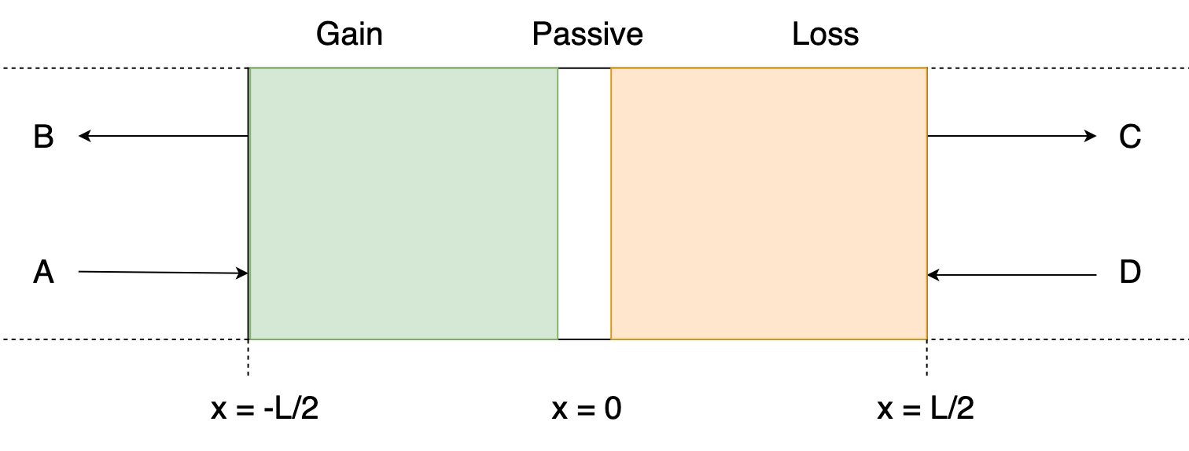
Let’s look at the plot of |λ| and symmetry breaking condition vs ωL for a modified heterostructure near the 𝒫𝒯-breaking point. This heterostructure consists of a passive layer (n_{p} = 3) of length 4% of L between gain and loss layers. n = 3 ± 0.005i

Slide 27

When do ATRs coincide with the phase boundary?
Condition for phase boundary
For an ATR to occur, T = 1
We may examine the properties of a 𝒫𝒯-Symmetric heterostructure along the phase boundary.
To achieve this, when we vary Im[n] (gain/loss) we will have to vary ω_{C} (critical frequency) simultaneously in order to preserve the phase boundary state.
For an ATR to occur, we require T = 1. Therefore, either R_{L} or R_{R} = 0 Say, R_{R} = 0 (or, R_{L} = 0) Then by the condition for phase boundary we have R_{L} = 4 (or, R_{R} = 4)

Slide 28
What have we covered up till now?
What are Symmetry Breaking Transitions?
When do they occur?
When do they coincide with ATRs?

Slide 29
Overview
What is a 𝒫𝒯-Symmetric Photonic Heterostructure?
What are Anisotropic Transmission Resonances (ATRs)?
What are symmetry-breaking transitions and when do they occur?
Is the 𝒫𝒯 transition unique?
Where can such 𝒫𝒯-Symmetric structures be implemented?

Slide 30
4) Is the PT transition unique?
A new scattering matrix
Phase Transition Conditions
A comparison of phase transitions
What are CPA laser points?

Slide 31
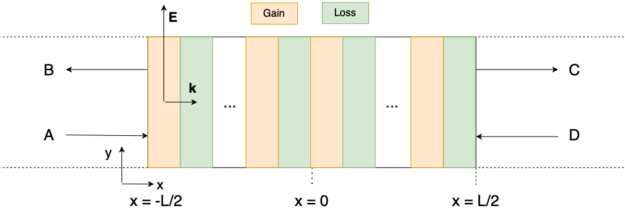
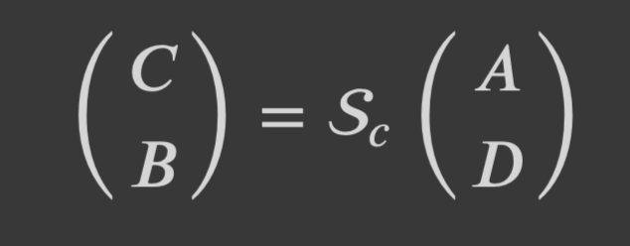
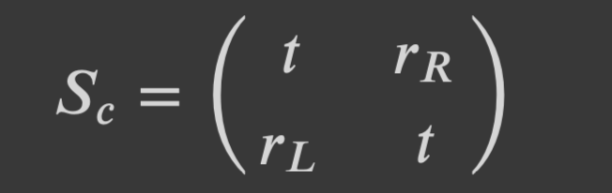
A new scattering matrix
The new scattering matrix definition

Slide 32
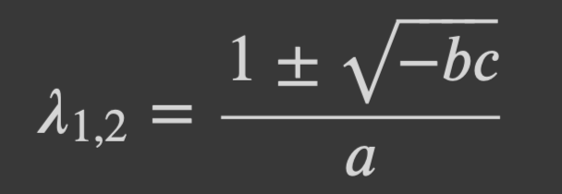
Phase transition conditions
Eigenvalues of the new scattering matrix
bc>0
Both eigenvalues complex (unimodular)
Symmetric phase of unimodular eigenvalues
T<1
bc<0
Both eigenvalues real and modulii ≠ 1
Broken symmetry phase as eigenvalues not unimodular
T>1
b=0 or c=0
Both eigenvalues equal
Symmetry breaking point
T=1

Slide 33
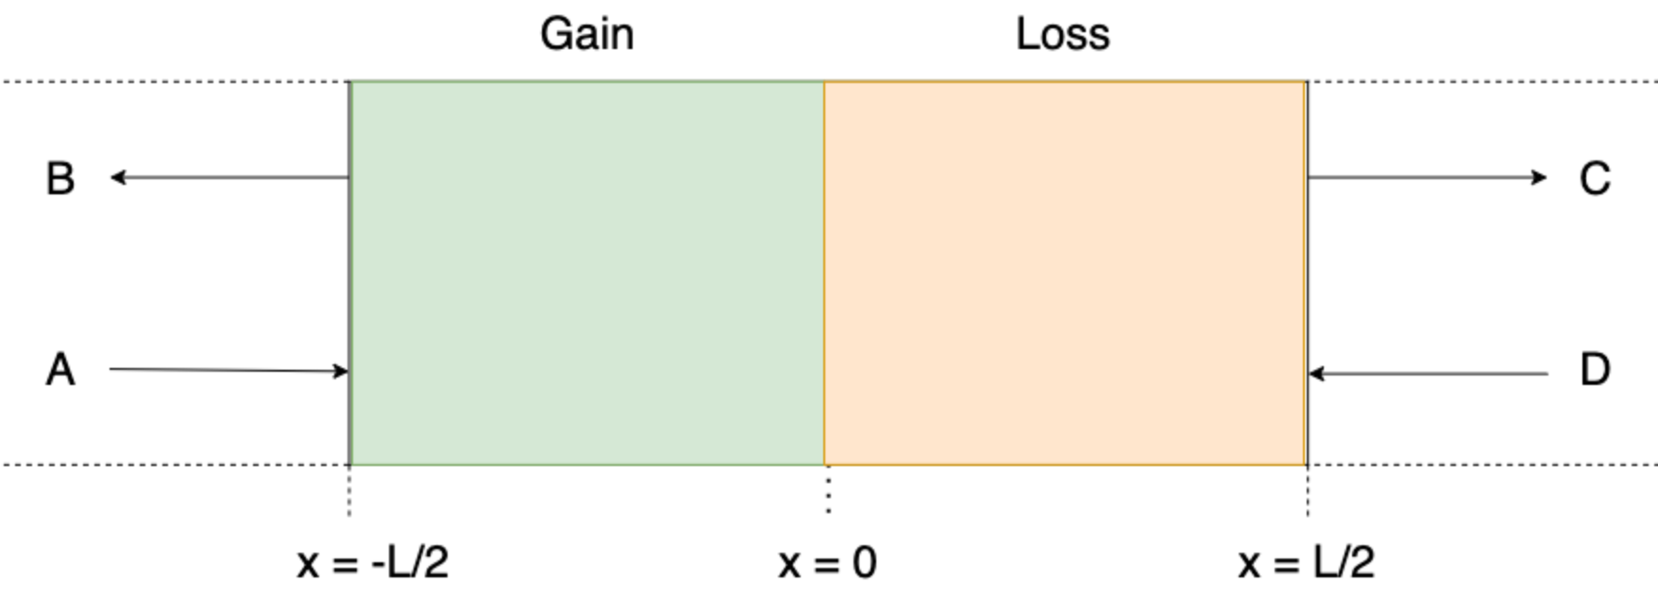
Comparison of phase transitions
Let’s go to the Jupyter Notebook to look at the phase transitions of the S_{C} and S₀ matrices for a simple heterostructure

Slide 34
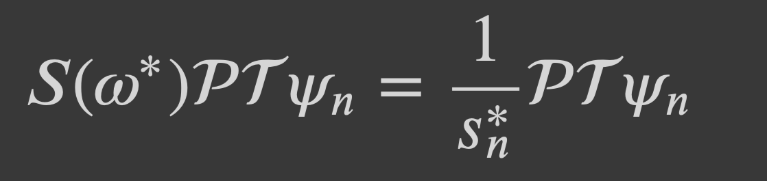
Comparison of phase transitions
⇒
s_{n} and ψ_{n} are an eigenpair of the S(ω) matrix
1/s_{n}* is an eigenvalue of the S(ω*) matrix
s_{n}=0 ⇒ |1/s_{n}*|⇾ ∞ and vice versa
Poles and zeros of the S matrix are necessarily complex conjugates
It does not matter which S matrix we take as poles and zeros of the S₀ and S_{c} matrix coincide
We now go to the Jupyter Notebook to see the plots for the zeros and poles of a simple heterostructure

Slide 35
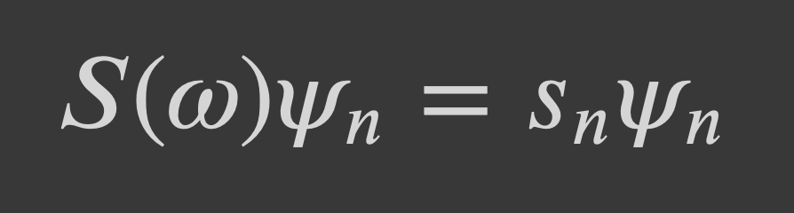
What are CPA laser points?
Pole and zero coincide on the real axis
If s_{n} is zero, RHS vanishes
If s_{n} is a pole, RHS blows up
Note: Eigenvector in this case is just a vector composed of the amplitudes of simultaneously incident beams

Slide 36
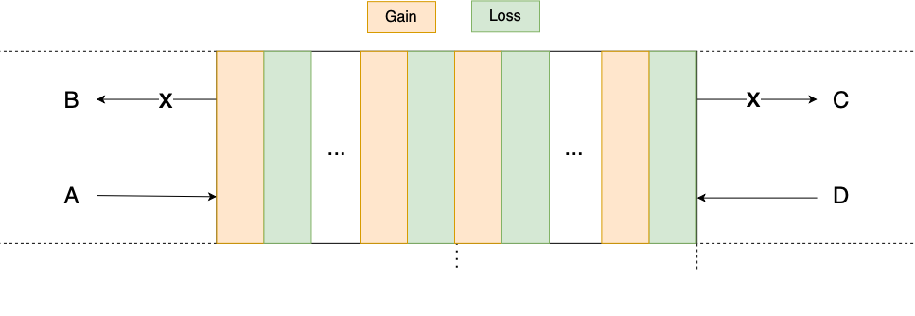
Physically...
The Coherent Perfect Absorber mode

Slide 37
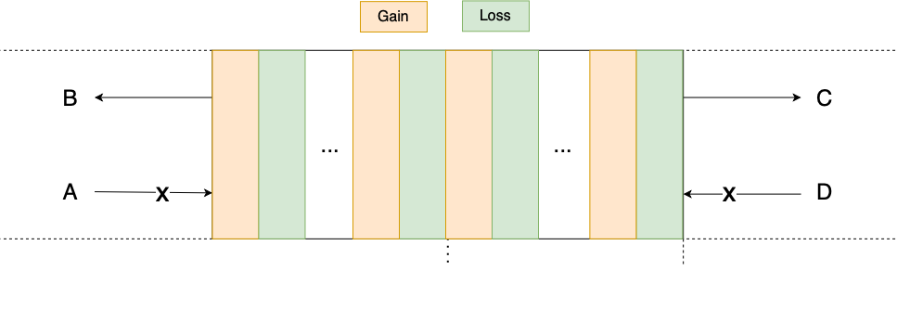
Physically...
The Lasing mode

Slide 38
What have we covered up till now?
A new scattering matrix
Phase Transition Conditions
A comparison of phase transitions
What are CPA laser points?

Slide 39
Overview
What is a 𝒫𝒯-Symmetric Photonic Heterostructure?
What are Anisotropic Transmission Resonances (ATRs)?
What are symmetry-breaking transitions and when do they occur?
Is the 𝒫𝒯 transition unique?
Where can such 𝒫𝒯-Symmetric structures be implemented?

Slide 40
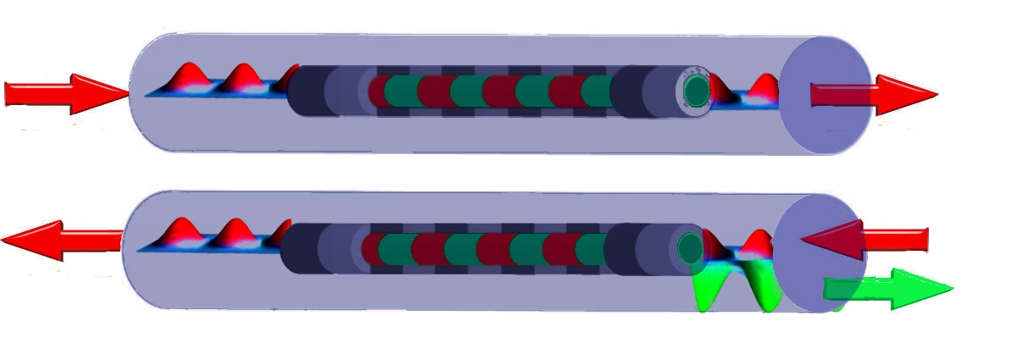
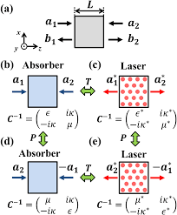
Realisations of PT-Symmetry
Lin et al - Unidirectional Invisibility induced by PT-Symmetric Periodic Structures
Unidirectional invisibility of a PT-symmetric Bragg scatterer. -The wave entering from the left (upper figure) does not recognize the existence of the periodic structure and goes through the sample entirely unaffected. -A wave entering this same grating from the right (lower figure), experiences enhanced reflection.
Xiao et al - Effective PT-symmetric metasurfaces for subwavelength amplified sensing
Schematic view of the P and T operation on CPA and lasing devices
...also Optical Computers, Optical Diodes, Power Oscillations

Slide 41
Contributions
Vaishnav V. Rao: S-matrix, Abeles matrix, Trivial and Non-Trivial ATRs, CPA laser points. Plot 3(a)-3(f), 5.1, 5(a) and 5(c)
Shyam Iyer: Generalized Unitarity Relations, ATR and Phase Boundary. Plots 2(a)-2(c), 4(a)-4(c), 5.1 and 5(a)
Mithil A. Vakde: Absence of Trivial ATRs in SH, Existence of ATRs in the asymptotic limit, Derivation of formulae for SH. Plots 2(a)-2(c), Plot 3(a)-3(f), Fig 3.1, Fig. 6(a) - 6(c).
Harshda Saxena: QM formalism, ATR theory, Phase Transition Boundaries, Uniqueness of S-matrix. Plot 4(a)-4(c), 5.1, 5(a) and 5(c)

Slide 42
Thank you!

