Slide 1
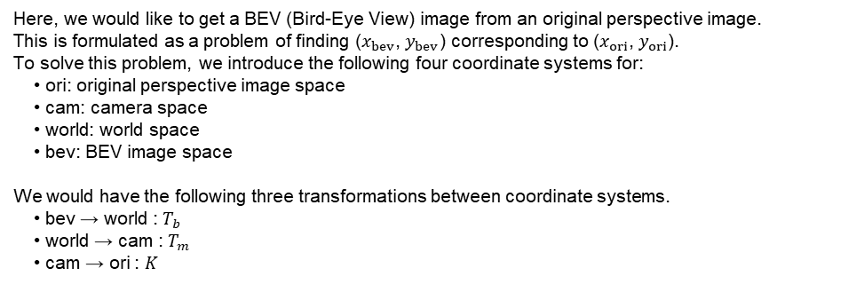


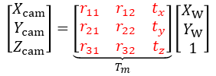









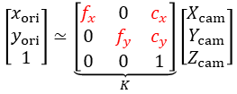

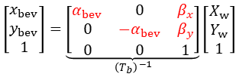


Aug 17 2020
Jungwon Kang
Getting a BEV (Bird-Eye View) image from an original perspective image
Here, we would like to get a BEV (Bird-Eye View) image from an original perspective image.
This is formulated as a problem of finding ($x_{bev}$, $y_{bev}$) corresponding to ($x_{ori}$, $y_{ori}$).
To solve this problem, we introduce the following four coordinate systems for:
• ori: original perspective image space
• cam: camera space
• world: world space
• bev: BEV image space
We would have the following three transformations between coordinate systems.
• bev → world : $T_{b}$
• world → cam : $T_{m}$
• cam → ori : $K$
Note that the red-color symbols
are parameters.
$$\left[\begin{matrix}x_{ori} \\ y_{ori} \\ 1\end{matrix}\right]≃K\left[\begin{matrix}X_{cam} \\ Y_{cam} \\ Z_{cam}\end{matrix}\right]$$
$$\left[\begin{matrix}X_{cam} \\ Y_{cam} \\ Z_{cam}\end{matrix}\right]=T_{m}\left[\begin{matrix}X_{W} \\ Y_{W} \\ 1\end{matrix}\right]$$
$$\left[\begin{matrix}X_{w} \\ Y_{w} \\ 1\end{matrix}\right]=T_{b}\left[\begin{matrix}x_{bev} \\ y_{bev} \\ 1\end{matrix}\right]$$
Transformation
from cam to ori
Transformation
from world to cam
Transformation
from bev to world
$$\left[\begin{matrix}x_{ori} \\ y_{ori} \\ 1\end{matrix}\right]≃\underset{K}{\underbrace{\left[\begin{matrix}f_{x} & 0 & c_{x} \\ 0 & f_{y} & c_{y} \\ 0 & 0 & 1\end{matrix}\right]}}\left[\begin{matrix}X_{cam} \\ Y_{cam} \\ Z_{cam}\end{matrix}\right]$$
$$\left[\begin{matrix}X_{cam} \\ Y_{cam} \\ Z_{cam}\end{matrix}\right]=\left[\begin{matrix}r_{11} & r_{12} & \begin{matrix}r_{13} & t_{x}\end{matrix} \\ r_{21} & r_{22} & \begin{matrix}r_{23} & t_{y}\end{matrix} \\ r_{31} & r_{32} & \begin{matrix}r_{33} & t_{z}\end{matrix}\end{matrix}\right]\left[\begin{matrix}X_{W} \\ \begin{matrix}Y_{W} \\ Z_{W}\end{matrix} \\ 1\end{matrix}\right]$$
$$\left[\begin{matrix}x_{bev} \\ y_{bev} \\ 1\end{matrix}\right]=\underset{{\left(T_{b}\right)}^{−1}}{\underbrace{\left[\begin{matrix}α_{bev} & 0 & β_{x} \\ 0 & {−α}_{bev} & β_{y} \\ 0 & 0 & 1\end{matrix}\right]}}\left[\begin{matrix}X_{w} \\ Y_{w} \\ 1\end{matrix}\right]$$
Supposing $Z_{w}=0$
for all the points in
the world space
• $α_{bev}$ : pixel/meter
• $β_{x}$ : $w_{bev}/2$
• $β_{y}$ : $h_{bev}−1$
$$\left[\begin{matrix}X_{cam} \\ Y_{cam} \\ Z_{cam}\end{matrix}\right]=\underset{T_{m}}{\underbrace{\left[\begin{matrix}r_{11} & r_{12} & t_{x} \\ r_{21} & r_{22} & t_{y} \\ r_{31} & r_{32} & t_{z}\end{matrix}\right]}}\left[\begin{matrix}X_{W} \\ Y_{W} \\ 1\end{matrix}\right]$$
$$Z$$
$$bev$$
$$x$$
$$cam$$
$$y$$
$$Y$$
$$X$$
$$Z$$
$$y$$
$$Y$$
$$W$$
$$W$$
$$x$$
$$X$$

