Slide 1
Intro to Data Analytics
Step by Step Student Guide
Instructor: Michael Valeri

Slide 2
WHO – Visualization Guide

Slide 3
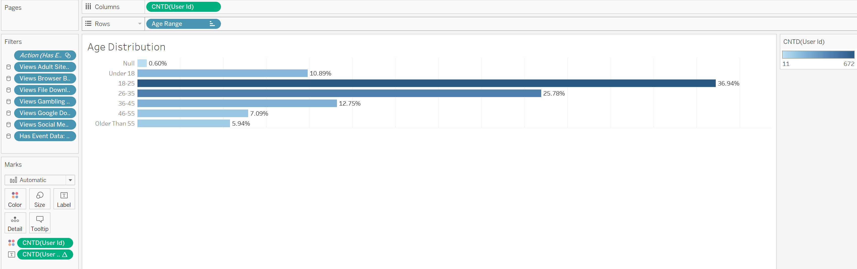
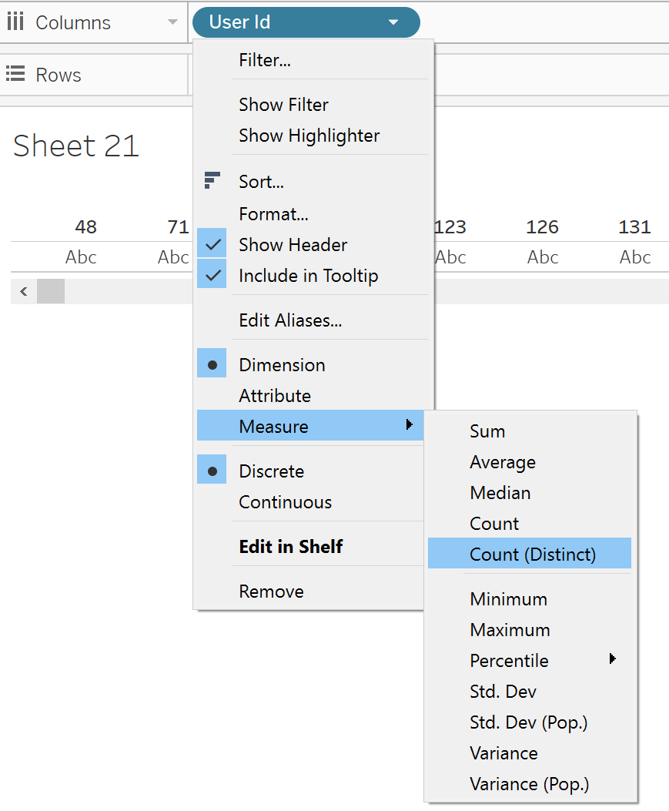
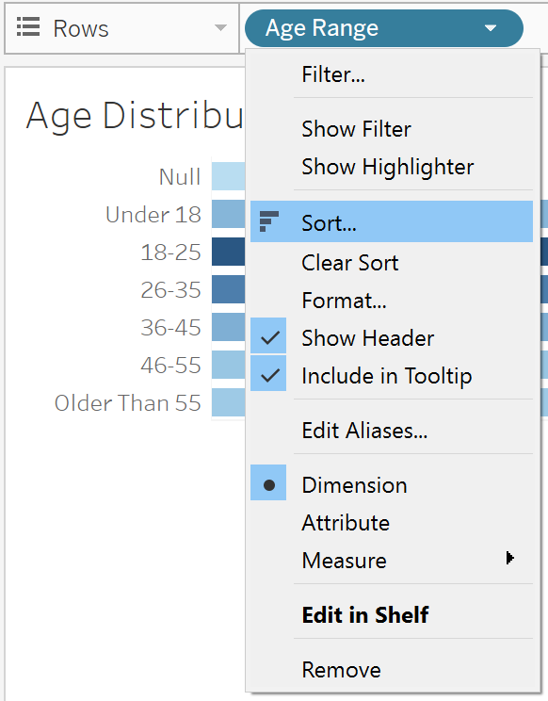
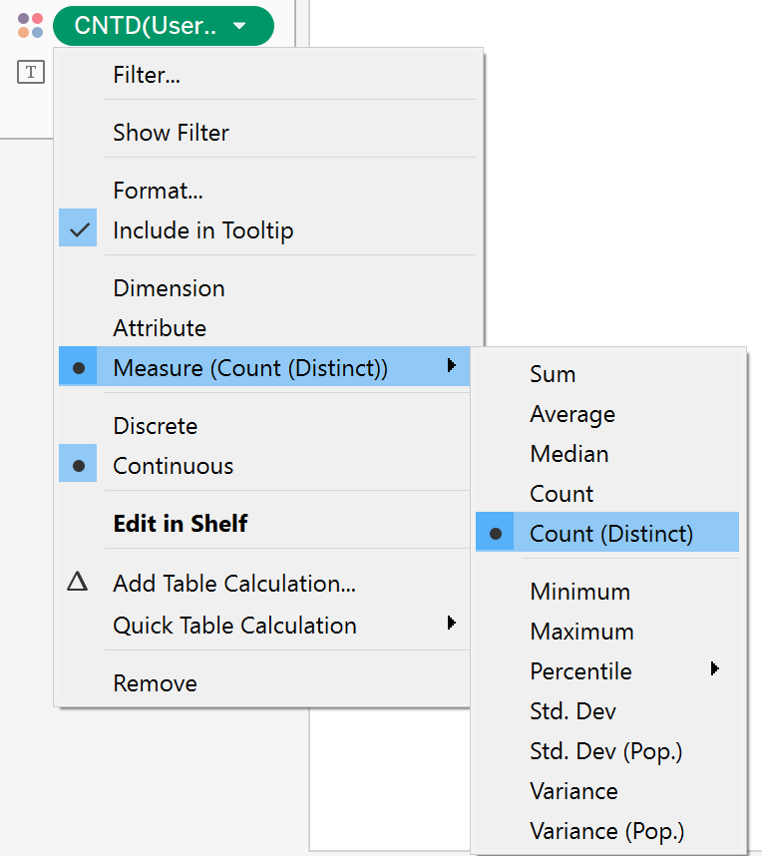
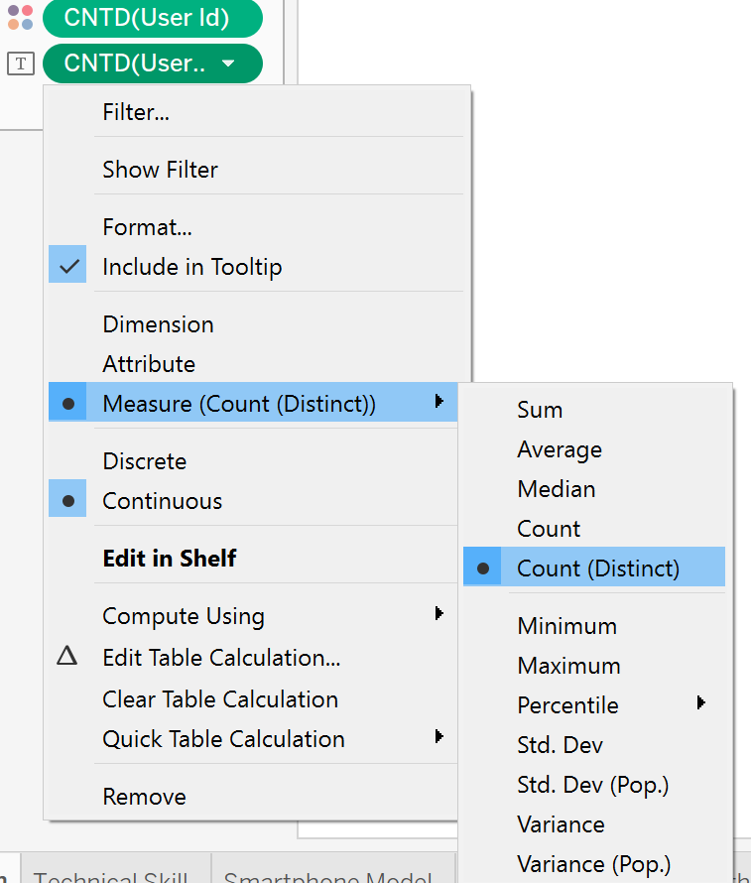
Distribution by Age – Bar Charts w/ Manual Sorting
Drag Age Range to Rows
Drag User_ID to Columns
Change User_ID → Measure → Count(Distinct)
Click Drop Down on Age Range → Sort to sort dimension

Slide 4
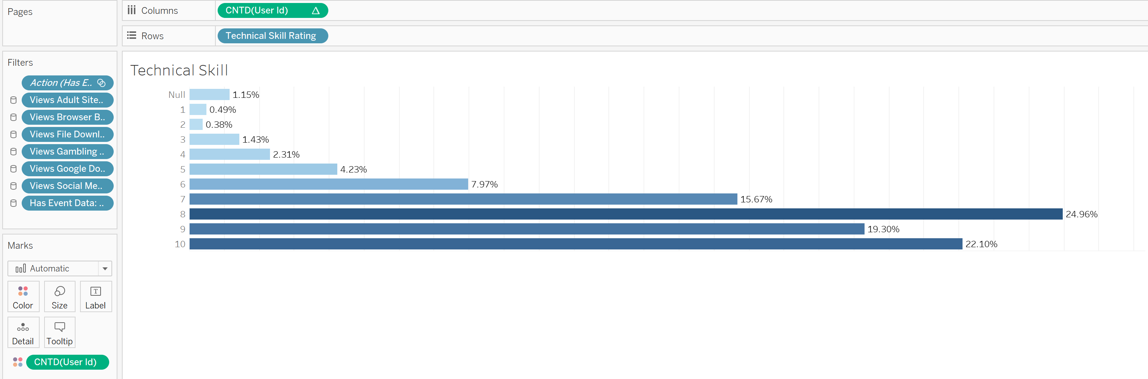
Distribution by Technical Skill – Bar Charts w/ Field Sorting
Same steps as Previous Slide, except with Technical Skill Rating

Slide 5
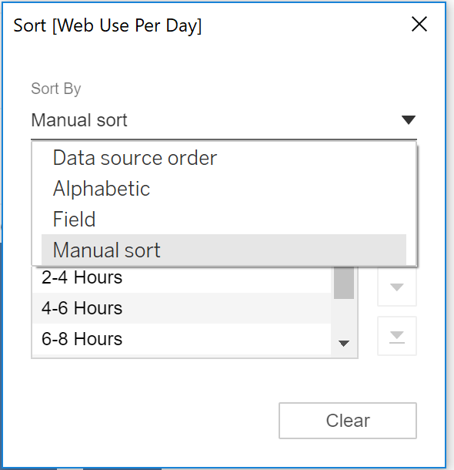
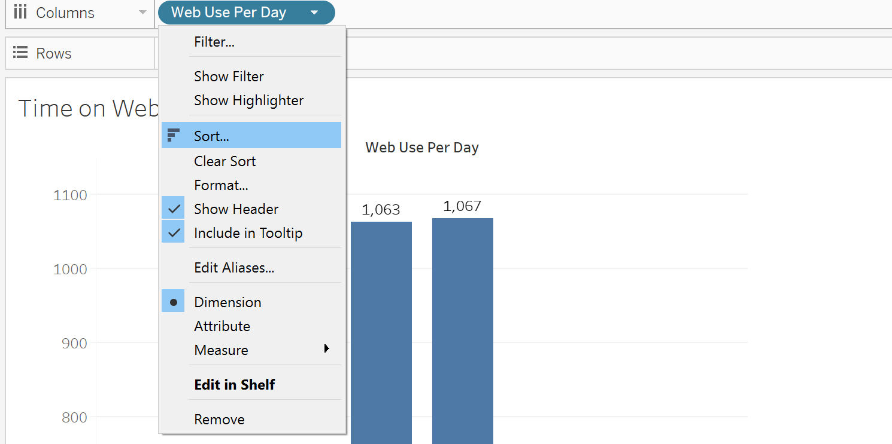
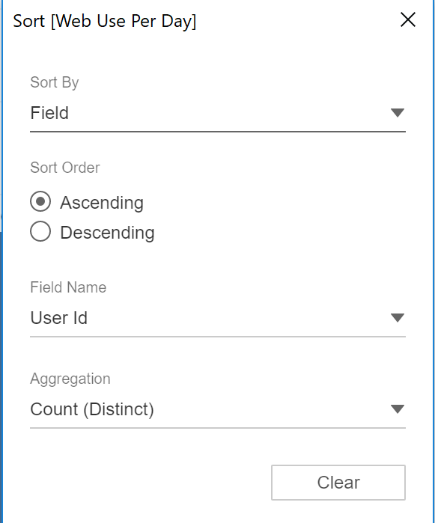
Sorting Data Manually and By Field
Click dropdown on column you want sorted
Choose between sorting manually or based on field
Manually → When there is an inherent relationship from left to right
Field → When there is NO inherent relationship from left to right
MANUAL
FIELD

Slide 6
WHAT – Visualization Guide

Slide 7
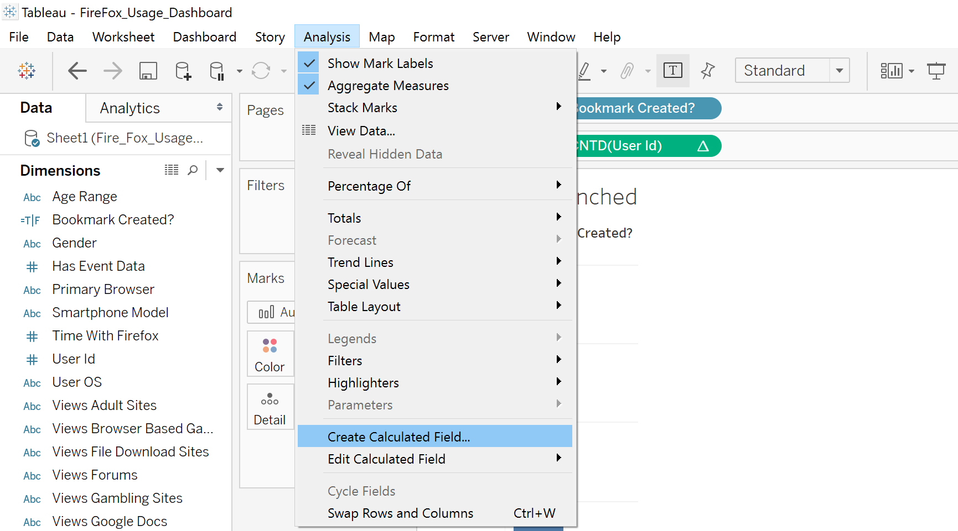
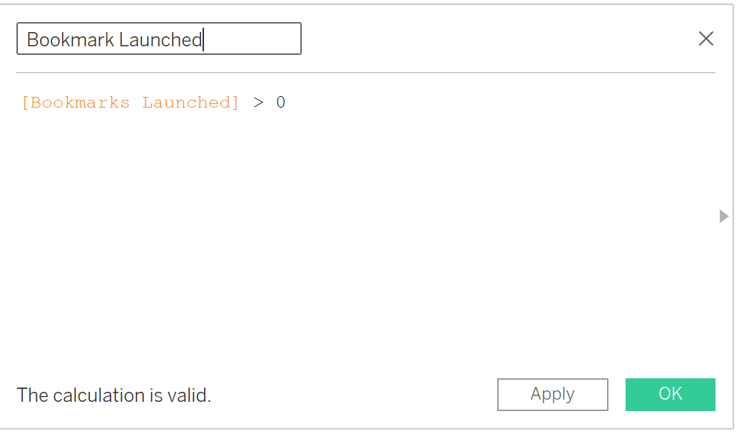
Launched 1 Bookmark – Calculated Fields
Click ‘Analysis’ then click ‘Create Calculated Field’
Type in your calculated field, Tableau provides syntax for support…
See if you can create for More Than 1 Tab…

Slide 8
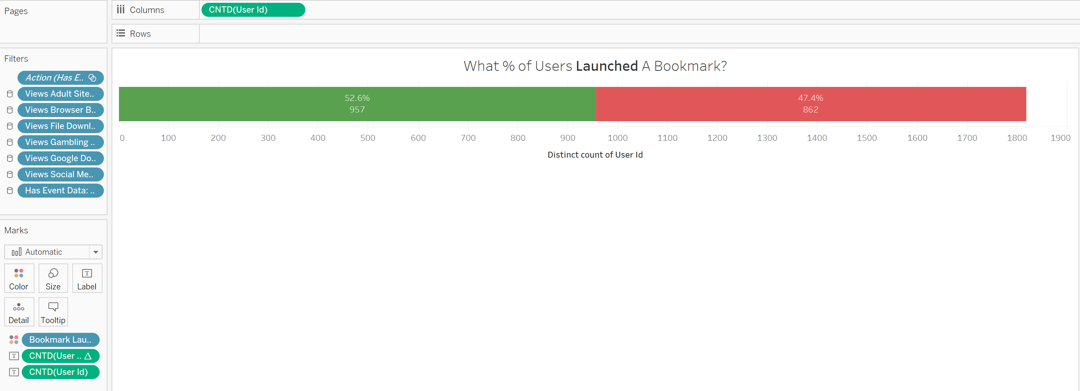
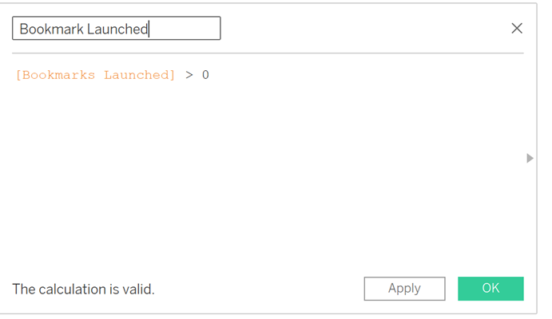
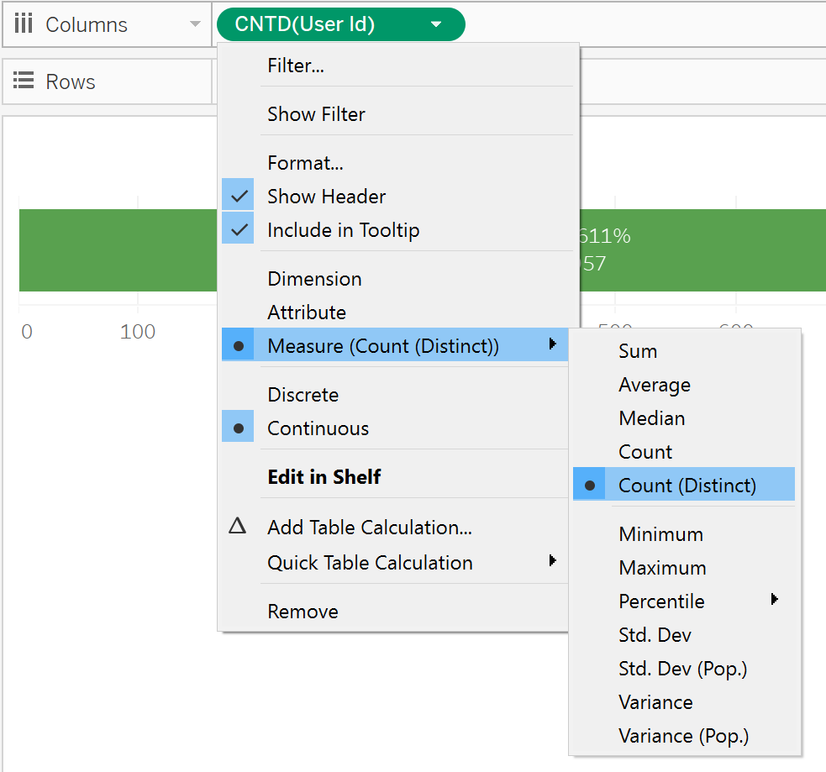
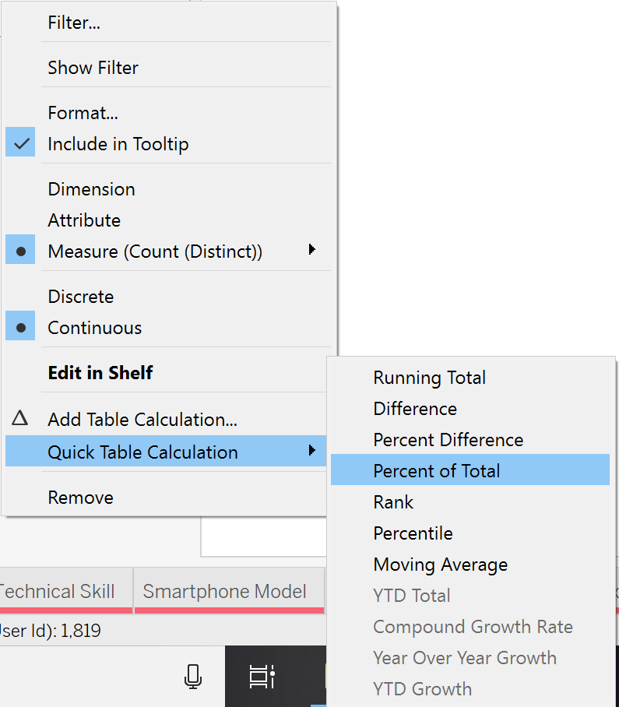
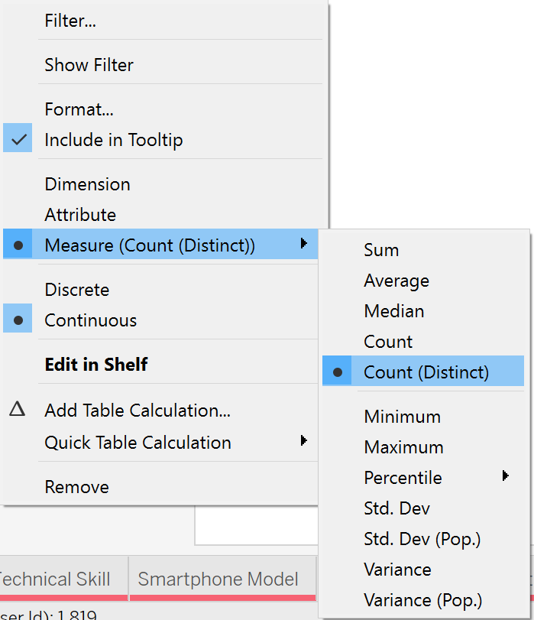
% of Users Who Launched a Bookmark – Template

Slide 9
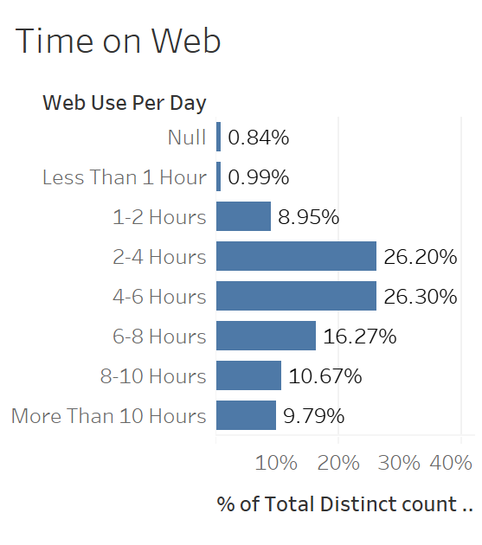
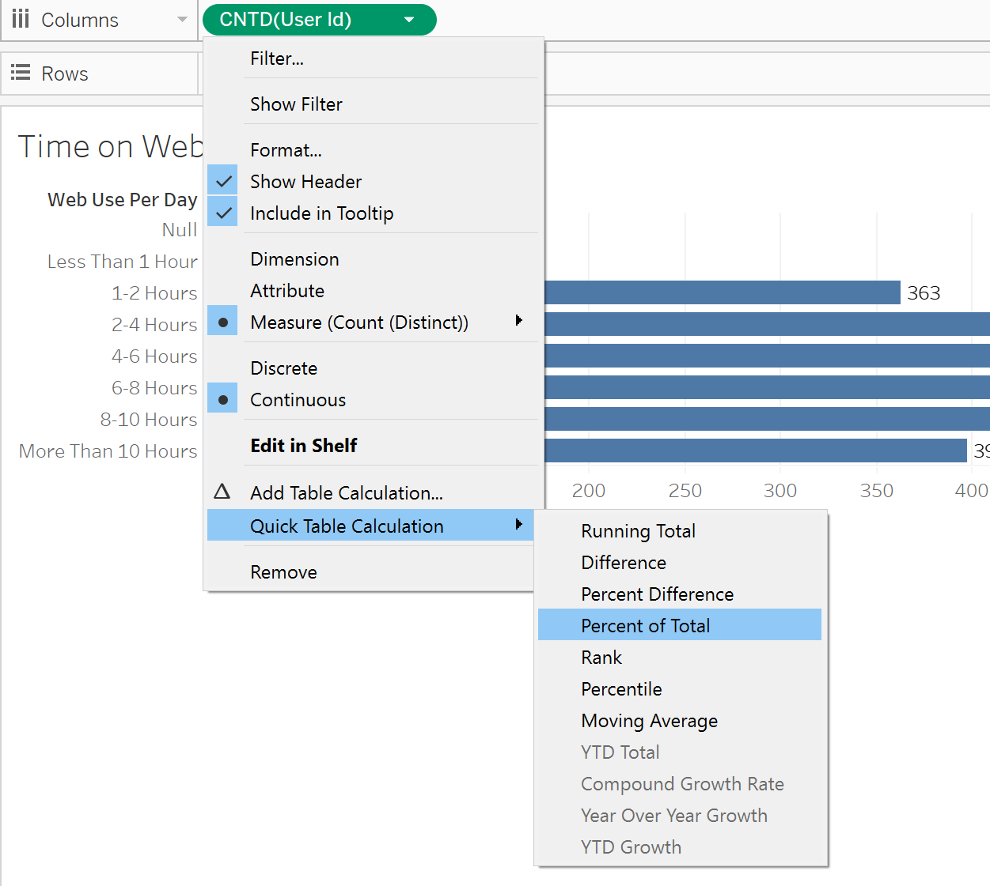
Using a Quick Table Calculation
Click measure you’d like to convert to a quick table calculation
Choose your option….Example is Percent of Total

Slide 10
HOW – Visualization Guide

Slide 11
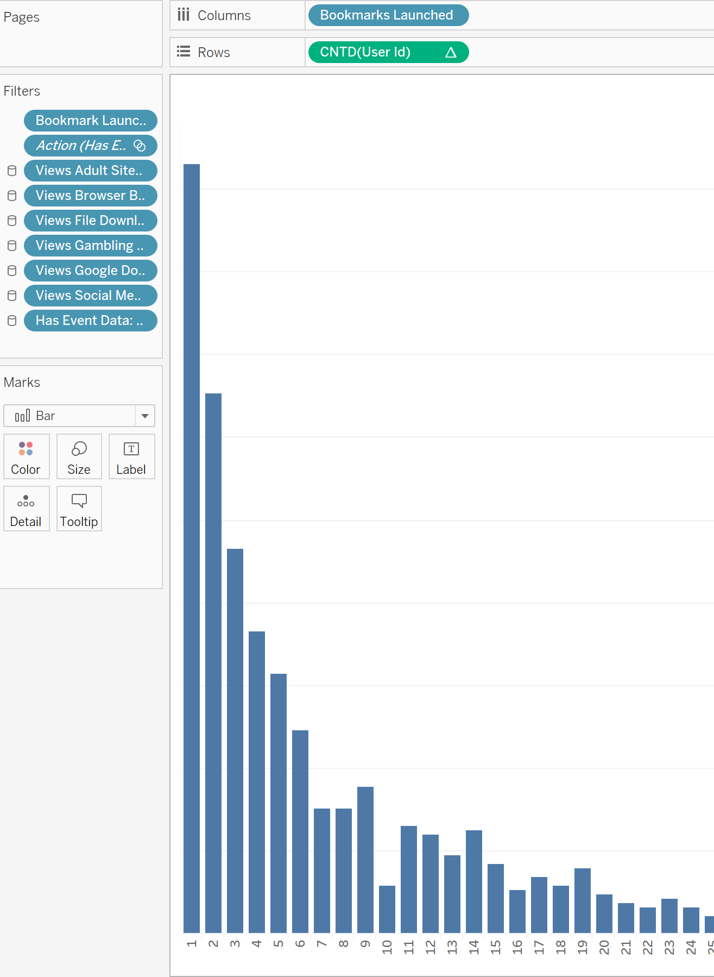
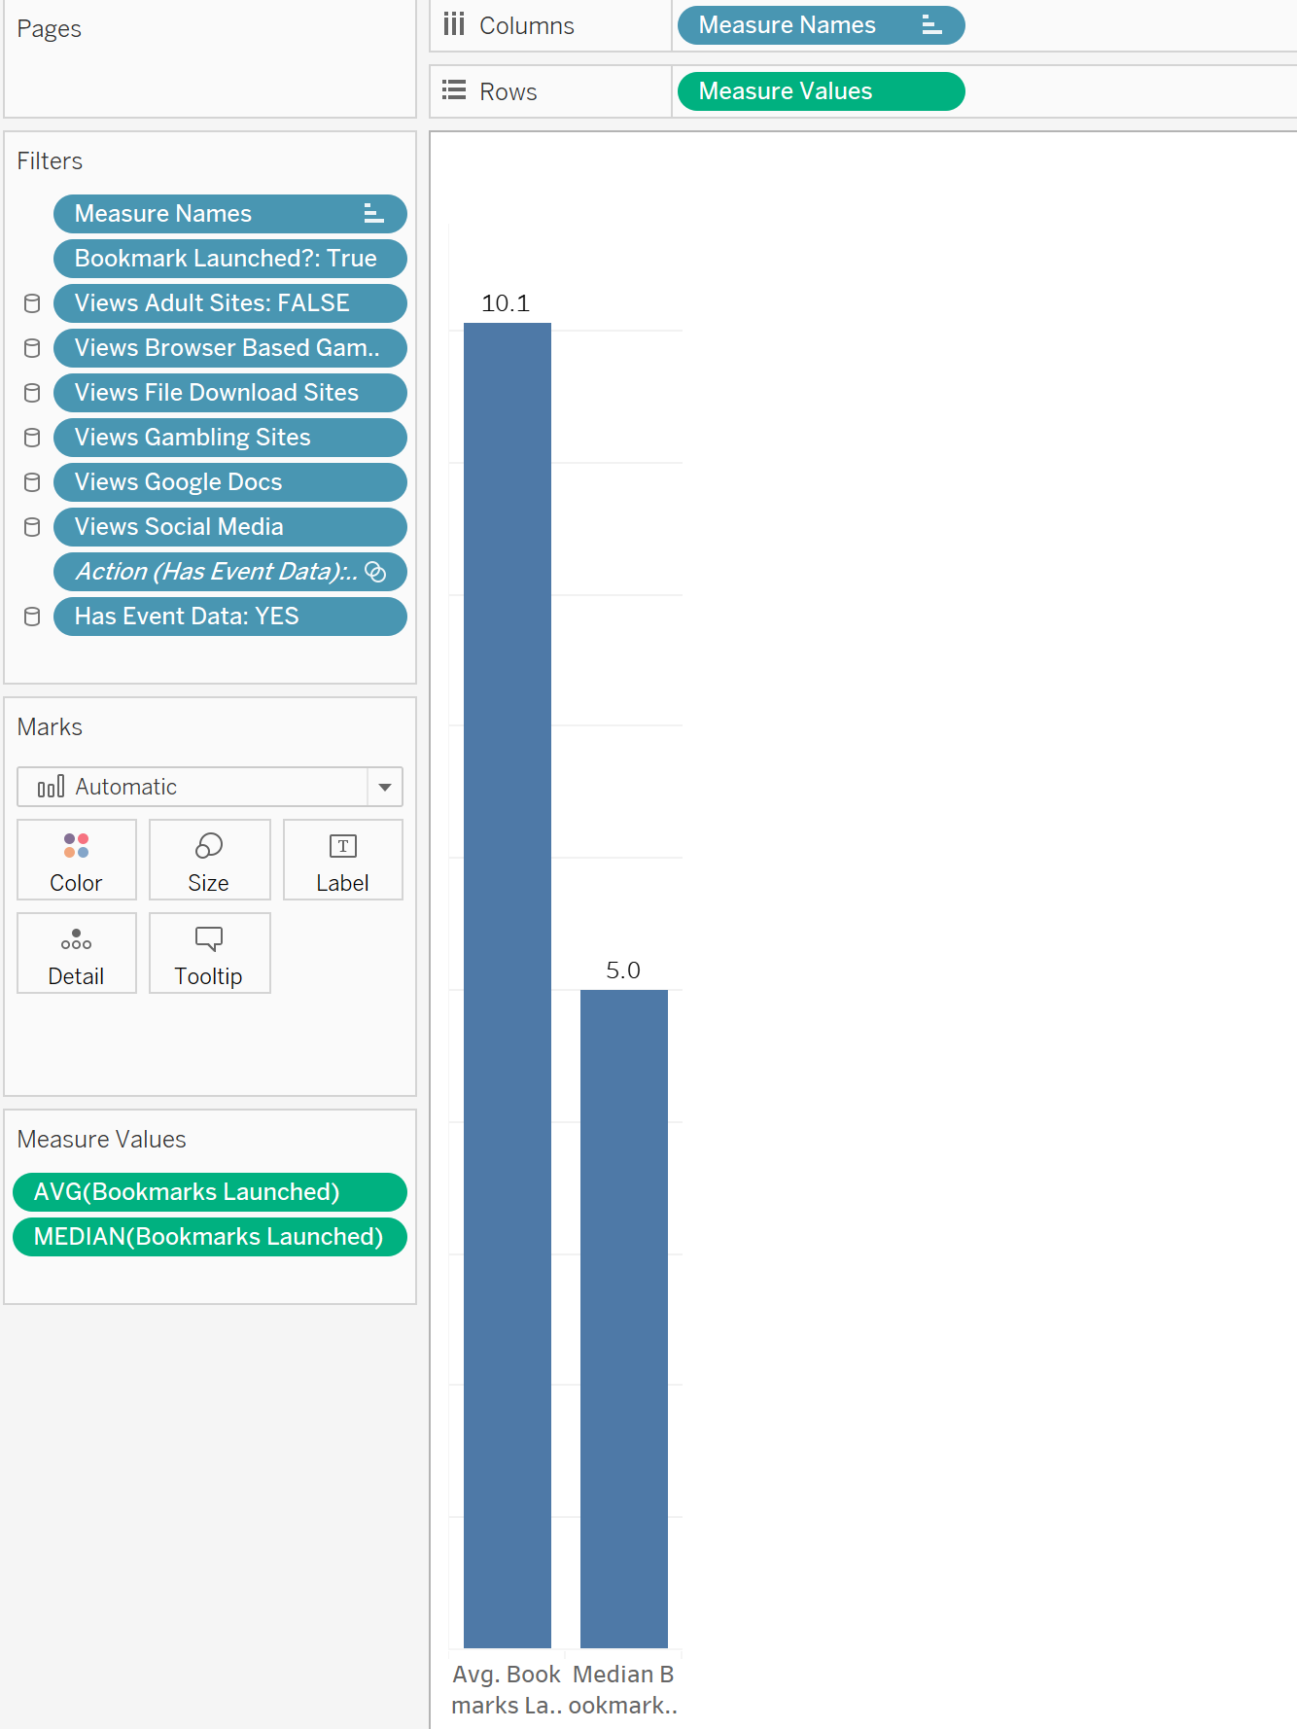
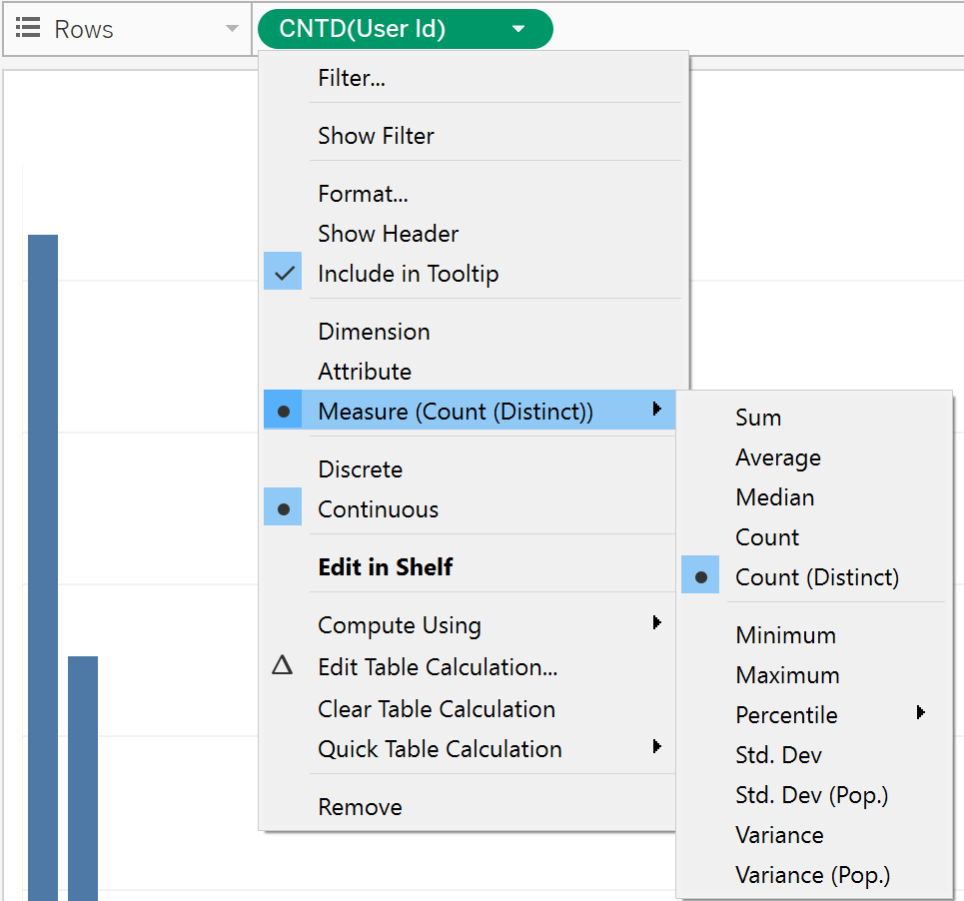
How Many Bookmarks Open and Median and Average – Template

Slide 12
PUTTING IT TOGETHER - Dashboarding

Slide 13

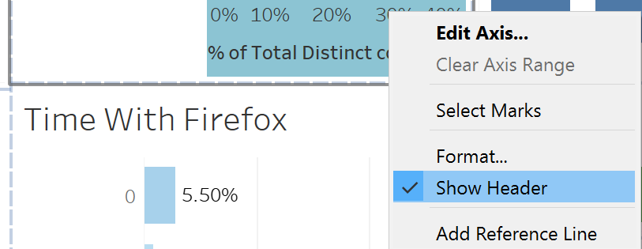
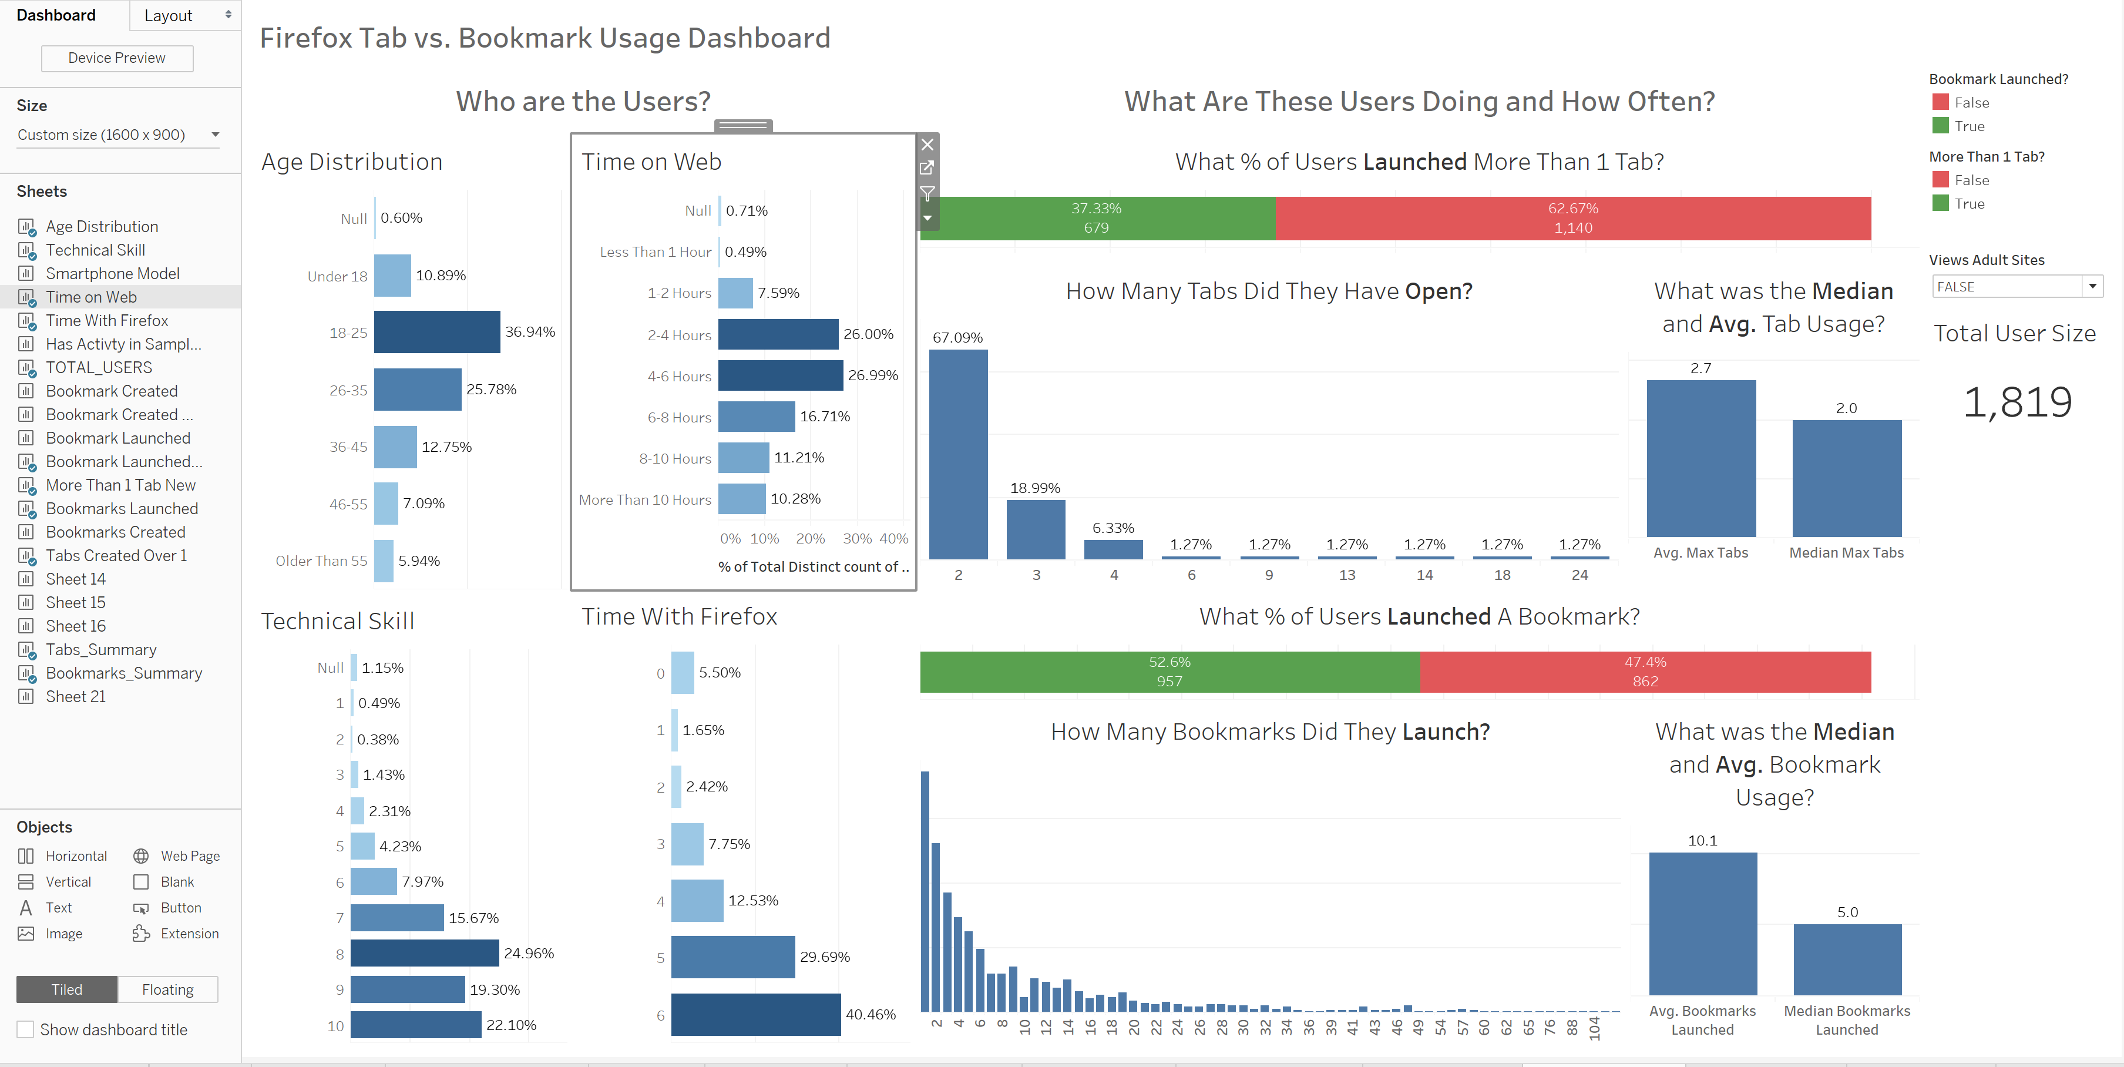
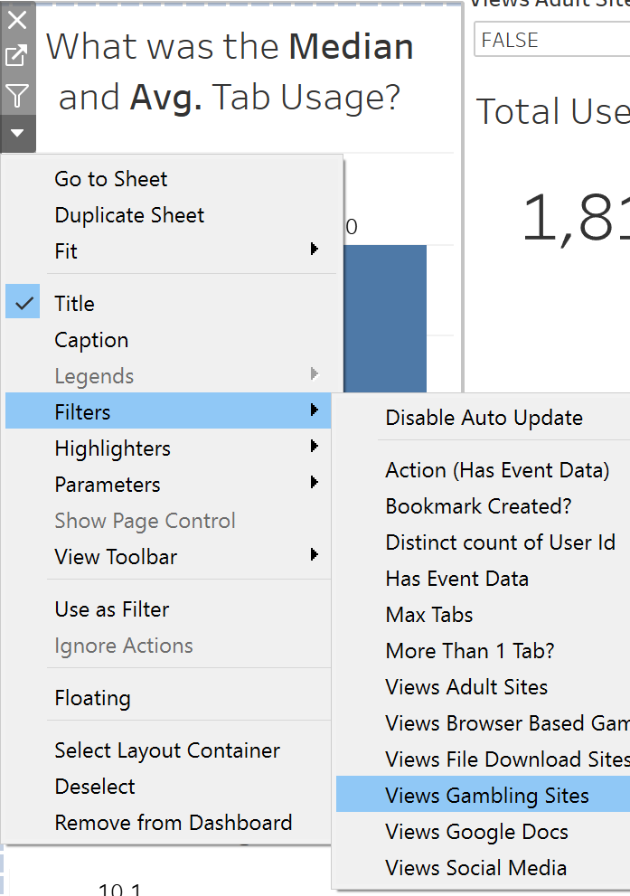
Putting it All Together – Dashboarding
This is the ‘Create Dashboard’ button
Remove “Show Header” on Measure Axis to declutter
Click and drag sheet’s you’d like to see on the dashboard
Can add filters to dashboard by selecting arrow on sheet → Filters → Selecting which to show.

Slide 14
APPENDIX ALL VISUALIZATIONS

Slide 15
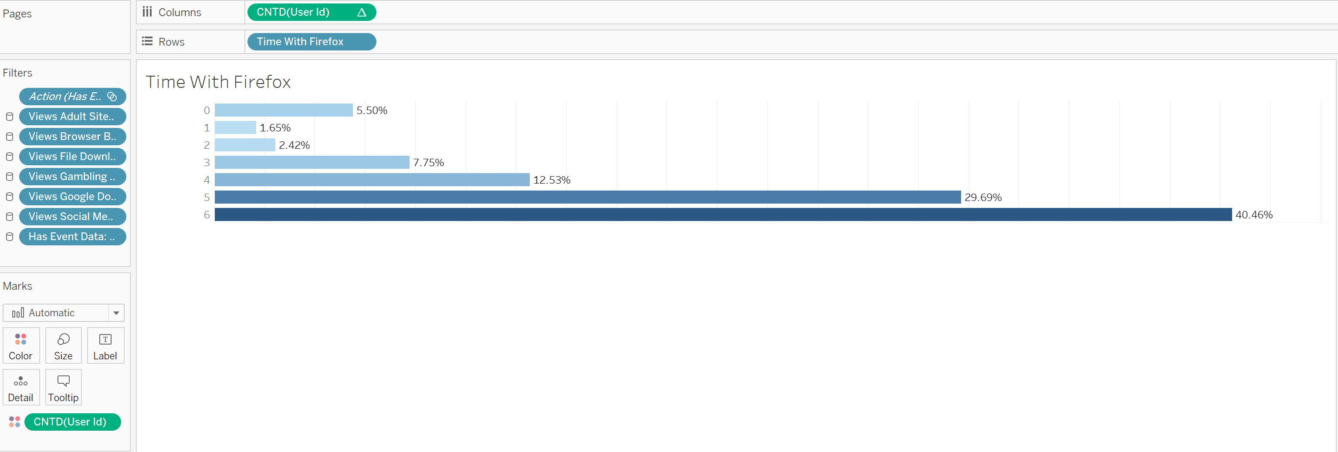
Time with FireFox – Template

Slide 16
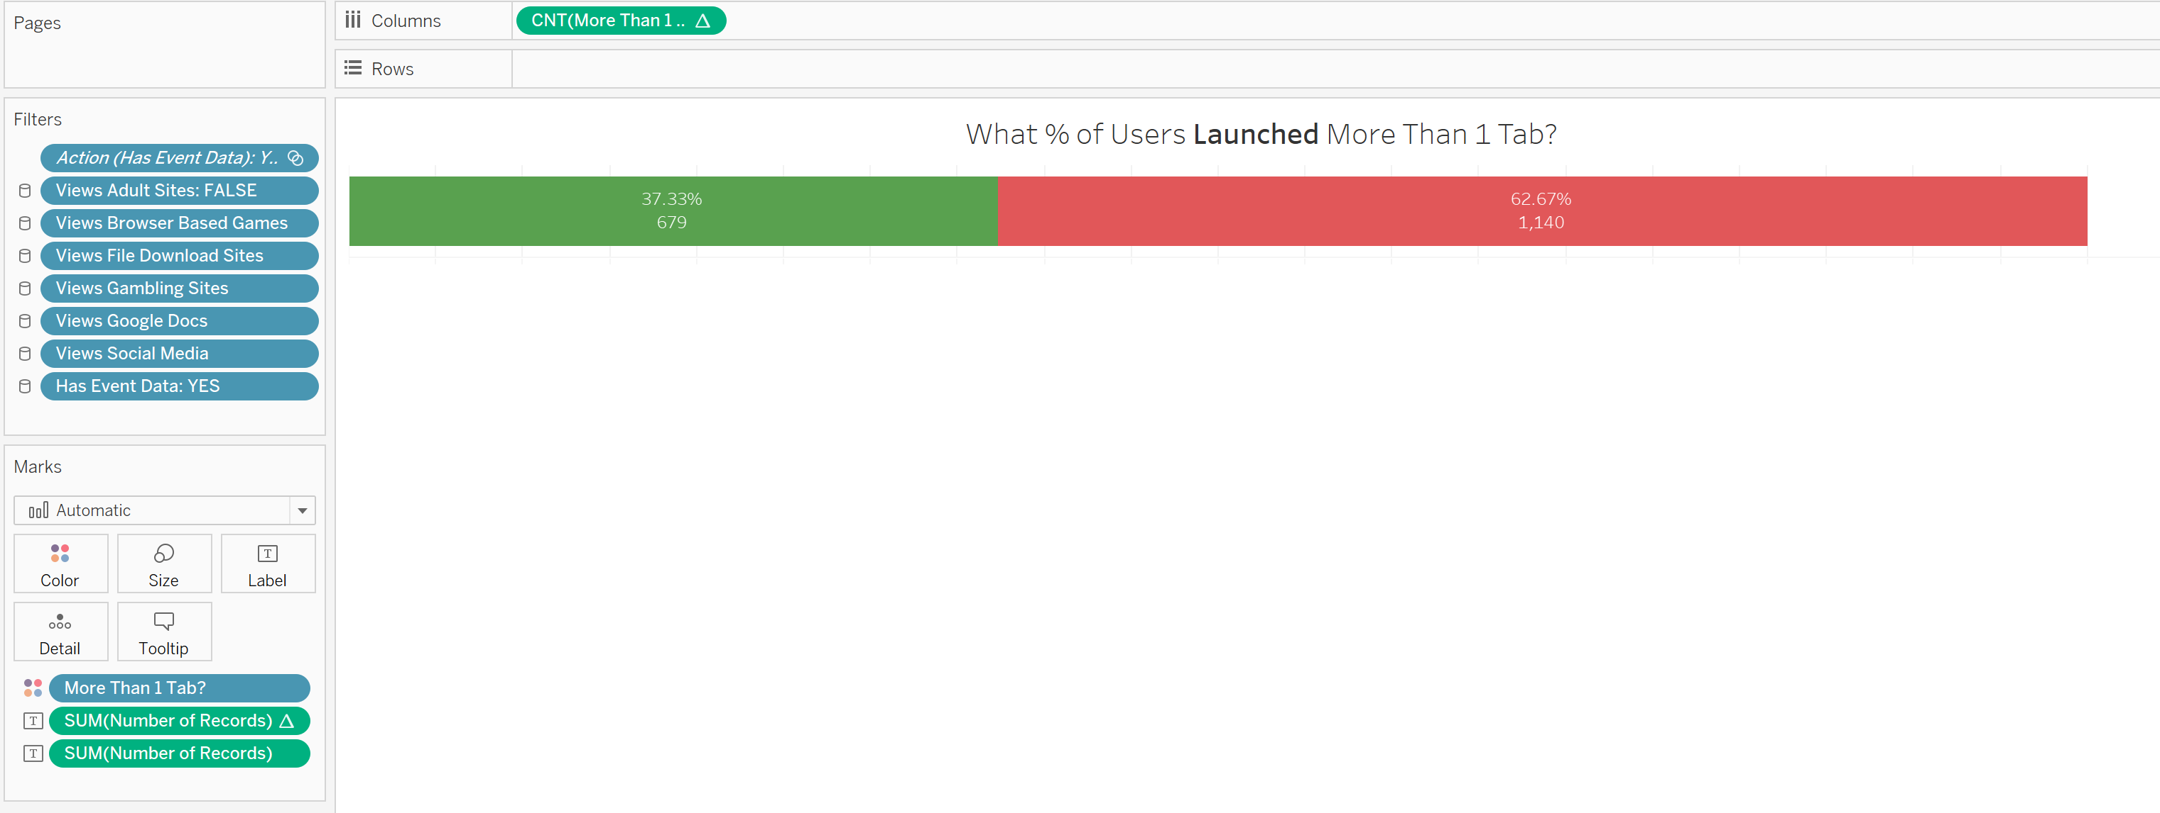
% of Users Who Launched More Than 1 Tab
Same steps as Previous Slide, except with Launched More Than 1 Tab

Slide 17
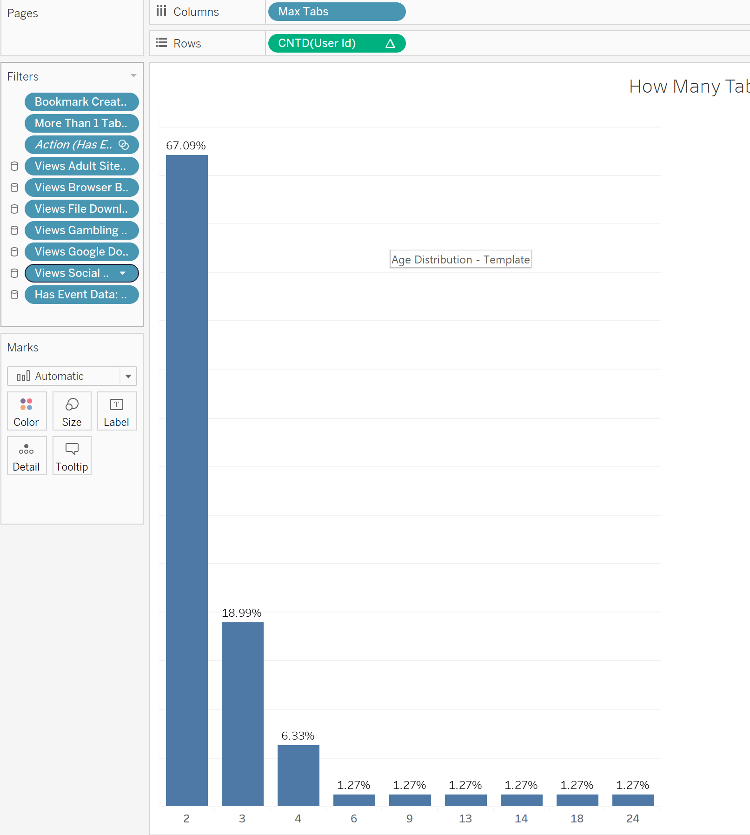
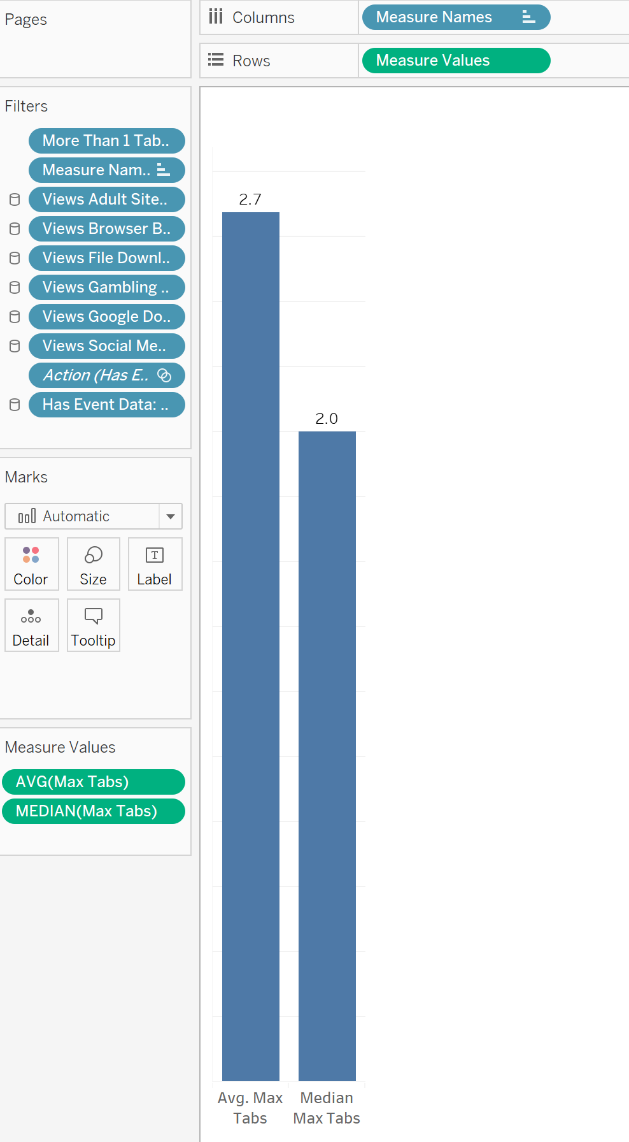
How Many Tabs Open & Median and Average – Template

