Slide 1
Maximum Clique Problem
By: Matthew VanCompernolle

Slide 2
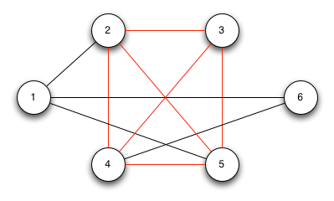
Graph Cliques
A clique is a subset of the vertex set C ⊆ V such that for every 2 vertices in C, there exists an edge connecting the two.
A maximum clique is a clique of the largest possible size in a given graph.

Slide 3
Maximum Clique
The maximum clique problem (MCP) is an NP-hard problem to get even an approximation.
Well suited for finding groups of related objects.
Some applications:
  Patterns in telecommunications traffic
  Computer vision and pattern recognition
  Design of error-correcting codes
  Fault diagnosis on large multiprocessor systems
  Exploit characteristics of social and information networks
  Bioinformatics

Slide 4
Existing Work
No existing

Slide 5
Sequential Implementation
Many different existing sequential implementations, with most being similar.
Found MCP algorithm explanations and code written in Java.
  Plan to convert the best perform implementation to C++, which appears to be the BBMC algorithm from what I have researched so far.

