Slide 1
Speech Translation for U.S. Army Africa
Project Lead: Steve LaRocca
Multilingual Computing and Analysis Branch
Information Sciences Division
Information Sciences Campaign
U.S. Army Research Laboratory

Slide 2
Multilingual Computing and Analysis Branch Speech Translation for USARAF
FY16 Accomplishments/Success Stories:
Tagalog MT built and tested using ARL Tagalog-English data
Restricted amount of parallel text and resources
Experiment predicts Army problem space for MFLTS
Dialect Adaptation effort well underway using GlobalPhone European French data and Kaldi speech recognition development software.
Special in-domain parallel French-English data set for Basic Intel Course to be completed in Q4.
New Tagalog in-domain test set, xxxx segments, yyyyy words
African-accented speech data collection in Libreville, Gabon. Establishment of a new 500 item central African speech data set for use in experimentation in Q1 FY17.

Slide 3
Multilingual Computing and Analysis Branch Speech Translation for USARAF
Project Title: Speech Translation for USARAF
PE/Project/Task Task Title, $Funding for Project from task
R2 FY17 Plans
PE/Project/Task Task Title, $Funding for Project from task
R2 FY17 Plans
Total Funding $xxxxk: $ Mission
PI: S. LaRocca 100% Mission
Research Team: M. Vanni 100% Mission
L. Hernandez 100% Mission
J. Morgan 100% Mission
G. Jahed 100% Mission

Slide 4
Speech Translation for USARAF Problem Space/ Challenges
Given modest amounts of accented speech data, which approaches to adapting existing ASR systems for world language can achieve acceptable performance with African-accented speakers?
Army operations require spoken communications with local populace and with partner militaries, many of whom know world languages but speak with local or regional accents.
In scientific terms, the Army needs a method to adapt technologies for well-studied languages, like French and Arabic, for their use with language sub-populations in Africa.
While this project addresses only a portion of the need to communicate with Africans, who collectively speak thousands of languages, it promotes cooperation with key partners in the fight against terrorist groups in Central and Western Africa.

Slide 5
Speech Translation State-of-the-Art
Pioneered by DARPA’s TRANSTAC program, speech translation system development for a new language currently requires hundreds of hours of transcribed speech at a cost of millions of dollars. High cost prevents the timely development of systems needed by USARAF.
IARPA’s BABEL program recently achieved success using speech data from related languages to develop speech recognition technologies for other languages. African-accented French can benefit from resources for French as a world language, once methods are established and evaluated.
The Army needs spoken language communication capabilities for use with African partners. 21 of the 54 African nations use French as a national language.
Research Questions or Hypothesis to address
How can existing mathematical models of speech and language be adapted to the language behaviors of sub-populations using only modest amounts of new annotated data?

Slide 6
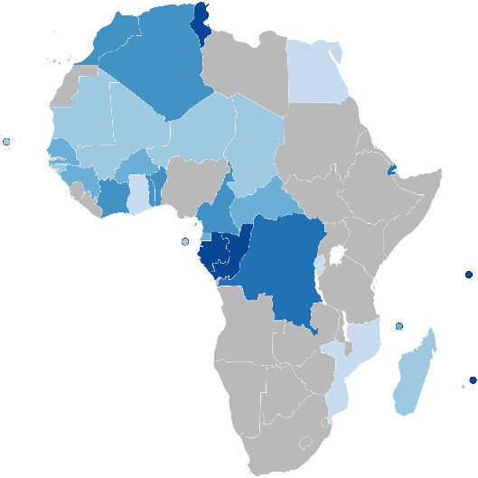
Multilingual Computing and Analysis Branch Speech Translation for USARAF
Research Goal
Goal: Understanding Information --
available as spoken language;
as pronounced by a sub-population of the language community.
FY17 | Q1 | Q2 | Q3 | Q4
Phonetic Model Adaptation
Domain Adaptation
Isoglos Modeling
6.1 6.2 Customer
Total
Milestone Objective or deliverable
6.1
6.2
customer
Intensity of coloration indicates the portion of national populations that speak and use French language.
Impact/Payoff
New capability for small USARAF teams to communicate with speakers of French in central African countries.
The adaptation of spoken language technologies for sub-populations of major language communities is unexplored and highly useful to the Army.
Notes:
Only show Major milestones on this chart

Slide 7
Overall Plan Schedule
 | FY15 | FY16 | FY17 | FY18 | FY19 | FY20
African-accented French recognition for Central Africa Experiment Analysis Model Development Simulation and Predictive evaluation
African-accented French recognition for Western Africa Experiment Analysis Model Development Simulation and Predictive evaluation
African-accented Arabic recognition for Tunisia Experiment Analysis Model Development Simulation and Predictive evaluation
6.1 Funds ($k) 6.2 Funds ($k) Customer ($k)
Total
2
4
Major Deliverable TRL, Transition tan = 6.1, pink = 6.2
2

Slide 8
Multilingual Computing and Analysis Branch Speech Translation for USARAF
Overall Project Approach/Strategy:
Adaptation is a practical alternative to brute force in providing Soldiers a capability to communicate with partners and local populations. In the case of French, a national language used as the language of instruction and business for 21 of Africa’s 54 nations, the adaptation of recognition systems for standard French for sub-populations promises to speed the development of communication capabilities while providing a better understanding of how broadly an African-accented recognition system can be used on that continent.
Technical Barriers:
This project requires that technologists reconsider the level of granularity required in mathematical modeling of human languages. While automatic speech recognition for French as spoken in France may be considered a solved problem, testing conducted by USARAF indicates that available software for French performs poorly when used by African military partners who speak French.

Slide 9
Multilingual Computing and Analysis Branch Speech Translation for USARAF
Campaign: Information Sciences Campaign Plan
Level 2: System Intelligence and Intelligent Systems
Level 3: Information Understanding
Level 4: Natural Language Processing
Level 5: Multilingual Computing for Low-Resource Languages
KCIs & CCEs:
KCI-IS-2 Taming the Flash-Floods of Networked Battlefield Information
CCE-IS-2 Natural Language Processing and Multi-Lingual Computing
KCI/CCE Technical Objectives Impacted:
CCE-IS-2 FY17 Goal (1), Evaluate alternative methods for adapting mathematical models of consonant and vowel sounds for a specific language community in a data constrained environment.

Slide 10
Multilingual Computing and Analysis Branch Speech Translation for USARAF
FY17 Tasks:
Task 1: Experimentally evaluate alternative methods for adapting mathematical models of consonant and vowel sounds for a specific language community in a data constrained environment. In the specific case of adapting an existing French speech recognition system for use by African-accented speakers, compute Word Error Rate (WER) scores for the ARL central African speech data test set on a baseline recognition system and then on adapted systems. (Researchers Morgan, LaRocca)
Task 2: Analyze customer use cases and produce a domain language model. (Researchers Vanni, Hernandez)
Task 3: Develop an isogloss mapping of central African French (Researchers Vanni, Jahed)
FY17 Technical Objectives/Milestones and Metrics:
Task 1: Achieve a target WER reduction of 20% is set for FY 17, along with the establishment of a generalizable algorithm for use in modifying other world language technologies for African-accented speakers.
Task 2: Produce and document a bilingual domain language domain, English-French, for use as training data for a speech translation system to support a specific recurring USARAF mission. Technical Report due Q2 FY17.
Task 3: Produce an estimated isogloss mapping of central African-accented French based on human geography, national boundaries and mother-tongue language substrata.

Slide 11
Multilingual Computing and Analysis Branch Speech Translation for USARAF
FY18 Tasks:
Transition to U.S. Army Africa an improved bidirectional French speech translation system that achieves a 20% WER reduction over an existing baseline system.
Conduct follow-on experimentation on adapting Arabic speech recognition systems with small amounts of North African-accented speech to refine methods and confirm that the ARL algorithm applies to world languages of separate language families.
Using Tunisian-accented Arabic data as a surrogate for Libyan data, achieve a WER reduction of 20% over a baseline Arabic system not specific to Africa
FY18 Technical Objectives/Milestones and Metrics

Slide 12
Speech Translation Deliverables and Collaborations
FY17 Deliverables:
A deliverable is a product of an objective or set of objectives. May also be a defined product from a TPA or other collaborative agreement, customer, etc
FY17 Technology Demonstrations or Validation Experiments
If applicable
Collaborations and Related Work:
Quantitative metrics
Measure | Target | % confidence
Journal publications
Conference publications
ARL Tech Reports
Patents

