Slide 1
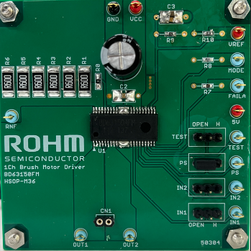
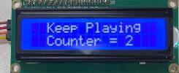
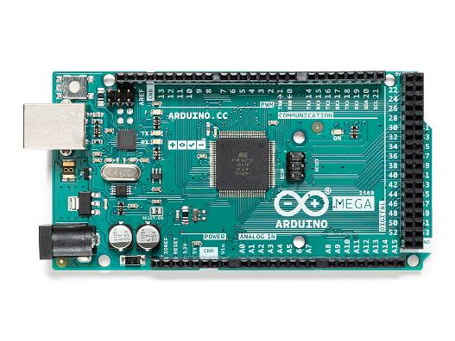
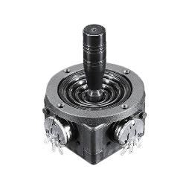
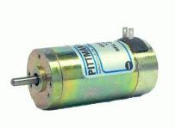
Direct connect Diagram
10 = PWM for Servo
9 = PWM IN1 (evk)
8 = PWM IN2 (evk) 7 = left limit (H = hit, L = not hit)
6 = right limit (H = hit, L = not hit) *7,6 (pulled up to 5V by Arduino)
5 = ball in cup (H = in cup)
4 = GND this to make SELF TEST work (when using “_servo_selftest.ino”)
DCDC: BD9E202FP4-EVK-001 (12V to 5V) BD9E304FP4-EVK-002 (24V to 12V)
24V
Vref has onboard divider
5V
5V
20=SDA
21=SCL
Right
Left
BD64950EFJ EVK
IN2 IN1
Laptop
**
No laptop,
Need VCC: 9-12V
A0
GND
5V
5V
(**)Connect motor to EVK for correct left-right joystick = left-right cup

Slide 2
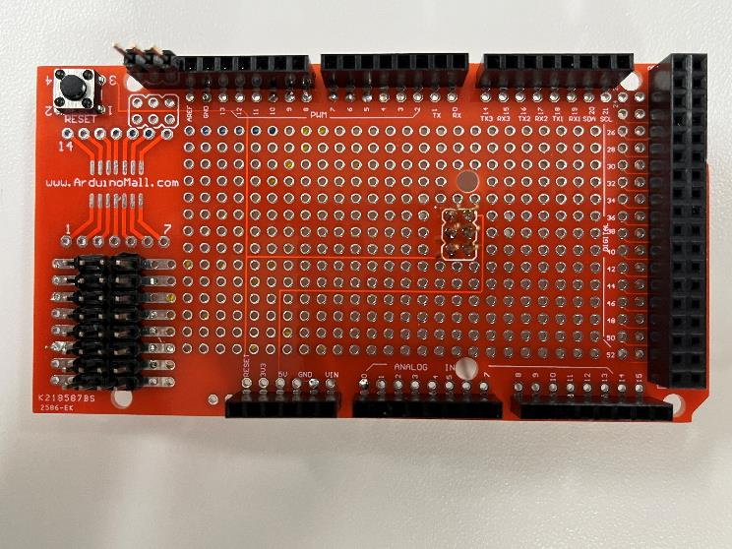
ProtoShield connect Diagram
Pin-10 (Servo) | 5V | ND | x
Pin-9 (PWM1) | 5V | GND | x
Pin-8 PWM2 | 5V | GND | x
x | 5V | GND | Pin-7 (Left Limit)
x | 5V | GND | Pin-6 (Right Limit)
Pin-5 (opto) | 5V | GND | x
 | 5V | GND | A0 (Joystick)
SCL (lcd) | 5V | GND | SDA (lcd)

Slide 3
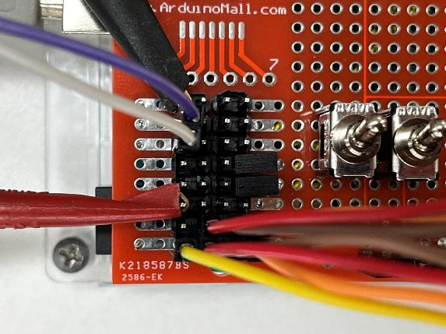
About “dip switches”
These dip switches are to “simulate” the limit switches.
Position:
Down = pin-6 or pin-7 is grounded (ie. Limit is simulated engaged)
Up = pin-6 or pin-7 is floating (when connected to actual jig, the dip switches should be in “up” position
L-LIM
R-LIM
UP
DOWN

