Slide 1
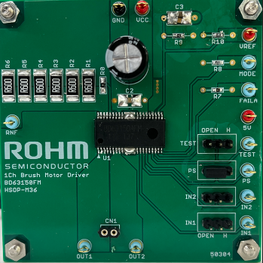
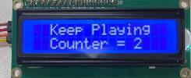
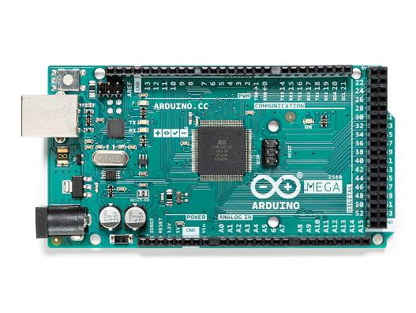
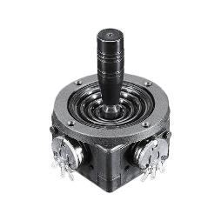
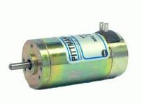
Diagram: Basic joystick + motor rotation + limit switch + ball in cup detection
10 = PWM for Servo
9 = PWM IN1 (evk)
8 = PWM IN2 (evk) 7 = left limit (H = hit, L = not hit)
6 = right limit (H = hit, L = not hit) *7,6 (pulled up to 5V by Arduino)
5 = ball in cup (H = in cup)
24V
Vref has onboard divider
5V
5V
20=SDA
21=SCL
Right
Left
BD63150FM EVK
IN2 IN1
Laptop
**
No laptop,
Need VCC: 9-12V
A0
GND
5V
5V
(**)Connect motor to EVK for correct left-right joystick = left-right cup

