Slide 1
Δ
ma
x
Δ
p
re
st
re
ss
Sa
mp
l
e
i
n
Pre
st
re
sse
d
Ma
g
n
e
t
i
ze
d
mi
n
i
mi
ze
d
e
n
e
rg
y
sa
mp
l
e
sa
mp
l
e
st
a
t
e
(A)
(B)
(C
)

Slide 2
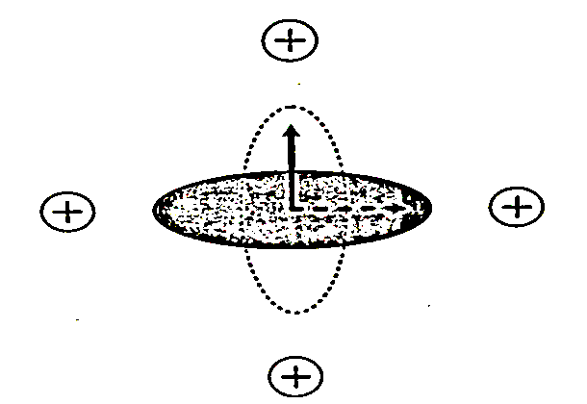
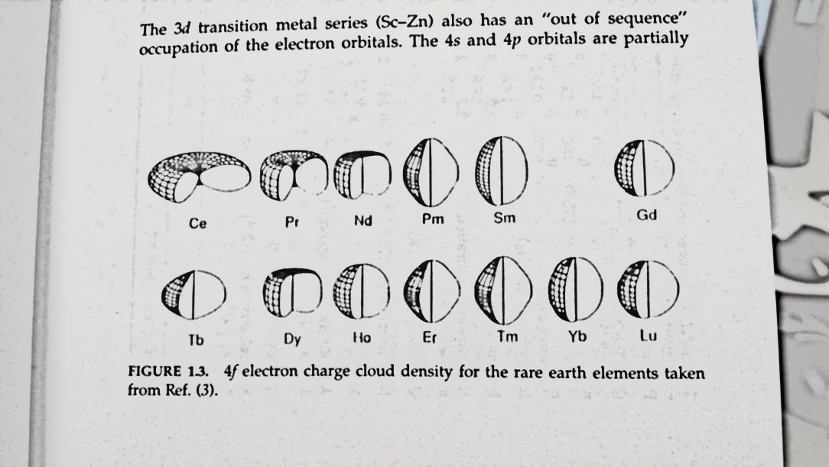

Slide 4
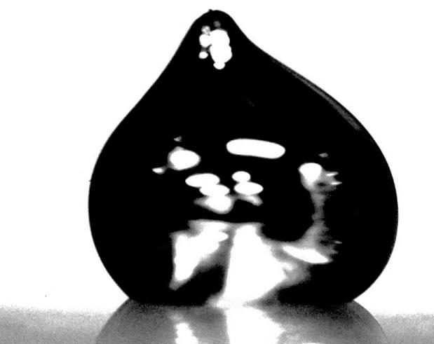
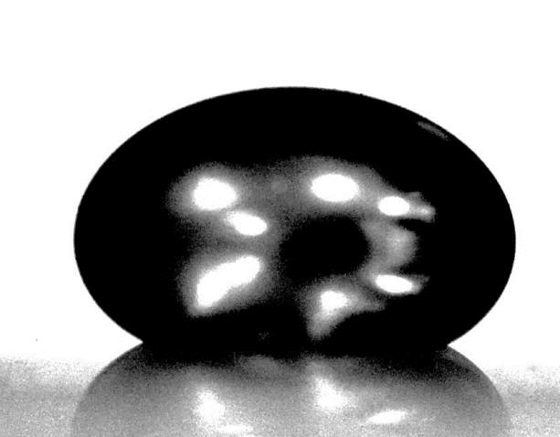
131.0°
140.1°
Glass
Glass

Slide 5
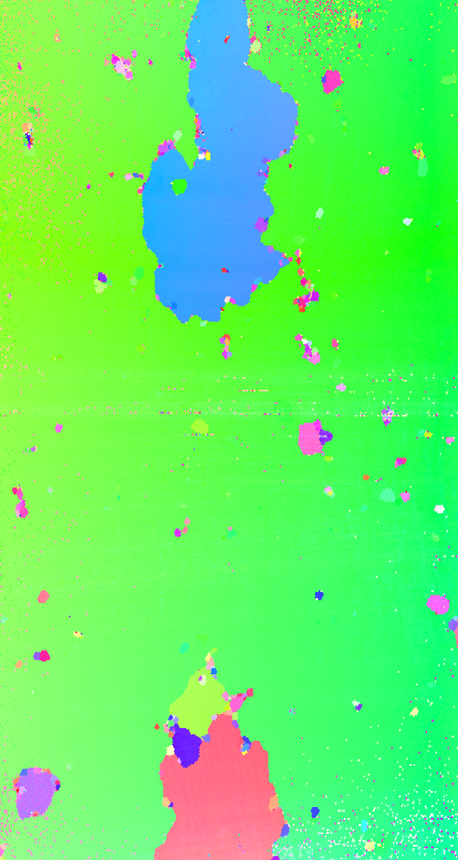
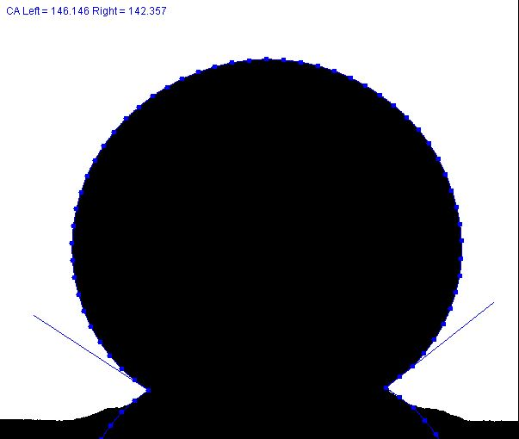
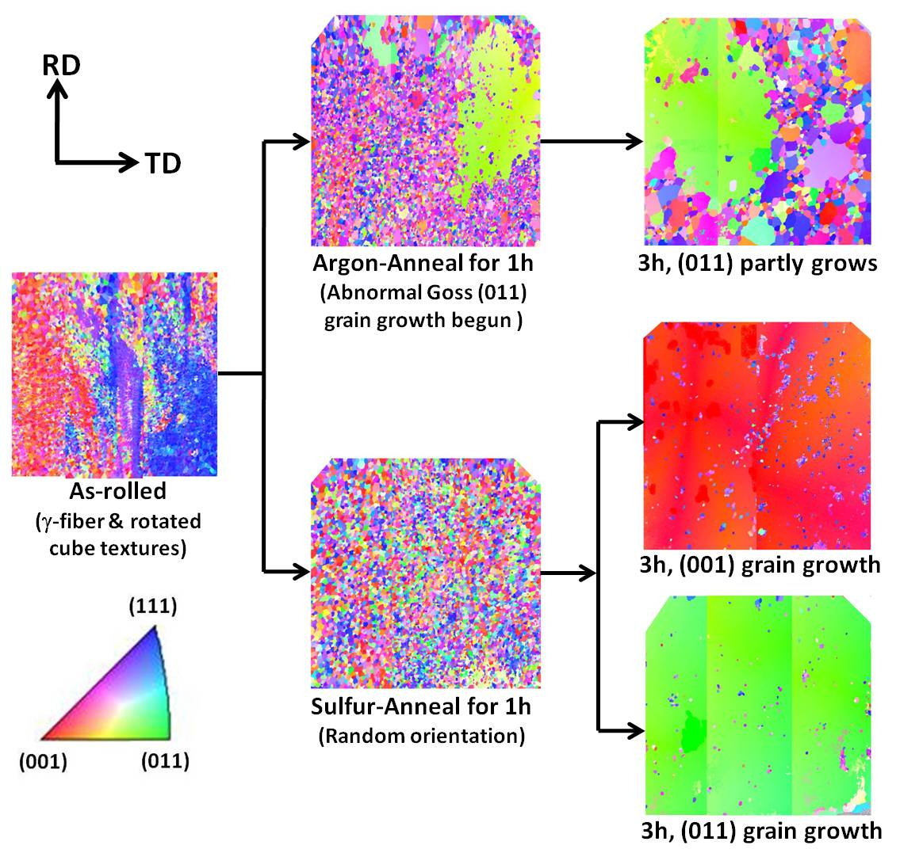
40.0°C
4.2 mm
~1.6 mm
2 mm

Slide 6
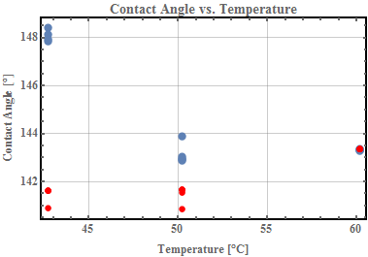
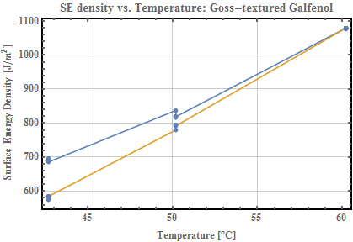
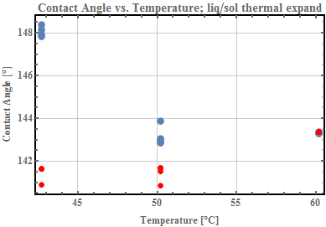

Slide 7
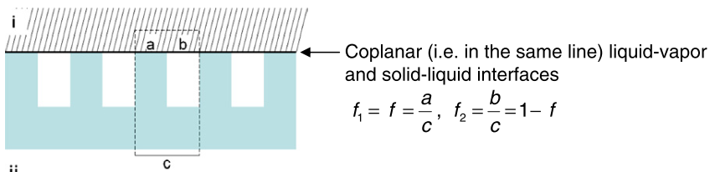

Slide 8
{110}<001> Goss texture
{100}<001> Cube texture
[010]
[100]
(110)
(100)
[100]
[110]
[001]
[010]
[001]
Rolling
Direction
Rolling
Direction
= Axis of easy magnetization

Slide 9
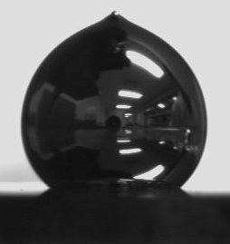
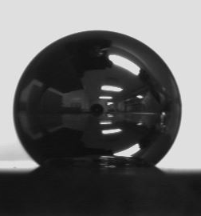
131.0°
140.1°
Galfenol
Galfenol

Slide 10
γ
γ
Liquid Gallium
SV
LV
θ
γ
Metal Grain
SL

Slide 11
