Slide 1
TrackSim – Railway Simulator

Slide 2
About
Provides a framework for building a Railway simulator
Main Features
  Railway Editor: friendly UI for adding/modifying railway components such as: TrackPoints, Segments, Trains, Routes and texts
  Scripting Simulator: the actual simulation is written in Python scripts. Framework provides easy interface between python and UI in runtime.

Slide 3
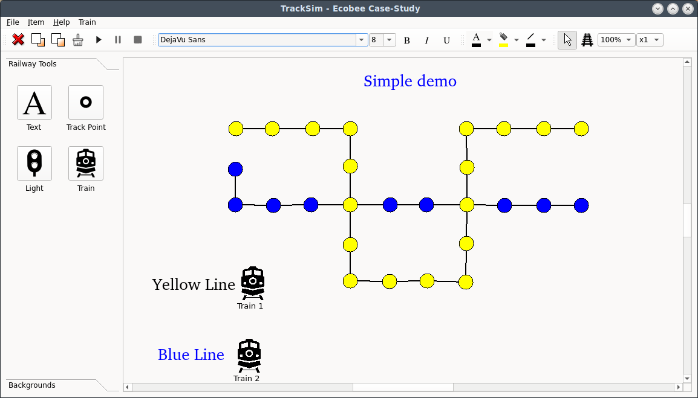
TrackSim UI

Slide 4
UI Controls
Add/Move/Delete: TrackPoints, Segments, Trains and Text
Create routes for trains
Set colour for most components: TrackPoint, Segments and Texts
Set view grid and zoom
Save/Load railways in JSON format
Launch Simulation
Dynamic interactions with simulator: toggle light signals
Control Simulation: pause, stop and speed

Slide 5
Demo Time
Editing
Save/restore
Run test.rlw
  Pause
  Manual signal toggle
  Speed change
  Route change Yellow termination/collision
Run collision.rlw (reverse route)
Show flexibility: run blink

Slide 6
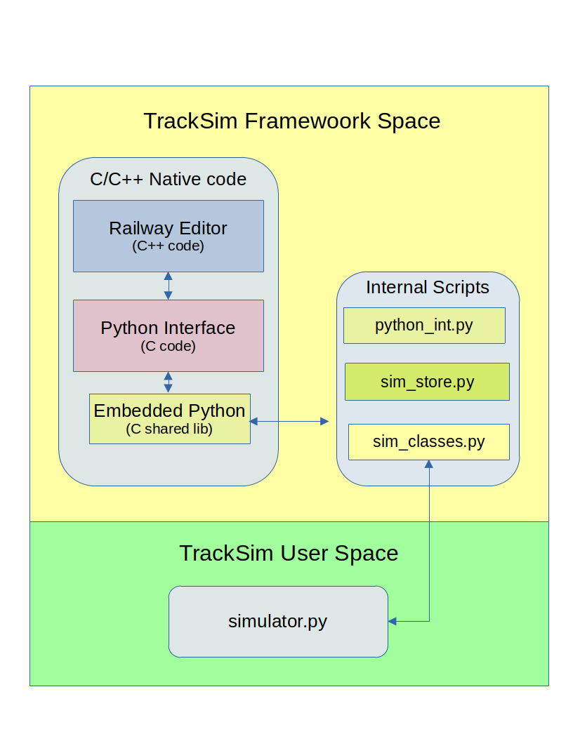
TrackSim Architecture

Slide 7
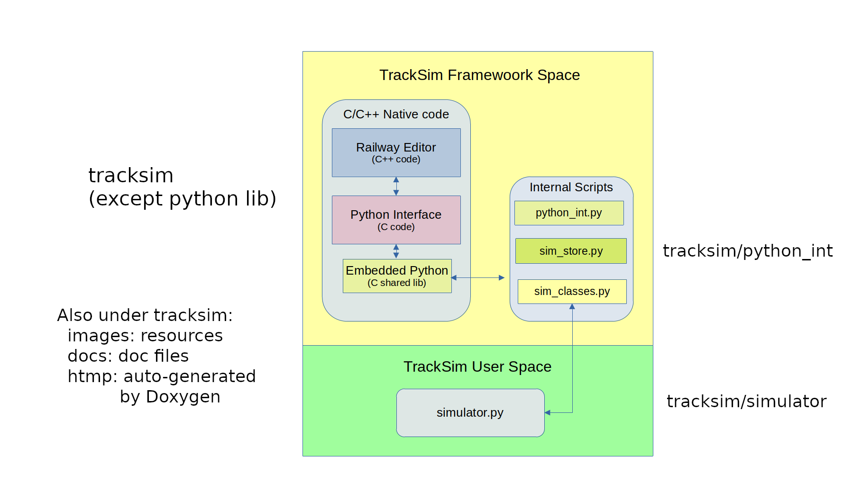
Directory Structure

Slide 8
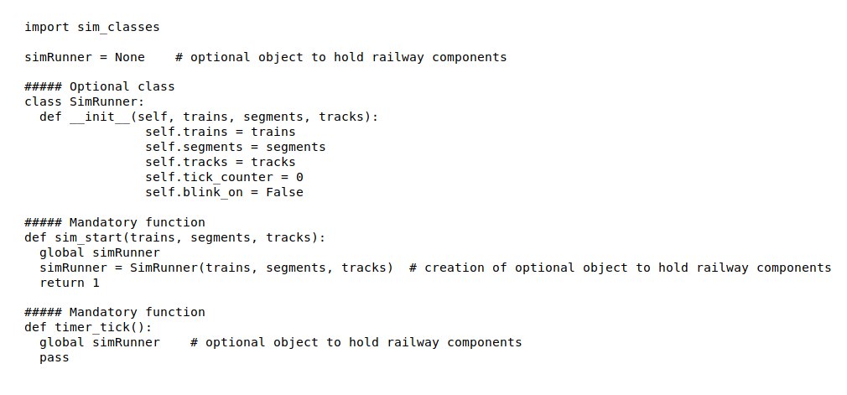
Minimum (void) Simulator Implementation

Slide 9
Project location
Location:
  https://github.com/mvaranda/tracksim
Build/Run: in github main page, or:
  https://github.com/mvaranda/tracksim/blob/main/README.md
Auto-generate documentation for code:
  Run doxygen in a bash under tracksim directory.
    To install doxygen (Debian/Ubuntu):
      Sudo apt install doxygen

Slide 10
Q&A
Live Q&A
Further questions: please send your question to m@varanda.ca

