Slide 1
Airbnb
IT Talents – season 12
Maria Vardzhieva & Kostadin Marinkov

Slide 2
Main functionality
User
Property
Booking
Register
Login
Logout
Edit profile
Delete profile
Get profile by user id
Get user with the most bookings
Get user who earned the most money
Add
Edit
Delete
Get by property id
Get all
Find nearby property
Filter properties
Add
Get by booking id
Get upcoming bookings
Get current bookings
Get finished bookings
Cancel booking

Slide 3
Main functionality
Review
Rating
Media
Add
Edit
Delete
Get all by property id
Add
Edit
Delete
Find all by property id
Find average rating by property id
Upload
Download
Get all by property id
Get all
Delete by media id
Delete all by property id

Slide 4














Used Technologies
JPA
Lombok

Slide 5
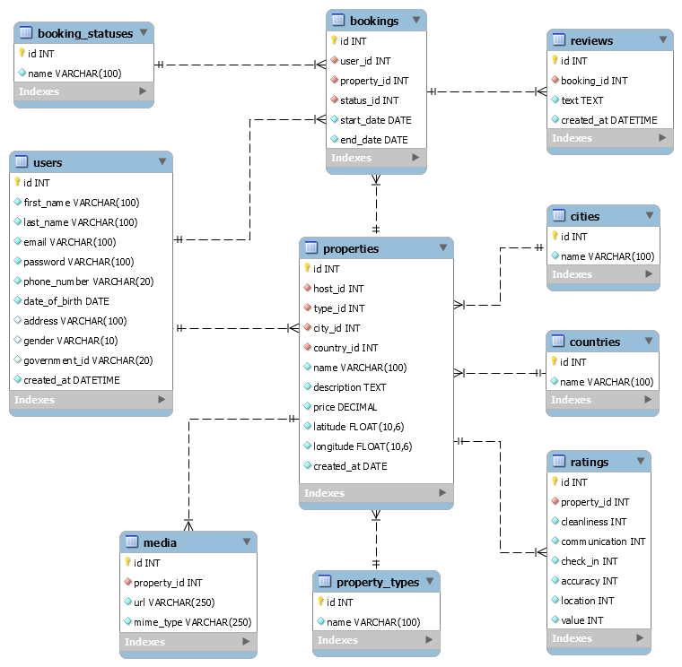
Database Diagram

Slide 6
Class diagram
Pojo
Repository
DAO
DTO
UserRepository
PropertyRepository
BookingRepository
ReviewRepository
RatingRepository
MadiaRepository
CityRepository
CountryRepository
PropertyTypeRepository
BookingStatusRepository
UserDAO
PropertyDAO
BookingDAO
PropertyMapper
UserDTO – 5
PropertyDTO – 4
BookingDTO – 1
ReviewDTO – 2
RatingDTO – 1
ExceptionDTO – 1
User
Property
Booking
Review
Rating
Media
City
Country
PropertyFilterSQLQuery

Slide 7
Class diagram
Controller
Service
Service - interfaces
Util
UserService
PropertyService
BookingService
ReviewService
RatingService
MadiaService
LocationService
UserServiceImpl
PropertyServiceImpl
BookingServiceImpl
ReviewServiceImpl
RatingServiceImpl
MediaServiceImpl
LocationServiceImpl
BookingStatusTypeConverter
Validator
UserController
PropertyController
BookingController
ReviewController
RatingController
MediaController
BookingStatusController
AbstractController
SessionManager

Slide 8
MVC
DTO
DAO
Design Patterns
Builder
Singleton

Slide 9
DEMO

Slide 10
Questions?

Slide 11
Thank you!

