Slide 1


Ice cream-project

Slide 2
Who are we?
Vasil Stanchev
Mentor: Panayot TSENKOV
Martin Atanasov
Emil Ribarev
Plamen Petkov

Slide 3
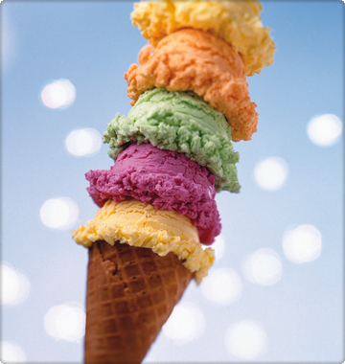
Resume
Imagine a hot summer day. Outside is boiling. You need something to cool down. You are so tired and can't go to the shop to buy ice cream. So you decide to order ice cream.The easiest way is using our program. We have so many different flavours of ice cream and many different types of cones to choose from.

Slide 4

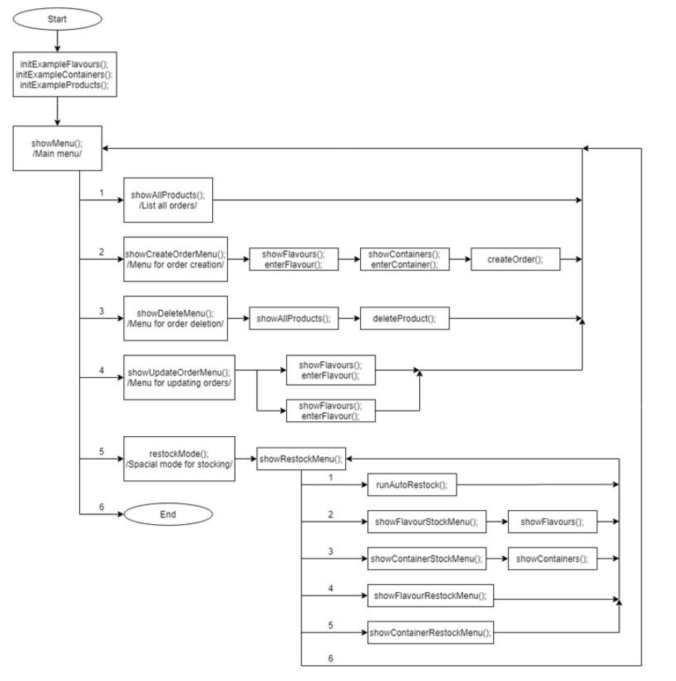
menu flowchart
A simplified flowchart of the ICECREAM

Slide 5




Used programming language and programs
Programs:
Visual Studio- that is the IDE where we wrote the code
Git hub- this is the platform for committing and keeping the code
Microsoft Teams- we used it for calls, collaboration and studying

Slide 6
improvements
For future development can be added more flavours, cones, etc.
Ice cream fillings can be added.
Option for other languages
Login menu

Slide 7



