Slide 1
Inheritance And Templates

Slide 2
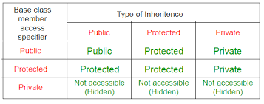
Inheritance (continue)

Slide 3
Problem 1: Create Point3dColor class with Color property

Slide 4
Problem 2: Create Point3dColoredLabeled class with Label And Color property

Slide 5
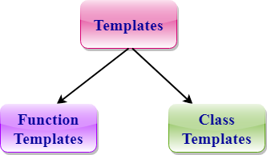
C++ Templates
Provides support for Generic Programing (Generic programming is a technique where generic types are used as parameters in algorithms so that they can work for a variety of data types.)
powerful feature which allows you to define the generic classes and generic functions
Notes:
https://www.javatpoint.com/cpp-templates

Slide 6
Function Template Example
template<class T>
T add(T &a, T &b)
{
T result = a + b;
return result;
}
int main()
{
int i = 2;
float m = 2.3;
cout << "Addition of i and i is :" << add(i, i);
cout << '\n';
cout << "Addition of m and m is :" << add(m, m);
return 0;
}

Slide 7
Class Template sYntax
template<class Ttype, …>
class class_name
{
.
.
}

Slide 8
Nontype Template Arguments Example
template<class T, int size>
class array
{
T arr[size]; // automatic array initialization.
};
int main()
{
array<int, 15> t1; // array of 15 integers.
array<float, 10> t2; // array of 10 floats.
array<char, 4> t3; // array of 4 chars.
}

Slide 9
Problem 3: Make All Point3d classes generic

