Slide 1

21.08.02
NordBioNet Summer School 2021 Proteogenomics Workshop
Marc Vaudel
Center for Medical Genetics and Molecular Medicine, Haukeland University Hospital, Bergen, Norway
Center for Diabetes Research, Department of Clinical Science, University of Bergen, Norway
THREE LEVELS [2015] TYLER HOBBS
Notes:
Artwork: THREE LEVELS [2015] by TYLER HOBBS (tylerxhobbs.com)

Slide 2
Comparing gene, RNA, and protein abundances

Slide 3
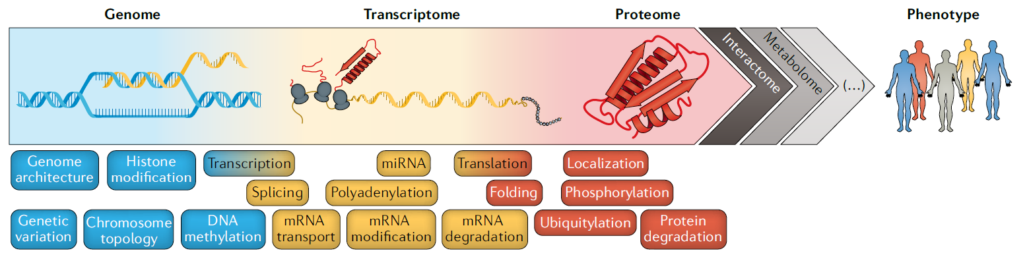

Gene > transcript > peptide > protein > proteoform
What is the right level to compare transcript and protein abundance?
3
Notes:
From doi: 10.1038/s41467-019-09018-y

Slide 4
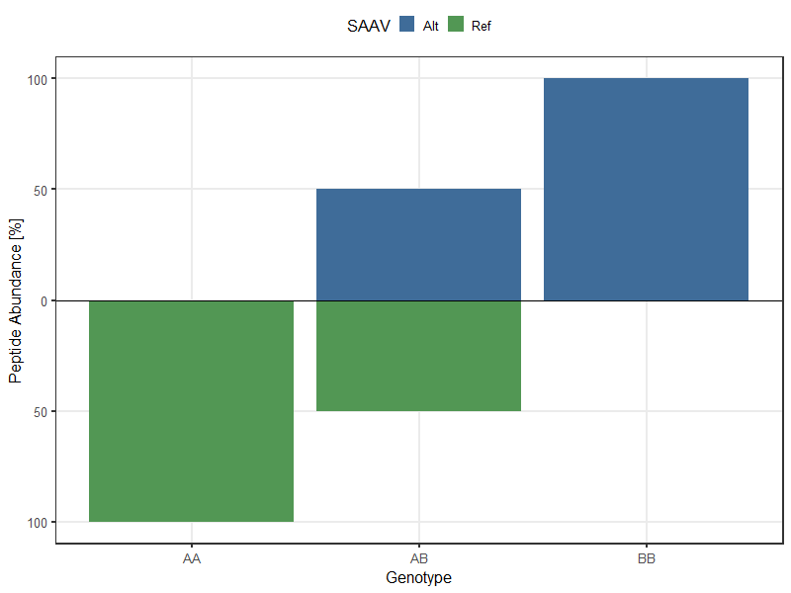
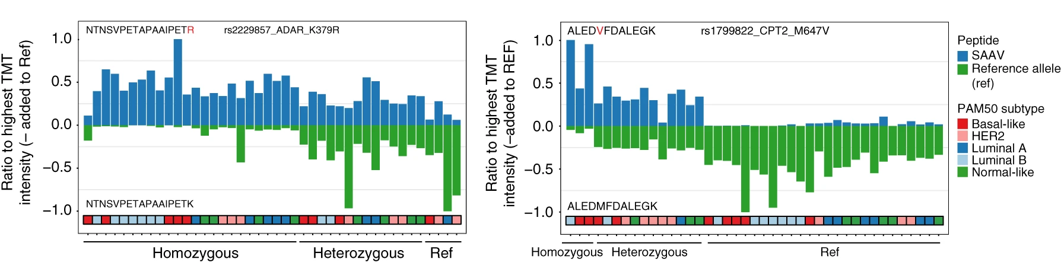
Genotype vs. peptide abundance
What can explain the difference between expected and observed distributions?
4
Notes:
From doi: 10.1038/s41467-019-09018-y

Slide 5
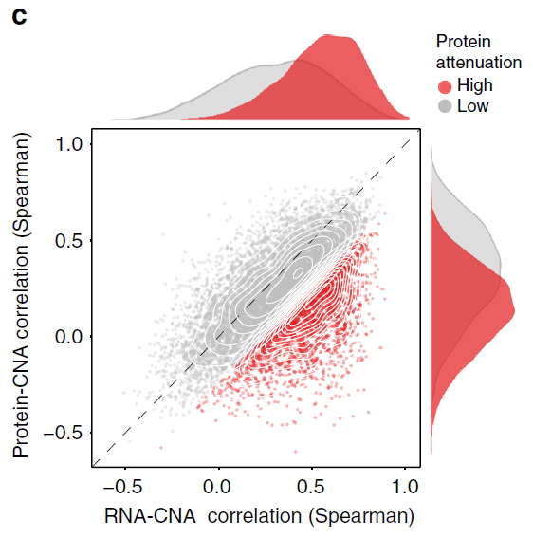
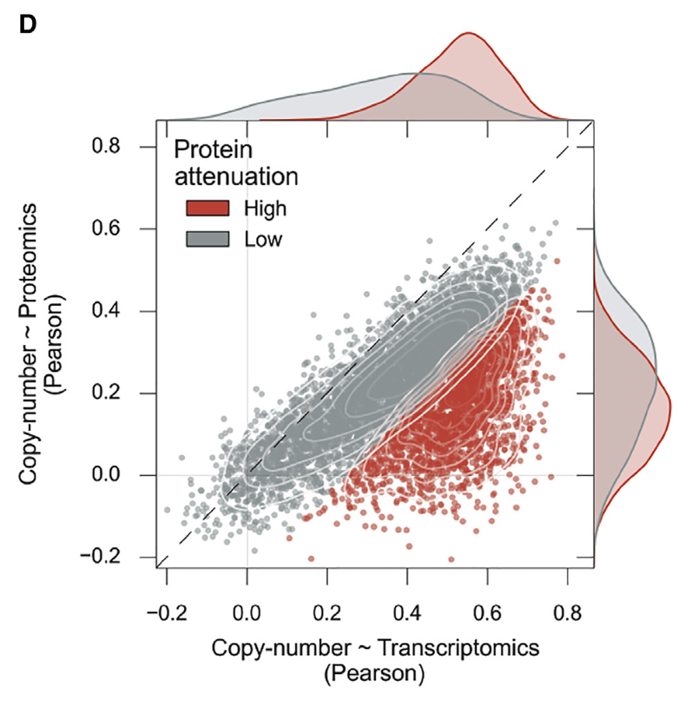
Copy number attenuation
What can be the source of copy number attenuation?
5
Notes:
From doi: 10.1016/j.cels.2017.08.013 and 10.1038/s41467-019-09018-y

Slide 6
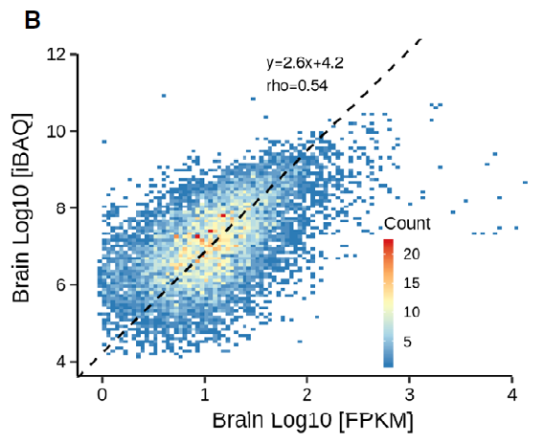
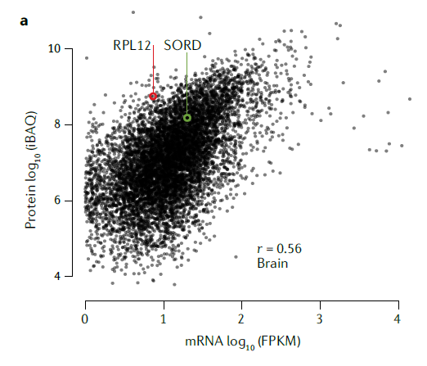
RNA vs. protein abundance
How can we take advantage of the RNA-protein correlation – or lack thereof?
6
Notes:
From doi: 10.15252/msb.20188503 and 10.1038/s41576-020-0258-4

Slide 7
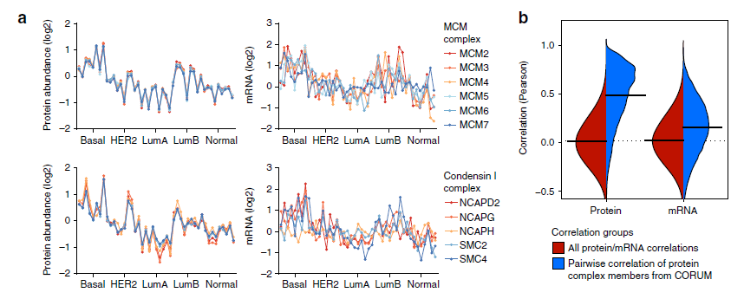
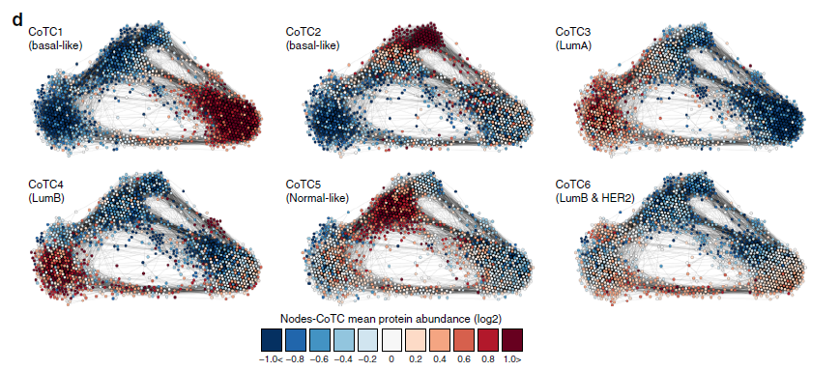
RNA vs. protein abundance
7
Notes:
From doi: 10.1038/s41467-019-09018-y

Slide 8
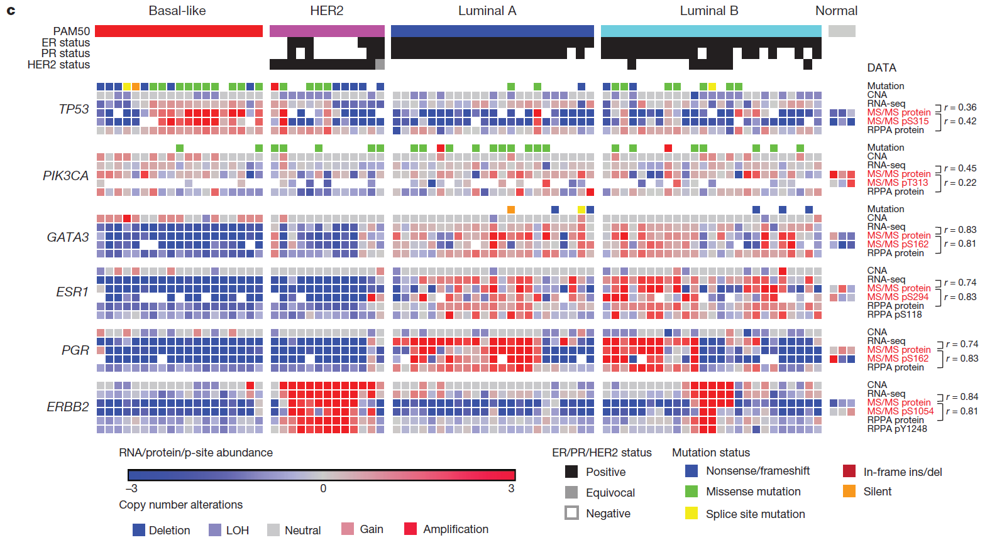
From genes to proteoforms
8
Notes:
From doi: 10.1038/nature18003

Slide 9
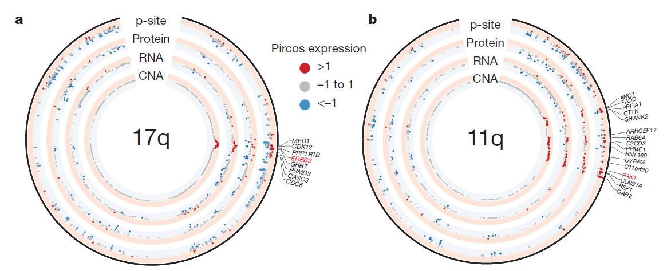
From genes to proteoforms
How can we take advantage of the combination of these analytical layers?
9
Notes:
From doi: 10.1038/nature18003

Slide 10
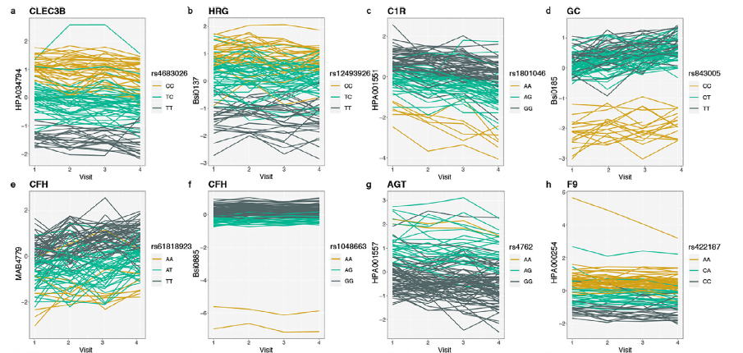
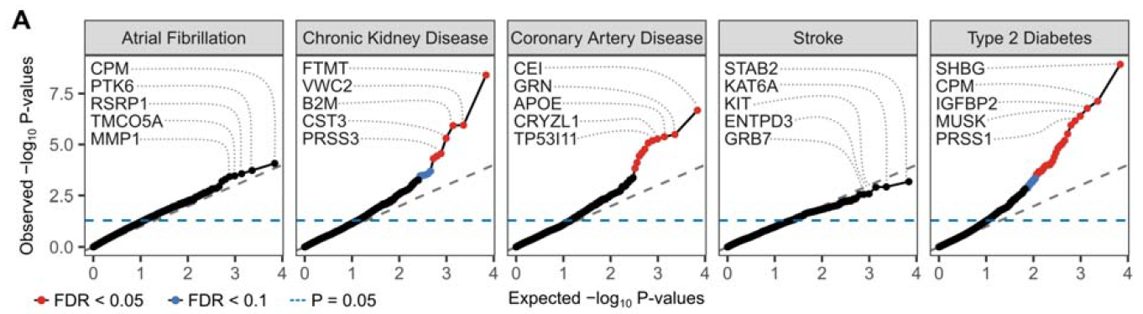
From genotypes to phenotypes
How would you use the association of genetic variants with biomarkers?
10
Notes:
From doi: 10.1016/j.ebiom.2020.102854 and 10.1101/2019.12.14.876474

Slide 11
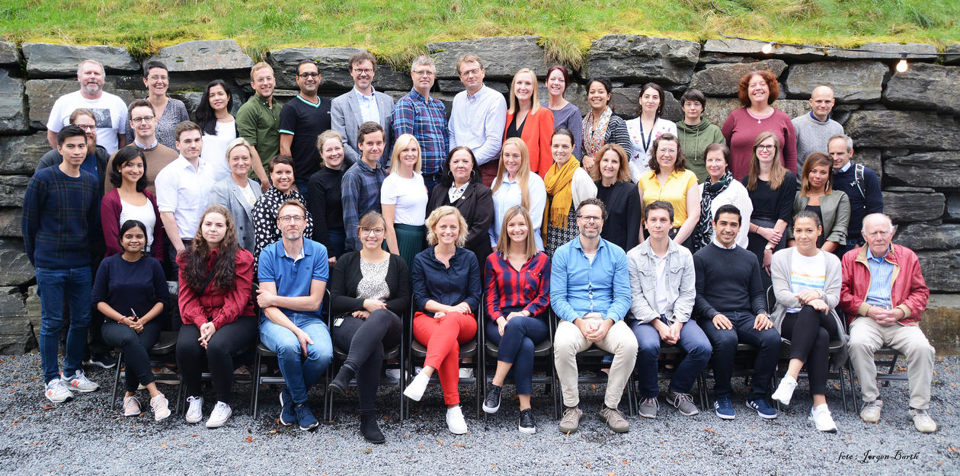


Acknowledgement

