Slide 1

Team Name : Graph Runners
Team Leader Name : Balaji Venkateswaran
Team Size : 1
Problem Statement : Building a virtual supply-chain knowledge graph on Snowflake with CoCo — no graph database, no data movement.
Notes:
Opening. Name the idea in one line: a knowledge graph that lives inside Snowflake as ordinary tables.

Slide 2

A knowledge graph with no graph database
Two Snowflake tables, graph analytics precomputed in SQL, and an agent that speaks English
“Which supplier sites are single points of failure?”
Asked in plain English. Answered from 26,524 real relationships, in 20 seconds.
37
2.36M
7,613
26,524
source tables
rows projected
graph nodes
graph edges
The graph is not a copy of the warehouse. It is a projection of it — built by SQL, refreshed by SQL, and queried where the data already lives.
All data synthetic · generated from a fixed seed · no real supplier or customer information
Notes:
The whole idea on one slide.

Slide 3
What this deck covers
01 The problem
02 The idea
Why supply-chain questions take days to answer
A virtual knowledge graph, built in place
03 The data
04 Criticality
37 tables and 2.36M rows projected into a graph
What the graph reveals that the warehouse cannot
05 The agent
06 The demo
Cortex tools, wiring, and conversation memory
Screenshots, real questions, verified answers
07 The agent fleet
08 Impact
Ten agents this graph can carry
Measurable outcomes and what comes next
Notes:
Roadmap for the deck.

Slide 4
1
PROBLEM BRIEF
Supply chains are graphs.
Warehouses are not.
Every real supply-chain question is a question about relationships — who feeds whom, what breaks if this stops, where is there no second source. Relational warehouses answer those badly, and slowly.
3–5 days
11 joins
0
typical answer turnaround
to trace one part
analysts who write recursive CTEs

Slide 5
The business problem
A component goes end-of-life. What breaks?
A supplier announces end-of-life on one connector. To size the exposure you must trace that part to every approved source, every BOM it appears in, every product built from those BOMs, every plant that builds them, and every customer waiting on the result — then do it again for the alternates.
Today
The hidden cost
With the graph
A senior analyst writes nested joins across eight tables. Three to five days. The answer is stale before it is read.
Because it is expensive, the question gets asked only after a disruption — never as prevention.
One English question. Twenty seconds. The same query runs for every part, every week, automatically.
Asterion Devices — a synthetic electronics manufacturer used throughout this prototype
Notes:
Ground the problem in a concrete, expensive scenario.

Slide 6
Who this is for
Four personas, four questions that previously needed an analyst
S
Supply Risk Manager
C
Commodity Buyer
“Which sites are single points of failure?”
“Which parts have only one approved source?”
Needs the answer weekly, not after an incident.
Drives dual-sourcing and negotiation leverage.
Q
Quality Lead
P
Plant Planner
“Which suppliers breach PPM targets, and why?”
“What feeds my plant, and what is fragile upstream?”
Joins scorecards and NCRs to the network.
Sees two hops out, not just direct suppliers.
Notes:
Four named users, each with a question the graph answers.

Slide 7
Why not just use a graph database?
We built that first. It is the reason this approach exists.
The graph-database route
The virtual-graph route
A second system. Another cluster to run, secure and pay for.
No new system. Two tables in the warehouse you already have.
A copy of the truth. ETL out of the warehouse, stale on arrival.
No copy. A projection, rebuilt by SQL on a schedule.
A second dialect. Cypher, which nobody on the team writes.
One dialect. SQL — and the agent writes it.
Governance split. Two places to grant, mask and audit.
One governance model. Snowflake roles, masking and audit.
Text-to-Cypher is brittle. Needed repair loops on most queries.
Semantic view grounds it. The agent queries a curated model.
Graph analytics are the valuable part. A graph database is just one way to get them — and on data that already lives in Snowflake, the expensive way.
Notes:
Pre-empt the obvious question: why not Neo4j? We tried.

Slide 8
2
THE IDEA
Project the graph.
Don't move the data.
A knowledge graph is not a database technology — it is a shape. Nodes, edges, and measures computed over them. All three can be expressed as SQL over tables that already exist.
2
8
0
tables define the graph
derived columns per node
bytes leaving Snowflake

Slide 9
What “virtual” means here
The graph is derived, not stored separately — three consequences follow
Derived
D
KG_NODES and KG_EDGES are built by SELECT statements over the star schema. Rebuild them and the graph is current.
Co-located
C
The graph sits in the same database, under the same roles, beside the facts it describes. A query can join graph to fact in one statement.
Disposable
D
Nothing is lost if the graph is dropped — it is a materialised view of relationships the warehouse already implies.
The same idea applies to any domain already modelled as a star schema — finance, telecom, healthcare
Notes:
Define the term precisely — three properties.

Slide 10
Architecture
Everything inside the Snowflake boundary except the browser
SOURCE · SCS.INVENTORY
37 base tables · 2,362,876 rows
DIM_PART
PO_LINE
FACT_INVENTORY
APPROVALS
GRAPH · SCS.KG
7,613 nodes · 26,524 edges · 5 analytical views
KG_NODES
KG_EDGES
VW_SPOF
VW_NODE_IMPORTANCE
SEMANTIC · SCS.SEMANTIC
9 facts · 4 dimensions · 5 metrics · 10 documents
SV_SUPPLY_CHAIN_KG
SCM_DOCUMENT_SEARCH
AGENT + APP
Cortex agent:run · Flask · CoCo-built
kg_analyst
kg_search
sql_exec
data_to_chart
No data leaves Snowflake. The browser receives rendered answers, never rows of source data.
Notes:
The architecture diagram required by the submission template.

Slide 11
One question, end to end
Measured on the running prototype
1
2
3
4
5
Question
Cortex agent
Semantic view
sql_exec
Answer
“Which supplier sites are single
points of failure?”
Plans, picks kg_analyst,
writes SQL
Resolves logical names to
KG_NODES / KG_EDGES
Runs it on COMPUTE_WH,
returns typed rows
Prose + table + chart +
subgraph + trace
20–45s
~120k
$0.10–0.16
end-to-end latency
tokens per answer
cost per answer
Latency is dominated by agent planning, not by the SQL — the queries themselves return in under a second
Notes:
Walk one question end to end, with the real timing.

Slide 12
How CoCo CLI built this
Every layer below was produced in a CoCo session
▸
Schema exploration
▸
SQL generation
Introspected 37 tables, 5 schemas and the semantic view directly over a live Snowflake connection.
Wrote the star schema, the KG projection, the graph analytics and the deployment script — 1,932 lines of SQL.
▸
Application build
▸
Agent configuration
Wrote and refactored the Flask app: agent transport, response parsing, subgraph builder, dashboard.
Discovered the agent spec schema by probing the account, then wired Analyst, Search, sql_exec and charting.
▸
Verification
▸
Browser automation
Computed ground truth in SQL and graded ten answers against it — the accuracy number on slide 41 is CoCo's own audit.
Drove the running app to capture the screenshots in this deck at full resolution.
Notes:
Which CoCo CLI capabilities did the work. Required by the template.

Slide 13
3
THE DATA
37 tables.
2.36 million rows.
A full synthetic supply chain — parts, suppliers, sites, plants, purchase orders, shipments, quality inspections and IoT readings — generated from a fixed seed so every figure in this deck reproduces.
37
2,362,876
1,932
base tables
rows
lines of SQL

Slide 14
Source data — 37 base tables, 2,362,876 rows
SCS.INVENTORY, the star schema the graph is projected from
Table group | Tables | Rows
Facts & events | 4 | 2,042,000
Transactions | 7 | 218,000
Quality | 2 | 11,000
Product & BOM | 5 | 47,060
Sourcing | 5 | 42,200
Reference dimensions | 14 | 2,616
Total | 37 | 2,362,876
Row counts read live from SCS.INFORMATION_SCHEMA.TABLES at build time
Notes:
The full base-table inventory with row counts.

Slide 15
From star schema to graph
Every node and edge is a SELECT — no loader, no external process
NODES — one row per canonical entity
EDGES — one row per relationship
INSERT INTO SCS.KG.KG_NODES
SELECT 'SUPPLIER_SITE' AS NODE_TYPE,
SITE_ID AS SOURCE_ID,
SUPPLIER_NAME||' - '||CITY AS LABEL
FROM SCS.INVENTORY.DIM_SUPPLIER_SITE;
INSERT INTO SCS.KG.KG_EDGES
SELECT n1.NODE_ID, n2.NODE_ID,
'APPROVED_SOURCE' AS EDGE_TYPE,
COUNT(*) AS WEIGHT
FROM SUPPLIER_PART_APPROVAL a JOIN ...;
Twelve entity types and fourteen relationship types, all from existing keys
A foreign key in the warehouse is already an edge — the projection simply names it. SUPPLIER_PART_APPROVAL becomes APPROVED_SOURCE; BOM_LINE becomes COMPONENT_OF; SHIPMENT_HEADER joined to lanes becomes OPERATES_LANE. Nothing is invented, and nothing is copied twice.
Full projection logic in deploy_production.sql, Part 4
Notes:
How rows become nodes and edges — the core mechanic.

Slide 16
The graph at a glance
Read live from SCS.KG at build time
7,613
26,524
7.0
nodes
edges
average connections per node
12
14
18
entity types
relationship types
connected components
7,613 nodes over 2,362,876 source rows is the point: the graph is a thin, high-value layer. It carries the relationships and the measures over them — the facts stay where they are, and are joined back when needed.
Notes:
Headline graph statistics.

Slide 17
Entities in the graph
7,613 nodes across 12 types
What these are
Part — 5,000 components with an approved-source trail
Supplier Site — 1,200 physical locations, the true risk unit
Supplier — 500 parent organisations
Product — 500 finished SKUs built from BOMs
Lane, Port, Carrier — the logistics layer
Plant, Warehouse — internal network
Notes:
Entity mix.

Slide 18
Relationships in the graph
26,524 edges across 14 types
The load-bearing edges
Approved Source — 6,678. Sourcing resilience lives here.
Supplies To — 5,811. Who feeds which plant.
Classified As — 5,000. Part to commodity.
Component Of — 2,508. BOM structure, recursive.
Operates Lane — 3,323. Carrier to route.
Single-sourcing, bottleneck and blast-radius questions are all APPROVED_SOURCE and COMPONENT_OF traversals
Notes:
Relationship mix — this is where the value is.

Slide 19
Derived columns on KG_NODES
Eight measures computed in SQL at build time — no graph engine involved
Column | Type | What it measures | Used for
DEGREE_IN | NUMBER | Inbound relationship count | Demand convergence
DEGREE_OUT | NUMBER | Outbound relationship count | Supply fan-out
DEGREE_TOTAL | NUMBER | Total connections | Overall connectivity
COMPONENT_ID | NUMBER | Weakly-connected component | Isolation / clustering
PAGERANK | FLOAT | Importance weighted by neighbours' importance | Which entities matter most
HUB_SCORE | FLOAT | HITS hub — breadth of outbound reach | Wide distributors
AUTHORITY_SCORE | FLOAT | HITS authority — inbound concentration | Demand sinks
BETWEENNESS | FLOAT | Share of shortest paths through the node | Bottleneck / chokepoint risk
Plus NODE_ID, NODE_TYPE, SOURCE_ID, LABEL and a PROPERTIES VARIANT — 13 columns in total, 8 of them computed.
Notes:
Explicitly answers: what derived columns were calculated on nodes.

Slide 20
Derived columns on KG_EDGES
Two computed columns, five analytical views, and the business-metrics layer
KG_EDGES — 7 columns, 2 computed
5 analytical views in SCS.KG
Column | What it measures
WEIGHT | Transaction count behind the relationship
BETWEENNESS | Edge-level shortest-path share
VW_SINGLE_POINT_OF_FAILURE
VW_NODE_IMPORTANCE
VW_DISRUPTION_EXPOSURE
VW_BOM_EXPLOSION
Plus EDGE_ID, FROM_NODE_ID, TO_NODE_ID, EDGE_TYPE, PROPERTIES
VW_COMMUNITY_SUMMARY
Business metrics joined onto the graph — KG_NODE_BUSINESS_METRICS
A view layered over KG_NODES that attaches commercial measures to each entity: total spend and PO count per supplier, average lead-time variance from goods receipts, defect PPM and inspection pass rate from quality records, and revenue per customer from sales orders. This is what lets one question span graph structure and business value — “which critical suppliers also carry the worst quality record?”
Defined in 02_enrich_semantic_view.sql
Notes:
Edge-level derived columns and the analytical views built on them.

Slide 21
The four graph measures, in business terms
All computed in SQL — iterative PageRank and HITS as recursive CTEs
PageRank
Betweenness
Importance that flows. An entity is important if important entities depend on it — not merely if it has many links.
How often an entity sits on the only path between two others. High betweenness is a chokepoint with no detour.
▸ Which suppliers actually matter
▸ Single points of failure
HITS hub / authority
Connected components
Two-sided influence: hubs fan out widely, authorities absorb concentrated demand.
Islands with no path between them. Reveals orphaned pockets of the network.
▸ Distributors vs. demand sinks
▸ Coverage gaps and isolation
Notes:
Make the four algorithms legible to a business audience.

Slide 22
The semantic view — what the agent actually sees
SV_SUPPLY_CHAIN_KG: 9 facts, 4 dimensions, 5 metrics over 2 tables
FACTS · 9
DIMENSIONS · 4
METRICS · 5
PAGERANK_VAL
ENTITY_NAME
TOTAL_NODES
BETWEENNESS_VAL
NODE_TYPE
TOTAL_EDGES
HUB_SCORE_VAL
RELATIONSHIP_TYPE
AVG_DEGREE
AUTHORITY_SCORE_VAL
COMPONENT
COMPONENT_COUNT
DEGREE_IN_VAL
MAX_PAGERANK
DEGREE_OUT_VAL
DEGREE_TOTAL_VAL
EDGE_WEIGHT
EDGE_BETWEENNESS
Why this matters more than the model
The view also carries synonyms (“entities”, “links”, “bottlenecks”), verified example queries, and an instruction telling the model to use PAGERANK for importance and BETWEENNESS for bottlenecks. That grounding is why text-to-SQL is reliable here and was not against raw tables.
Notes:
The semantic view is what makes text-to-SQL reliable.

Slide 23
The unstructured half
Cortex Search over the documents the graph cannot hold
SCM_DOCUMENT_SEARCH
Contracts — quality guarantees, penalty and liability clauses
Scorecards — quarterly PPM, OTD and responsiveness
NCRs — defect reports with root cause and disposition
Alerts & ECOs — disruption notices and change orders
One chat, both worlds
“Which critical suppliers also breach their quality targets?” needs betweenness from the graph and PPM from a scorecard PDF. The agent holds both tools, so that is one question — not a graph query plus a document search plus a human joining them in their head.
Notes:
The unstructured half — Cortex Search.

Slide 24
4
CRITICALITY
Why the graph
earns its place.
These are the answers the warehouse cannot produce at any reasonable cost — not because the data is missing, but because the questions are about paths, not rows.
1,790
18
5
single-sourced parts
network components
true chokepoints

Slide 25
The graph is real
A live slice: two plants, one hop out, drawn from actual KG_EDGES rows
NEXORA COMPONENTS
THETA SEMICONDUCTORS
IONIC MANUFACTURING
Asterion Sao Paulo
Asterion San Jose
ORION COMPONENTS
CIPHER SOLUTIONS
PENTAWAVE TECHNOLO…
Country
Customer
Plant
Supplier
Supplier Site
Warehouse
28 nodes and 26 edges sampled live from SCS.KG · layout by force-directed spring embedding
Notes:
A real slice of the graph, laid out by networkx and drawn natively.

Slide 26
Criticality 1 — single points of failure
Ranked by betweenness: sites that sit on paths with no alternative
Why this is not a row count
A site with many connections is busy. A site with high betweenness is load-bearing — traffic has no other route through. The two are different, and only the second tells you what to dual-source first.
TOP FIVE CHOKEPOINTS
▸ KAPPA INDUSTRIES - Bogota
▸ LAMBDA SEMICONDUCTORS - Guadalaj…
▸ QUANTUM COMPONENTS - Stuttgart
▸ CREST MANUFACTURING - Manila
▸ CREST SOLUTIONS - Guadalajara
Notes:
Criticality evidence 1 — the chokepoints.

Slide 27
Criticality 2 — the network is not one network
18 connected components: one giant, 17 orphaned fragments
What the fragments mean
Unreachable stock. Entities with no path to any plant — inventory nobody can consume.
Broken master data. A supplier with no approved part, a part with no BOM. The graph surfaces it as an island.
Acquisition residue. Sub-networks that were never joined to the main sourcing structure.
99.8% of entities sit in one component. The remaining 17 are exactly the kind of quiet data-quality failure nobody queries for.
Notes:
Criticality evidence 2 — isolation.

Slide 28
Criticality 3 — where the network concentrates
Average connections per entity type: plants absorb every flow
Reading this chart
Twelve plants carry 566 connections each on average — eighty times a typical part.
That asymmetry is the risk profile of the whole network in one number: disruption at a plant propagates everywhere, disruption at a part is contained.
It also says where to instrument first. Twelve entities, monitored well, cover most of the blast radius.
Notes:
Criticality evidence 3 — where load concentrates.

Slide 29
What the warehouse alone cannot answer
Not “harder” — structurally absent without traversal and centrality
Question | Without the graph | With the graph
Which sites are single points of failure? | No measure of path criticality exists | Betweenness, one ORDER BY
What breaks if this part is discontinued? | Recursive CTE, hand-written per case | COMPONENT_OF traversal
Which suppliers actually matter? | Spend ranking — misses structural importance | PageRank over the network
Are there isolated pockets of the network? | Nobody thinks to ask | COMPONENT_ID, already computed
Which parts have no second source? | GROUP BY HAVING — possible, but blind to depth | APPROVED_SOURCE degree, with blast radius
The middle column is not a technology gap. It is the reason these questions are asked after a disruption instead of before one.
Notes:
Direct comparison: SQL-only vs graph.

Slide 30
5
THE AGENT
Four tools.
Zero deployment.
The agent's model, instructions and tools are defined in the application and sent with every request. There is no stored AGENT object to create, grant, or keep in sync with the code.
4
0
1
tools attached
stored agent objects
place to change config

Slide 31
The four tools
Attached inline on every agent:run request
K
kg_analyst
Turns the question into SQL against the semantic view
RESOURCE
cortex_analyst_text_to_sql
SV_SUPPLY_CHAIN_KG
K
kg_search
Retrieves passages from contracts, NCRs, scorecards, alerts
RESOURCE
cortex_search
SCM_DOCUMENT_SEARCH
S
sql_exec
Executes the generated SQL and returns typed rows
RESOURCE
sql_exec
COMPUTE_WH
D
data_to_chart
Emits a Vega-Lite spec the UI renders directly
RESOURCE
data_to_chart
— no resource needed
Tool definitions live in app.py — AGENT_TOOLS and AGENT_TOOL_RESOURCES
Notes:
What each tool does and what it points at.

Slide 32
Why the tools are inline, not stored
A design decision, discovered the hard way
Stored AGENT object
Inline on every request
ALTER cannot set a spec. Only CREATE OR REPLACE works — which discards existing conversation threads.
Version controlled. Tool changes arrive through code review.
DDL to change a prompt. Config drifts from the code that depends on it.
No deployment step. Nothing to create, grant or migrate.
Shared blast radius. Other clients break when you retune.
Per-request control. A “concise” toggle can change instructions for one call.
POST https://<account>.snowflakecomputing.com/api/v2/cortex/agent:run
{ "models": { "orchestration": "claude-sonnet-4-6" },
"tools": [ kg_analyst, kg_search, sql_exec, data_to_chart ],
"messages":[ { "role": "user", "content": [...] } ] }
X-Snowflake-Authorization-Token-Type: PROGRAMMATIC_ACCESS_TOKEN ← required
Notes:
The design decision judges should notice.

Slide 33
Conversation memory
agent:run is stateless, so the app carries the transcript
A real exchange
How it is carried
Q1
List the top 5 supplier sites by betweenness. Number them 1 to 5.
6 turns replayed on every request
Q2
What country is number 4 in?
1,500 chars per answer, 8,000 across the transcript
A2
CREST MANUFACTURING – Manila → Philippines
Newest first, so the oldest turns drop when the budget runs out
Q3
And number 2?
A3
LAMBDA SEMICONDUCTORS – Guadalajara → Mexico
Tagged context, instructing the agent not to re-answer them
The budget is the whole design. An earlier version truncated each answer to 400 characters — enough to cut a markdown table off after its header row, so “what country is number 4 in?” had nothing to resolve against. Sizing it to hold a whole table is what makes row-level follow-ups work.
Notes:
Conversation memory — how follow-ups resolve.

Slide 34
6
THE DEMO
Running software.
Real answers.
Every screenshot that follows was captured from the running prototype against the live Snowflake account — no mockups, no staged data.
14/14
9/10
20–45s
sample questions answered
verified exact
per answer

Slide 35
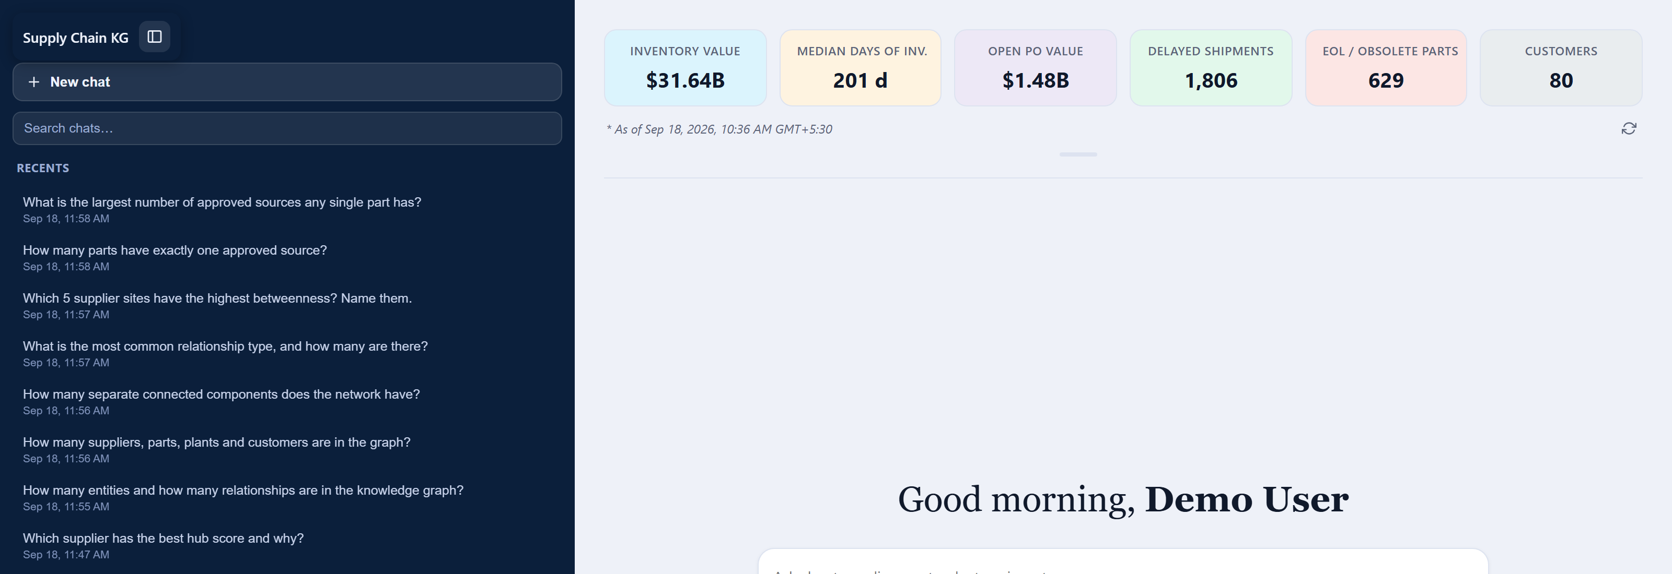
The application
Dashboard metrics read with plain SQL; chat answered by the agent
$31.64B
201 d
1,806
inventory value, latest snapshot
median days of inventory
delayed shipments
Tiles bypass the agent deliberately — six fixed numbers are cheaper and more deterministic as SQL
Notes:
The landing page: dashboard read straight from the star schema.

Slide 36
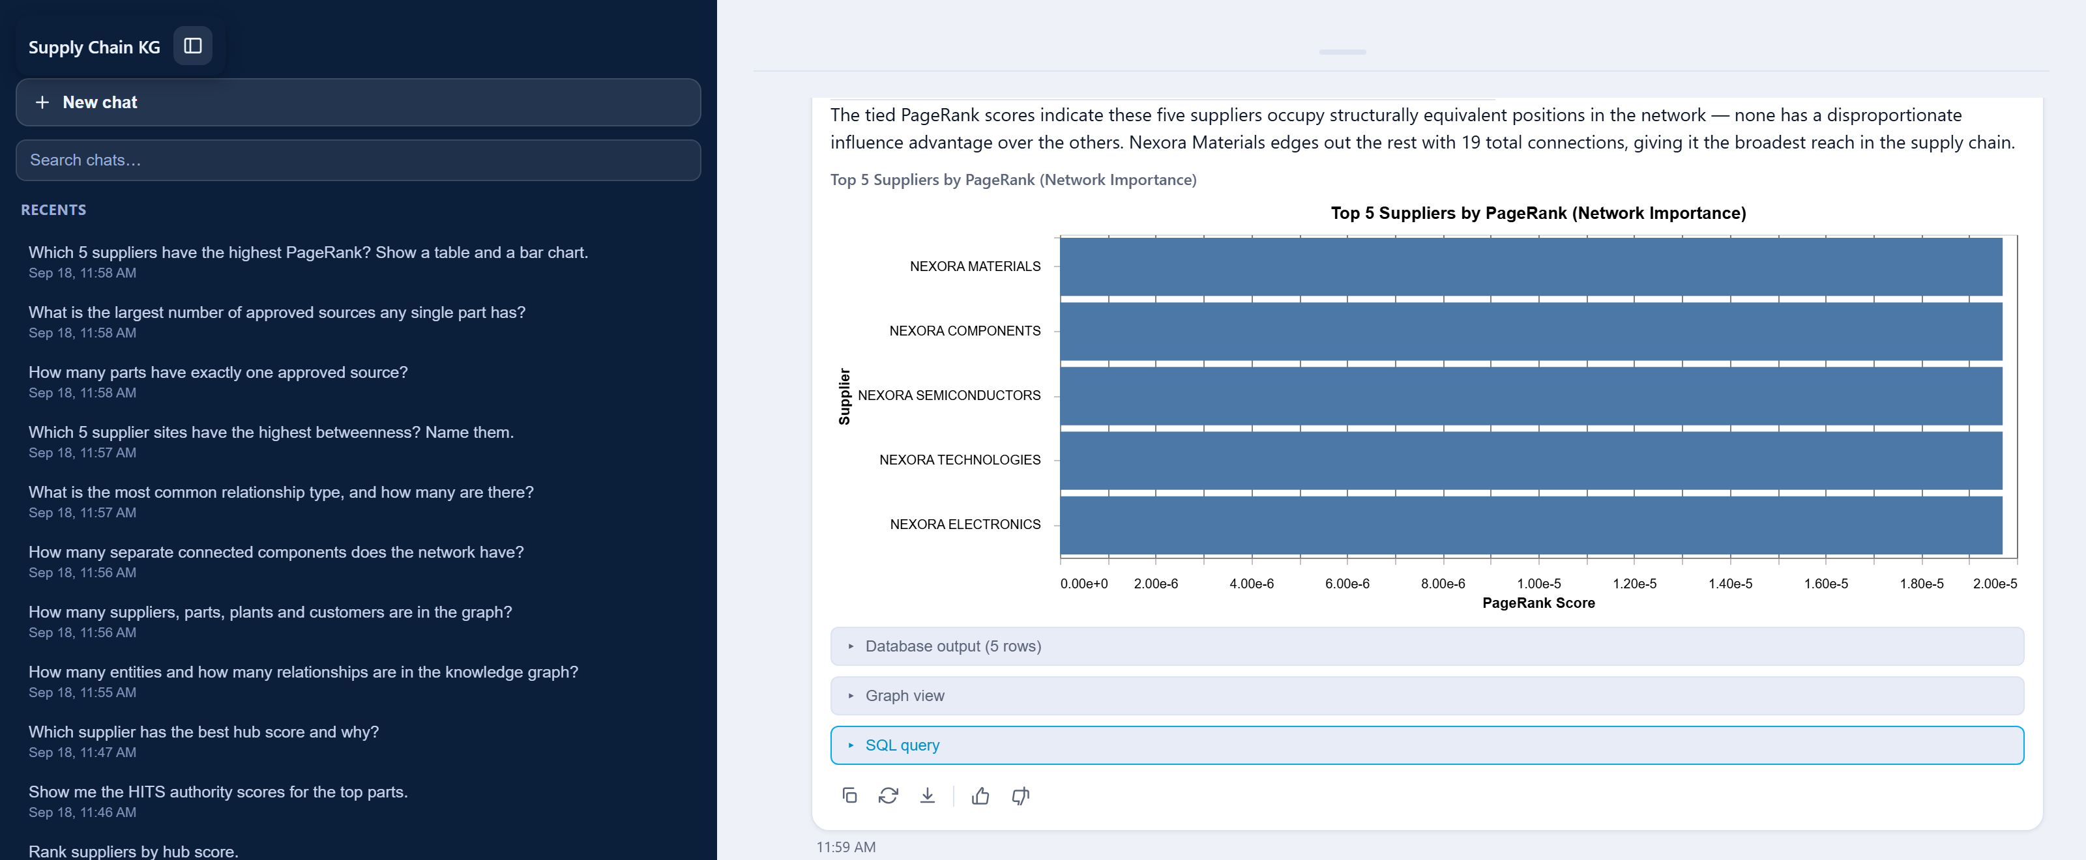
An answer
“Which 5 suppliers have the highest PageRank? Show a table and a bar chart.”
Prose, a structured table and a Vega-Lite chart — all from one agent turn
Notes:
A complete answer: prose, table, chart.

Slide 37
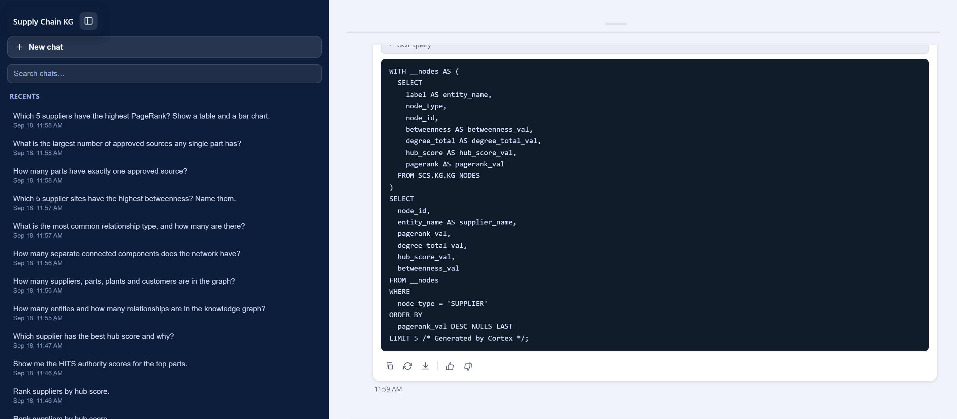
Every answer shows its work
Database output, graph view and the executed SQL, expandable under each answer
Three panels
Database output — the typed rows the agent actually read
Graph view — entities in the answer looked up in KG_NODES and expanded one hop
SQL query — the statement that ran, with logical names expanded to real tables
An answer you cannot audit is an answer you cannot act on.
Notes:
Transparency: the SQL, the rows, and the subgraph.

Slide 38
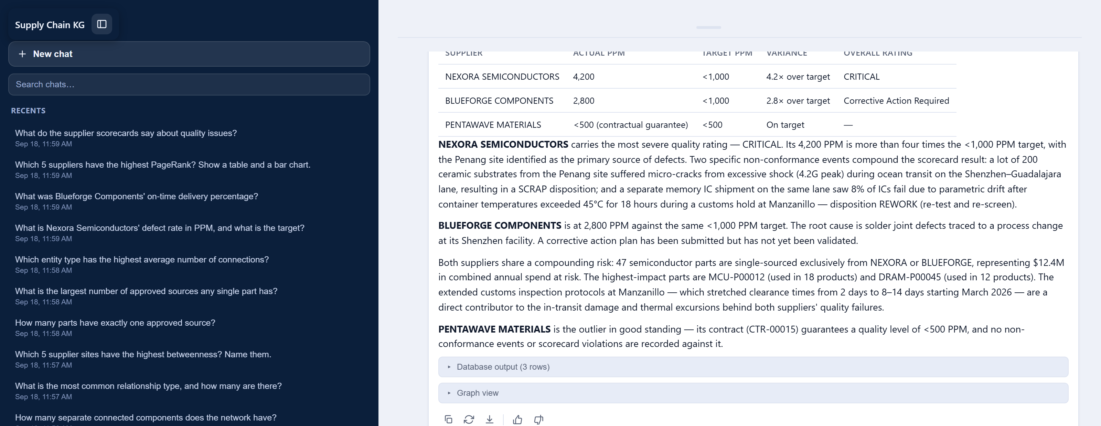
The same chat answers the documents
“What do the supplier scorecards say about quality issues?”
Answered by kg_search over Cortex Search — no SQL, same conversation
Notes:
The unstructured path, same chat.

Slide 39
Verified questions and answers — the graph
Ground truth computed independently in SQL, then compared
Question | Agent answer | SQL truth
How many entities and relationships? | 7,613 / 26,524 | 7,613 / 26,524 | ✓
Suppliers, parts, plants, customers? | 500 / 5,000 / 12 / 80 | 500 / 5,000 / 12 / 80 | ✓
How many connected components? | 18 | 18 | ✓
Most common relationship type? | APPROVED_SOURCE, 6,678 | APPROVED_SOURCE, 6,678 | ✓
Top 5 sites by betweenness? | Kappa, Lambda, Quantum, Crest, Cobalt | same five, same order | ✓
Largest number of approved sources? | 8 (Connector-00198) | 8 | ✓
Highest average connections? | Plants, 566 | PLANT, 566.3 | ✓
Full transcript and checker in the repository — every figure reproducible against the same account
Notes:
Verified question/answer pairs, graph questions.

Slide 40
Verified questions and answers — the documents
Cortex Search answers, checked against the corpus itself
Question | Agent answer | Source truth
Nexora Semiconductors' defect rate and target? | 4,200 PPM vs <1,000 target | 4,200 PPM, target <1,000 | ✓
Blueforge Components' on-time delivery? | 71% against a 90% target | OTD: 71% (target 90%) | ✓
How many parts have exactly one approved source? | 1,788 parts | 1,790 parts | ✗
The one that missed — and why we are showing it
The agent reported 1,788 single-sourced parts against a true 1,790 — a 0.1% error, but a real one. It matters because the same question has two defensible answers: counting the KG's APPROVED_SOURCE edges gives 1,790, while counting SUPPLIER_PART_APPROVAL across all 30,000 parts gives 10,556. The semantic view scopes the agent to the graph. Knowing that boundary is the difference between a demo and a system you can trust.
Notes:
Document questions plus the one miss.

Slide 41
Accuracy
Ten questions, ground truth computed independently in SQL
How this was measured
Truth first. Every expected value computed in SQL before the agent was asked.
Programmatic grading. Answers parsed for the expected figures — no human marking their own homework.
Full stack exercised. Both tools, charts, tables and the markdown fallback path.
Failures reported. The single miss is on the previous slide, not rounded away.
14/14
9/10
0
100%
sample questions answered
verified exact
hallucinated entities
answers with executable SQL
Notes:
The accuracy headline, honestly framed.

Slide 42
7
THE AGENT FLEET
One graph.
Ten agents.
The knowledge graph is the substrate. Once relationships and centrality are queryable in SQL, each of these is a prompt and a tool binding — not a new pipeline.
10
1
0
agents specified
shared semantic layer
new data movement

Slide 43
Agents this knowledge graph can carry — 1 of 2
Each is a prompt plus a tool binding over the same semantic layer
1
Supply Risk Sentinel
2
Dual-Source Advisor
3
EOL Impact Analyst
“Which sites became chokepoints this week?”
“Which single-sourced parts carry the most spend?”
“What breaks if this part is discontinued?”
kg_analyst · betweenness · scheduled
kg_analyst · APPROVED_SOURCE · spend
kg_analyst · COMPONENT_OF traversal
Prevention, not post-mortem
Ranked qualification backlog
Blast radius in seconds
4
Supplier Quality Auditor
5
Contract Risk Reader
6
Logistics Route Analyst
“Which critical suppliers breach PPM?”
“Which contracts lack penalty clauses?”
“Which lanes concentrate delay risk?”
kg_analyst + kg_search · scorecards
kg_search · DOCUMENT_CORPUS
kg_analyst · lanes, ports, carriers
Structure joined to evidence
Commercial exposure surfaced
Reroute before the miss
Notes:
Agents 1-6 that can run on this graph.

Slide 44
Agents this knowledge graph can carry — 2 of 2
7
Inventory Health Agent
8
Network Coverage Auditor
9
New-Supplier Onboarding
10
Executive Briefing Agent
“Where is slow-moving stock concentrated?”
“Which entities are orphaned from the network?”
“Where would this supplier reduce risk most?”
“What changed in the network this month?”
kg_analyst · DOI · FACT_INVENTORY
kg_analyst · COMPONENT_ID
kg_analyst · centrality delta
all tools · scheduled digest
Working-capital release
Master-data defects found
Sourcing strategy, quantified
One page, every Monday
What makes a fleet possible rather than ten integration projects
Each agent shares one semantic view, one search service, one governance model and one set of precomputed measures. Adding the eleventh agent means writing a prompt and choosing which of the four tools it may call — no new pipeline, no new copy of the data, no new access-control surface. The marginal cost of an agent approaches the cost of describing it.
Notes:
Agents 7-10, plus what they share.

Slide 45
8
IMPACT
From three days
to twenty seconds.
The measurable outcome is not that a question is answered faster. It is that a question too expensive to ask weekly becomes cheap enough to automate.
~99.9%
$0.13
37→2
time reduction
average cost per answer
tables to query

Slide 46
Impact
Measured against the manual baseline this replaces
Outcome | Before | After | Change
Time to answer a network question | 3–5 days | 20–45 seconds | ~99.9% faster
Tables an analyst must reason about | 37 | 2 (via semantic view) | 18× simpler
Skill required | SQL + domain expert | Plain English | Opened to the org
Cost per answer | ~4 analyst-hours | $0.10–$0.16 | 3 orders of magnitude
Cadence achievable | After an incident | Weekly, automated | Prevention, not forensics
Auditability | Analyst's private query | SQL shown with every answer | Fully traceable
99.9%
18×
$0.13
reduction in time to answer
fewer tables to reason about
average cost per answer
Cost measured from the agent's own token accounting across the ten verified questions
Notes:
Measurable outcomes — required by the submission template.

Slide 47
Scalability
The architecture has no moving parts that scale badly
Data volume
New domains
The graph is SQL over tables. 2.36M rows today; the same projection runs on 2.36B — Snowflake handles the scale-out, and the node/edge layer stays thin.
Any star schema projects the same way. Finance, telecom and healthcare all have entities and foreign keys that already imply a graph.
New agents
Operations
A prompt and a tool binding. The semantic layer, governance and measures are already there.
Nothing to run. No cluster, no loader, no sync job — a scheduled task rebuilds the projection.
The costly parts of a graph platform — the cluster, the sync, the second governance model — are exactly the parts this design does not have.
Notes:
How this scales, and what it costs to scale.

Slide 48
Beyond the demo
What is built, what is next, and what we know is missing
BUILT
NEXT
KNOWN LIMITS
Graph projection + 8 node measures
Semantic view over the inventory star
Agent scoped to the KG, not the star schema
Semantic view with verified queries
Scheduled projection refresh
PageRank uniform on synthetic data
Cortex Search over the corpus
Alerting agent on centrality deltas
Graph rebuilt in batch, not streaming
Four-tool agent, inline config
Row-level security by plant / region
10-document corpus — illustrative
Chat UI with SQL, table, chart, subgraph
Streamlit-in-Snowflake front end
One miss in ten on scope-sensitive counts
Conversation memory
Temporal graph — how centrality moves
Ground-truth accuracy harness
Notes:
Honest roadmap: what is built, what is next, what is known-limited.

Slide 49
What we verified
Findings from building it, not claims about it
Checked | What we found | What we did
Agent tool wiring | The stored agent had no data tools — it asked for a CSV every time | Attached Analyst, Search, sql_exec, charting
Agent spec schema | Three schema errors: sample_questions shape, search_service key, missing execution_environment | Probed the account, corrected against the docs
Response parsing | Block type is tool_result, not tool_results — structured rows were being silently dropped | Rewrote the parser against the real payload
Multi-query answers | First result set was being shown with the last answer — table contradicted the prose | Take the last result set, with its own SQL
Answer accuracy | 9 of 10 exact; one off by 2 on a scope-sensitive count | Documented the boundary rather than hiding it
Each of these was found by running the system against real data — not by reading the code
Notes:
Close the credibility loop: what we verified and what we found.

Slide 50

The graph was already there.
Every foreign key in the warehouse is an edge nobody had named. Naming them — and computing what they imply — took SQL, a semantic view and an agent. No new database.
37 → 2
7,613
26,524
9/10
tables to query
nodes
edges
verified exact
github.com/mvbalaji/supplychain_KG
Graph Runners · CoCo CLI Hackathon, GCC Edition · All data synthetic
Notes:
Close on the single idea.

