Slide 1


Pre-Sales Pitch · Confidential
AI-Powered CRM for
Modern Revenue Teams
Unify your entire revenue cycle — from first touch to signed contract
— powered by Anthropic Claude AI.
39
35+
2
CLM
Data Entities
API Modules
AI Engines
Full Contracts
Notes:
Welcome. Open by asking: 'How many tools does your team use today just to close a deal?' ArborMind collapses that stack into one AI-native platform.

Slide 2



THE CHALLENGE
Sales teams lose deals to fragmented, outdated tools
Siloed Systems
Zero AI Intelligence
Contract Chaos
Sales, contracts, email and approvals live in 4+ separate tools. No unified view of the customer.
Manual lead research, no scoring, no enrichment. Reps spend 30% of their day on admin work.
Contracts emailed as attachments with no versioning, no audit trail, missed renewals and lost revenue.
4+ tools per rep
30% time on admin
40% missed renewals
Notes:
Ask the room: 'How many of these sound familiar?' Each card maps to a tool your prospect is paying for separately today.

Slide 3


ONE PLATFORM
AI-Powered Intelligence
Every revenue
conversation. One place.
Unified Revenue Platform
ArborMind CRM unifies Lead Management, Pipeline, Quoting, Contract Lifecycle, Approvals, Email and AI Intelligence — without stitching together point solutions.
Enterprise-Grade Security
Built on React 19 · Express.js · PostgreSQL · Anthropic Claude
Notes:
Position ArborMind as the single source of truth for the entire customer lifecycle.

Slide 4





COMPLETE FEATURE SET
Everything your revenue team needs — nothing they don't
Lead & Contact Mgmt
Pipeline & Deals
Quotes & Orders
Contract Lifecycle
Capture, score, enrich and convert leads into opportunities
Kanban pipeline, stage history and multi-currency forecasting
Price book builder, approval flows and one-click PDF export
CLM templates, versioning, renewals and expiry alerts
Campaigns
Email Integration
AI Assistant
Access Control
Member lists, engagement events and UTM attribution
IMAP inbox sync, SMTP sending and open/click tracking
Anthropic Claude agentic tools for research and automation
RBAC + record-level permissions with full audit logs
Notes:
Walk left-to-right, top-to-bottom. Pause on AI Assistant and Contract Lifecycle — biggest differentiators vs. HubSpot or Salesforce Essentials.

Slide 5
AI-POWERED INTELLIGENCE
Powered by Anthropic Claude + OpenAI
Meet your AI
Revenue Copilot
Lead Intelligence
Agentic Automation
Smart Analytics
✓ Company website research
✓ Live CRM data queries
✓ Pipeline health scoring
✓ Buyer type classification
✓ Document generation
✓ Campaign attribution
✓ AI-scored lead ranking
✓ Email drafting
✓ Win/loss patterns
✓ Contact discovery
✓ Opportunity insights
✓ Renewal forecasting
Notes:
Claude is an agent with access to live CRM data — it can search leads, draft contracts and enrich accounts without leaving the CRM.

Slide 6


END-TO-END REVENUE FLOW
From first touch to signed contract — all in one system
1
2
3
4
5
6
Capture
Enrich
Qualify
Quote
Contract
Renew
Website visitor
UTM lead
AI scoring &
research
Pipeline &
opportunity
Price book &
approval
CLM template
& sign
Auto-renewal
alerts
< 2 min
Real-time
1 click
Zero
Lead to scoring
AI enrichment
Quote to order
Missed renewals
Notes:
Each stage is where traditional CRMs require a different tool. ArborMind handles all six natively.

Slide 7
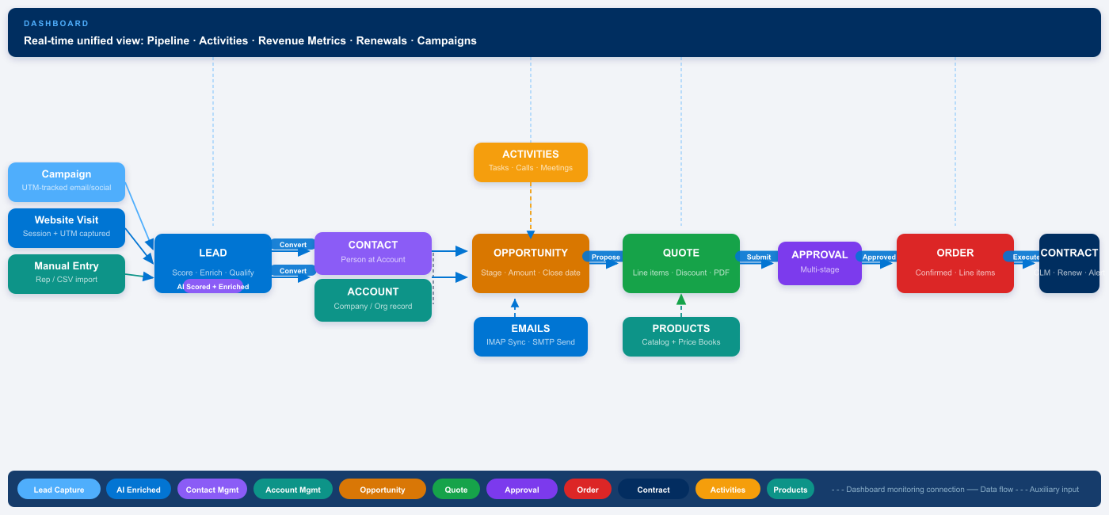
CRM DATA FLOW
End-to-end entity journey — Dashboard → Lead → Contact → Opportunity → Quote → Order
Notes:
Walk through the diagram left to right. Dashboard sits at the top monitoring every entity in real time. The dashed lines show monitoring connections; solid arrows show data flow.

Slide 8
1
Template
CONTRACT
LIFECYCLE
MANAGEMENT
Reusable CLM templates with merge fields and clause libraries
2
Draft
Rich text editor with version history and diff comparison
CLM
3
Approval
Multi-stage role-based routing with conditional approval rules
End-to-end contract control from template to renewal.
4
Active
Executed contract with milestone and obligation management
5
Renewal
Auto-renewal tracking, expiry alerts and renegotiation triggers
Notes:
CLM is a key differentiator — it typically requires a separate $20k+ tool. ArborMind includes it natively with versioning, auto-renewal, and configurable approval chains.

Slide 9
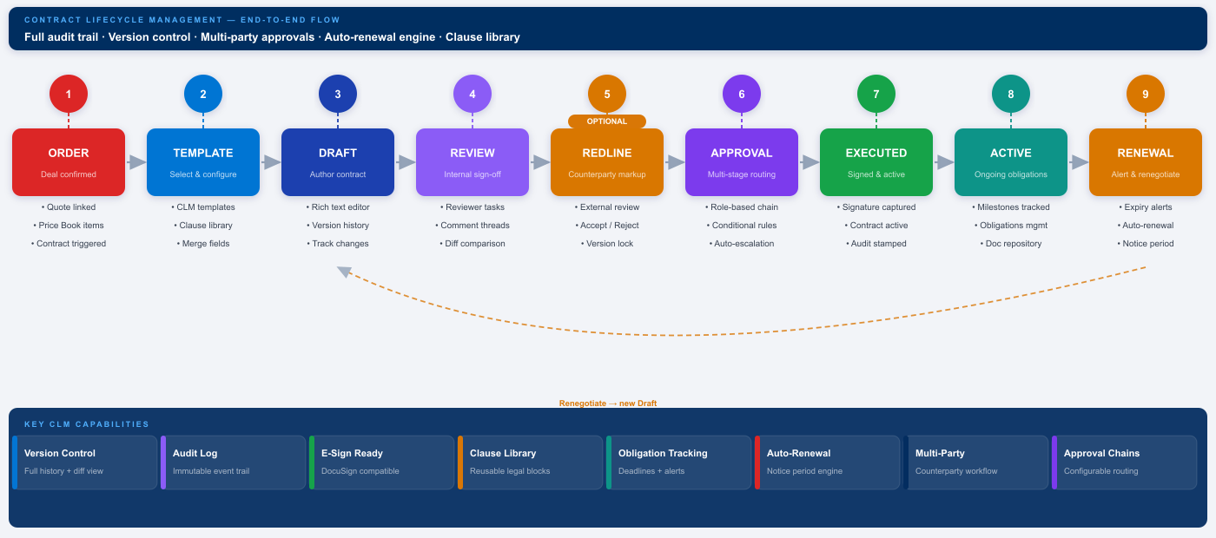
CLM FLOW
Order → Template → Draft → Review → Redline → Approval → Executed → Active → Renewal
Notes:
Walk through each numbered stage. The dashed arc at the bottom shows the renegotiation feedback loop — when a renewal triggers a new negotiation cycle it creates a new Draft from stage 3, not a new contract from scratch.

Slide 10
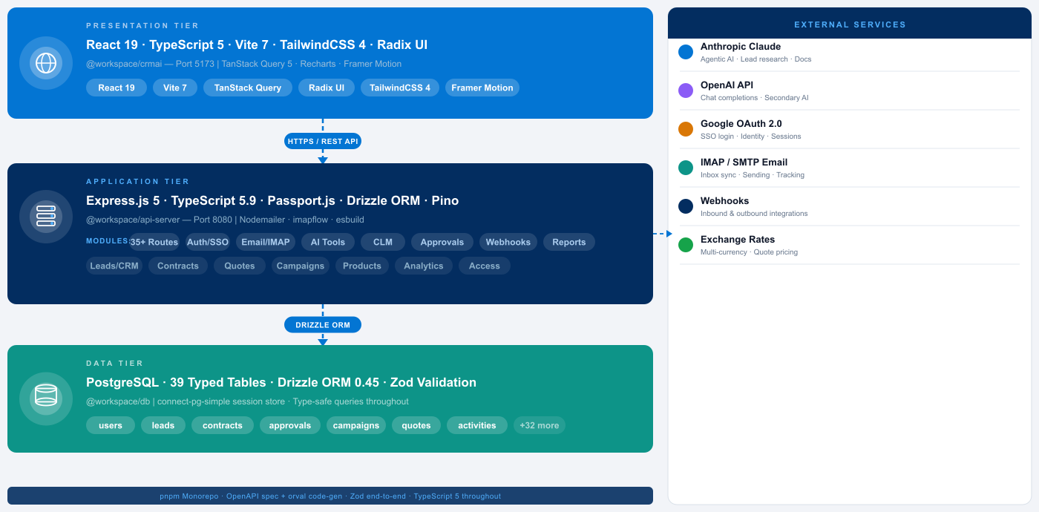
SYSTEM ARCHITECTURE
Three-tier TypeScript monorepo — built for reliability and scale
Notes:
Three tiers: React SPA → Express.js API → PostgreSQL. All packages share types via the OpenAPI spec. External services connect to the API tier only.

Slide 11

TECHNOLOGY STACK
Modern, proven and production-ready
Frontend
Backend
Data & AI
React 19.1
Express.js 5
PostgreSQL
TypeScript 5
Node.js ≥ 18 (ESM)
39 typed schemas
Vite 7.3
TypeScript 5.9
Drizzle migrations
TanStack Query 5
Passport.js + OAuth 2
Anthropic Claude API
Radix UI (full suite)
Drizzle ORM 0.45
OpenAI API
TailwindCSS 4
Pino structured logging
PDFKit / jsPDF
Recharts 2
Nodemailer (SMTP)
XLSX bulk import
Framer Motion 12
imapflow (IMAP)
Webhook engine
pnpm Monorepo · OpenAPI spec + orval code-gen · Zod validation end-to-end · esbuild · Google OAuth 2.0
Notes:
All packages are actively maintained, latest versions. One PR can update a shared library and propagate through all apps with full type safety.

Slide 12



SECURITY & ACCESS CONTROL
Enterprise-grade protection
for every record and every role
Google OAuth 2.0
Role-Based Access (RBAC)
Secure SSO login. 7-day encrypted sessions in PostgreSQL. HTTP-only cookies.
Admin / Super Admin / Manager / Rep — per-screen levels: none / view / read-only / edit.
Record-Level Permissions
Immutable Audit Logs
Granular CRUD per role per record type — Lead, Opportunity, Contract, Account and more.
Every permission change recorded with timestamp, actor, and old/new value.
Notes:
Two independent permission tiers is a key differentiator. Most CRMs only have screen-level RBAC. Record-level RLAC means a rep can see the Contracts screen but only view their own contracts.

Slide 13
WHY ARBORMIND
How we compare against traditional CRM and point solutions
Capability
ArborMind CRM
Traditional CRM
Point Solutions
AI Lead Intelligence
✓ Built-in (Claude)
✗ Add-on only
Separate tool
Contract Lifecycle (CLM)
✓ Full CLM module
✗ Not included
Separate $20k+
Multi-stage Approvals
✓ Configurable
✗ Basic or none
Manual process
Email + IMAP Sync
✓ Native inbox
✓ Basic
Separate tool
Record-Level Permissions
✓ RBAC + RLAC
Limited
N/A
Price Books + CPQ
✓ Full quote builder
Basic
Separate CPQ
Open TypeScript Stack
✓ Monorepo
Closed SaaS
Varies
ArborMind replaces 3–5 point solutions with one integrated, AI-native platform.
Notes:
Let the table speak. The rightmost two columns represent the status quo your prospect is living with today.

Slide 14
COMMERCIALS
Investment & Packaging
[ PLACEHOLDER — Pricing to be confirmed. Replace with agreed commercial terms before sharing externally. ]
MOST POPULAR
Starter
Professional
Enterprise
[ $ TBD ]
[ $ TBD ]
[ Custom ]
per user / month
per user / month
annual contract
For growing sales teams getting started.
Quotes, approvals, campaigns and AI intel.
Full CLM, unlimited users, dedicated support.
✓ Up to [X] users
✓ Up to [X] users
✓ Unlimited users
✓ Lead & Contact Mgmt
✓ Everything in Starter
✓ Everything in Professional
✓ Opportunity Pipeline
✓ Quotes & Price Books
✓ Contract Lifecycle (CLM)
✓ Basic Email Integration
✓ Approval Workflows
✓ Record-Level Permissions
✓ Standard Reporting
✓ Marketing Campaigns
✓ Custom Integrations
✓ [ X GB ] Storage
✓ AI Lead Intelligence
✓ Dedicated CSM
[ All prices exclude applicable taxes ] · [ Min. contract term: TBD ] · [ Onboarding fee: TBD ] · [ Volume discounts available ]
Notes:
PLACEHOLDER — do not share externally until pricing is finalised. Replace all bracketed values with agreed commercial terms.

Slide 15



READY TO TRANSFORM YOUR REVENUE CYCLE?
Let's get started
Book a live demo and see ArborMind CRM in action with your own data.
1. Live Demo
2. Pilot Setup
3. Go Live
45-minute deep dive
with your use cases
Sandbox provisioned
in under 24 hours
Onboarding & migration
support included
arbormind.ai · hello@arbormind.ai
Notes:
Close with energy. Offer to start the sandbox setup immediately — removing friction from the next step is key.

