Slide 1

Human Factors
+ social technical problems
…encountered by Queens Medical Centre
in ensuring optimal cyber security
Notes:
This presentation will consider human factors and social technical problems encountered by Queens Medical Centre in ensuring optimal cyber security through an appointment and scheduling management information system (ASMIS).
It will encompass a critical examination of effective strategies to promote and manage the human factor in cyber security. As well as an evaluation of the social and ethical considerations in developing and applying usable security.

Slide 2

Introduction
Managements Concern
Community growth
High call volume
Patients not being seen on time
Telephone bookings
Cyber crime
Addressing the Concern
Implementation of an appointment and scheduling management information system (ASMIS).
Notes:
The clinic offers various specialisations, traditionally appointments were scheduled via telephone then added manually to a scheduling system. High call volumes and population growth, combined with the human interaction required can result in patients not being attended to in a timely manner, meaning decreased customer satisfaction (Zhao, et al. 2017).
To ensure a high level of customer service and accurate scheduling, the management of Queens Medical Centre implemented ASMIS, allowing appointments to be booked online. Naturally, management is concerned with the high rate of cybercrime within the healthcare sector. Since 2010, data breaches in this sector have increased exponentially and it is now one of the most targeted industries by cyber criminals (Argaw, et al. 2020). Nikakos et al (2021) state that healthcare professionals have at times experienced the greatest volume of cyberattacks with most significant impact relating to social engineering.

Slide 3
Three Human Factors
01
Training + Awareness
02
Cyber Culture
03
Stakeholders + Leadership
Notes:
This presentation considers three human factors and social technical problems associated with ASMIS, human interaction and how to mitigate them.
These being;
Training and awareness,
Cyber Culture,
and Stake holder and leadership engagement.

Slide 4
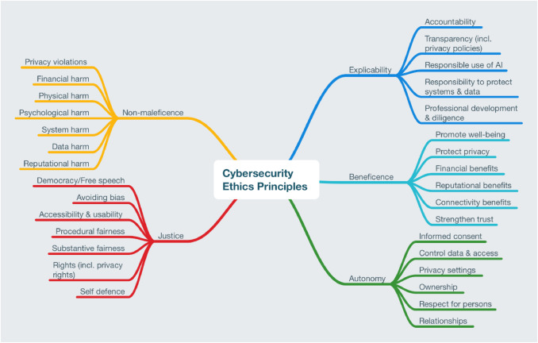
Ethical Considerations
Sensitivity of
- Patients
- Doctors
- Board Members
- GDPR
Figure1. Five cybersecurity ethics principles (Formosa et al, 2021).
Notes:
Arguably, there are broad ethical considerations to be made by any medical institution given the sensitivity of data they store.
Cybersecurity ethics must be applied to cultivate ethical sensitivity of patients, doctors, and board members (Formosa et al, 2021).
GDPR is a new requirement for Queens as the clinic will now be storing personal patient information.

Slide 5
Training + Awareness
Weakest Link? or
GREATEST Asset
Hi + Low
Level Training
User Awareness
Motivation
Is Key
Make
Training Fun!
Game-Based Learning
Notes:
Employees can be the weakest link in cyber defence however, with the right training employees can be your biggest allay (Pollini et al, 2021).
A study was conducted in 2010 to determine the impact of cyber threat education and awareness intervention. This involved numerous groups of people from many different companies presented with hi-level (low detail) and low-level (high detail) cyber training.
The high detail training made the most significant impact, compared to the low detail training, users in the high detail training changed their personal and work passwords to be more complex and set a schedule for future changes.
The study found that when users are educated and trained about proper security practices, their behavior can be changed to enhance online security for themselves and the firms where they are employed (Kevin et al 2010).
Training is ethically essential. NIST (2017) reported that 35% of all data breaches are attributed to negligence or human error.
Interestingly Kaspersky Lab and B2B International undertook a study on the role that employees play in the fight against cybercrime. The result revealed that 52% of all businesses believed that they are at risk from within (Kaspersky, 2017).

Slide 6


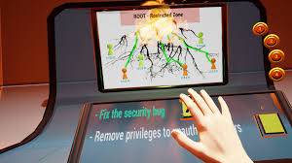
Game Based Learning
CyberCEIGE
Anti-phishing Phil
MAKE IT FUN!
Notes:
Importantly, traditional cyber training does not work for everyone, motivation is the key ingredient to successful learning.
Employee motivation for cyber training and awareness can be difficult to achieve as people have different motivators. Many forms of security training fail, as the users are not required to think and apply security concepts.
One interesting avenue for learning and motivation is game-based learning, computer and video games are specialised in motivation.
A highly interactive video game used by the US military (CyberCIEGE) could be used as an organizational training tool and has proved to be an effective addition for basic cyber awareness training programs (Benjamin et all 2007).
80% of all breaches in 2021 occurred from phishing attacks. Therefore, a game such as Anti Phishing Phil which is based on learning science principles could be used as an effective training awareness tool.
Another study suggests that playing the game for 15 minutes dramatically increases knowledge of identifying three types of phishing URL’s: IP based URLs, sub domain, and deceptive. The results conclude that interactive games can be a promising way of teaching awareness of phishing attacks (Sheng et al, 2007).

Slide 7

Cyber Culture
Research has been conducted for decades
Surveys + questionnaires are most often used to measure this
40% of employees hide an incident when it happens
Organizational culture plays a substantial role in cyber culture models
Identify the key cybersecurity behaviors
Establish cybersecurity networks
Build a cybersecurity Hub
Develop a brand for cybersecurity team
Align security awareness with campaigns
Notes:
Cyber security has been researched for decades and still many businesses fall short of creating a successfully secure culture.
Betsy et al (2021) analyzed 58 research articles over ten years from 2010, using the PRISMA systematic literature review technique. The research indicated that there had been a significant increase in creating sturdy security cultures by implementing top down, consistently managed frameworks. It highlighted that creation of organizational culture played a substantial role in cyber models.
Kasperky (2017) reports that 40% employees of businesses globally hide an incident when it happens. Embedding security into the corporate culture means that staff will be less overwhelmed when security incidents occur, having standard operations procedures in place increases the probability of being reported efficiently (Tourinsky, 2021).
Three similar large organizations in Australia implemented five key initiatives to improve their cyber culture.

Slide 8
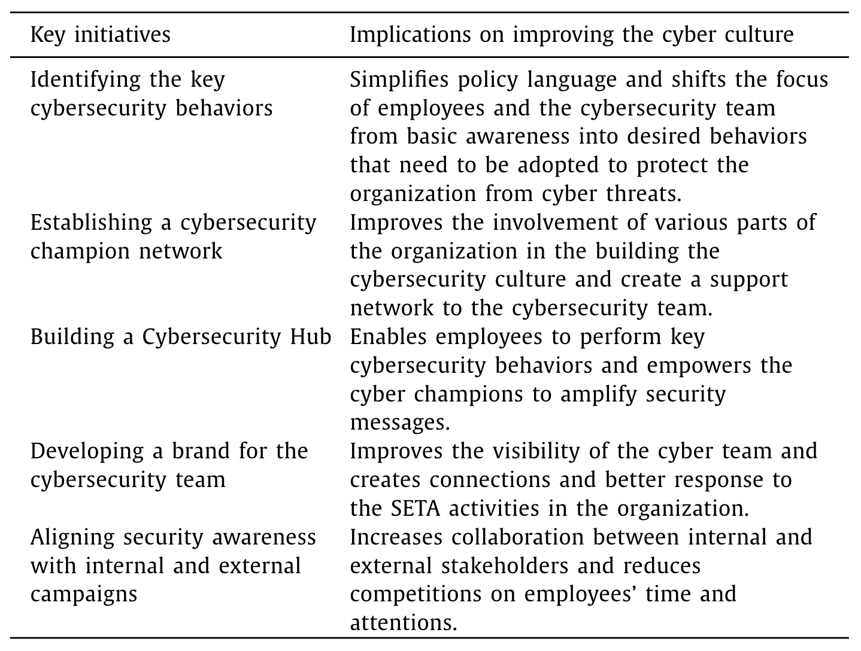
Improving Cyber Culture
Table 1. Key initiatives and its implication on improving the cyber culture (Moneer, 2020).
Notes:
The study showed that five initiatives dramatically influenced a positive culture change in businesses.
It was highlighted that building a cybersecurity culture takes continual investment and effort, follow up assessments are needed to evaluate the culture and to achieve sustainable behavioral change (Moneer, 2020).

Slide 9
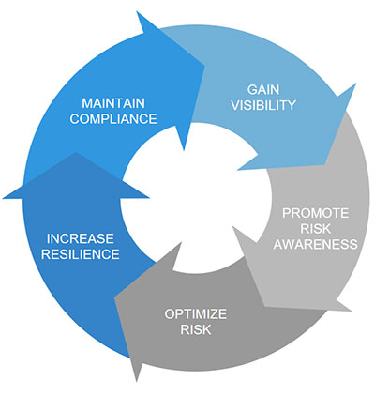
Information Security Lifecycle
1.
Cyber Risk
2.
Continual Improvement
= Network Breach
= Loss of Data
= Financial Loss
= Reputational Damage
Fig. 2. NIST Cybersecurity Lifecycle (Isaca.org, 2019).
Notes:
Today, more than ever cyber security and cyber risk encompasses not only risk of network breach but also loss of data, financial loss or irreparable reputational damage. (Rothrock et al, 2018).
Stakeholders play a vital role in the implementation and continual improvement of the cyber security lifecycle.

Slide 10
Leadership Requirements
Setting the tone
Empowering staff
Speaking positively
Taking responsibility
Notes:
Executives can no longer simply delegate cyber security to the information technology department. It is the responsibility of every employee at every level. (Rothrock et al, 2018).
Business executives, while familiar with the business and risk management, often view cybersecurity as solely a technical problem. This mindset needs to shift into incorporation and awareness of the human elements of risk as a core component of leadership (Hasib 2014).
Achievable through:
- Setting the tone of importance in security, leading by example. Employees notice and respect senior management when they fully take on the cyber security space (Tourinsky, 2021).
- Empowering staff by making it easy to raise security concerns at any level within the organisation.
- Speaking positively and freely to staff about the importance of cyber security within the organisation.
- Taking responsibility for the potential security risk they pose as likely targets(whales) for attackers to exploit and should take appropriate measures to act accordingly.

Slide 11
ASMIS + Digital
Improved Efficiency
02
Quality of Service
Human Factor = Key to Success
Culture, Training and Stakeholder Buy In
Notes:
ASMIS has been proven to dramatically improve efficiency and quality of service within the healthcare sector.
However, digital transformation and the COVID-19 global pandemic expedited the adoption rate of health information systems at the loss of the human factor (Nifakos et al, 2021).
The Human factor is a scientific field that is underutilized and undervalued in information security and cybersecurity (NSTC, 2016).
To quote Auguste Kerckhoffs, “It must be easy to use and must neither require stress of mind, nor the knowledge of a long series of events”. Understanding the human factor is the key to success in developing a security aware culture.

Slide 12
Creating a genuine cyber culture with adequate motivational cyber security training, alongside stake holder and management buy in, while incorporating the human factor is key to mitigating security risks associated with human characteristics (Kadena and Gupi, 2021).
Ultimately…
Notes:
It's essential for Queens Medical Centre to create a genuine cyber culture with adequate motivational cyber security training, alongside stakeholder and management buy in.
In doing this they must also incorporate the human factor, which is key in mitigating the security risks associated with human characteristics (Kadena and Gupi, 2021).

