Slide 1


CreativeConnect
Digital Marketing Project
Pathway 4 — Founder's Challenge
WHAT I OWN
Iyaash Ahmed
Student ID A273864
Technical build, booking flow and measurement
Team: Hammadh · Iyaash · Aiman
The public website and booking page
The request form and its API route
The lead store and protected admin inbox
GA4 event instrumentation
The end-to-end deployment test
Notes:
Opening — see speech, Slide 01. Keep to 30 seconds.

Slide 2

CreativeConnect
SHARED STORY
The venture concept
A planned photo and video studio in Malé, serving personal and commercial projects across the Maldives.
Who it serves
What it sells
Why a brief, not a checkout
Couples planning weddings and elopements; resorts, hospitality teams and smaller brands. Events, portraits and family sessions are secondary.
Photo and film together, scoped around one brief, with a written quote before anything is booked.
Crew, schedule and deliverables depend on the project, so the site collects a brief instead of taking instant payment.
Notes:
Speech slide 03.

Slide 3

CreativeConnect
SHARED SYSTEM
The customer journey
Four handoffs. Each one has to work, and each one is measurable.
01
02
03
04
Instagram
Website
Booking
Lead inbox
→
→
→
Audience discovers a post
Explores services and work
Sends a project brief
Team follows up
The details a visitor chooses to give us are first-party data, exchanged for a written quote — not collected without a purpose.
Notes:
Speech slide 09.

Slide 4

CreativeConnect
SHARED EVIDENCE
Build status and proof still needed
I separate what the source code contains from what the deployed service can prove.
Shown in the supplied source
Proven on the deployed service
Website with four package cards and a booking page
Form route into a SQLite lead store
Protected admin inbox with pipeline stages
GA4 event calls in the code
Public URL opens on desktop and mobile
A dated test request reaches the inbox
The stage can be changed by the team
GA4 events visible in DebugView / Realtime
A working local build is not proof. Every claim on the next slides is a dated capture from the live service.
Notes:
Speech slide 11.

Slide 5

CreativeConnect
E01
Public website
The live site, opened without any admin login.
E01 · PUBLIC SITE
Owner
Iyaash
INSERT SCREENSHOT
Live URL + date, desktop and phone
Capture exactly
Home page on desktop and mobile, with the URL bar visible.
Check
Domain, date, hero, navigation and the booking call to action.
Notes:
Speech slide 12. Say the exact URL and the date of the capture.

Slide 6

CreativeConnect
E02
Packages and Going Big
Three approved starting prices and a fourth custom-quote tier.
E02 · PACKAGES
Owner
Iyaash
INSERT SCREENSHOT
Four cards, prices, Request a custom quote button
Capture exactly
The live packages section showing all four cards.
Check
From MVR 2,500 / 5,500 / 9,500 and Going Big as a custom quote.
Base prices cover a single Greater Malé location. Travel, extra crew and wider production are quoted in writing.
Notes:
Speech slide 13.

Slide 7
CreativeConnect
E03
Booking request
A clearly labelled test request, submitted like any visitor.
E03 · BOOKING
Owner
Iyaash
INSERT SCREENSHOT
Form + thank-you page, labelled TEST
Capture exactly
The completed form and the confirmation page.
Check
Package preselected, required fields, date, confirmation wording.
Notes:
Speech slide 14.

Slide 8
CreativeConnect
E04
Lead inbox and status
The same request inside the protected admin inbox.
E04 · LEAD INBOX
Owner
Iyaash
INSERT SCREENSHOT
Redact name, email and phone before capturing
Capture exactly
The leads list, with contact details redacted.
Check
Matching date and time, stage moved from Booking request to Contacted.
Pipeline stages: Booking request → Contacted → Quote sent → Booked → Lost.
Notes:
Speech slide 15.

Slide 9
CreativeConnect
E05
GA4 verification
Measurement checked on the deployed site, not in the code.
E05 · GA4
Owner
Iyaash
INSERT SCREENSHOT
Remove this slide if GA4 is not connected in time
Capture exactly
DebugView during the test journey, plus Realtime during the class visit.
Check
Property ID, date, and the order page_view → form_start → generate_lead.
generate_lead is marked as the key event. Consent Mode v2 denies analytics storage until a visitor accepts.
Notes:
Speech slide 16. If GA4 is not live, delete this slide and its narration.

Slide 10


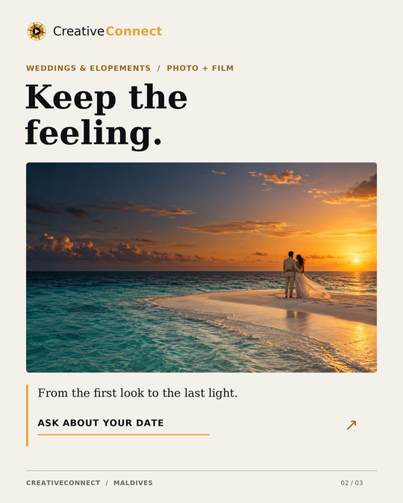
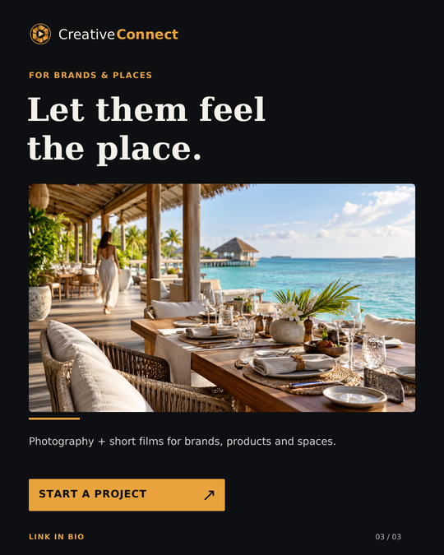
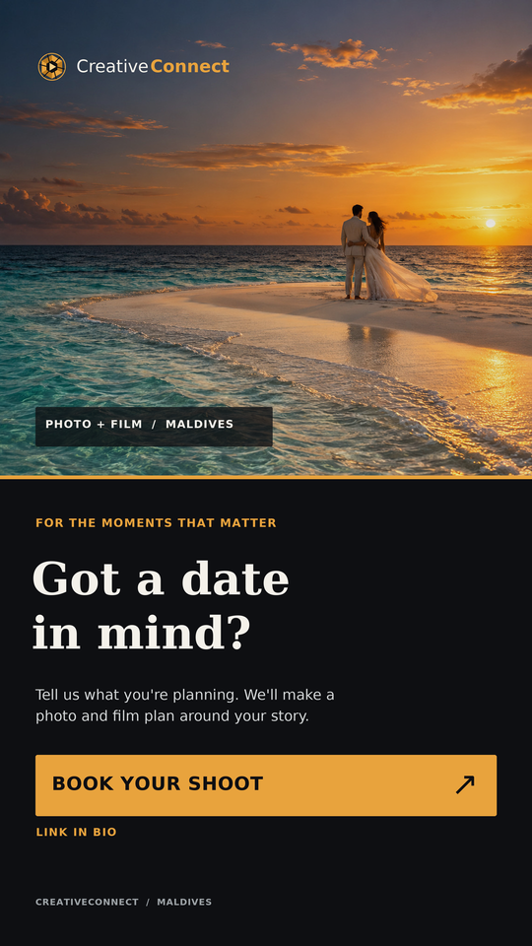
CreativeConnect
E06
Active social connection
Aiman owns the content. I verify that the link works end to end.
E06 · INSTAGRAM
Owner
Aiman creates the content. I verify the link.
Published
The four creatives above go out today.
Post 01 · Studio intro
Post 02 · Weddings
Post 03 · Brands
Story · Book your shoot
Check
INSERT SCREENSHOT — the live @mvcreativeconnect profile and the bio link opening the booking page on a phone
Handle, post dates, bio link, and the booking page reachable in two taps.
Creatives shown are the approved campaign assets. Only claim engagement figures once the posts are actually live.
Notes:
Speech slide 17. Only claim what is actually published.

Slide 11

CreativeConnect
SHARED SCORECARD
Targets versus actual results
Targets were written before launch. Test activity is counted separately from live activity.
Metric | Target — first 7 days | Actual as at 28 Sep | Source
Website sessions | 150 | Not yet measured | GA4 report
Package selections | 40 | Not yet measured | GA4 event
Form starts | 20 | Not yet measured | GA4 event
Submitted enquiries | 5 | 0 genuine | Admin inbox + GA4
Labelled test requests (excluded) | n/a | 1 — 23 September | Admin inbox
Instagram reach | 800 | Posts published today | Insights
Bio or story link taps | 60 | Posts published today | Insights
Targets set for the seven days from launch, 28 September to 4 October. Amber cells are replaced with real figures before the presentation. A test enquiry is never presented as a customer result.
Notes:
Speech slide 21. Fill every cell before recording.

Slide 12
CreativeConnect
INDIVIDUAL ANGLE
Technical ownership
Under the visible pages: a form route, a lead store and a protected inbox.
Booking form
Six fields, plus a brief, locations and budget range when a custom quote is chosen.
API route
Validates on the server as well as the browser, rate limits abuse and blocks bot submissions.
Lead store
SQLite. Each request keeps its own status, source, timestamp and private notes.
Admin inbox
Password protected, with roles, CSV export and a JSON backup.
Privacy
Consent recorded with the request. The privacy page names our own database, not an outside CRM.
Notes:
Speech slide 24.

Slide 13
CreativeConnect
INDIVIDUAL ANGLE
Deployment test sequence
Four steps, four separate failure points.
01
Open the public URL on a second device
02
Submit a clearly labelled test request
03
Find it in the protected inbox and change its stage
04
Confirm the matching GA4 events
A polished home page is worth nothing if the request disappears after submission.
Notes:
Speech slide 25. State the issue you found, or say there was no blocking issue.

Slide 14

CreativeConnect
TEAM SYNTHESIS
Conclusion
A small, usable journey: discover the offer, send a brief, get a written quote.
What we proposed
What I built
What the evidence shows
A clear photo and film offer for couples and brands, with prices approved in writing.
A public site, a booking request, a lead store and a protected inbox, instrumented for GA4.
____ verified live elements, with test activity labelled and kept out of the results.
Next priority: ____________________________________________
Notes:
Speech slide 29.

Slide 15
CreativeConnect
TEAM MASTER
References and documentation
DataReportal (2025) Digital 2026: Maldives. Available at: https://datareportal.com/reports/digital-2026-maldives (Accessed: 28 September 2026).
Google (2025) Next steps for Privacy Sandbox and tracking protections in Chrome, 22 April. Available at: https://privacysandbox.google.com/blog/privacy-sandbox-next-steps (Accessed: 28 September 2026).
Google (2026) About key events, Google Analytics Help. Available at: https://support.google.com/analytics/answer/9267568 (Accessed: 28 September 2026).
Google (2026) Set up consent mode on websites, Google for Developers. Available at: https://developers.google.com/tag-platform/security/guides/consent (Accessed: 28 September 2026).
Hick, W.E. (1952) 'On the rate of gain of information', Quarterly Journal of Experimental Psychology, 4(1), pp. 11-26.
Oldroyd, J.B., McElheran, K. and Elkington, D. (2011) 'The short life of online sales leads', Harvard Business Review, March. Available at: https://hbr.org/2011/03/the-short-life-of-online-sales-leads (Accessed: 28 September 2026).
Project documents: CreativeConnect Venture Concept; CreativeConnect Package Price Approval; CreativeConnect Project Report (technical documentation).
Notes:
Speech slide 30.

