Slide 1

Team Members:
Anup Ahuje
Manish Varma Datla
Nursultan Dyussebayev
Prabhu Saitu
Tech Integrated:
GS1 ()
Blockchain (Ethereum Blockchain, Smart Contracts, Solidity, MetaMask )
Web (Flask, JavaScript, HTML & CSS)
Mobile (iOS)
What Challenge(s) You focused on:
Business Problem 3: Transparency and Certifications
Business Problem 4: Data Discovery

Slide 2





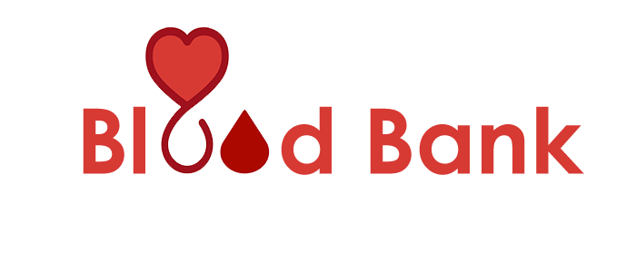
Problem
Blood Donor
Blood Bank
Lab Tests
Hospitals
Blood Receiver
Less than 10% of the eligible US population donates blood.*
1 in 7 hospital patients need blood.*
*https://www.lstream.org/about-donating/donation-facts/

Slide 3
Problem
Donors DO NOT KNOW how their blood is being utilised
*https://www.lstream.org/about-donating/donation-facts/

Slide 4


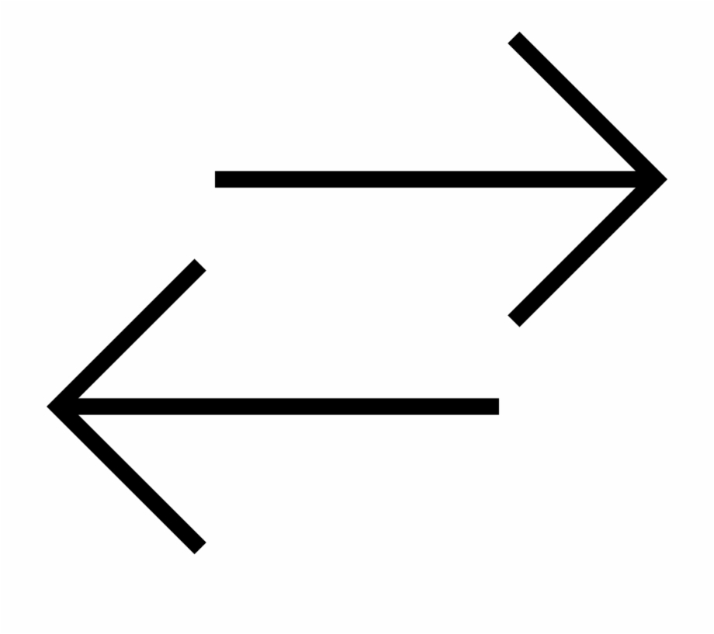
Distributed - Traceable
Solution
Verified - Validation & Certification
Secure Database - Tamper Proof Data Sharing
Ethereum Blockchain

Slide 5
DEMO

Slide 6
LET’S
SAVE LIVES
DONATE BLOOD

