Slide 1
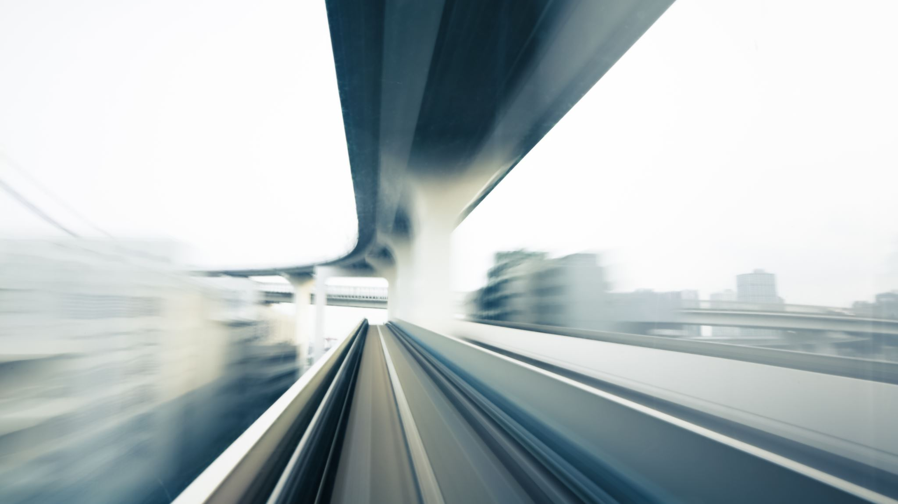
CONNECTR
Asa Kohrman, Marco Pizarro, Max Vandervelden

Slide 2

Making public transit easier through connection

Slide 3
MARKET RESEARCH
CityMapper
Transit
Google/Apple Maps
Yikyak
Allows you to see all bus/train stations in your area
Easy for exploration/new places
Multiple different considered modes of transportation
Social feature where you see how your tracking has helped other people
Shows bikeshare options and nearby lines
connected to Uber/Lyft
live updates
transportation overview
shows multiple transportation options
best integrated with Google search
Location based posts
Community engagement
Clean, fun UI

Slide 4
TASKS
Chatbot Support
Interaction with Other Riders
Direct Messaging
Media Sharing
Notes:
Simple
You’ve been waiting for a bus for a while and need to ask the chatbot a question about how delayed the next bus is.
You want to meet other people on your ride and ask other riders if they want to meet you at your stop.
Moderate
You are getting off soon and want to directly message the user who wants to meet up.
Complex
You are listening to a good song/podcast and invite the person next to you to listen as well.

Slide 5
VALUES IN DESIGN
Accessible design
clean and uncrowded design
disclaimers about accessibility of trains and buses
Connected design:
Safeguards to prevent harassment
Encourage users to interact with each other
Usability
Make transit visualization uncomplicated
Accessibility
Connection
Usability

Slide 6
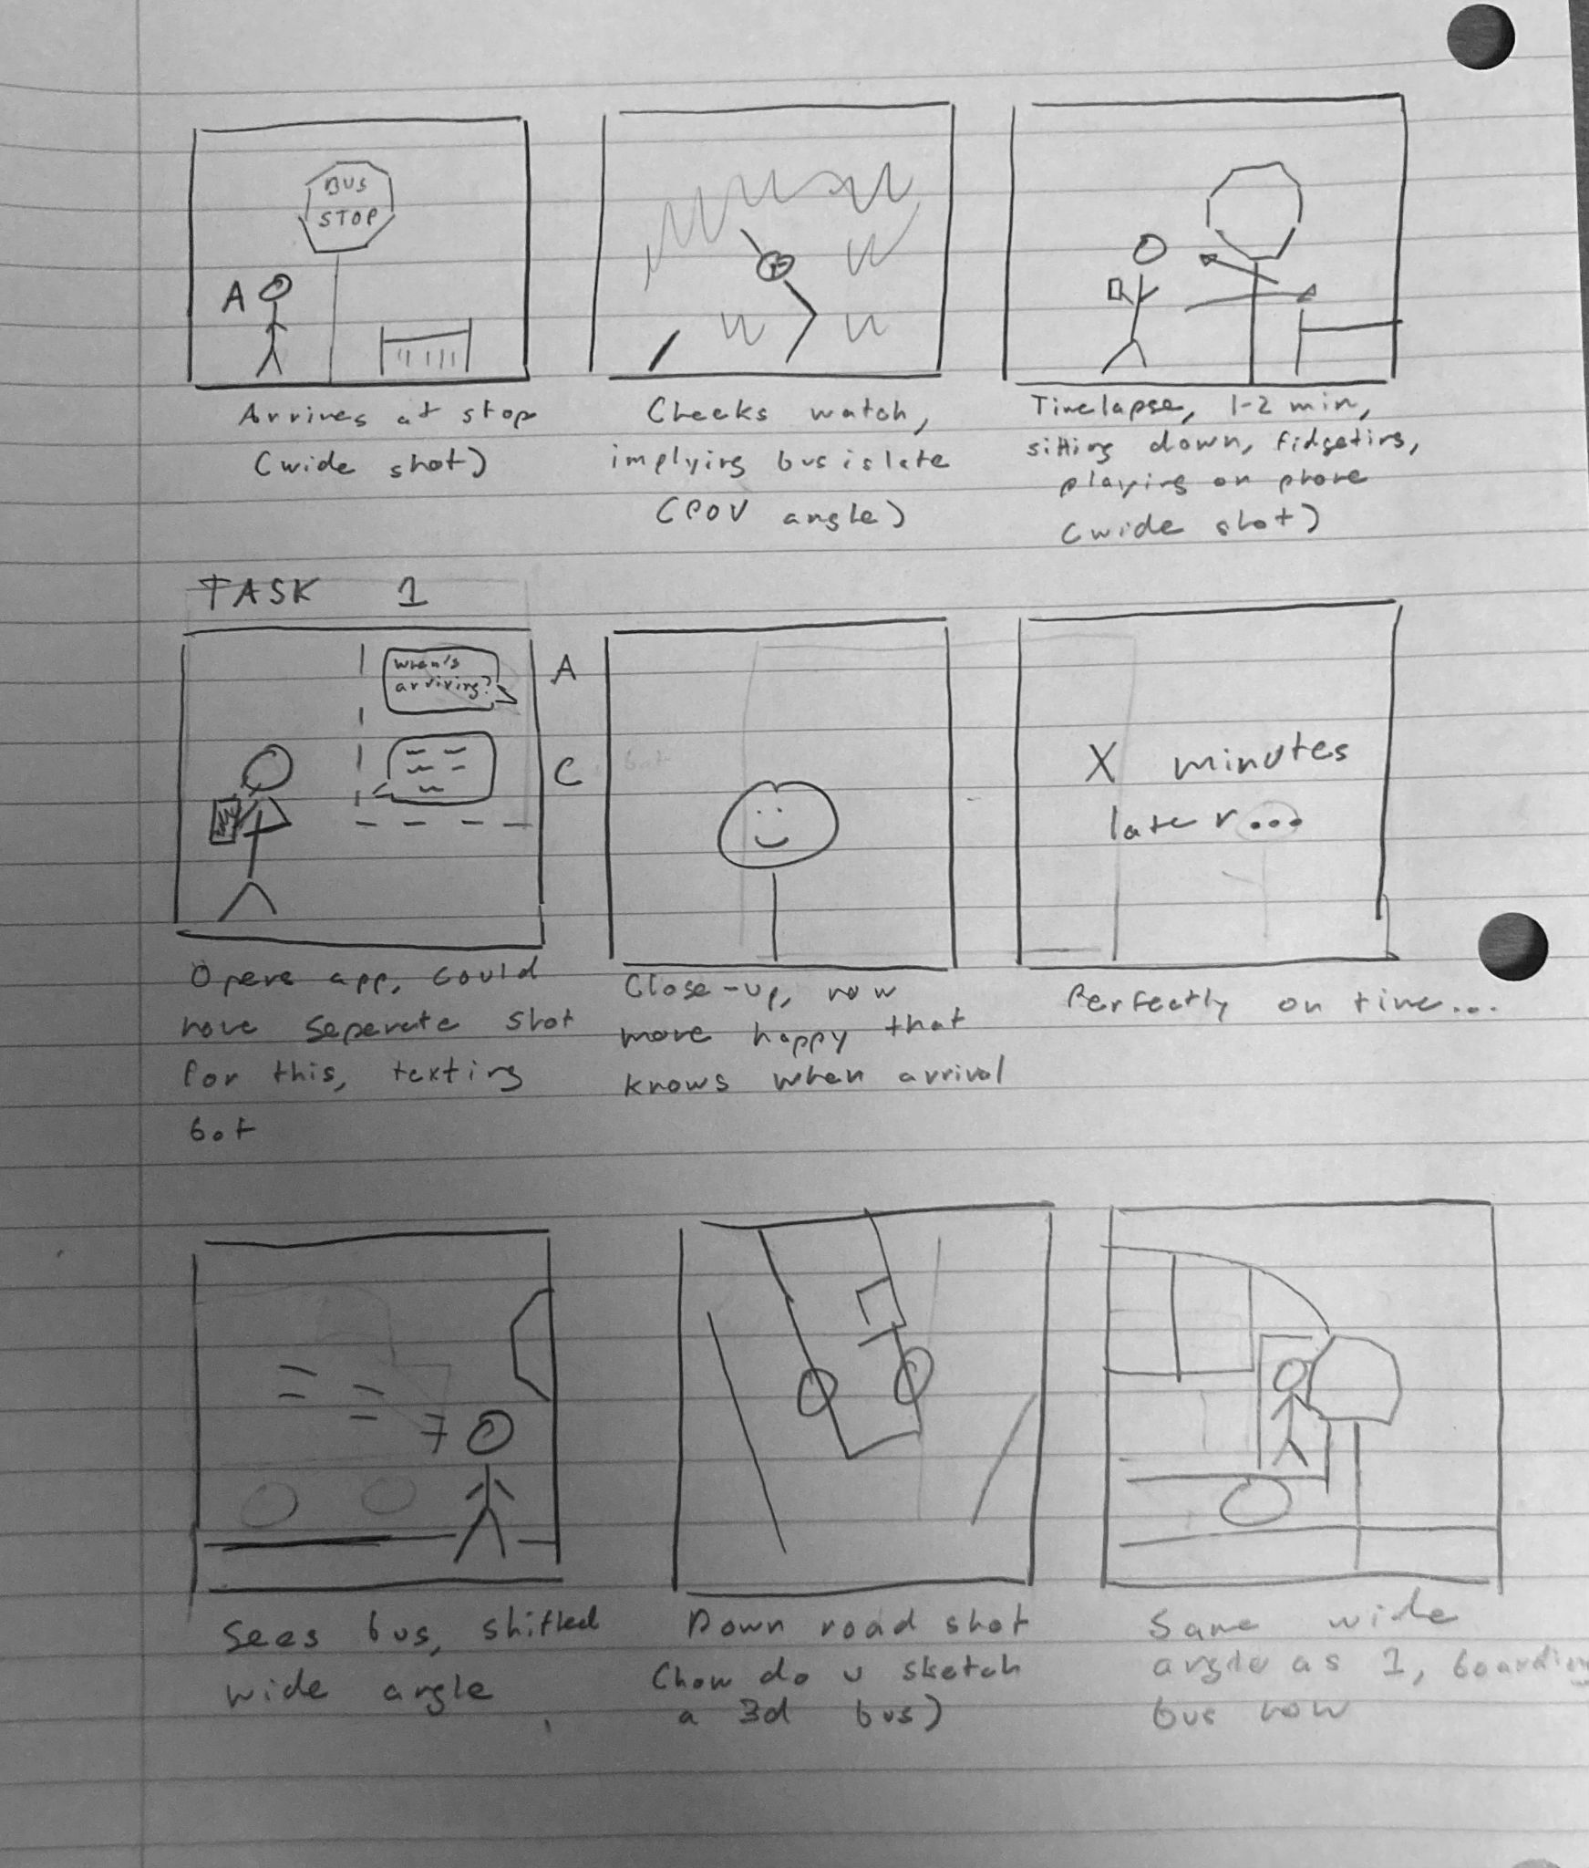
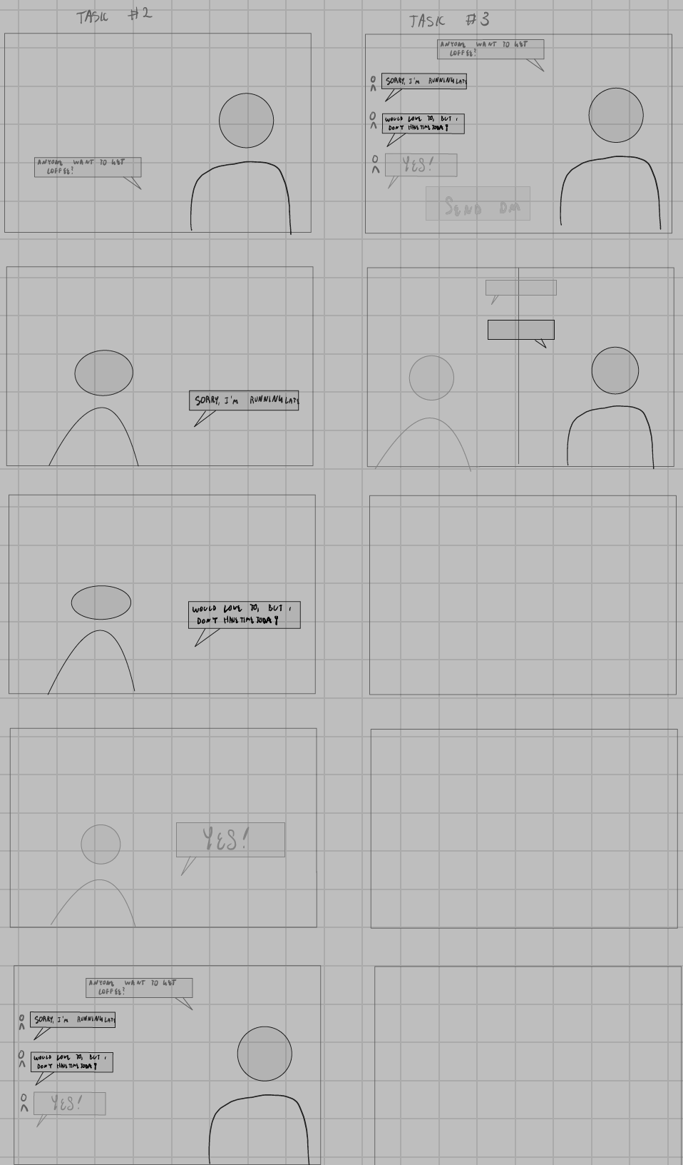
ASA’S STORYBOARD

