Slide 1
Bring EHR-S FM tooling into
Common HL7 Toolset
(FHIR IG Tooling)
HL7 WGM virtual JAN2025

Slide 2


Topics
EHR product IG family and the canonical hl7.ehrs
EHR IG logo requirements?
IG preprocessor – node script to convert the max source file to Requirements
  GitHub Action - not enabled on HL7 repo
  Hook in template in ant file?
Maybe to much detail, but how to do the FP ig
Other open issues

Slide 3
Bring EHR-S FM tooling into Common HL7 Toolset
(FHIR tooling infrastructure)
HL7 WGM virtual JAN2024

Slide 4
Update JAN2024
Function Statement → description
  Why: is rendered in artifacts list and Function Statement is shorter
Function Description →purpose
  Why: more verbose now rendered in function page
The suggested solution is “short description for use in lists” extension, but that is not used by the IG publisher :-(
Function Reference → derivedFrom
http://hl7.org/fhir/extensions/StructureDefinition-canonicalresource-short-description.html

Slide 5
Move EHR-S FM tooling to FHIR tooling infrastructure
HL7 WGM New Orleans MAY2023

Slide 6
Update MAY2023
New FHIR R5 Requirements Resource http://hl7.org/fhir/5.0.0-draft-final/requirements.html
Requirements.reference and Requirements.statement.reference

Slide 7
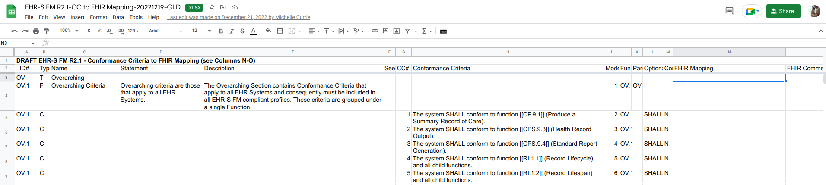
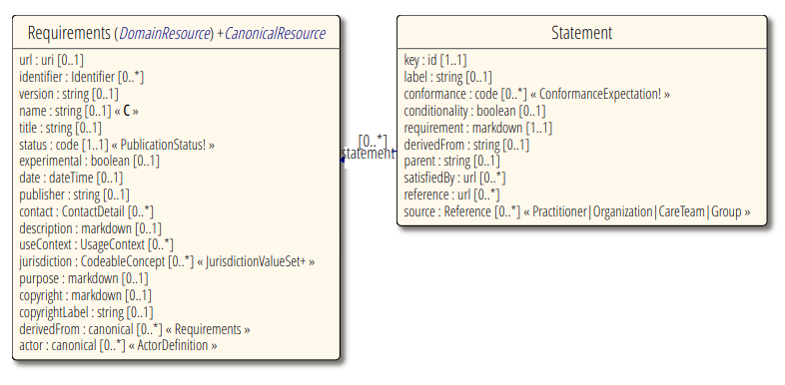
Mapping FM R2.1 to FHIR Requirements Resource
data reqs
OV.1#02
Name = filtered title
Req.short!
N.B. Terms differ
e.g. FHIR Mapping vs satisfiedBy
Conformance criteria vs requirement
Optionality vs conformance
If this is a Functional Profile
reference

Slide 8
0
FM
Requirements: EHRSFMR2.1
.id: “EHRSFMR2.1”
.title: “EHR System Functional Model R2.1”
.version: “R2.1”
.status: “active”
Typo in Description of “description” → “Natural language description of the actor” → “requirement” FHIR-39054
Why is cardinality of conformance 0..*? FHIR-39057
1
Section
Requirements: CP
.id: “EHRSFMR2.1-CP”
.title: “Care Providion”
.parent: “EHRSFMR2.1”
2
Requirements:
.id: “EHRSFMR2.1-CP.1”
.title: “CP.1 Manage Clinical History”
.parent: “CP”
.reference “EHRSFMR1#DC.1.4”
Header
http://hl7.org/fhir/extensions/0.1.0/StructureDefinition-canonicalresource-short-description.html
.reference is missing at top level
FHIR-40274 new
How can I do the hierarchy
Section → Header → Function?
Try .parent or Composition. See FHIR-39059
https://build.fhir.org/ig/HL7/fhir-extensions/StructureDefinition-requirements-parent.html
3
Requirements: CP.1.4
.id: “EHRSFMR2.1-CP.1.4”
.title: “CP.1.4 Manage Problem List”
.extension.short: “Create and maintain patient-specific problem lists.”
.description: “A problem list may include, but is not limited to chronic conditions, diagnoses, or symptoms, injury/poisoning (both intentional and unintentional), adverse effects of medical or dental care (e.g., drugs, surgical), functional limitations, visit or stay-specific conditions, diagnoses, or symptoms.. ...”
.parent “EHRSFMR2.1#CP.1”
.statement [ {
.key: “EHRSFMR2.1-CP.1.4-03”
.label: “CP.1.4#03”
.conformance: “SHALL”
.requirement: “The system SHALL provide the ability to manage the status of each problem (e.g., active, inactive, resolved).”
.satisfiedBy: http://hl7.org/fhir/StructureDefinition/Condition#Condition.clinicalStatus
.reference: “EHRSFMR1#DC.1.4#03”
} ]
Function
How to do “IF” conditional statements? FHIR-39058
4
Criteria
.derivedFrom is used in FPs, but canonical at top level, but string at statement level?
Explained: See description in resource

Slide 9
Notes
Did initial R5 IG build: https://vdzel.home.xs4all.nl/ehrsfm-fhir-r5/, source https://github.com/mvdzel/ehrsfm-fhir-r5
What template to use? New: EHR Family?
QA: Add FM/FP rules in constraints of Requirements resource?
Output
  Sorting – Looks like grouping in the ig.json gets the result! (generate grouping and resources in script or should this be something in IG gen?)
  Show more attributes with criteria?
  Align with current FM/FP PDFs
Work on an FP example

Slide 10
Move EHR-S FM tooling to FHIR tooling infrastructure
HL7 WGM Henderson JAN2023

Slide 11
Update JAN2023
New FHIR R5 Requirements Resource https://build.fhir.org/requirements.html
Work on mapping data reqs FM R2.1 to FHIR Resources
  Added FHIR Path column to input spreadsheet for FM publication tooling
Work on convert script FM/FP R2.1 to R5 Requirements resources
IG Publisher tooling needs update to generate FM/FP format HTML (determine format)

Slide 12
Move EHR-S FM tooling to FHIR tooling infrastructure
HL7 WGM Baltimore 2022-sept

Slide 13
Now
What it does
  Spreadsheet template for authoring
  Generate FM/FP Publication (csv,html,pdf+isopdf)
  FM/FP Validation QA
New
  FM R3 and data requirements in FHIR – Prototype CP.1.4 Problemlist
  FHIR R5 Requirement Resource http://build.fhir.org/requirements.html

Slide 14
Current tooling stack
Specifications in HL7 MAX format generated from spreadsheet by node scripts
.Net MAX Library and .Net FM/FP Compiler / Validator (& schematron)
Apache FOPS and Ruby for csv/html/pdf
Command line – N.B. Sparx EA not used anymore
All in a Docker image available on github
Work-in-progress and version control of source material in bitbucket.hl7.org(restricted) output on hl7.org

Slide 15
Next tooling
Only html output same look & feel as FHIR specs now
  New view like current FM/FP publication table view with the FM/FP w/ links to FHIR IG artifacts
  Coverpage and Overview chapters could be html
Use the auto-IG-builder infrastructure
First step: Authoring still spreadsheet and script to convert to FHIR artifacts, publication pipeline new

Slide 16
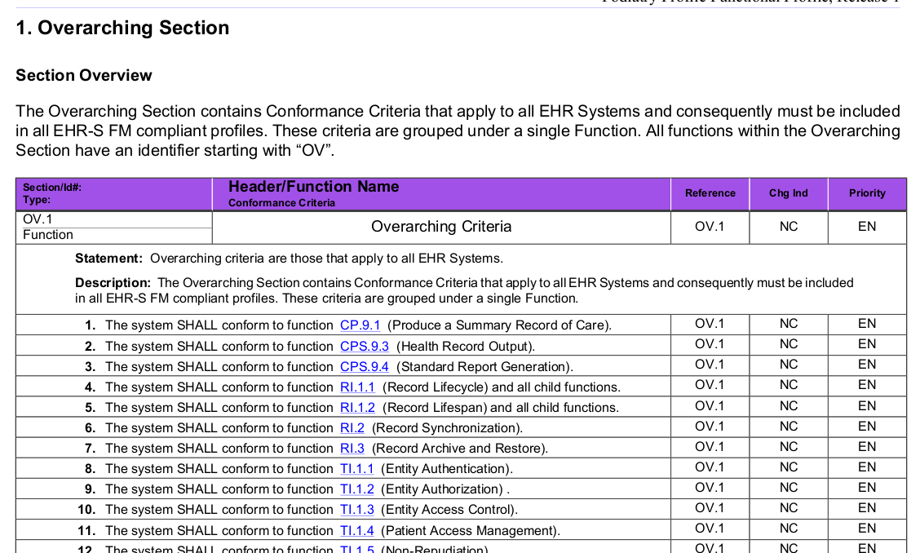

Slide 17
Questions
FHIR Logical Resources needed to contain all FM/FP content, some as IG page templates, do we need a Function resource?
IG Publisher Output: If the table view cannot be achieved by changes to the IG pages, the FHIR IG Publisher needs adjustment or extension, just like for IHE with the sequence diagrams.
Validation / QA:
  How to add/define the FM/FP validation rules?
  Hook into IG QA for Validation
Relation with https://jira.hl7.org/browse/PSS-2088 “Standard Personal Health Record”?
And who will do what?

