Slide 1
Tail Recursion in Scala

Slide 2
Tail Recursion in Scala What we’re going to cover:
My appreciation of Alvin Alexander
A simple recursion example
A brief explanation of stacks and frames
How to break our simple example
How to fix our example using tail recursion

Slide 3
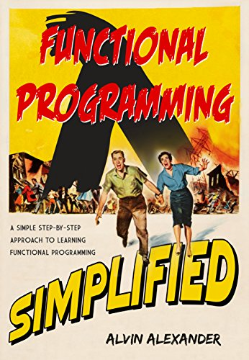
All Hail Alvin
The example used during this session is taken directly from Alvin Alexander’s fantastic book – “Functional Programming, Simplified: (Scala Edition)”
Go and buy it ^{[1]}
Or read it online for free! ^{[2]}
[1] https://www.amazon.co.uk/Functional-Programming-Simplified-Alvin-Alexander-ebook/dp/B076J7CJKY
[2] https://alvinalexander.com/scala/fp-book/learning-functional-programming-in-scala

Slide 4
Simple Recursion
Simple example, summing all the numbers in a list
“Sum” function takes a list of integers and returns an integer
Check if we’ve reached the end of the list (List() or Nil)
If we’re not at the end of the list, call the function again (recurse) and add the result to the head of the list

Slide 5
Stacks and Frames
Each Thread has a Stack (Call Stack)
Each Stack contains Frames (Stack-Frames)
For the sake of this session
“A stack frame is created every time a new method [function] is called”
“Stack frames can have different sizes, depending on the method’s parameters, local variables, and algorithm.”
“code can only access the values in the current stack frame”
https://alvinalexander.com/scala/fp-book/recursion-jvm-stacks-stack-frames
https://alvinalexander.com/scala/fp-book/recursion-visual-look-jvm-stack-frames

Slide 6
The Problem
Why do we care about stacks and frames?
Can our code handle summing all the numbers to a million?
What happens if we have a list with a much higher (or unknown) quantity of elements?
sum(List(1 to n)) => ???

Slide 7
Tail Recursion
The compiler optimises and controls the numbers of frames required in recursion
Add the @tailrec annotation to your function for compiler guidance
Rule of Tail Recursion: The recursive call must be the very last call of the function
So, why is our simple example not tail recursive?

Slide 8
Summary
Tail recursion can make iterating over large data structures much more efficient and help alleviate the dreaded StackOverflowError
The compiler is your friend (@tailrec)
If the size of the data structure is known and small enough bear in mind that simple recursion can be easier to read
There are cases where tail recursion is not recommended^{[1]}
Alvin’s FP book is fantastic, well worth a look
“Rock the JVM” (Daniel Ciocîrlan) provides an excellent Tail Recursion tutorial ^{[2]}, among many other great tutorials!
Code from this session can be found here -> github.com/mveeprojects/ScalaRecursion
[1] https://softwareengineering.stackexchange.com/a/331715
[2] https://blog.rockthejvm.com/sorting/

Slide 9
Thanks for listening!

