Slide 1
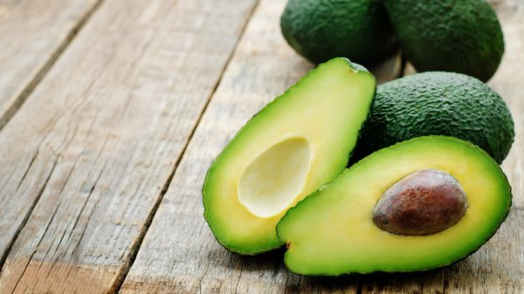
HASS AVOCADO BOARD
Mireya Vera Loo

Slide 2
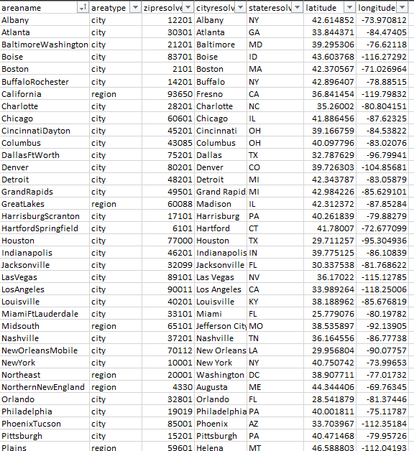
What did you build and how does it work?

Slide 3
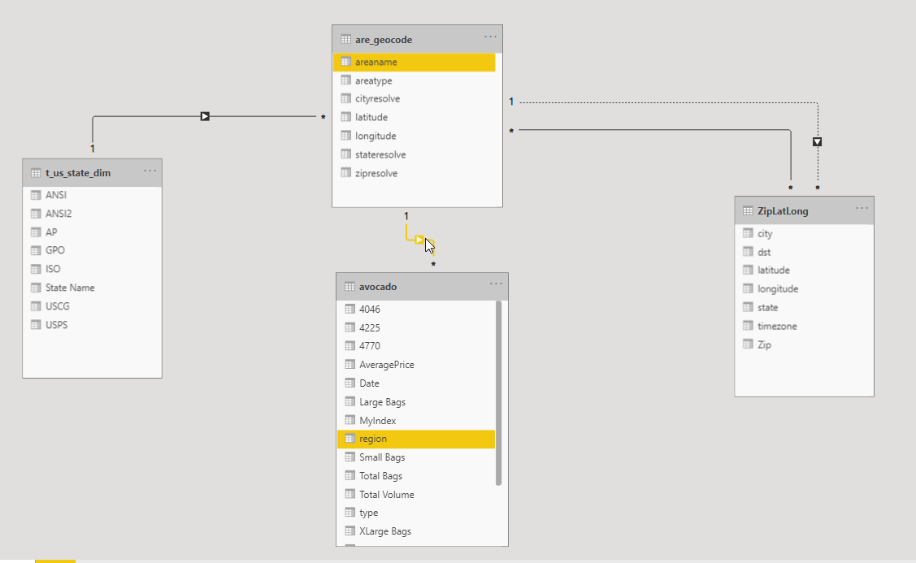
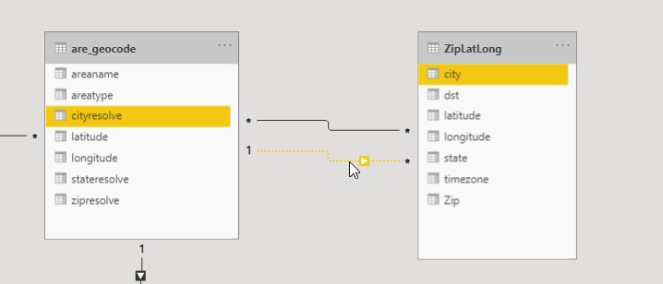

Slide 4
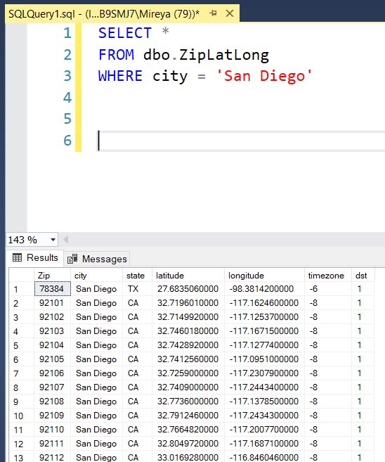
What logic did you use to overcome one City found in more than one State?

Slide 5
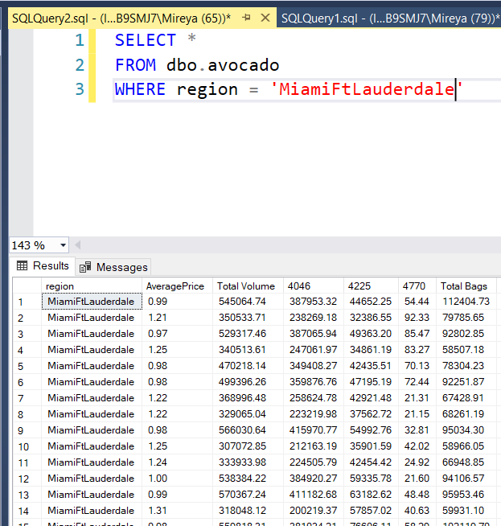
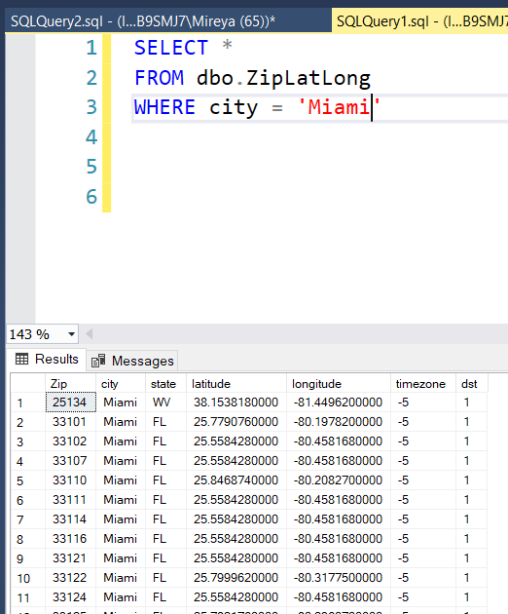
What logic did you use to deal with regions that imply larger metropolitan areas?

Slide 6
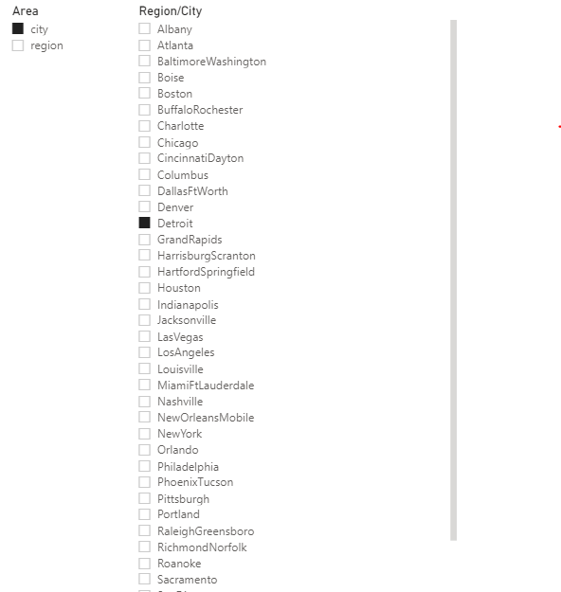
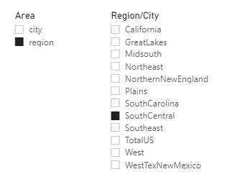
We want to re-brand "region" as "area" so please show us the results from that perspective 1. Segment "area" into two groups: city and region 2. There should be 12 regions and 42 cities

Slide 7
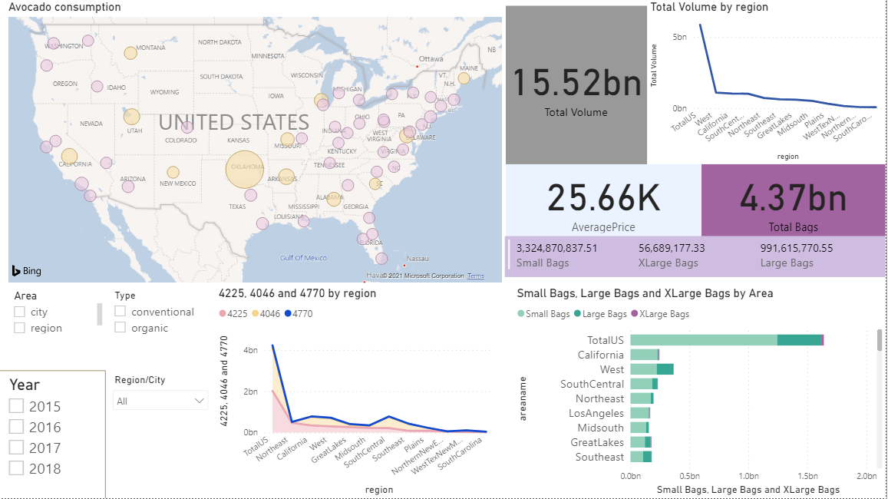
What is the purpose and objective of your dashboard?

