Slide 1

Houses Prices Prediction
Mireya Vera

Slide 2
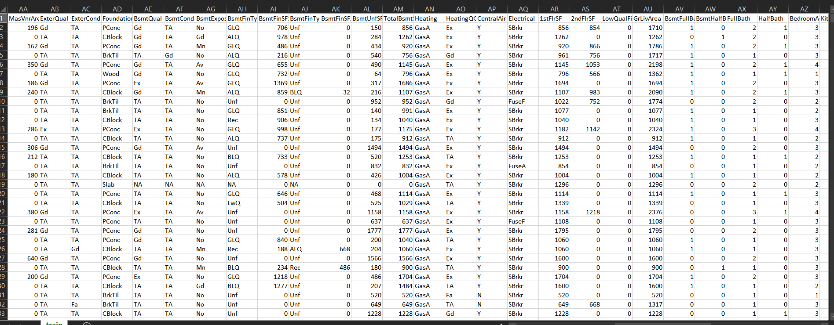
DATA:

Slide 3
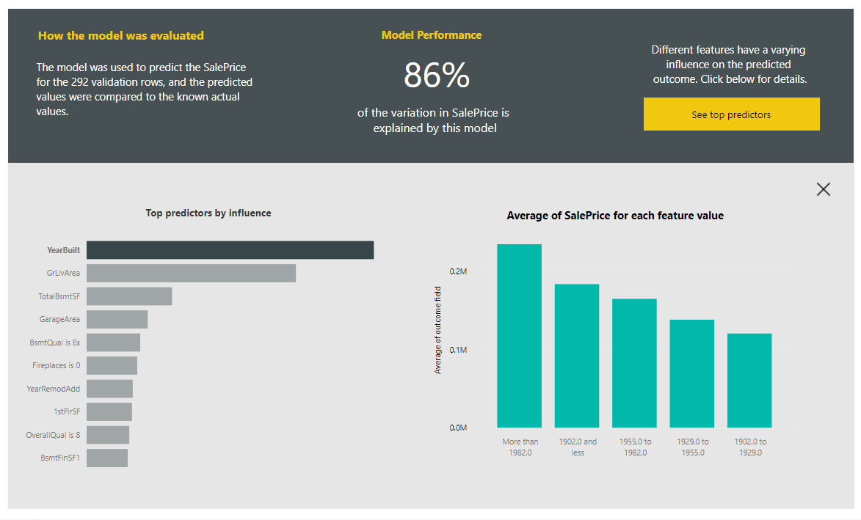
Model Report:

Slide 4
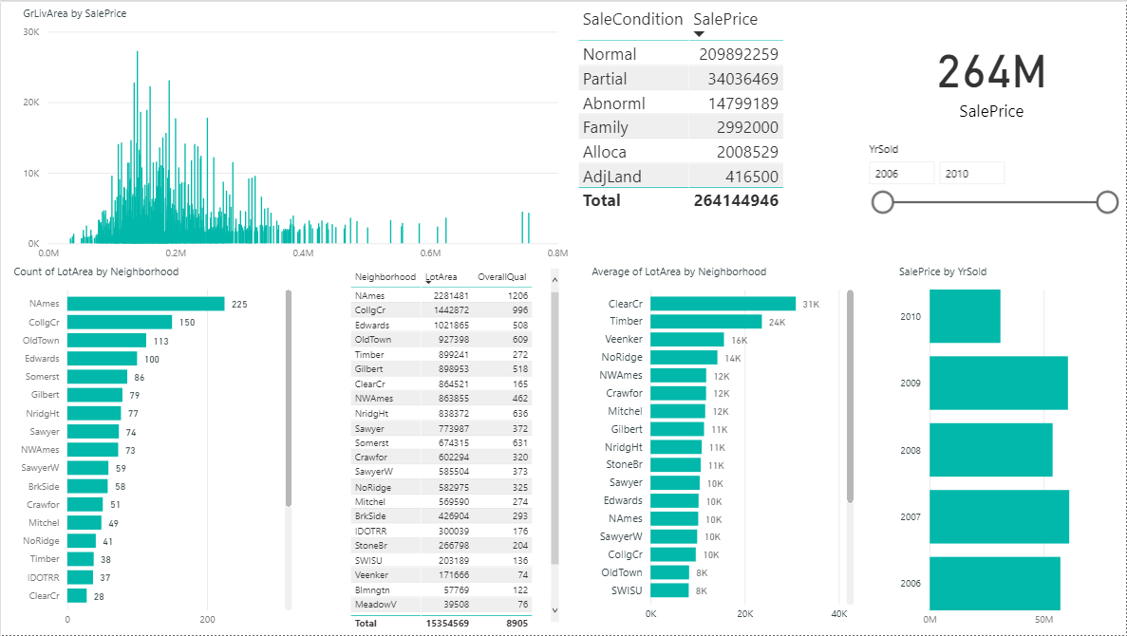
Dashboard”

