Slide 1
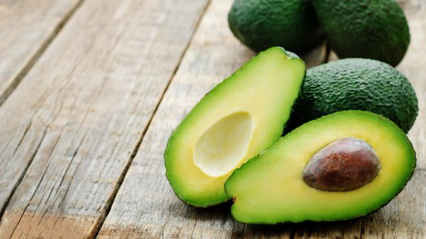
HASS AVOCADO BOARD
Mireya Vera Loo

Slide 2
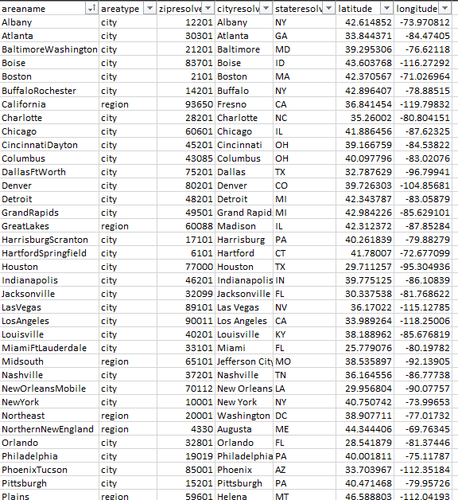
What did you build and how does it work?
First, I merged Avocado and ZipLatLong into one table to obtain all the regions and cities in one place. (excel document). Using SQL server, I was able to find the right Latitudes, Longitudes, and Zip codes.

Slide 3
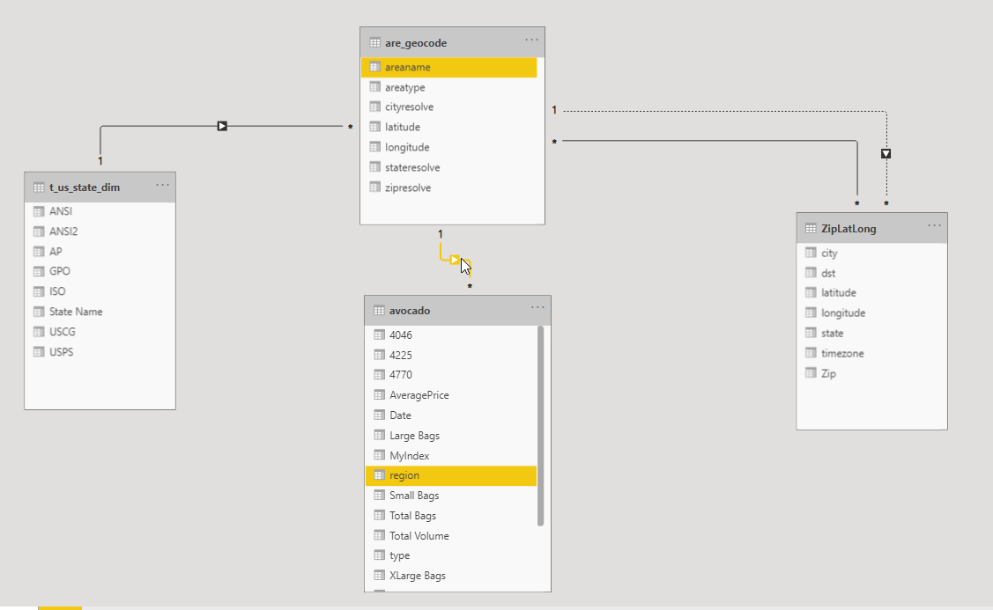
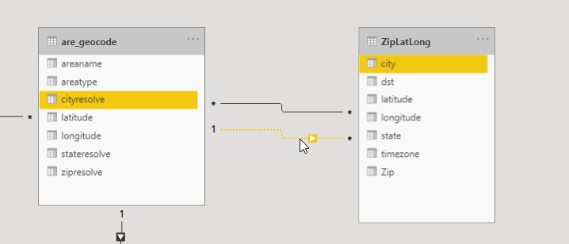

Slide 4
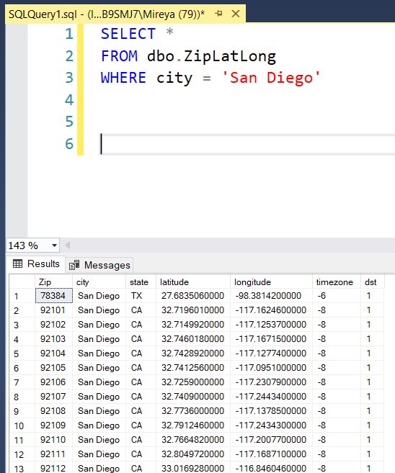
What logic did you use to overcome one City found in more than one State?
Since San Diego is found in California, I took the first Zip code that shows CA as the state.

Slide 5
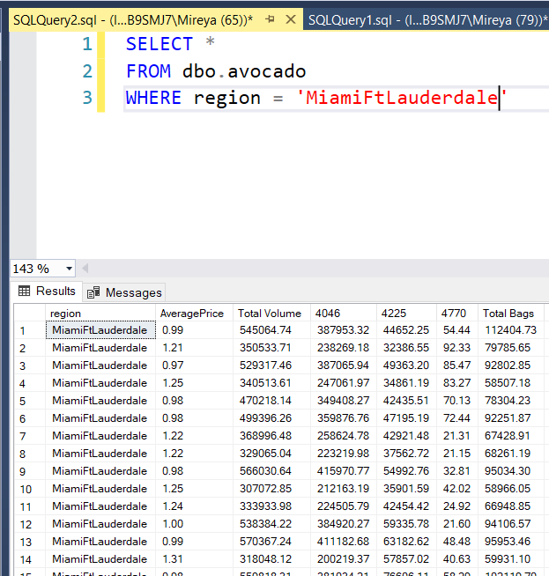
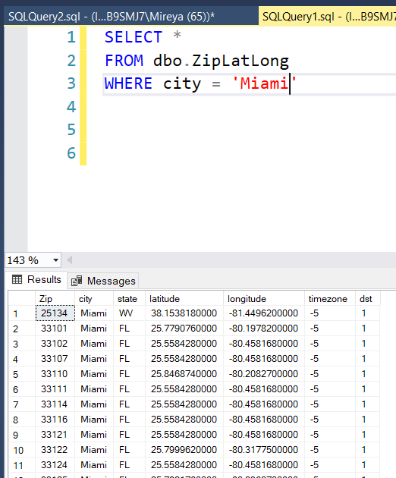
What logic did you use to deal with regions that imply larger metropolitan areas?
I opted for the first city written to be able to get a longitude and latitude.

Slide 6
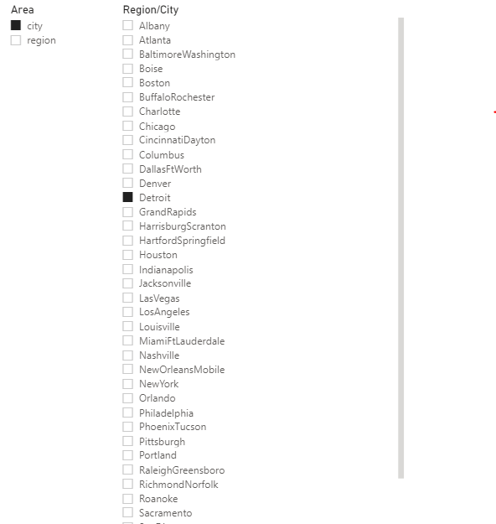
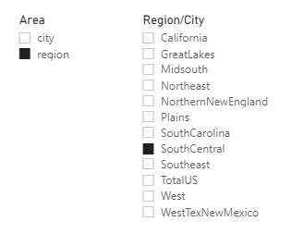
We want to re-brand "region" as "area" so please show us the results from that perspective 1. Segment "area" into two groups: city and region 2. There should be 12 regions and 42 cities

Slide 7
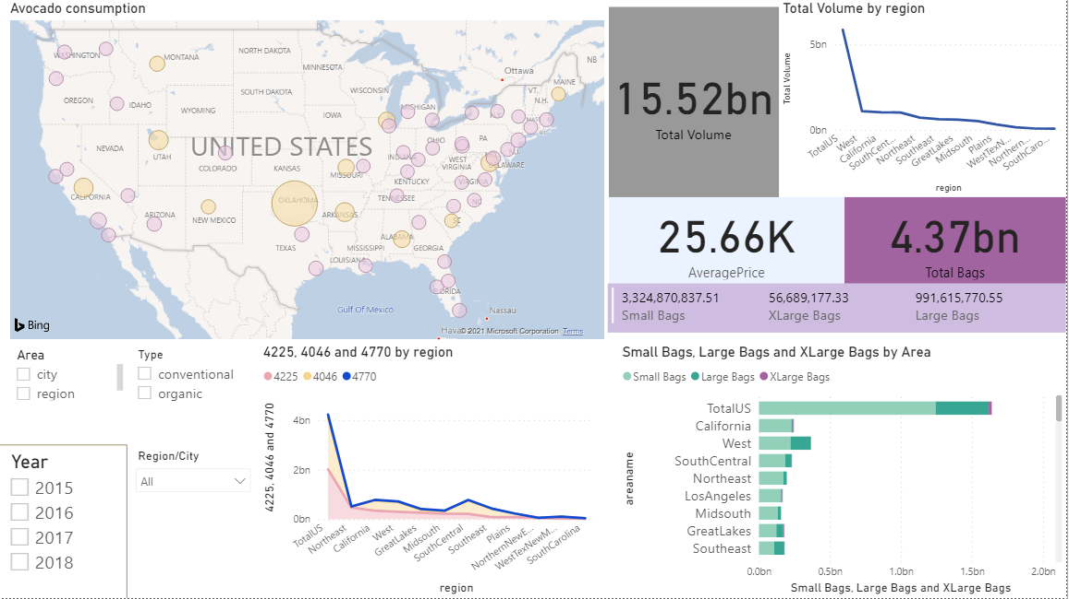
What is the purpose and objective of your dashboard?
Find the Avocado consumption in the US.
Per region
Per bag
Size
Per avocado
size
Per year
Per type

