Slide 1
ggplot2
R-Ladies Ljubljana 4.6.2024
Presentation based on: https://ggplot2.tidyverse.org/articles/ggplot2.html and https://rstudio.github.io/cheatsheets/data-visualization.pdf
Usefull resources:
https://r-graph-gallery.com/index.html

Slide 2
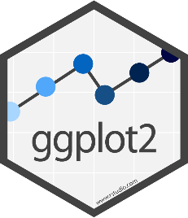
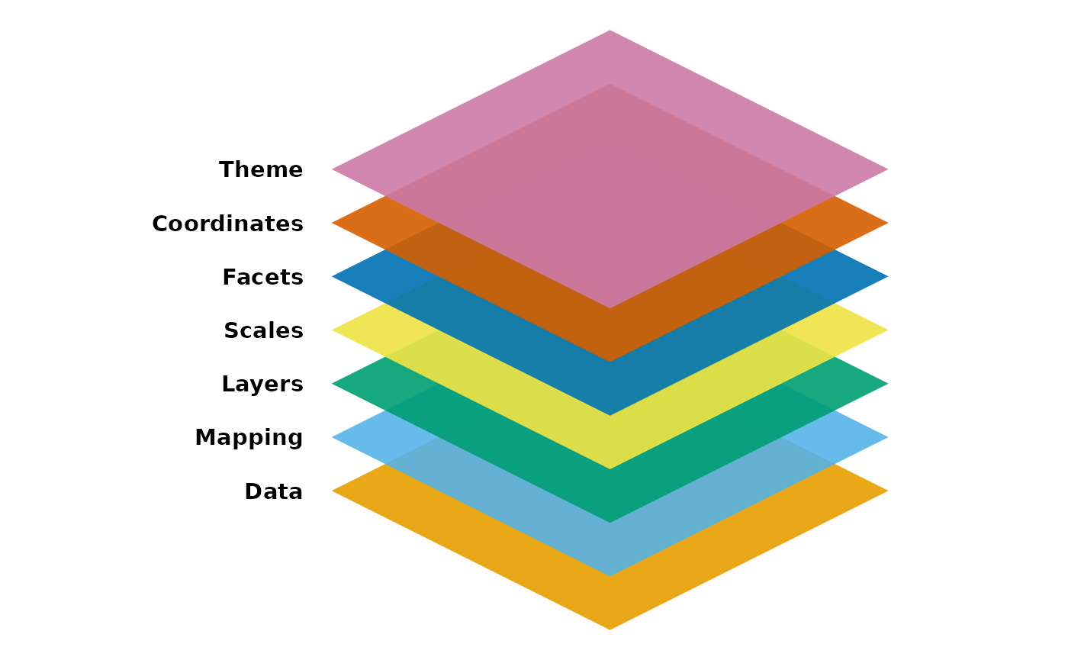
Plotting figures and graphs with ggplot
ggplot is the plotting library for tidyverse
Powerful
Flexible

Slide 3
Data
Rectangular data frame (rows observations, columns variables)
Follows the same conventions as the rest of tidyverse
Data stored in tibbles/data.frames
Data is arranged in 'tidy' format
Data.frame is the first argument to each function
ggplot(data, )

Slide 4
Mapping
Instructions on how the data will be ploted
Using aes() function to make pairs of graphical
ggplot(data, mapping = aes())

Slide 5
Layers
Take mapped data and display into human readable representation of data
Geometry (HOW data is displayed points, line, boxplot …)
Statistical transformation (WHAT data is displayed)
Position adjustment (WHERE a piece of data is displayed)
geom_*() or stat_*()

Slide 6
Layers – geom_*()
Geometries are types of plot
geom_point() Point geometry, (x/y plots, stripcharts etc)
geom_line() Line graphs
geom_boxplot() Box plots
geom_col() / geom_bar() Barplots (stacked/grouped)
geom_histogram() Histogram plots
geom_area() Area under the data
…
Aesthetics are graphical parameters which can be adjusted in a given geometry

Slide 7
Layers – stat_*()
Add summary statistics to discrete data
Main options
geom – how is this going to be displayed
pointrange (default)
errorbar
linerange
Crossbar
fun.data
Function to produce
Min, Centre, Max
Eg mean_se, mean_cl_boot, mean_cl_normal,mean_sdl
Can also use fun.min, fun, fun.max separately

Slide 8
Drawing a barplot (geom_col() or geom_bar())
Two different functions – depends on the nature of the data
If your data has values which represents the height of the bars use geom_col or geom_bar(stat = „identity“)
If your data has individual values and you want the plot to either count them or calculate a quantitative summary (usually the mean) then use geom_bar
Many geometries are “summarising geometries”. They calculate one or more aesthetics for you.

Slide 9
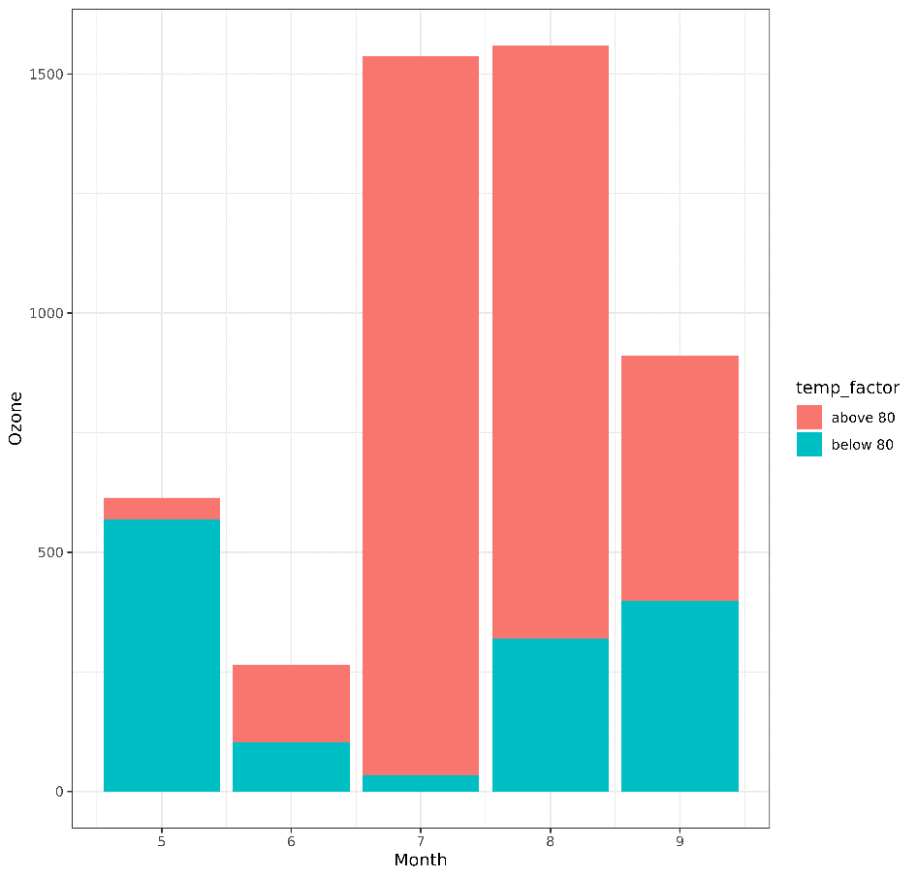
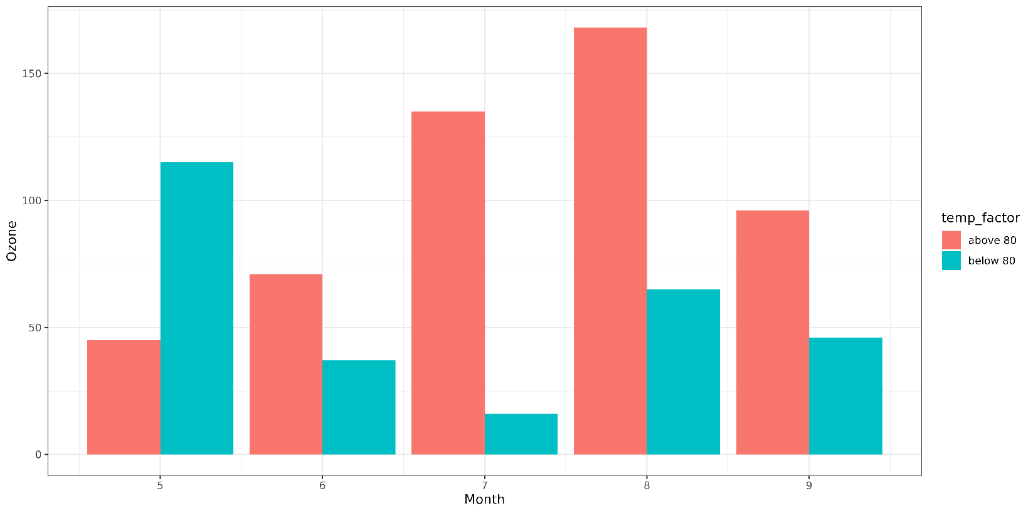
Stacked and Grouped Barplots

Slide 10
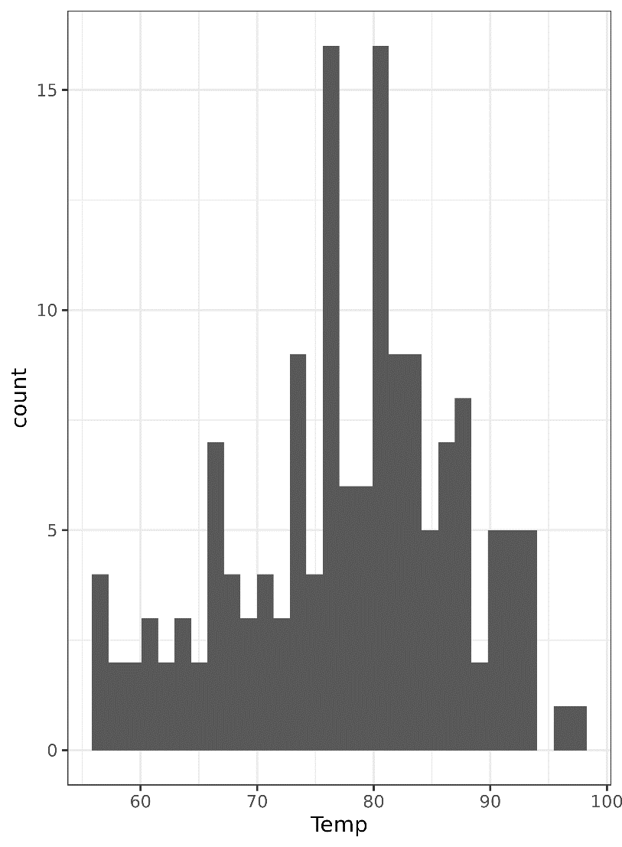
Plotting distributions - histograms

Slide 11
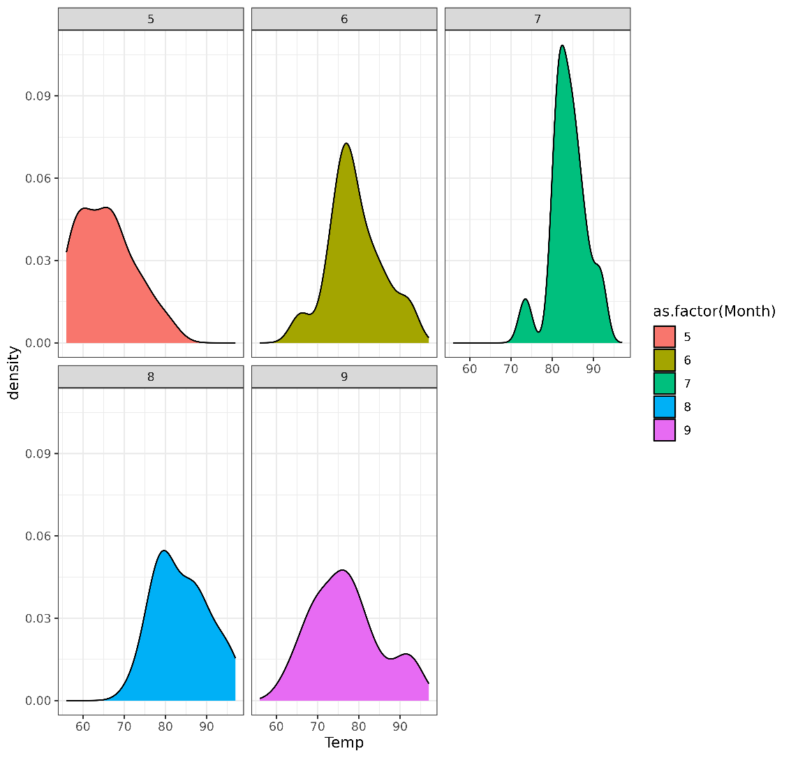
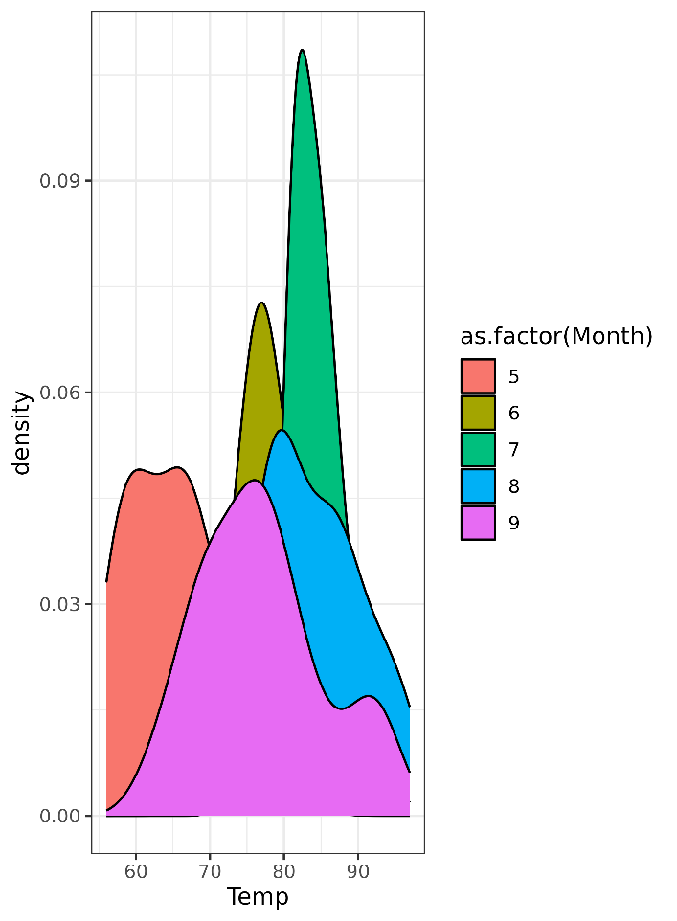
Plotting distributions - density

Slide 12
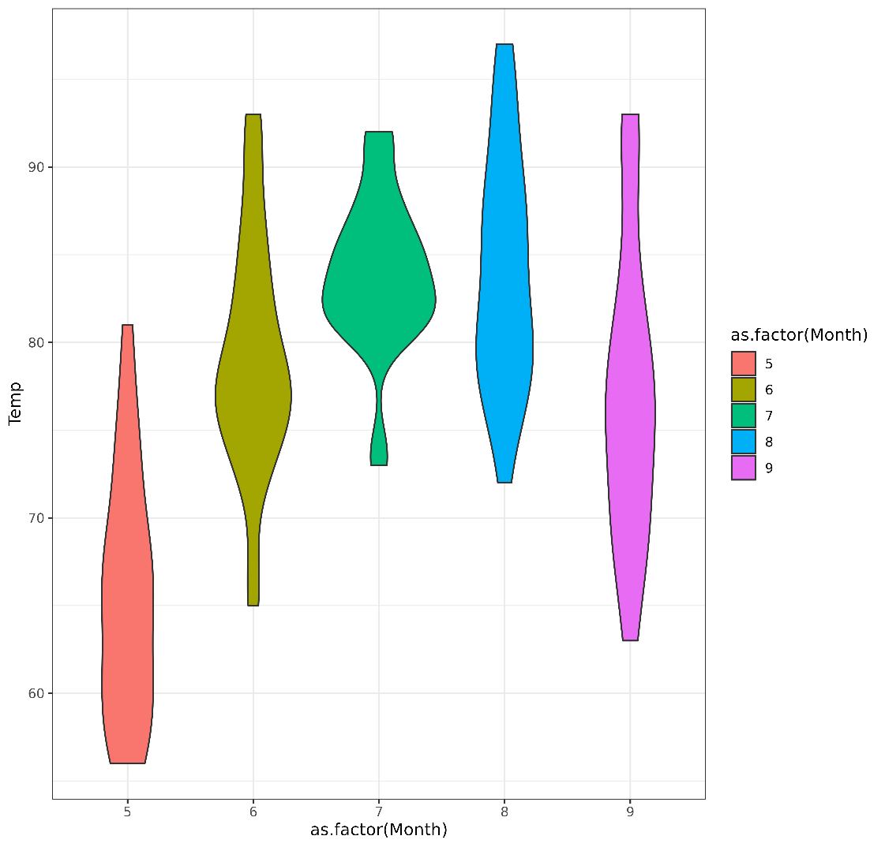
Plotting distributions – violin plots

Slide 13
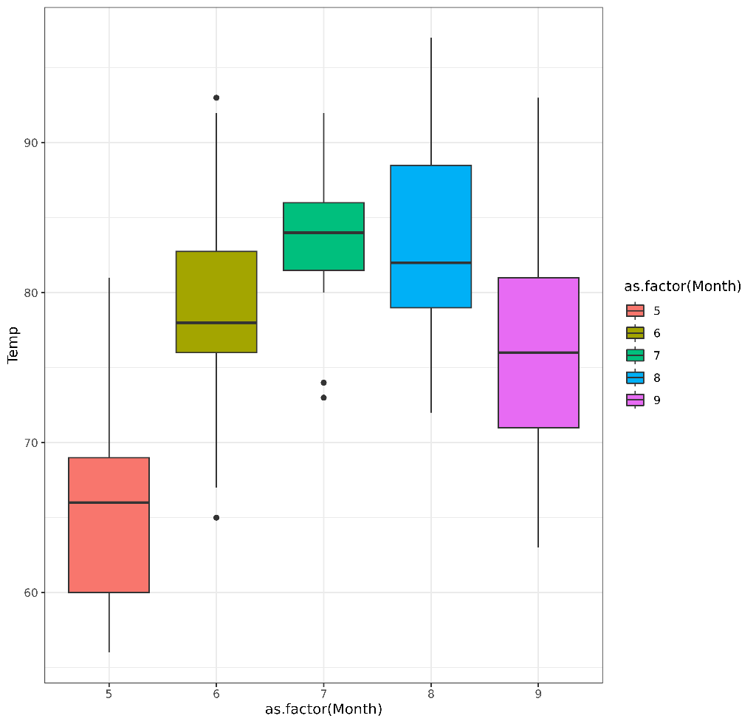
Plotting distributions – boxplots

Slide 14
Scales
Change the limits of plot, setting breaks, formating labels, applying transformation (make sure you remember to also write this on the axis)!
scale_{asthetic}_{type}()
scale_color_manual(values = ‚red‘)

Slide 15
Axis scaling options
Transforming scales
scale_x_log10()
scale_x_sqrt()
scale_x_reverse()
Equivalent _y_ versions also exist
Switching axes
coord_flip()
Adjusting ranges
scale_x_continuous()
limits=c(-5,5)
breaks=seq(from=-5,by=2,to=5)
minor_breaks
labels
coord_cartesian()
xlim=c(-5,5)
ylim=c(10,20)

Slide 16
Facets
Faceting allows you to take a single graph definition and create multiple graphs of the same type based on additional categorical factors
facet_grid draws graphs in rows and columns based on 1 or 2 factors
facet_wrap draws a 2D arrangement of graphs based on a single factor

Slide 17
Coordinates
coord_fixed()
coord_flip()
coord_cartesian()
…

Slide 18
Axis and plot titles
Can add calls to functions to set them individually
ggtitle("Main title")
xlab("X axis")
ylab("Y axis")
Can set them all together with labs()
title="Main title"
x="X axis"
y="Y axis"

Slide 19
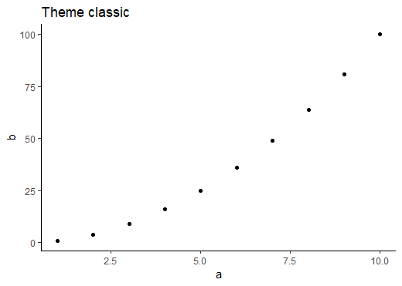
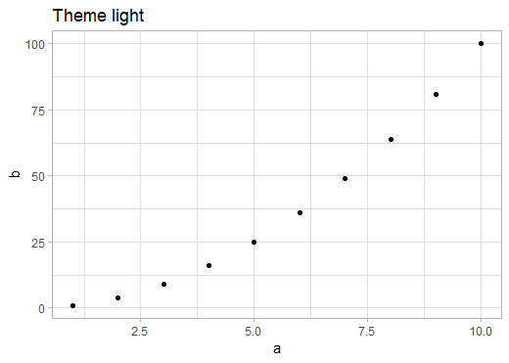
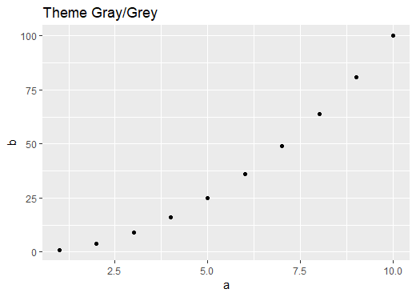
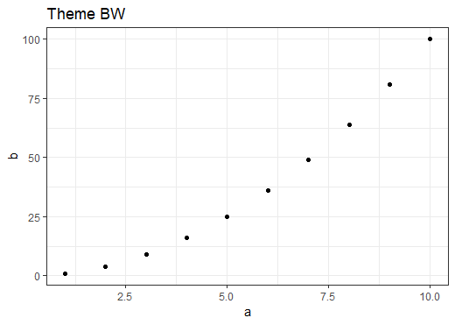
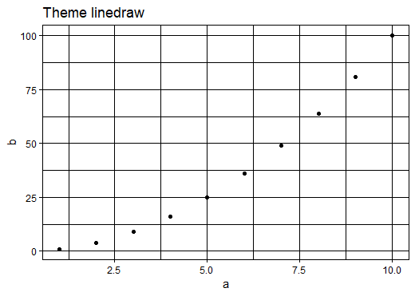
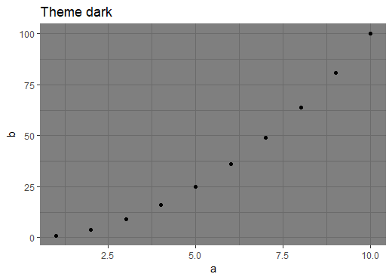
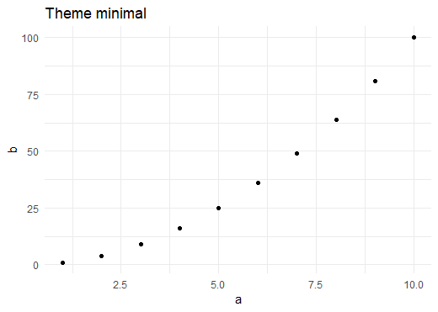
Themes
theme_grey()
theme_bw()
theme_dark()
theme_light()
theme_minimal()
theme_classic()
theme_linedraw()

Slide 20
Setting and Customising themes
Globally
theme_set(theme_bw())
In a single plot
+ theme_bw()

Slide 21
Customising themes
theme_update(plot.title = element_text(hjust = 0.5))
plot + theme(plot.title = element_text(hjust = 0.5))
theme(line, rect, text, title, aspect.ratio, axis.title, axis.title.x, axis.title.x.top, axis.title.x.bottom, axis.title.y, axis.title.y.left,axis.title.y.right, axis.text, axis.text.x, axis.text.x.top, axis.text.x.bottom, axis.text.y, axis.text.y.left, axis.text.y.right, axis.ticks, axis.ticks.x, axis.ticks.x.top, axis.ticks.x.bottom, axis.ticks.y, axis.ticks.y.left, axis.ticks.y.right, axis.ticks.length, axis.line, axis.line.x, axis.line.x.top, axis.line.x.bottom, axis.line.y, axis.line.y.left, axis.line.y.right, legend.background, legend.margin, legend.spacing, legend.spacing.x, legend.spacing.y, legend.key, legend.key.size, legend.key.height, legend.key.width, legend.text, legend.text.align, legend.title, legend.title.align, legend.position, legend.direction, legend.justification, legend.box, legend.box.just, legend.box.margin, legend.box.background, legend.box.spacing, panel.background, panel.border, panel.spacing, panel.spacing.x, panel.spacing.y, panel.grid, panel.grid.major, panel.grid.minor, panel.grid.major.x, panel.grid.major.y, panel.grid.minor.x, panel.grid.minor.y, panel.ontop, plot.background, plot.title, plot.subtitle, plot.caption, plot.tag, plot.tag.position, plot.margin, strip.background, strip.background.x, strip.background.y, strip.placement, strip.text, strip.text.x, strip.text.y, strip.switch.pad.grid, strip.switch.pad.wrap)
https://ggplot2.tidyverse.org/reference/theme.html

Slide 22
Colors
With names ‚red‘, ‚blue‘ etc. OR HEX code ‚#af867b‘
Quantitative colors
Qualitative colors (define for each variable)
https://htmlcolorcodes.com/ or https://medialab.github.io/iwanthue/

Slide 23
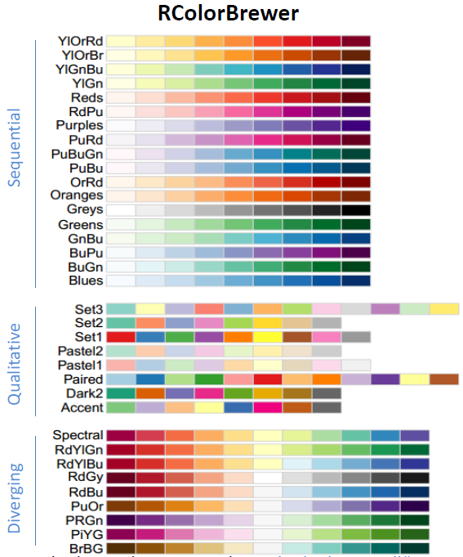
ColorBrewer Scales
Quantitative
scale_colour_distiller
Categorical
scale_colour_brewer

Slide 24
Factors
Similar to text (character) vectors, but with some differences
They have controlled values – you can limit which values can be added
The values which can go in are tracked separately to the data
The values which can go in have an explicit order
ggplot respects the ordering of factors, so converting to factors is the simplest way to re-order a plot

Slide 25
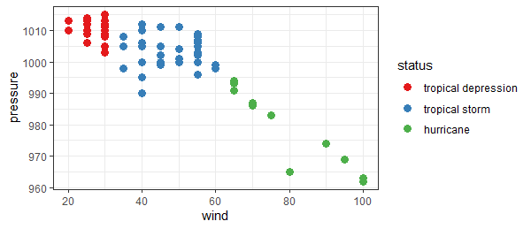
Categorical Colour Ordering
storms %>%
mutate(status=factor(status, levels=c("tropical depression","tropical storm","hurricane"))) %>%
filter(year==1983) %>%
ggplot(aes(x=wind,y=pressure, colour=status)) +
geom_point(size=3)+
scale_color_brewer(palette="Set1")

Slide 26
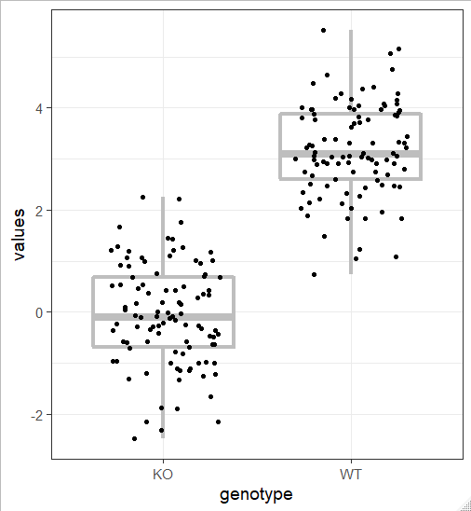
Overlaying raw data and summaries
many.values %>%
group_by(genotype) %>%
sample_n(100) %>%
ggplot(aes(x=genotype, y=values)) +
geom_boxplot(size=1.5, colour="grey") +
geom_jitter(height=0, width = 0.3)

Slide 27
Adding Reference / Regression Lines
geom_hline – Adds a horizontal line (specify yintercept)
geom_vline – Adds a vertical line (specify xintercept)
geom_abline – Adds an angled line (specify slope and intercept)
Values can come from the lm function to generate a linear model
geom_smooth – Calculates and draws regression lines
Loess smoothed curves
Linear modelled lines

Slide 28
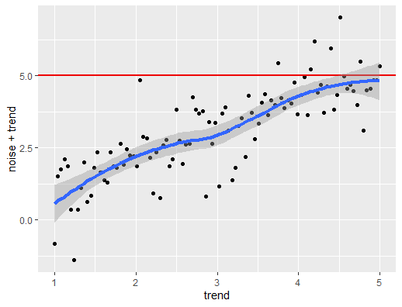
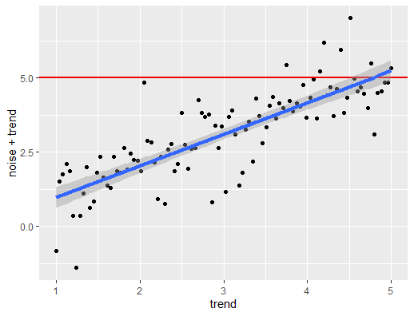
Trend lines
trend_data %>%
ggplot(aes(x=trend,y=noise+trend)) +
geom_point() +
geom_hline(
yintercept=5, size=1, colour="red2") +
geom_smooth(size=1.5)
trend_data %>%
ggplot(aes(x=trend,y=noise+trend)) +
geom_point() +
geom_hline(
yintercept=5, size=1, colour="red2") +
geom_smooth(size=1.5, method="lm")

Slide 29
Annotation
The annotate function allows you to add geometries with data not coming from the original tibble
An easy way to put small additions (usually text) on your plot
Aesthetic mappings are set by arguments to annotate
Values can be multi-element vectors (unlike fixed aesthetics)
Use the geom argument to say which geometry to use

Slide 30
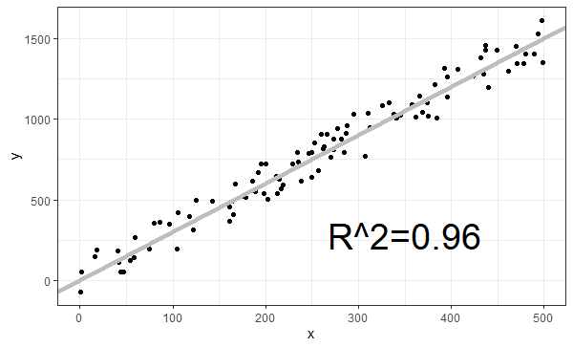
Annotation
data %>%
ggplot(aes(x=x,y=y)) +
geom_point() +
geom_abline(slope = 3, intercept=0, size=2, colour="grey") +
annotate(geom="text",x=350,y=280,label="R^2=0.96", size=10)

Slide 31
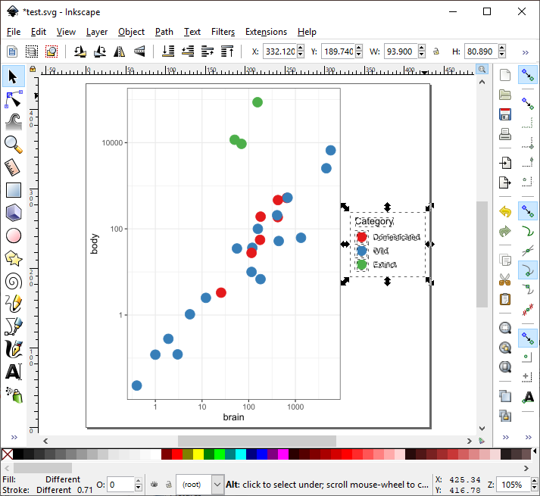
Saving plots
Operates on the last drawn plot by default
ggsave(
filename = "test.svg",
device = "svg",
width = 6,
height = 6
)

