Slide 1
SOLID principes
Notes:
Front page

Slide 2

mathias.vermeiren@axxes.com
Mathias Vermeiren
3 jaar bij Axxes
.Net developer
Web & Desktop
Trainee Augustus 2015
Remmicom – 1 jaar
IdWeaver / BNP Paribas – 6 maanden
Test-Aankoop – 1,5 jaar
Notes:
Wie ben ik?
Algemene info over mezelf:
23 jaar
Poederlee
Zwemmen, Snowboarden
- KHK/Thomas More (toegepaste informatica)
Development & me

Slide 3
Now, who are you?
Notes:
Tour de table.
Over jezelf:
Wie, waar, leeftijd, hobbies etc
Hoeveel ervaring met development? Altijd .net of niet? Persoonlijke projecten?

Slide 4
Overview
Origins
Single responsibility
Open/closed
Liskov substitution
Interface segregation
Dependency inversion

Slide 5
Origins
Robert C. Martin (Uncle Bob)
Begin 2000
Slechte code vermijden
Notes:
Wie kent de solid principes? Of al van gehoord?
5 principles aangegeven door Robert C. Martin, Michael Feathers maakte er solid van
Manier van programmeren
Ook goed voor testing
Betere programmeur, door betere code
Gemakkelijk te onderhouden
Gemakkelijk uit te breiden
Robuuste code

Slide 6
Terms
Coupling
Graad waarmee classes/methods direct gelinkt zijn
Cohesion
Hoe goed 2 of meer delen van een systeem met elkaar werken
Notes:
Cohesion
4x100m a lot better then 1x400m
Goede software beschikt ook een lage coupling en een hoge cohesion

Slide 7
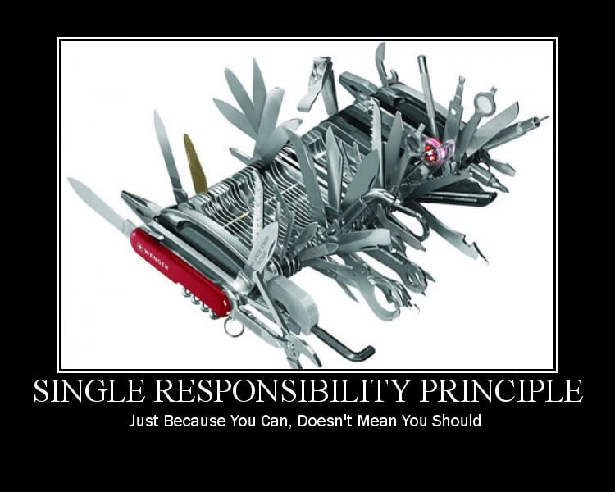
Single Responsibility Principle (SRP)

Slide 8
Single Responsibility Principle (SRP)
Any class must have one, and only one, reason to change
Elke klasse/module heeft maar één taak
Waarom?
Onderhoudbaar
Testbaar
Flexibel en uitbreidbaar
Parallel development
Decoupling
Notes:
This principle means that a class must have only one responsibility and do only the task for which it has been designed.
Otherwise, if our class assumes more than one responsibility we will have a high coupling causing our code to be fragile with any changes.

Slide 9
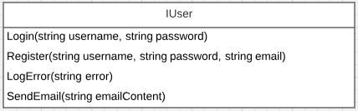
Single Responsibility Principle (SRP)

Slide 10



Single Responsibility Principle (SRP)

Slide 11
Exercise

Slide 12
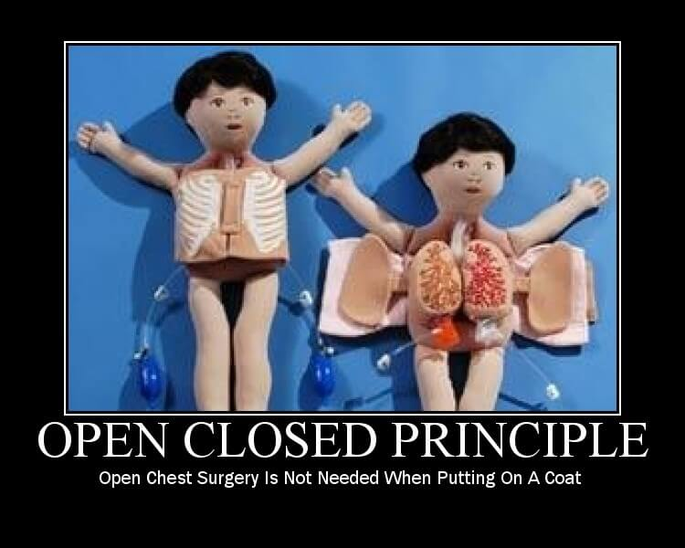
Open Closed Principle (OCP)

Slide 13
Open Closed Principle (OCP)
Software entities (classes, modules, functions, etc.) should be open for extension, but closed for modification
Open for extension
Nieuwe features/uitbreidingen kunnen toegevoegd
Closed for modification
De huidige code moet niet aagepast worden voor de nieuwe features
Notes:
According to this principle, a software entity must be easily extensible with new features without having to modify its existing code in use.

Slide 14
Open Closed Principle (OCP)
Software entities (classes, modules, functions, etc.) should be open for extension, but closed for modification
Waarom?
Onderhoudbaar
Mogelijk om enkel de nieuwe feature testen
Goedkoper
Volgt Single responsibility principle
Notes:
Goedkoper omdat er minder getest moet worden

Slide 15
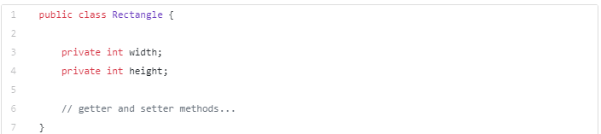
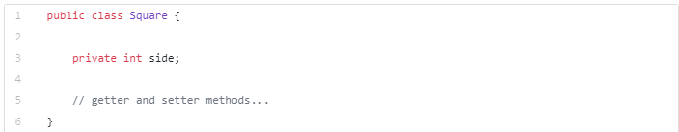
Open Closed Principle (OCP)

Slide 16
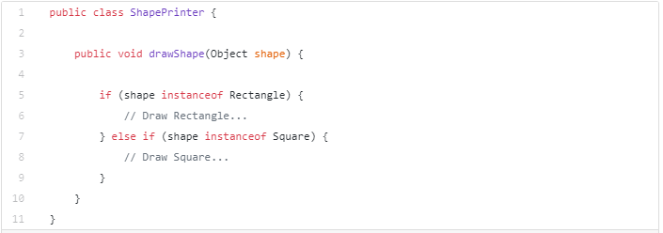
Open Closed Principle (OCP)

Slide 17

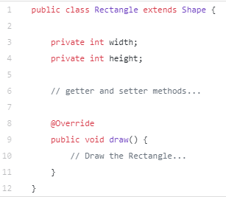
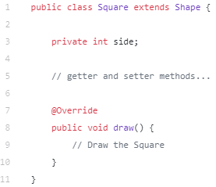
Open Closed Principle (OCP)

Slide 18
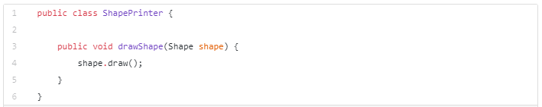
Open Closed Principle (OCP)

Slide 19
Exercise

Slide 20
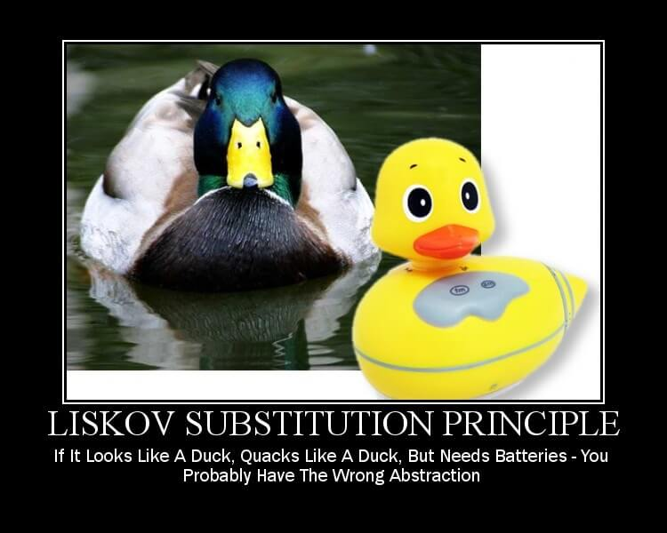
Liskov Substitution Principle (LSP)

Slide 21
Liskov Substitution Principle (LSP)
Objects in a program should be replaceable with instances of their subtypes without altering the correctness of that program
Waarom?
Geen exceptions door de subtype
Uitbreiden zonder functionaliteit aan te passen
Code is herbruikbaar
Hiërarchie makkelijker te begrijpen
Notes:
This principle was defined by Barbara Liskov and says that objects must be replaceable by instances of their subtypes without altering the correct functioning of our system.

Slide 22
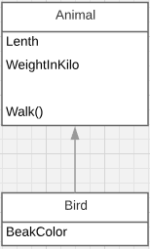
Liskov Substitution Principle (LSP)

Slide 23
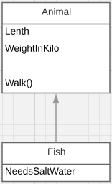

Liskov Substitution Principle (LSP)

Slide 24
Exercise

Slide 25
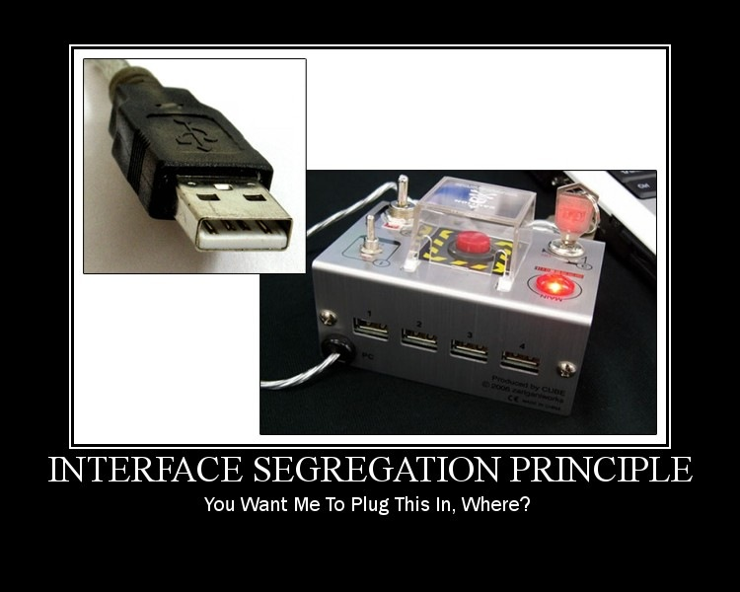
Interface Segregation Principle (ISP)

Slide 26
Interface Segregation Principle (ISP)
Many client-specific interfaces are better than one general-purpose interface
Waarom?
Decoupling
Gemakkelijker refactoren
Geen onnodige properties/methods
Notes:
This principle defines that a class should never implement an interface that does not go to use. Failure to comply with this principle means that in our implementations we will have dependencies on methods that we do not need but that we are obliged to define.
Therefore, implement specific interfaces is better to implement a general purpose interface. An interface is defined by the client that will use it, so it should not have methods that this client will not implement.

Slide 27
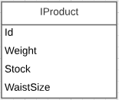
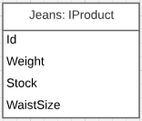
Interface Segregation Principle (ISP)

Slide 28
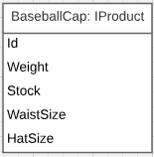
Interface Segregation Principle (ISP)

Slide 29
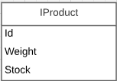


Interface Segregation Principle (ISP)

Slide 30
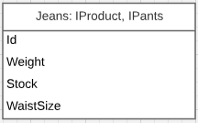
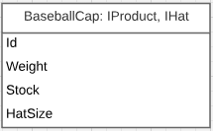
Interface Segregation Principle (ISP)

Slide 31
Exercise

Slide 32
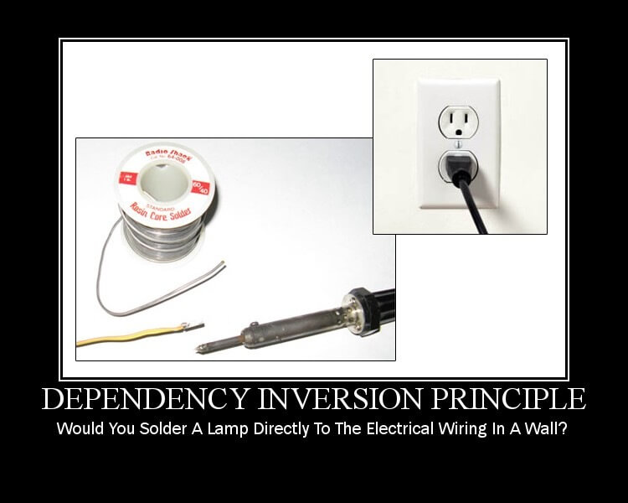
Dependency Inversion Principle (DIP)

Slide 33
Dependency Inversion Principle (DIP)
Abstractions should not depend on details. Details should depend on abstractions
Dependency Injection =/= Dependency Inversion
Waarom?
Decoupling
Code meer herbruikbaar
Notes:
The Dependency Inversion Principle means that a particular class should not depend directly on another class, but on an abstraction (interface) of this class.
When we apply this principle we will reduce dependency on specific implementations and thus make our code more reusable.
We willen niet dat low level objects er nood aan hebben om te weten hoe ze geimplementeerd worden.
“you want the time, Buddy? I’m gonna need a ThingThatTellsTime, and then it’s all yours.” (Usually you wouldn’t write this rather pointless method, but I wanted to keep the example as simple as humanly possible).
Dependency Inversion is a different kind of tradeoff. To visualize it, don’t think of code just yet. Think of a boss yelling at a developer. Before the ‘inversion’ this would have been straightforward. “Developer! You, Bill! Write me a program that tells time!” and Bill scurries off to do it.

Slide 34
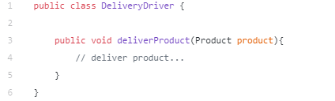
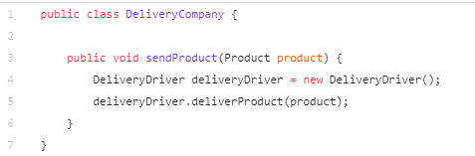
Dependency Inversion Principle (DIP)

Slide 35

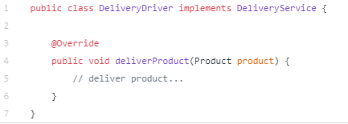
Dependency Inversion Principle (DIP)

Slide 36
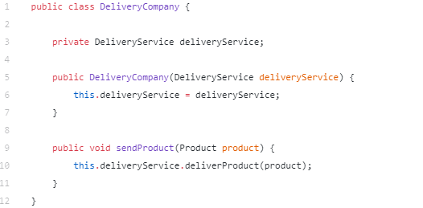
Dependency Inversion Principle (DIP)

Slide 37
Exercise

Slide 38
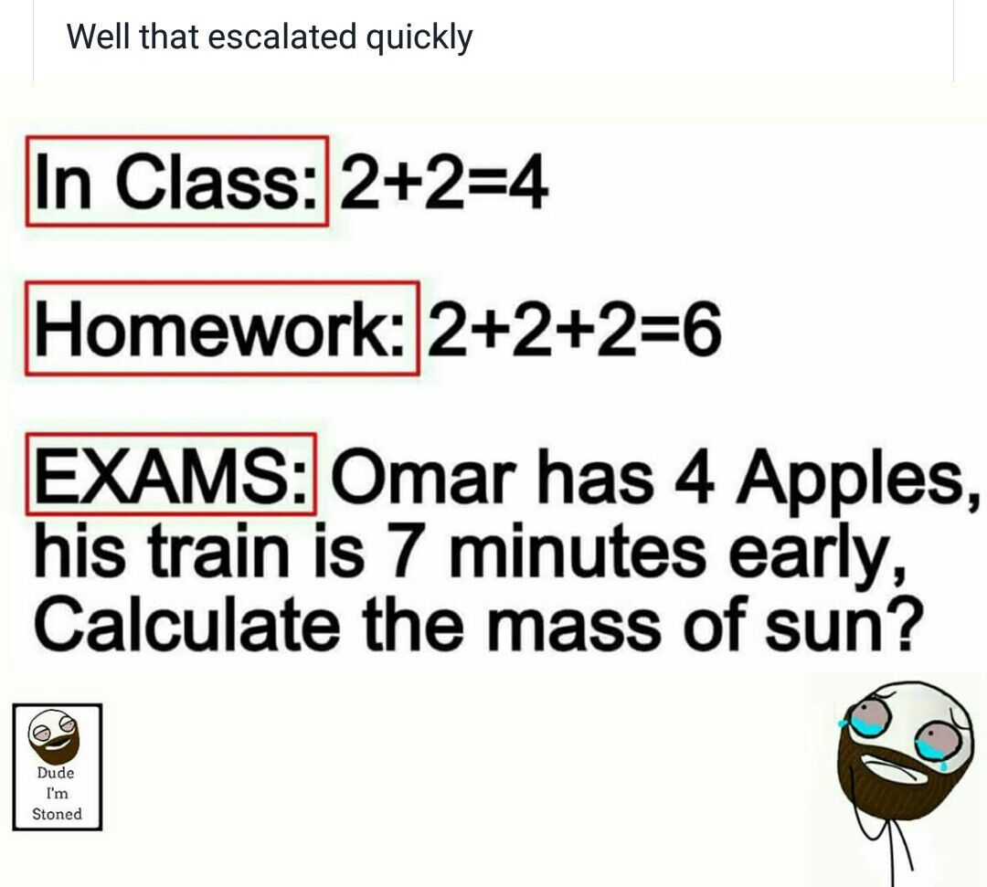
Conclusion
Notes:
Following SOLID principles is essential if we are to build quality software that is easy to extend, robust and reusable. Also is important not forgetting to be pragmatic and use common sense because sometimes over-engineering can make simple things more complex.

Slide 39
Conclusion
Kwaliteitsvolle software
Onderhoudsvriendelijk
Leesbaar
Testbaar
Uitbreidbaar/herbruikbaar
Goedkoop
Beetje common sense
Maak het niet te ingewikkeld
Notes:
Following SOLID principles is essential if we are to build quality software that is easy to extend, robust and reusable. Also is important not forgetting to be pragmatic and use common sense because sometimes over-engineering can make simple things more complex.

