Slide 1
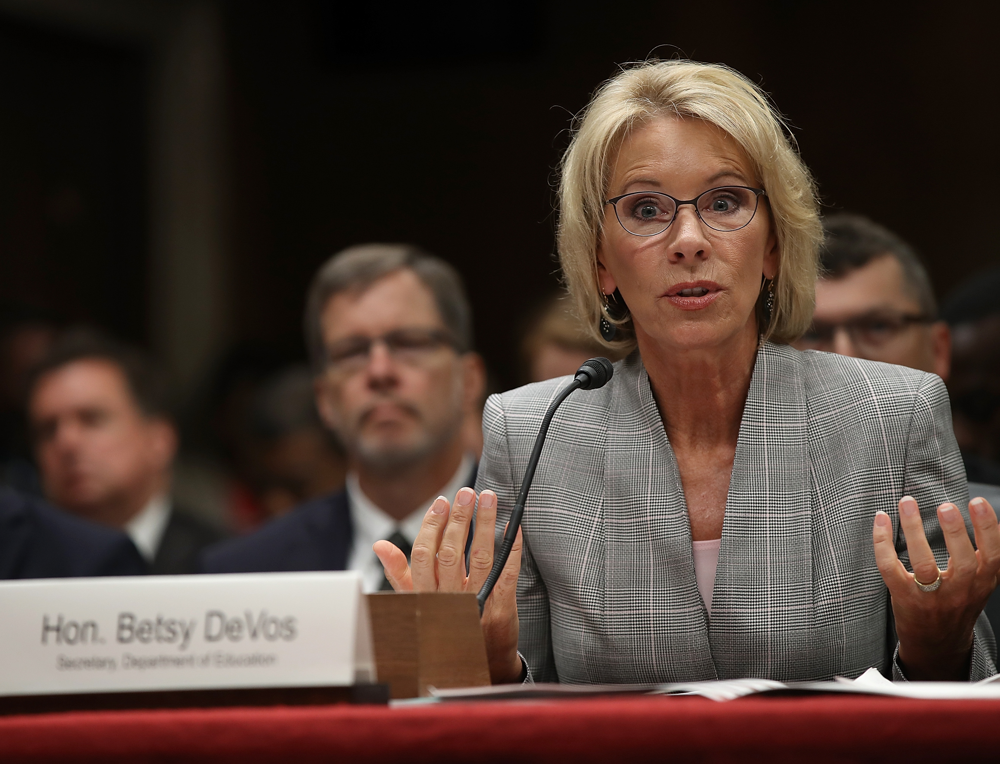
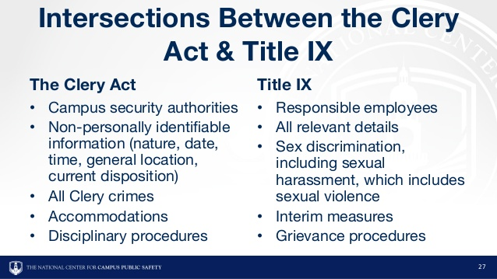
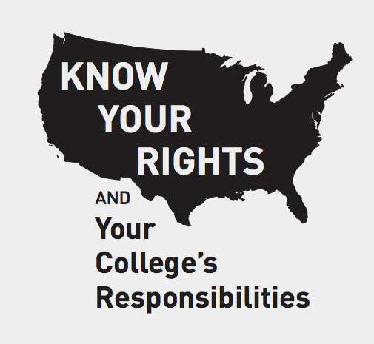
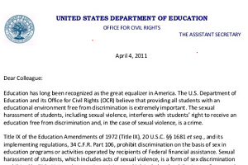
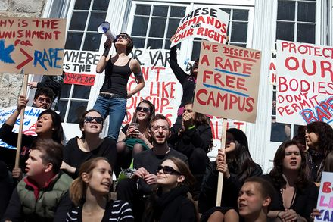
Collegiate Compliance
Oregon State University ∙ College Student Services Administration
Title IX & the Clery Act
Gunnar Whisler ∙ whislerg@oregonstate.edu
*trigger warning: sexual assault
Retrieved from:https://tinyurl.com/ydbwlmow
Moving Forward: Trump-Devos Administration Direction
Rescinded Obama Administration guidelines are vastly different from newly proposed guidelines.
Definition of sexual harassment previously included “unwelcome conduct of a sexual nature”, including “unwelcome sexual advances, requests for sexual favors, and other verbal or non-verbal, or physical conduct of a sexual nature.” (Green, E.L., 2018).
New narrow definition: “unwelcome conduct on the basis of sex that is so severe, pervasive, and objectively offensive that it denies a person access to the school’s education program or activity.” (Green, E.L., 2018).
Schools are not responsible for sexual harassment conduct violations that occur off of campus, nor are they held responsible if a formal complaint has not been filed to proper authority figures. (Green, E.L., 2018).
Institutions only found responsible for discrimination if it is proven they have been “deliberately indifferent”. (Green, E.L., 2018).
Adds to the rights of the accused by allowing schools to pick the evidentiary standard: preponderance of evidence (currently used) or clear and convincing. (Green, E.L., 2018).
Furthermore, gives the accused (and accuser) the right to cross-examine and involve off-campus lawyers. (Green, E.L., 2018).
Religious schools no longer have to prove religious tenet that is at odds with compliance of Title IX. (Flannery, M.E., 2018)
Retrieved from: https://tinyurl.com/y7g22hwf
2011, “Dear Colleague” Letter from Department of Education during Obama Administration
Retrieved from: https://tinyurl.com/y7znenhl
Do campuses under report sexual assault statistics?
Study by Yung (2015) shows that schools reported 44% more sexual assault statistics during an auditing period than before or after being audited. No other crime showed this phenomenon.
Retrieved from: https://tinyurl.com/ybtb4jop
History of the Clery act
History of Title IX
An amendment to the Higher Education Act of 1965. Originally known as Title II of the Student Right-to-Know and Campus Security Act of 1990. (McCallion, 2014).
Has been gradually amended overtime to reflect what we know it as today (McCallion, 2014).
Named after Jeanne Clery, whom was raped and murdered in her dorm room at Lehigh University in 1986 (McCallion, 2014).
Central mandate that charges for higher education institutions to report crime statistics and audits at random and in response to a complaint against an institution (Yung, 2015).
Written into federal law to combat gender discrimination towards both students and faculty/staff members (Stromquist, 2013).
Initially written with equality in collegiate athletics in mind after cases of gender discrimination about the fairness and opportunities offered for female athletes (Cheslock, J. J., & Eckes, S. E., 2018).
21st century saw this law being used to combat complacency in universities in regards to sexual assault. (Cheslock, J. J. & Eckes, S. E., 2018)
REFERENCES:
Cheslock, J. J. & Eckes, S. E. (2018). Statistical evidence and compliance with Title IX. New Directions for Institutional
Research, 138, 31-45. doi: 10.1002/ir
Flannery, M. E. (2018). The new Title IX: Cross-examination of rape victims. National Education Association. Retrieved
from: http://neatoday.org/2018/11/26/betsy-devos-title-ix/
Green, E. L. (2018). New U.S. sexual misconduct rules bolster rights of the accused and protect colleges. The New York
Times. Retrieved from: https://www.nytimes.com/2018/08/29/us/politics/devos-campus-sexual-assault.html
McCallion, G. (2014). History of the Clery Act: Fact sheet. Congressional Research Service, 1-2.
Stromquist, N. P. (2013). Education policies for gender equity: Probing into state responses. Education Policy Analysis
Archives, 21, 65, 1-31. doi: 10.14507/epaa.v21n65.2013
Yung, C. R. (2015). Concealing campus sexual assault: An empirical examination. Psychology, Public Policy, and Law, 21,
1, 1-9. doi: 10.1037/law0000037
Retrieved from: https://tinyurl.com/ybj8vnt2

