Slide 1
Social media activation calendar
July 2024

Slide 2
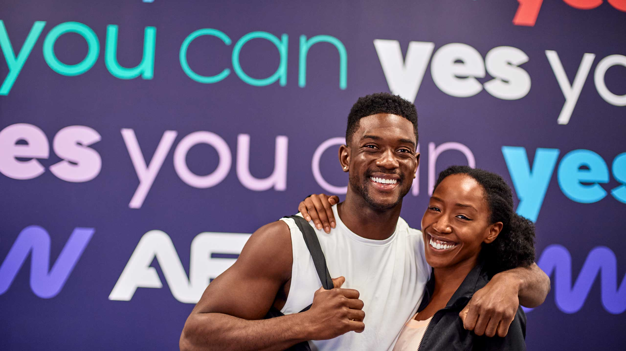
AGENDA
Social Calendar Ideas
Social Media Industry News and Platform Updates
#SocialHack
Trending Sounds
Kudos

Slide 3
July 2024
SUNDAY | MONDAY | TUESDAY | WEDNESDAY | THURSDAY | FRIDAY | SATURDAY
 | 1 6 MORE MONTHS TIL 2025 How we doing? Do a check-in and have members share their goals for the second half of the year. OR highlight some wins from the first half of the year to encourage and celebrate accomplishments of your members. | 2 BINGO! Haven't integrated the AF Bingo card into your club yet? Now is your time! Share a Reel talking about how members can participate and note if there are any prizes at stake to drive competition to the next level! | 3 BIG STRETCH We've noticed that many people, both on our App and on social, are looking for options to stretch sore/tight muscles. Share out a stretching routine focusing on a specific body part or type of movement. | 4 FOURTH OF JULY Happy 4th of July! Share a post today showing off those in the gym, some patriotic colors in the gym, or throw together a quick workout that can be done from anywhere! | 5 REVIEWS Share a review someone has left on your Google profile, Facebook Page, or Yelp profile! This can help new prospects when gauging their options! | 6 FUNNY MOMENT Bring a little lightness to your grid. Share out a silly gym post, whether that be a Reel from a trending topic or a quick, light-hearted quote.
7 GETTING BACK IN FLOW The holiday weekend is coming to a close and the Sunday Scaries are in FULL FORCE. Share tips or tricks on how to help ease back into life. | 8 MINDFULNESS Talk about how mindfulness can help with many different facets of life and how you can incorporate it in the gym or into your everyday routine. | 9 FAMILY DINNER What is a crowd pleasing (and maybe even macro-friendly) healthy recipe you love to serve up? Share out a Reel or recipe card of a recipe that can serve multiple people! | 10 MEMBER SPOTLIGHT Use this Template from the Brand Marketing Center to create a brand-aligned Member Spotlight for your Instagram! You can use the pin feature to pin this member for the month/week they are being celebrated! | 11 POP CULTURE MOMENT Share out a meme or create a Reel utilizing one of the recommended trending sounds to post. Tip: don't schedule this one more than a few days ahead. | 12 AMAZON PRIME DAYS Prime Days are upon us and the deals are everywhere. If you want to get in on the conversation, share Amazon purchases that fuel your gym experience (ex: clothes, energy drinks, accessories, gym bags, etc) | 13 AROUND TOWN What's going on locally? Is there a little league baseball tournament? How about music in the park? Share what's going on around your area – ESPECIALLY if you will be present at the event!
14 MEMBER SUCCESS This post is perfect to plan ahead and schedule! Share a success story of a member in your gym. Reminder: these results for "success" do not need to be life changing – even being able to get better sleep at night is a success to share! | 15 RECIPE SHAREOUT Create or share a recipe out on your page! Putting the instructions in another slide to create a carousel or in the caption to promote users to save your post for later! | 16 MOBILITY Mobility is huge buzzword in the fitness industry, and for good reason! Share a mobility routine for a certain area of the body or for a certain consumer group, such as office workers or blue-collar laborers. | 17 NATIONAL TATTOO DAY Show off those AF tattoos! Whether you’re an owner, staff or member – we wanna see 'em! And don't forget to tag @anytimefitness. | 18 MEET THE CREW Whether it's your member of the month or a new staff member, introduce, or RE-introduce, this person to your social page and share a small bio about how they are involved in your gym fam! | 19 CLASSES Share your class schedule! When and how can someone join in on the group fitness fun? Or share a Reel of a sneak peak for an upcoming class. | 20 VACATION HACK How do you stay on track of nutrition while vacationing - especially with all that yummy food and fun drinks that could be present? Share tips on how to take the guilt out of having fun while staying on track.
21 GROCERY LIST What are your grocery list staples? Share helpful tips on how to navigate the chaos of the grocery store while on the hunt for foods that fuel your fitness journey. | 22 App-titude The AF Access Pass is a great accessory helping make healthy happen anywhere, anyTIME! Share a post educating your following on Access Pass and how it can help make getting to the gym even easier. Reminder: Access Pass is only available in the USA and Australia at this time. | 23 YUMMY EATS Personalize a recipe by sharing out a recipe that has in-season produce or something you can find locally. This is the perfect time to create a Reel! | 24 #TRENDING Use a sound from the Trending Sounds slide to give your algorithm a boost. Interacting and creating content using Instagram's Reels is a great way to show the algorithm you like to participate in what's popular on the app. | 25 HEALTH BENEFITS What health benefits does working out, or a specific type of workout, promote. Pro tip: poll your community through Stories to find out what they are looking for. | 26 GROUP TRAINING Showcase your class schedule or images and videos from live inside your Group Training time. | 27 BENEFITS OF PERSONAL TRAINING What are the benefits of working with a Coach at AF? Why should someone take the next steps? Share and show how Coaching takes you to a new level in your fitness journey.
28 WALK IT OUT Who doesn't a little sunshine and fresh air?! Share a stat about how implementing walks into your routine can improve X. You can also take this in a different direction by compiling "Add Your Music" sticker suggestions and compiling an AF playlists for users to jam out to on their walk! | 29 STAFF SHOUTOUT Have an absolute rockstar on staff that deserves some celebrating? Post their accomplishments on your feed and help celebrate all their hard work! | 30 STRENGTH MOVEMENT Show off a strength movement and how to advance the movement for those who are looking to up a certain aspect of their workout regimen. Challenge your followers to implement the movement in their workouts this week!

Slide 4
Social Media industry news and updates
Need Marketing assistance?
Facebook Renews Focus on Young Users
Instagram Says Using Certain CTAs Can Impact Post Reach
Instagram Shares More Info on the Distribution of Longer Reels Clips
Instagram Rolls Out New Notes Features, Including Likes
Instagram Adds New Features for Broadcast Channels
Marketing Support Inbox:
https://jira.sebrands.com/plugins/servlet/desk/site/af/
Brand Marketing Center:
https://app.sproutloud.com/member/home

Slide 5
#SocialHack Media Mix
When thinking about what is going on your Instagram grid, you will want to consider mixing multiple formats of media to provide a more dynamic experience. The Instagram platform has many different ways you can approach content:
1) Reels – Reels are the term for videos, sized to fit your phone’s screen (9:16) and can be as long as 90 seconds. With Reels you can add certain Instagram stickers, as well as sounds, text and editing to enhance your video. Read more about Reel here.
2) Photo – Instagram's original format! The single photo post. You can have orientations of 1:1, 4:5, and 1.9:1 and within the app’s platform you can add filters to edit the picture. You can also now add songs snippets to play over your photo while users scroll through their feed.
3) Carousels – These are multi-photo posts that will be oriented however you crop the first image (following the above photo ratios). You can add up to 10 photos in one Carousel on Instagram, but there are talks of expanding this and expanding Carousel feature to Reels – but that’s just talk for now! Learn more about how and why you should use Carousels here.
4) Stories – We often mention the utilization of Stories on Instagram. You can think of Stories as standalone posts or as compliments to help drive consumers to your post. Learn more about Stories and how to use them here.
When planning your Instagram grid, think of how you can vary your media that you are sharing. Some accounts may have better luck with viewers being more drawn to watching their Stories where Reels can help assist in reaching a broader audience! Many users on the app have certain content preference types, just like we all have preferences on when we should do cardio! You can always test and learn from your insights to see the best ways your audience responds and engages with you and your account. Give it a try! Happy creating!

Slide 6
Trends and Trending Sounds
TikTok
reels
Concious Baby Four Season Orlando
Million Dollar Baby
Espresso by Sabrina Carpenter
Original Sound – James Jones ft. Shooting Stars by Bag Raiders
Beautiful Things Chainsmokers Remix (Template)
Clams Casino, Imogen Heap – I'm God
Make Yourself A Priority Chase Your Goals (Template)
TOO SWEET x RIVERS – Alterego (Template)

Slide 7
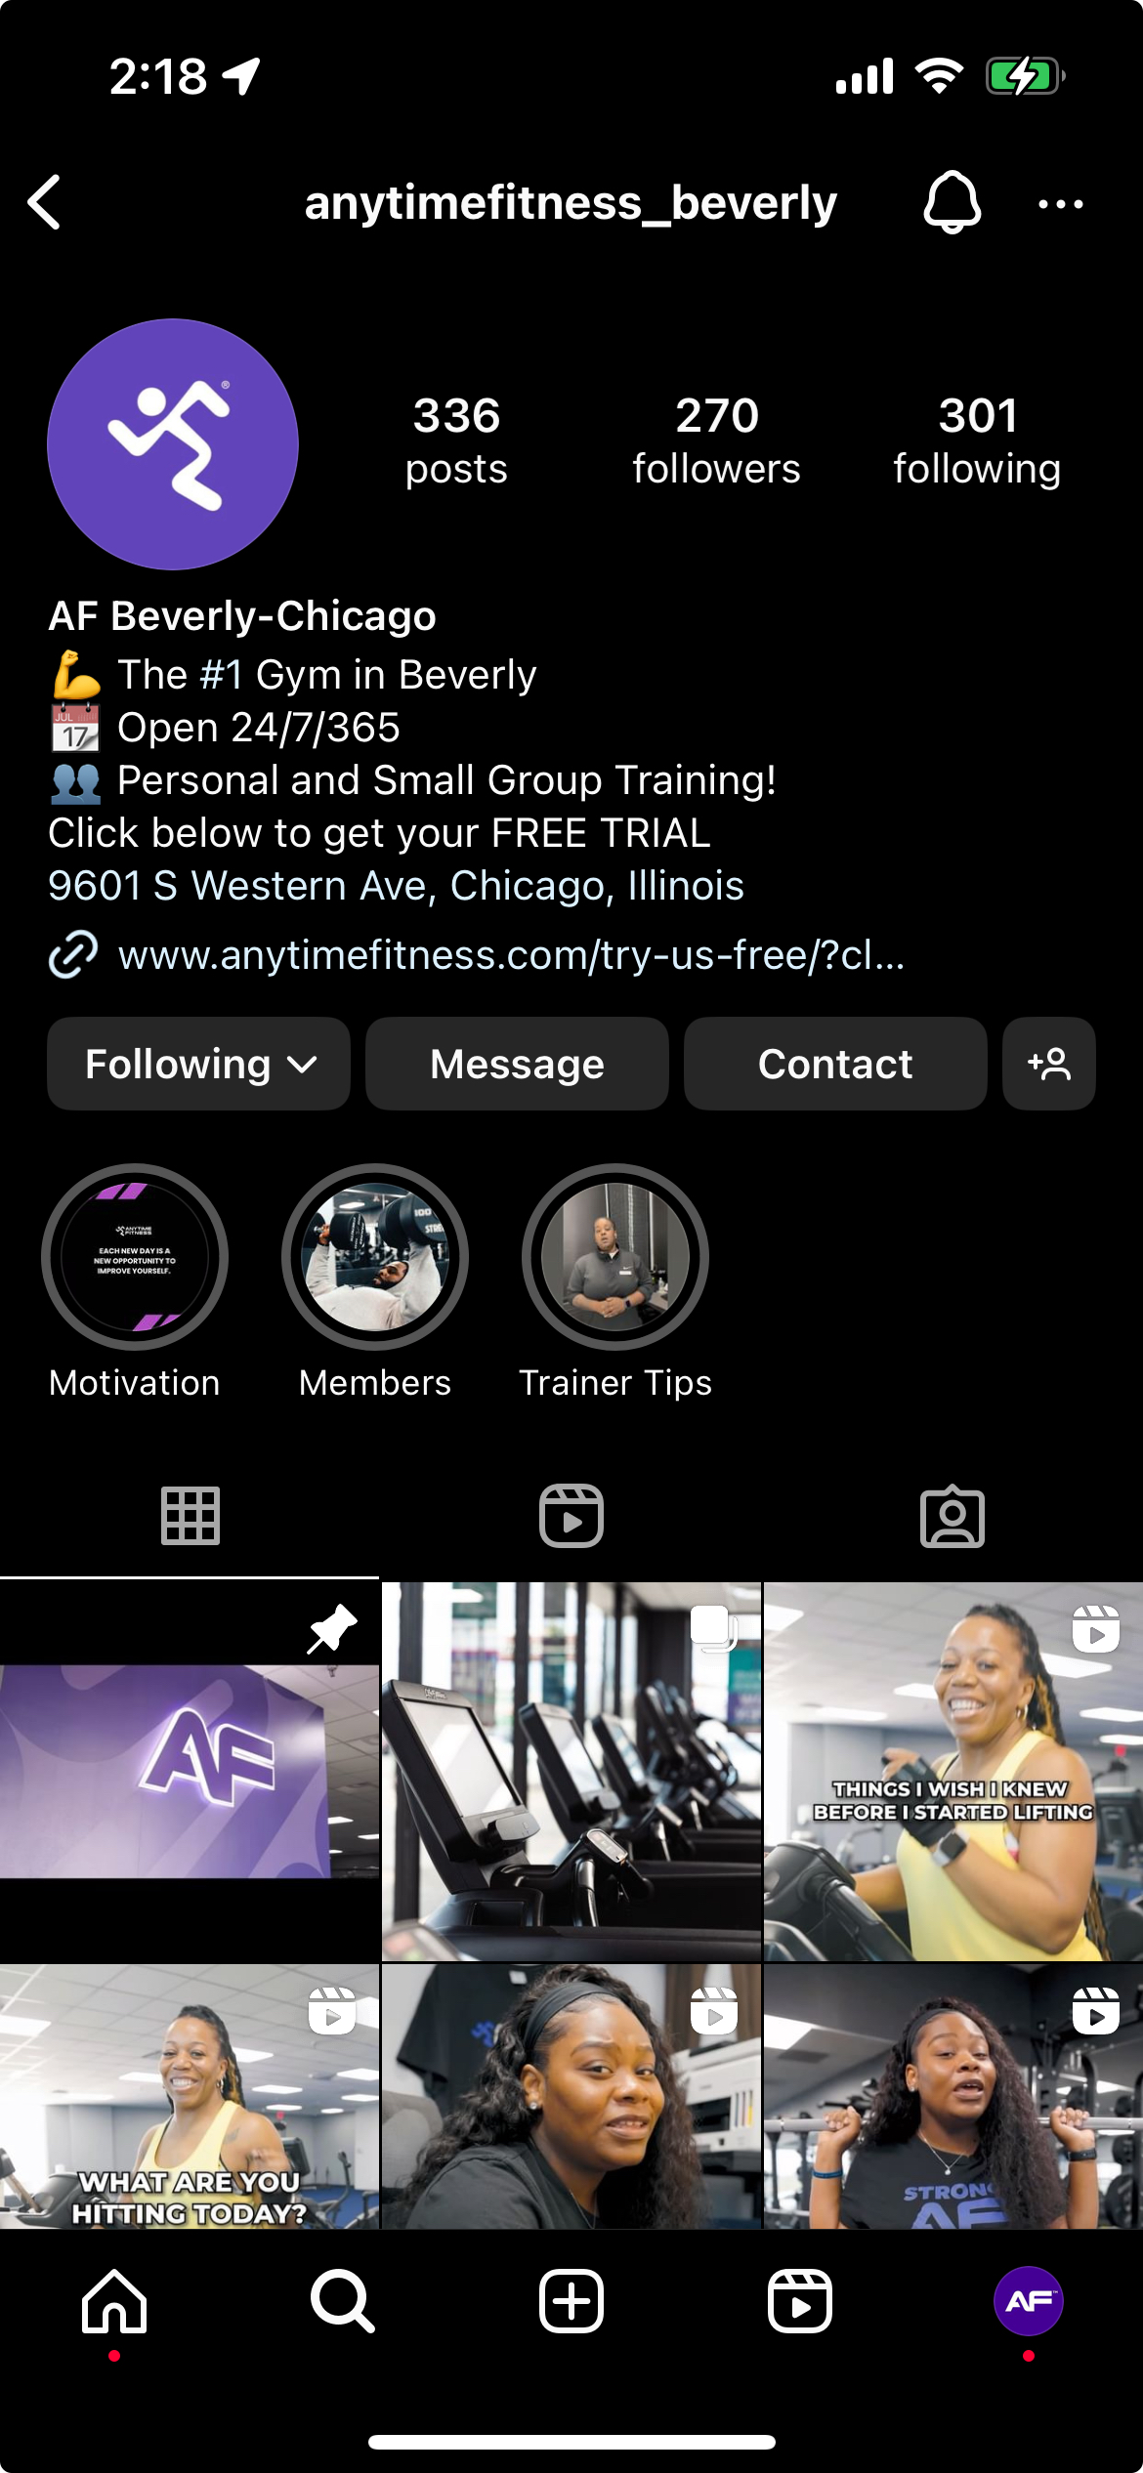
AF Club Content Shoutout
Anytime Fitness Beverly (Chicago, IL)
@anytimefitness_beverly
You are creating some fantastic Reels content! And we love your use of pinning content that helps showcase your gym. Keep up the awesome work! 💜
Anytime Fitness Garden District (New Orleans, LA)
@afgardendistrict
Your photography is stellar! You do a great job of showcasing your members and staff in their element. Way to go team! ❤️💪

