Slide 1
Social media activation calendar
MAY 2024

Slide 2
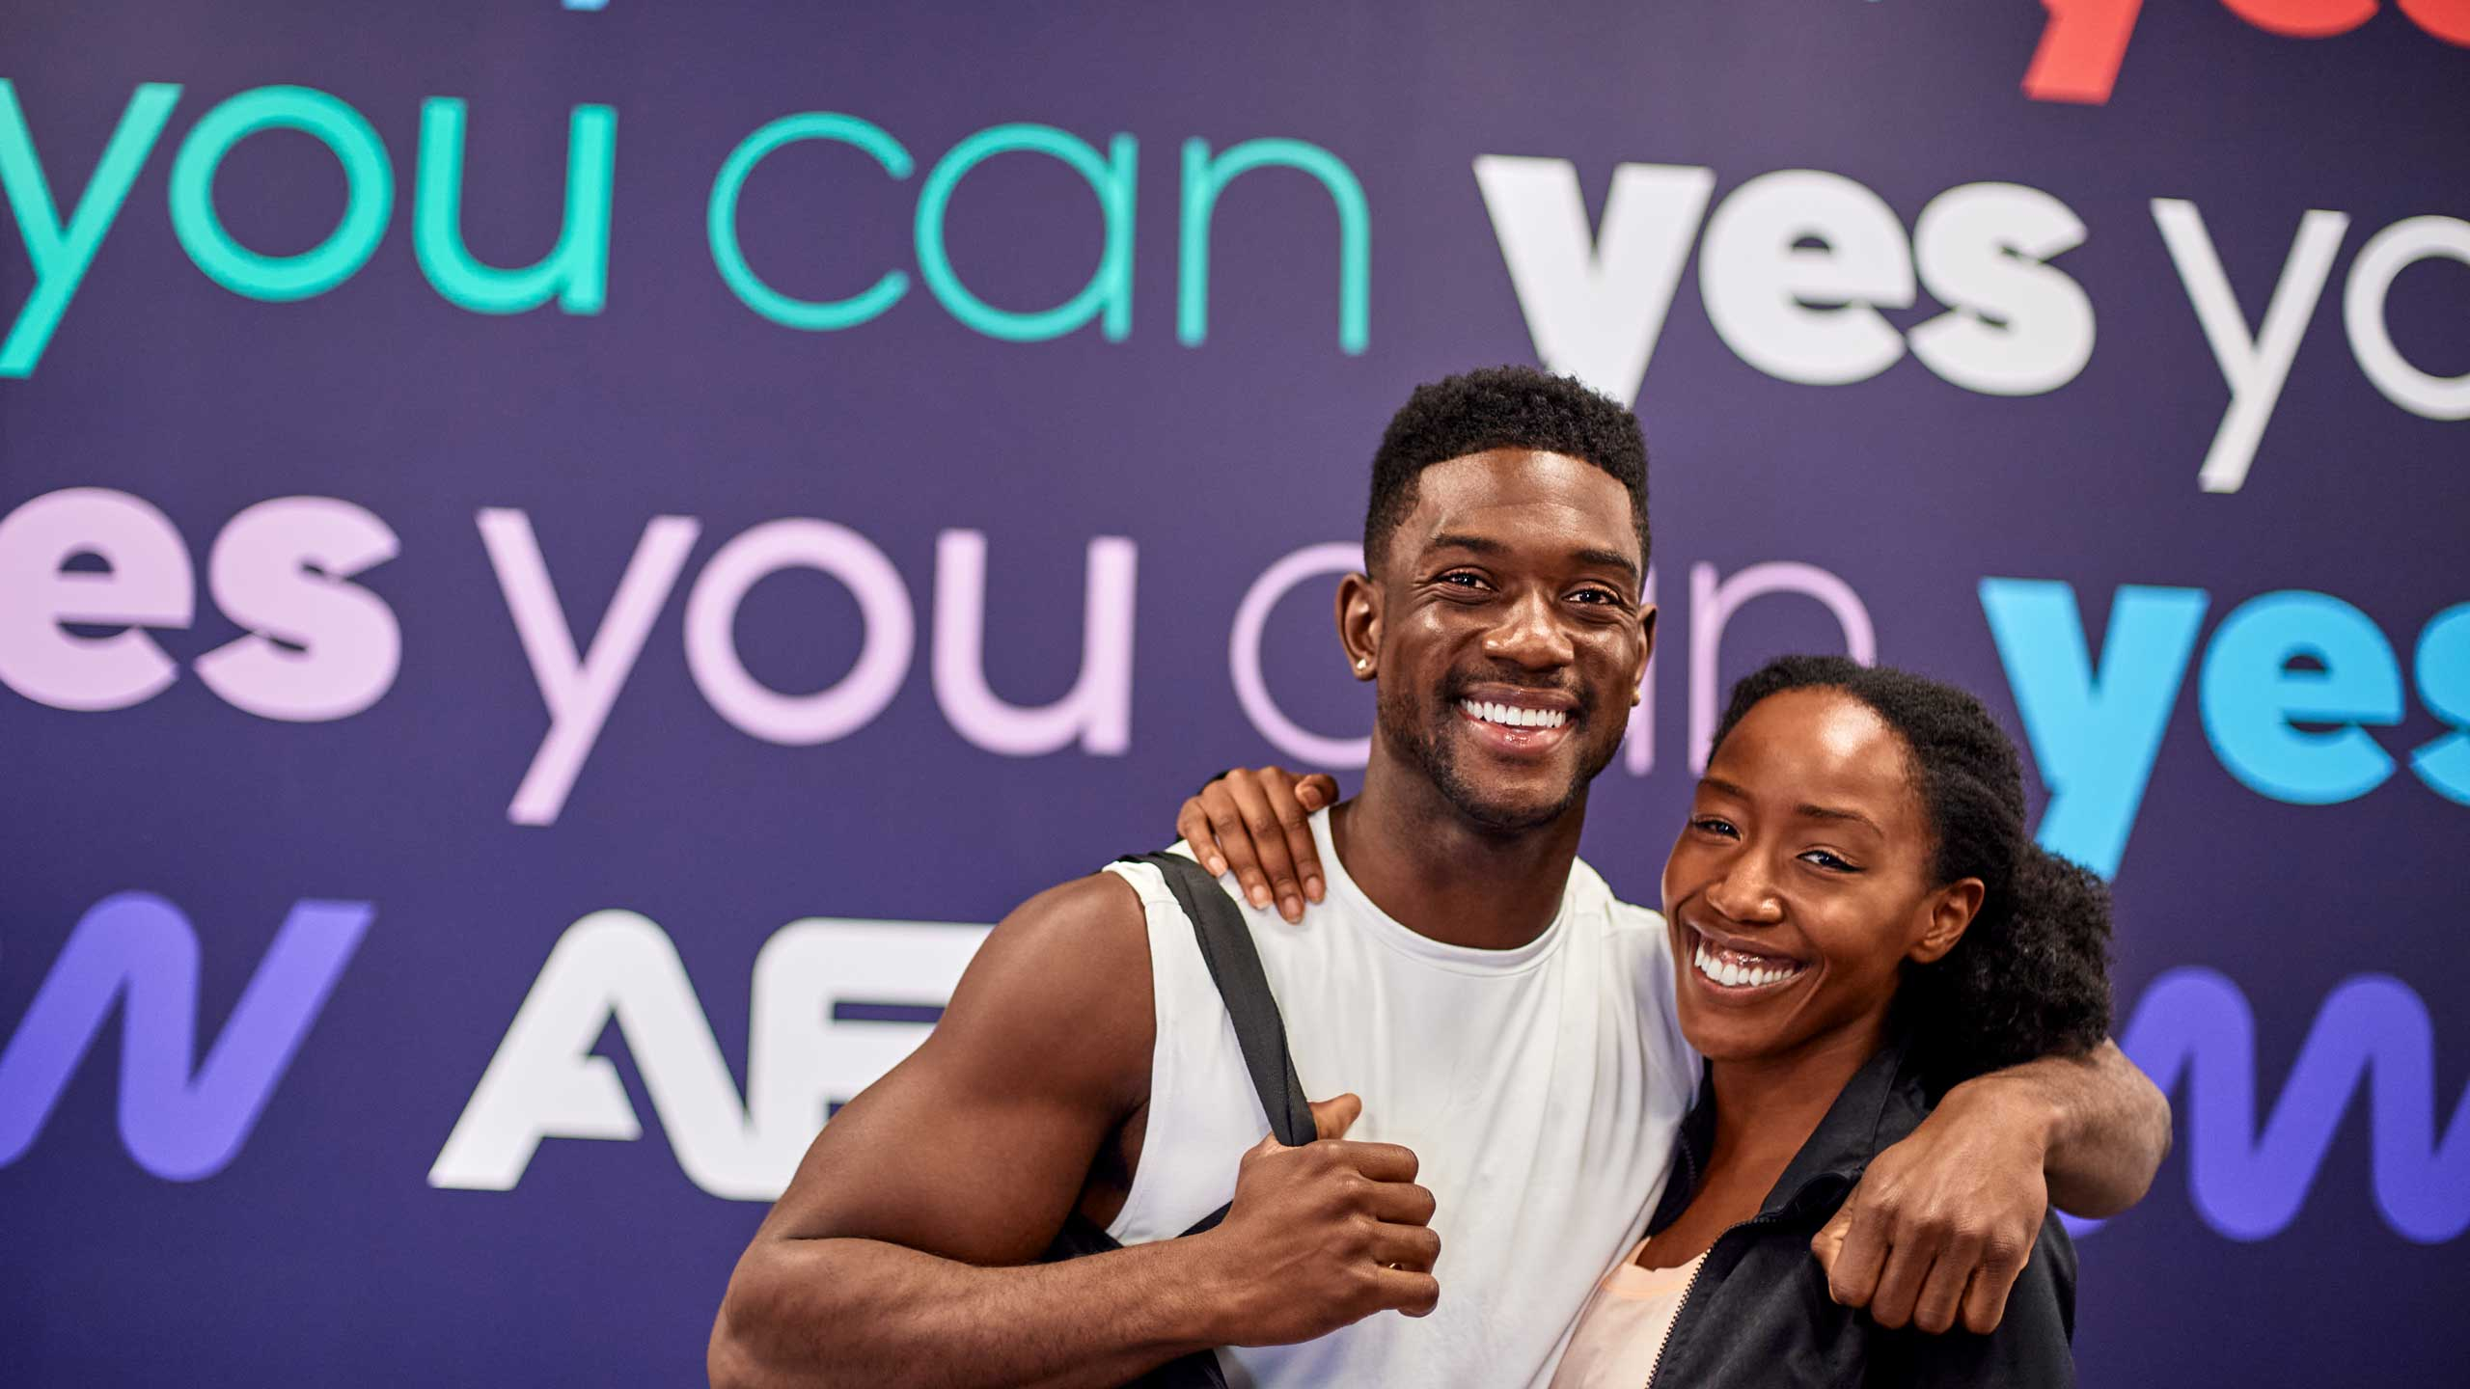
AGENDA
Social Calendar Ideas
Social Media Industry News and Platform Updates
#SocialHack
Trending Sounds
Kudos

Slide 3
May 2024
SUNDAY | MONDAY | TUESDAY | WEDNESDAY | THURSDAY | FRIDAY | SATURDAY
 |  |  | 1 MENTAL HEALTH MONTH Mental health and physical health are connected, and it's National Mental Health Month and National Fitness Month! Share a fact on how Mental Health can be supported by fitness. | 2 HABIT STACKING Habit stacking is a great way to help integrate new habits into our existing schedule. Share a habit hack you utilize in your daily life to help inspire others. | 3 FLASHBACK FRIDAY This one's for the OGs! Share photos from your club opening whether that was 2 months ago or 10 years ago ! | 4 NATIONAL FITNESS DAY Celebrate National Fitness Day! Hosting an in-club workout? Snap some pics! Or try creating a HIIT circuit the whole family can get on! Just a few of the MANY ways you can celebrate #NationalFitnessDay.
5 #TRENDING Use a sound from the Trending Sounds slide to give your algorithm a boost. Interacting and creating content using Instagram's Reels is a great way to show the algorithm you like to participate in what's popular on the app. | 6 MEMBER SPOTLIGHT Use this Template from the Brand Marketing Center to create a brand-aligned Member Spotlight for your Instagram! You can use the pin feature to pin this member for the month/week they are being celebrated! | 7 MACHINE MOVEMENT Demo a machine in your gym and film a Reel to post. Share reasons to utilize the machine vs free weights or other alternatives. | 8 AMENITIES Share amenities that are around the gym, how to use them/access them and what benefits they provide! This could be a great post to pin on your profile for prospective members during the spring campaign! | 9 MYTH BUSTERS While the internet helps us connect with information, we may not have had access to in the past, it also means that people may be searching for answers in the wrong places. Help dispel a popular fitness-industry myth. Need ideas? Check out the Community tab in the AF App to see what questions are being asked. | 10 STRENGTH MOVEMENT Show off a strength movement and how to advance the movement for those who are looking to up a certain aspect of their workout regimen. Pro Tip: poll your followers on Instagram Stories to find out what they want to know. | 11 NATIONAL FOAM ROLLING DAY National Foam Rolling Day, whoop whoop! Create a Reel of some common foam rolling movements members can use for recovery! And don't forget to use #NationalFoamRollingDay
12 MOTHER'S DAY Celebrate the kick-a** mothers of your #AFfam! Snap some pictures of moms (bonus points for moms with their kiddos of any age!) and post in celebration of all their dedication to their families and the gym! | 13 LEVEL UP! Share a progression of movements to help members level-up their fitness routine! | 14 SEASONAL MEALS As the spring turns to summer, fresh produce becomes more available and those from up north can finally start grilling again! Share a fun campfire friendly recipe or how to incorporate local produce into a crowd-pleasing recipe! | 15 BETTER SLEEP MONTH Sleep and fitness are things that go hand-in-hand. Many people are not aware of the ways exercises can improve their sleep quality! Share some tips for those who struggle with getting a good night of rest. | 16 WORKOUT SPLIT How many times a week should I work out? Is it okay to only do lower body? Share some common workout splits such as PPL and how members can incorporate this set-up into their routine! | 17 APP POWER Pairing the AF App with the in-club experience helps unlock an advantage that many members may not be aware of! Share ways members can utilize the app to take their fitness journey to the next level! | 18 COMMUNITY HAPPENINGS Are you having any events at the club? Are there any festivals or big events happening in your town or city? Share out things about the community for your followers to interact with!
19 GROUP TRAINING Give your members a peak into a Group Training session! Interview your SGT regulars and create a Reel of their answers as to why they keep coming back! | 20 ACTIVE RECOVERY How can I stay on track without feeling like I'm doing nothing? Many people feel that if they skip a day they'll fall off the wagon completely. Share some low-impact active recovery ideas! | 21 WORLD MEDITATION DAY Channel your inner Zen and share out a post on World Meditation Day! Share out a statistic on how meditation can benefit a person or share | 22 POP CULTURE MOMENT Share out a meme or create a Reel utilizing one of the recommended trending sounds to post. Tip: don't schedule this one more than a few days ahead | 23 IS IT SUMMER YET? Your audience Is full of questions and ideas for what they want to see, so don't waste your opportunity. Utilize the Story stickers or post a Feed post asking what members are looking to accomplish this summer. You can utilize these ideas to further enhance your content creation for the month of June! | 24 #RealAF TOUR Take a Reel of a quick tour of the gym! Showcase what makes your gym the place to be! | 25 REVIEWS Share a review someone has left on your Google profile, Facebook page or Yelp profile! This can help new prospects when gauging their options!
26 SUNDAY RESET Share a habit or tip that can help members with their Sunday reset and ward off those #SundayScaries! This doesn't have to be a life changing tip, even the smallest tip can help elevate the experience! | 27 AF App-titude The AF Access Pass is a great accessory helping make healthy happen anywhere, anyTIME! Share a post educating your following on Access Pass and how it can help make getting to the gym even easier. Reminder: Access Pass is only available in the USA and Australia at this time. | 28 WEEKLY RESET Encourage followers to share how the prepare for the week. Pro-tip: create a story to collect followers' responses and use the customizable templates in the Brand Marketing Center to showcase these tips. | 29 INVITE A FRIEND Looking for free leads? Your members got you! Who doesn't love a workout buddy? Head to SOCi and schedule a post utilizing the Invite A Friend posts in the Library! | 30 MEET THE COACH Showcase a Coach from your staff utilizing this template from the Brand Marketing Center! Have them share some fun facts about themselves to connect with your audience. Bonus Points: Have them do an IG Story takeover for a "Day In the Life" preview! | 31 CORE Let's work those abs! Share a functional core workout – think outside the box. Share out movements that aren't your normal crunches and can challenge those looking to turn it up a notch.

Slide 4
Social Media industry news and updates
Need Marketing assistance?
Instagram Tests Option To Comment on Specific Frames Within a Carousel Update
Instagram Updates Hashtag Search To Broaden Discovery
Instagram Is Experimenting With an Option To Add Files to DMs
Marketing Support Inbox:
https://jira.sebrands.com/plugins/servlet/desk/site/af/
Brand Marketing Center:
https://app.sproutloud.com/member/home

Slide 5
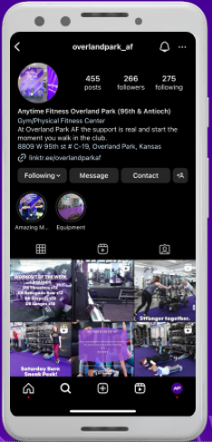
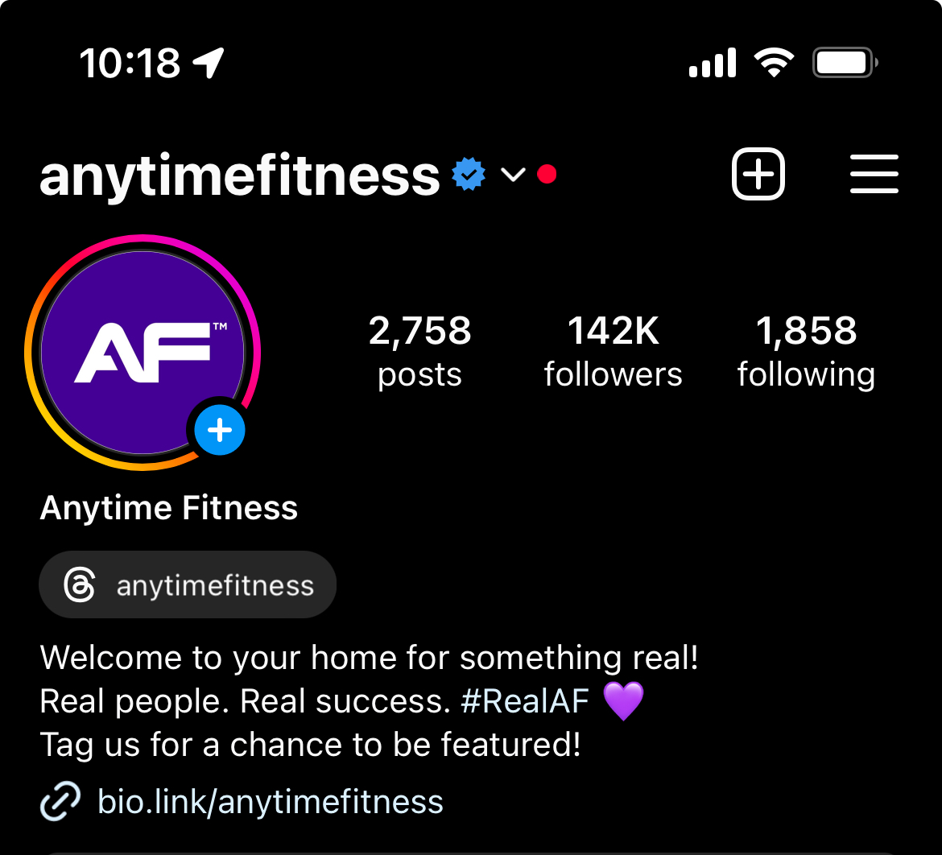
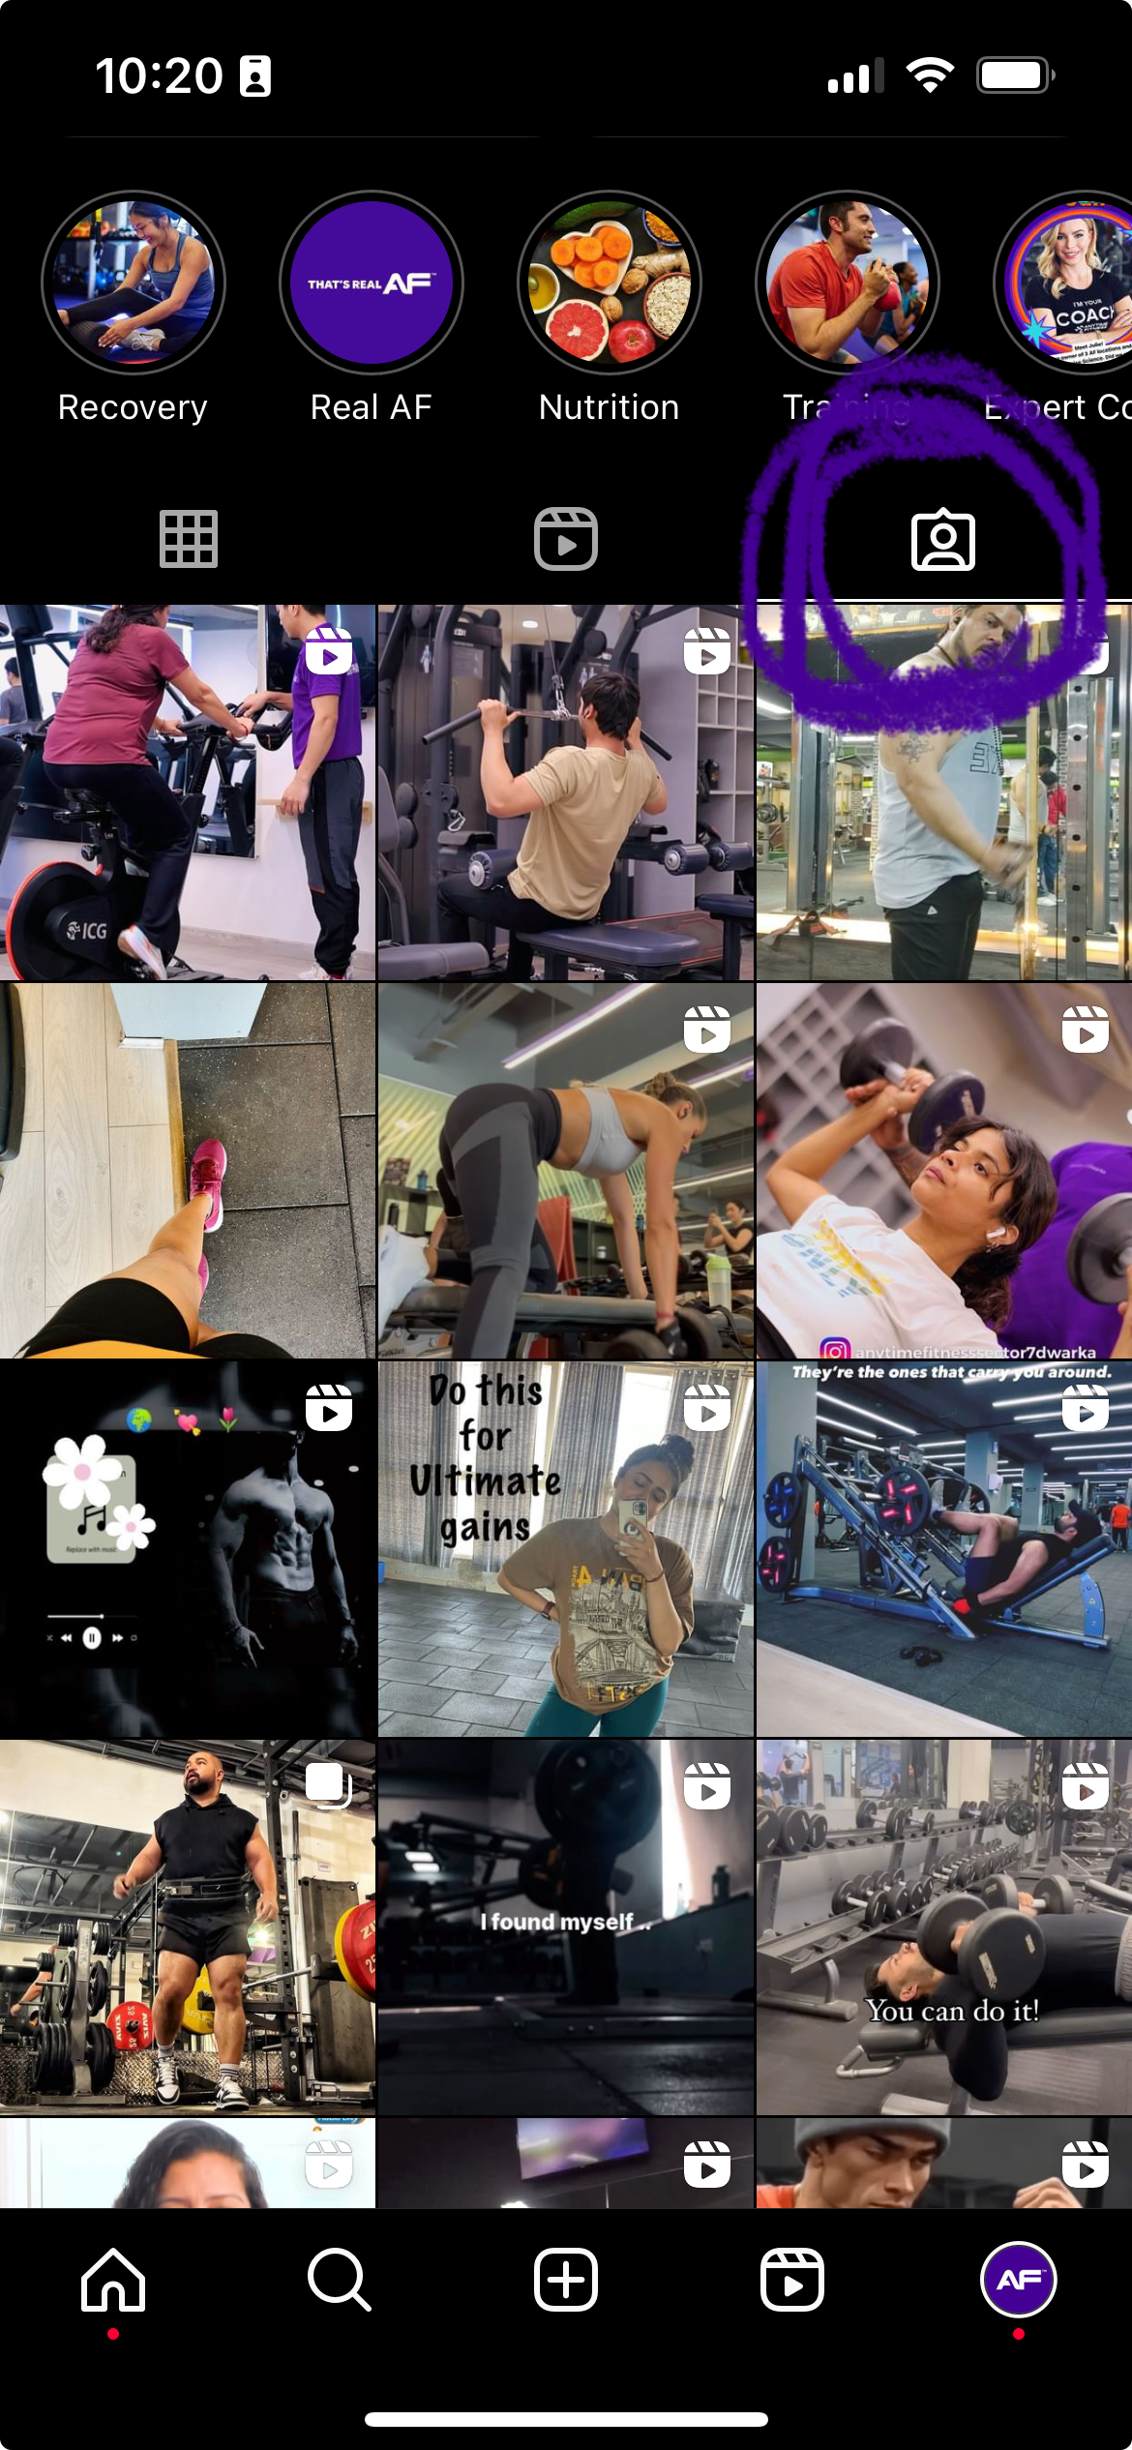
#SocialHack User Generated Content (UGC)
What is User Generated Content (UGC)?
User Generated Content is just what it sounds like – content (in this case social media content) created by follower/members of the gym!
How to Find UGC?
UGC can be found more easily than you may think! Great places to check are in your tagged photos on Instagram or in your DMs where people may be tagging you in Instagram Stories. If you take 10-15 minutes per day to do proactive engagement, you can also utilize this engagement time to also save or find UGC content! Once you've found a piece you would like to use, DM the account asking for permission and let them know you will tag them in the post to give them credit! (This part is crucial as sharing content without consent can create many issues, so always ask first!)
Why utilize UGC in your social plan?
UGC is a high-performing and extremely authentic way to reach potential gym members.
90% of consumers say authenticity is important when deciding which brands they like and support (up from 86% in 2017).
UGC helps create a balance of branded, polished social media assets and real experiences and help potential members "see themselves" in the content! People want to be able to connect and resonate with the brand they are choosing to put money and time into. UGC is also FREE, unlike sourcing content from influencer.
Consumers find UGC 9.8x more impactful than influencer content when making a purchasing decision.
Tagged Content

Slide 6
Trends and Trending Sounds
TikTok
reels
Don't ask me how I did it, it was hard
Look at this one, look at that one
Hamilton – Mr. Madison
End of the Beginning by Djo
Oh no, I'm devastated
L.A. Love by Fergie ft YG (Template)
Murder on the Dance Floor HEYYY
Discipline (Template)
Training Season x SNM Remix
Rule Number Everyday

Slide 7
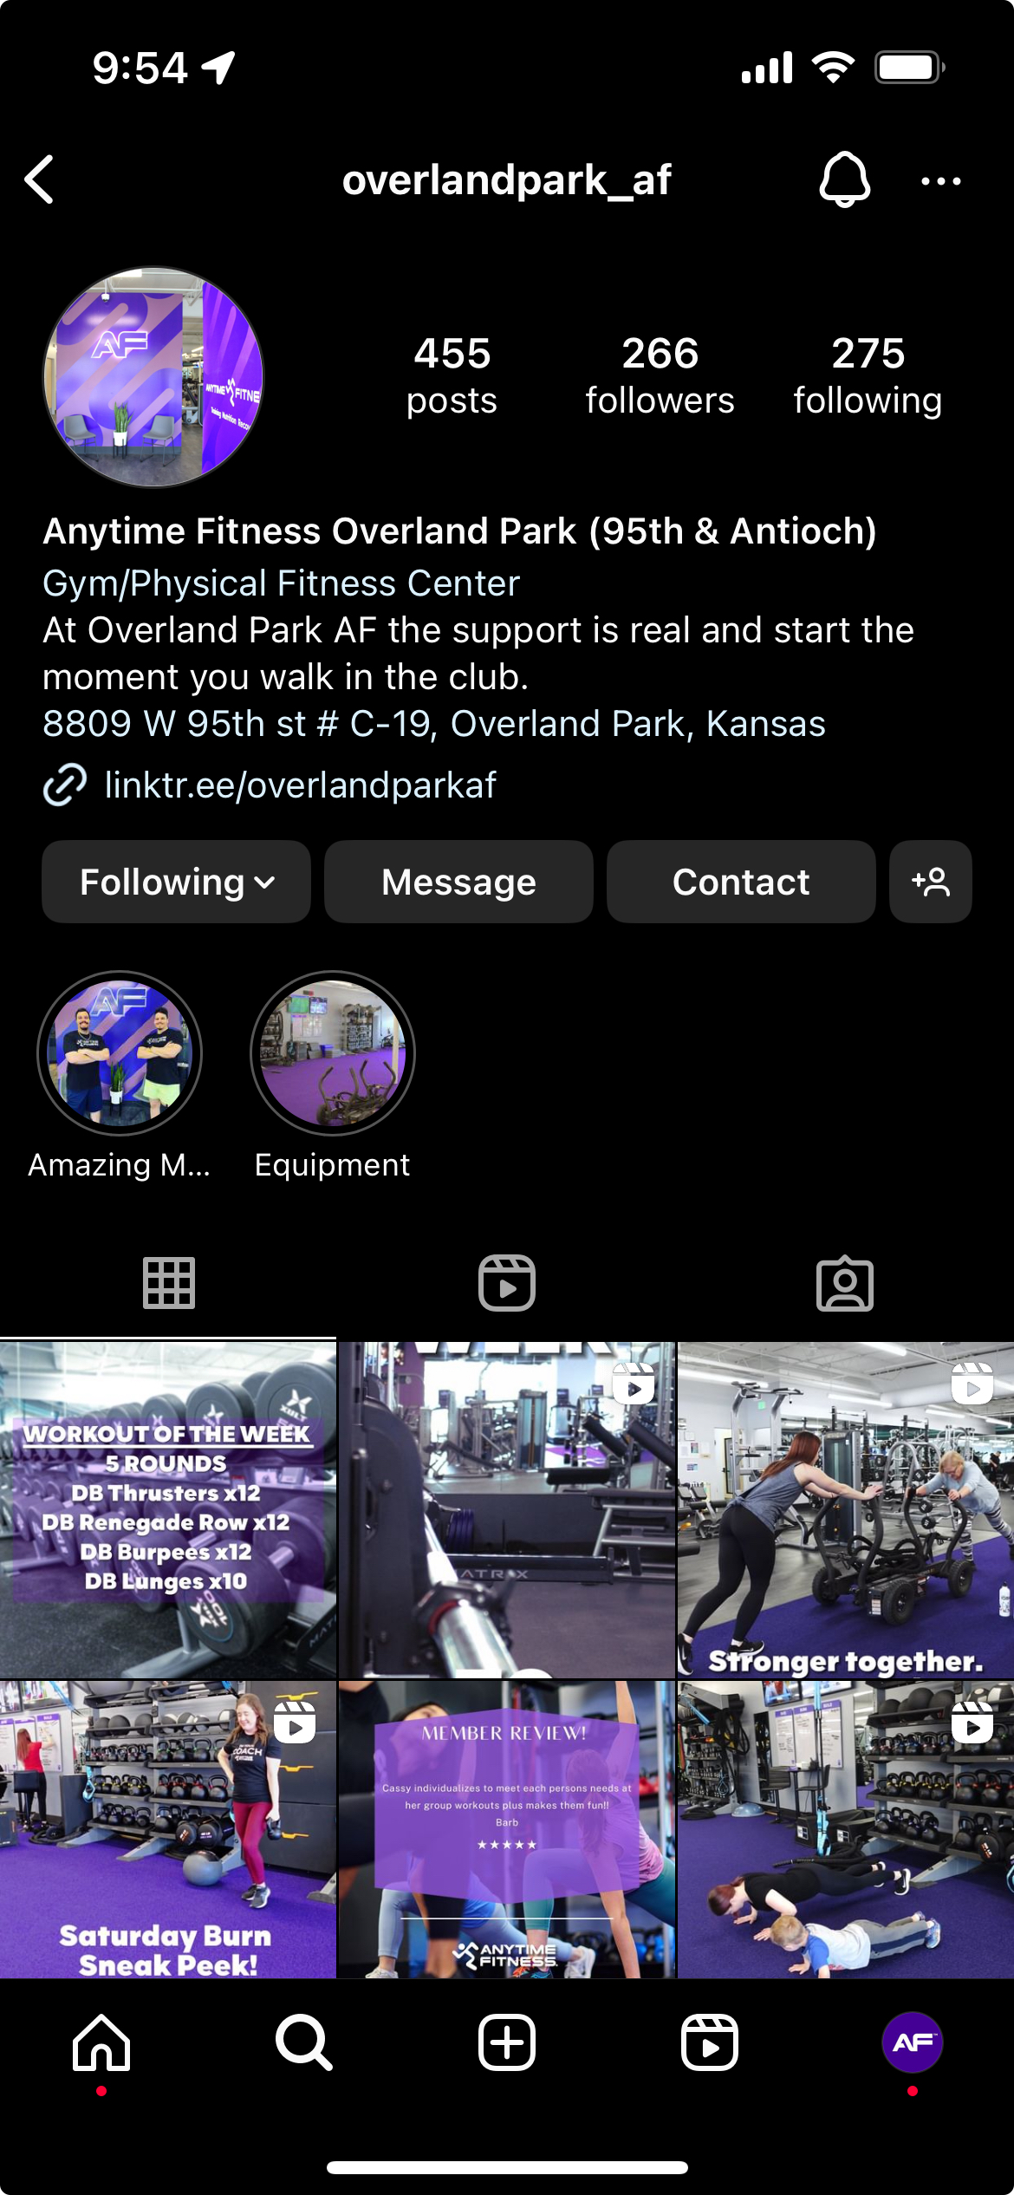
AF Club Content Shoutout
Anytime Fitness Overland Park, KS
@overlandpark_af
Sneak peaks of SGT and showcasing members and staff – you are doing a great job! We love seeing that branded font in use! Keep up the great work! 💜
Anytime Fitness Lowell, IN
@anytimefitness_lowell
You can truly see your community shine through in your content! Showcasing some awesome events and sharing interactions that happen in the gym – great job! ❤️💪

