Slide 1
AF Training Progressions & Regressions

Slide 2
MOVING IS ESSENTIAL
Notes:
Moving well is essential not just for gym performance, but for meeting the ever-changing demands of everyday life. Whether lifting a toddler, carrying groceries, standing up from a chair, or rotating to check a blind spot, our ability to move efficiently and adapt to different loads, angles, and environments directly impacts our strength, mobility, and long-term resilience.

Slide 3
6 FOUNDATIONAL MOVEMENT PATTERNS
PUSH
PULL
HINGE
SQUAT
LUNGE
ROTATION
Notes:
The six foundational movement patterns—Push, Pull, Hinge, Squat, Lunge, and Rotation—form the basis of nearly every physical task we perform. Mastering and progressing these movements isn’t just about lifting heavier weights; it’s about building the adaptability to handle real-world challenges safely and effectively. Understanding the complexity of movement means recognizing that no two days feel exactly the same. Fatigue, stress, injuries, or external demands can impact how well we move, making it crucial to adjust movement difficulty dynamically—not just for performance goals, but to maintain functional independence and prevent injury as life throws new demands our way. By strategically progressing or regressing movements through load, tempo, range of motion, and body position, we create a training framework that helps individuals build strength where they need it, reinforce stability where they lack it, and develop movement confidence for both training and daily life. The ability to scale exercises ensures that everyone—regardless of age, experience, or ability—can train safely, make progress, and stay prepared for whatever life requires.

Slide 4
AF Training Progressions & Regressions Principles
Train for Life, Not Just the Gym
Movement quality comes first—before load, intensity, or complexity. The goal is not just strength in the gym but resilience in daily life.
Empowerment Through Adaptability
Regaining mobility, stability, and strength allows people to move with confidence in any scenario—whether lifting a barbell or carrying a child. Progressions expand possibilities, ensuring clients feel capable, not restricted.
Function Over Formula
We progress or regress movements based on how they help people feel, function, and perform in the real world. By adjusting load, tempo, ROM, and stability, we meet clients where they are today while guiding them toward long-term success.

Slide 5
The High Five Assessment
This screen evaluates core stability, lower-body mechanics, and overall coordination by testing five fundamental movement patterns: Perform 5-10 reps per movement (per side if applicable).
Overhead Squat | Split Squat | Single-Leg Balance Reach | Plank | Birddog
For each of the five movements, you’ll record: Pain/Functionality Score: 0 to 3, using the following key:
0 = Pain is indicated (movement cannot be continued or is very uncomfortable) | 1 = Movement is dysfunctional or cannot be completed without modification | 2 = Movement is functional but with clear compensations | 3 = Movement is functional without noticeable compensation (movement can be loaded today)

Slide 6
Why This Matters
The High Five Assessment provides a real-time snapshot of where a client is on the movement continuum, allowing coaches to place them on the appropriate regression or progression ladder quickly.

Slide 7
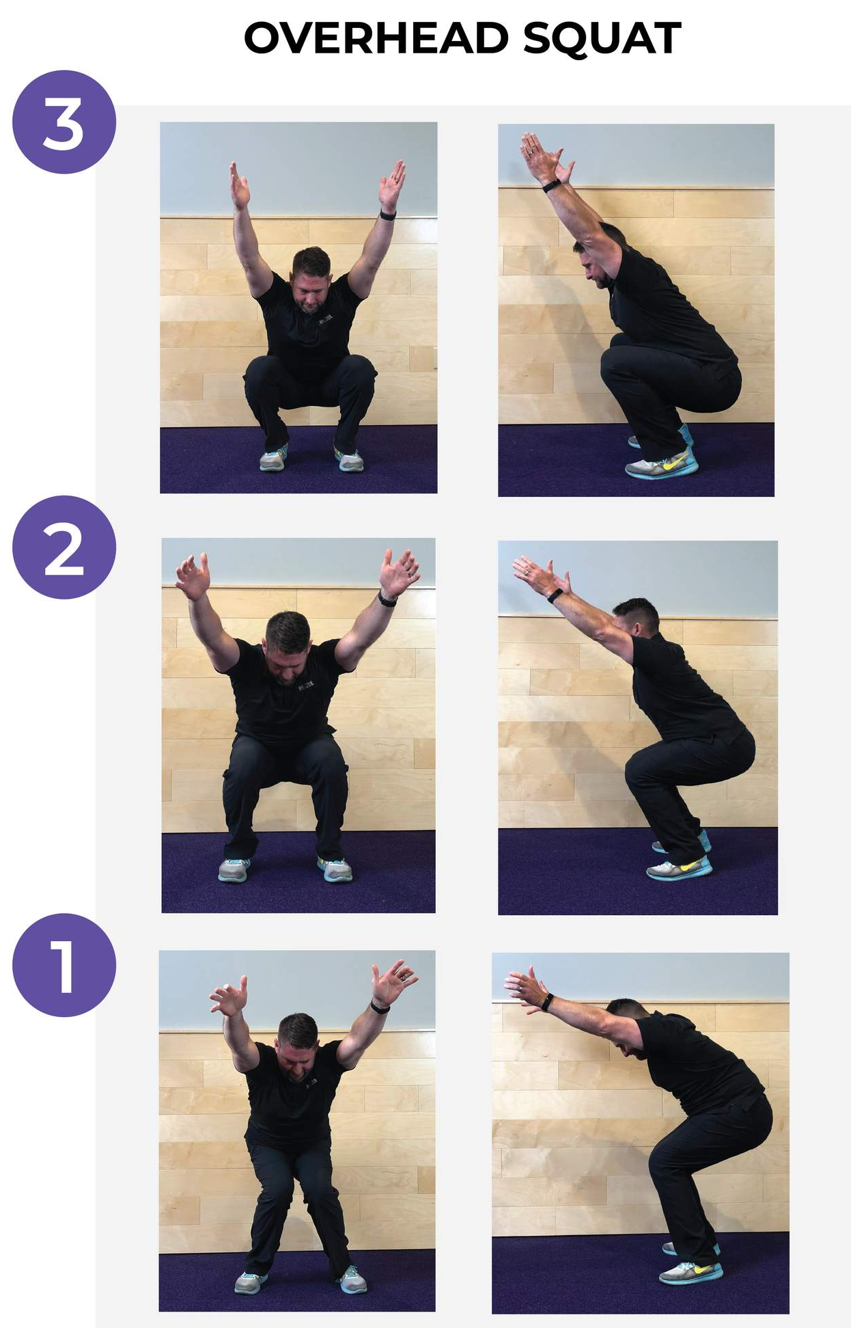
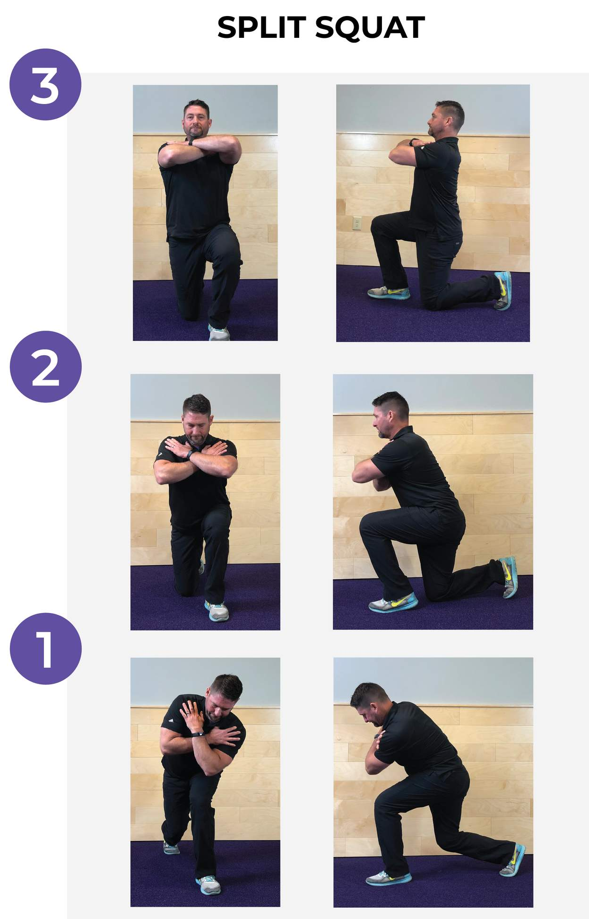
Overhead Squat & Split Squat
Evaluates thoracic and shoulder mobility along with core control under load.
Low Scores indicate difficulty maintaining a neutral spine in hinge-based lifts.
Recommended adjustments:
Start with supported or lower-depth variations to reinforce stability before progressing.
Notes:
Efficient Evaluations
Screens multiple planes, upper/lower-body strength, stability, and core control in under 10 minutes.
Immediate Feedback
Clients quickly identify movement limitations, such as: "I can’t hold my plank past 20 seconds without sagging.”
"My left knee collapses during a split squat.”
Real-Life Application
These tests reflect essential movement patterns used in daily life, including squatting, stepping, bracing, and coordinating limbs effectively.

Slide 8
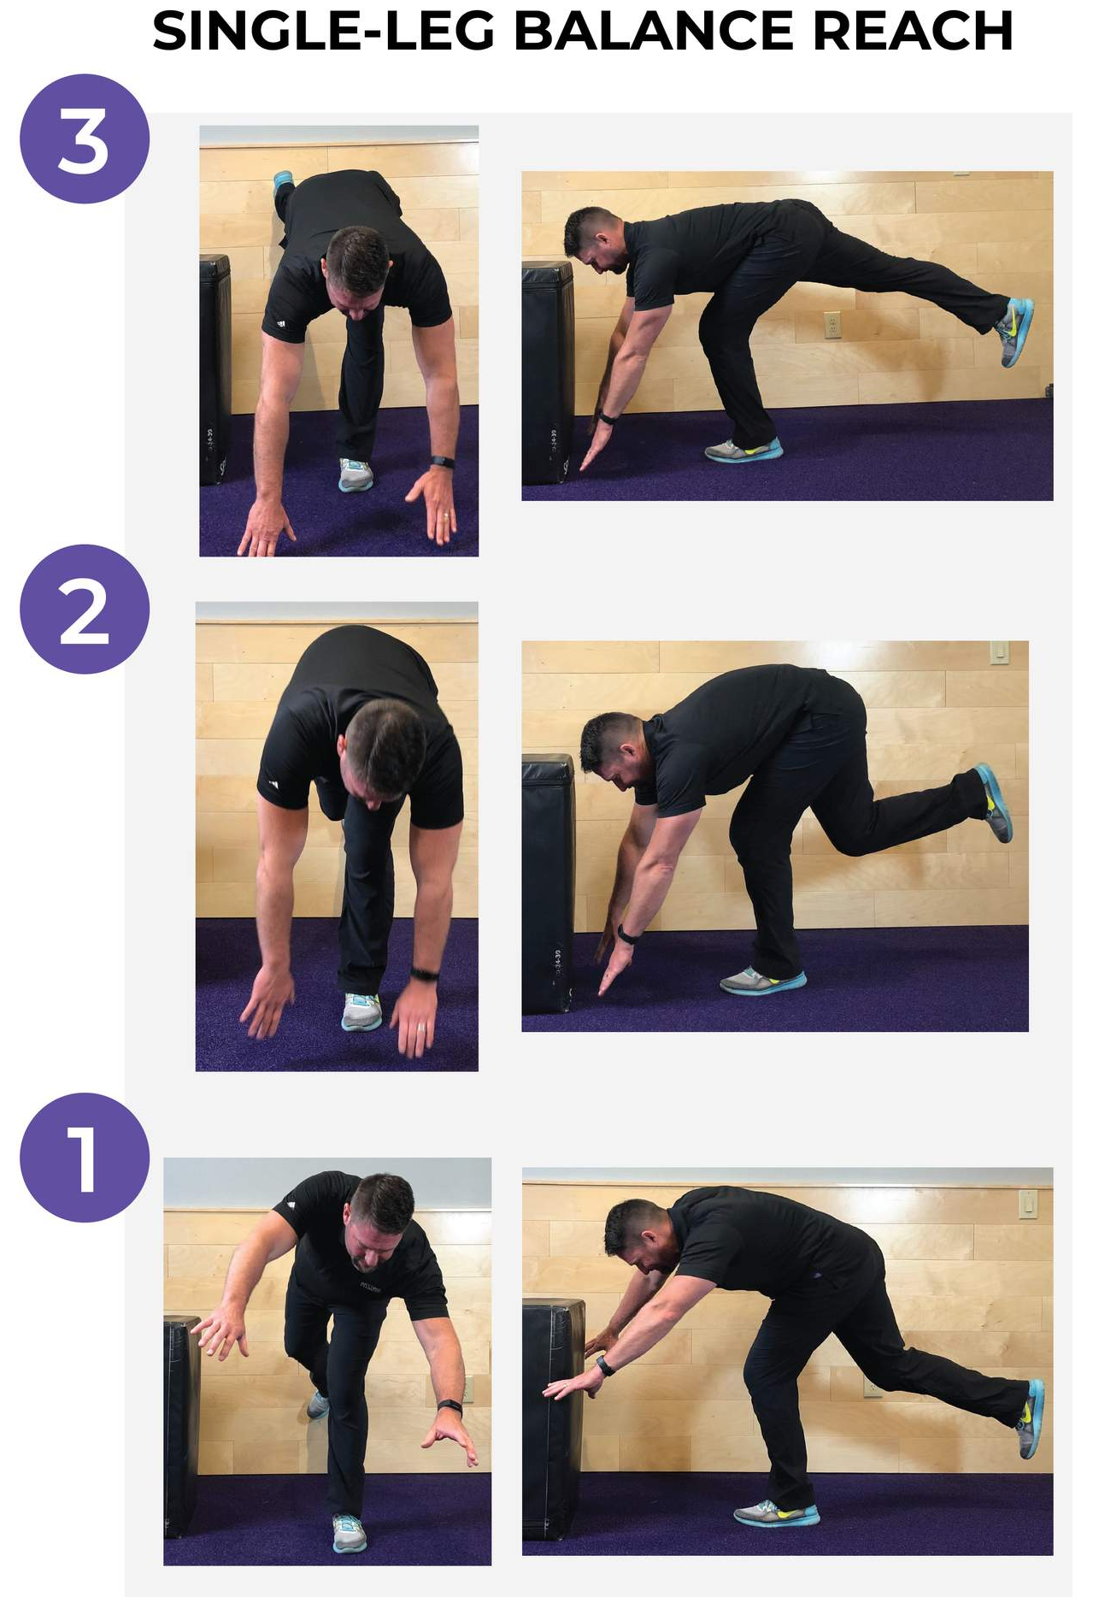
Single Leg Balance Reach
Single-Leg Balance Reach:
Assesses unilateral stability and proprioception.
A score of one or two suggests single-leg RDLs may be too advanced at this stage.
Recommended adjustments: Begin with two-legged variations, partial range of motion, or suspension assistance before advancing.
They may start with two-legged variations and build single-leg capacity over time with partial-range or TRX support.
Notes:
Efficient Evaluations
Screens multiple planes, upper/lower-body strength, stability, and core control in under 10 minutes.
Immediate Feedback
Clients quickly identify movement limitations, such as: "I can’t hold my plank past 20 seconds without sagging.”
"My left knee collapses during a split squat.”
Real-Life Application
These tests reflect essential movement patterns used in daily life, including squatting, stepping, bracing, and coordinating limbs effectively.

Slide 9
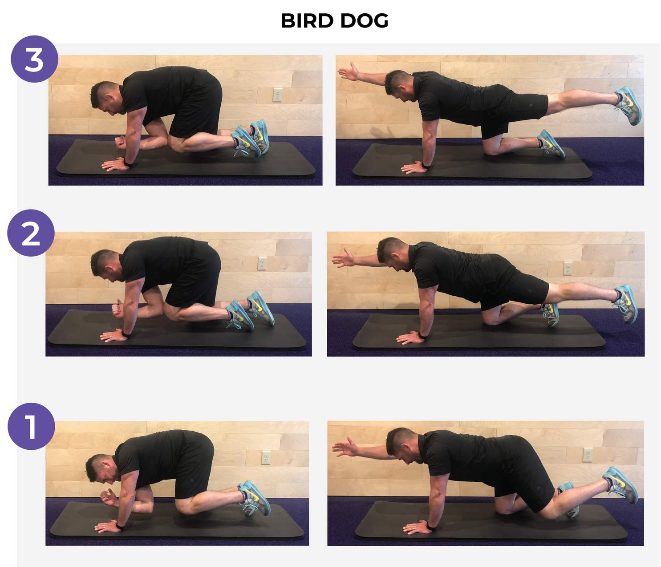
Bird Dog
Evaluates thoracic and shoulder mobility along with core control under load.
Low Scores indicate difficulty maintaining a neutral spine in hinge-based lifts.
Recommended adjustments:
Start with supported or lower-depth variations to reinforce stability before progressing.
Notes:
Efficient Evaluations
Screens multiple planes, upper/lower-body strength, stability, and core control in under 10 minutes.
Immediate Feedback
Clients quickly identify movement limitations, such as: "I can’t hold my plank past 20 seconds without sagging.”
"My left knee collapses during a split squat.”
Real-Life Application
These tests reflect essential movement patterns used in daily life, including squatting, stepping, bracing, and coordinating limbs effectively.

Slide 10
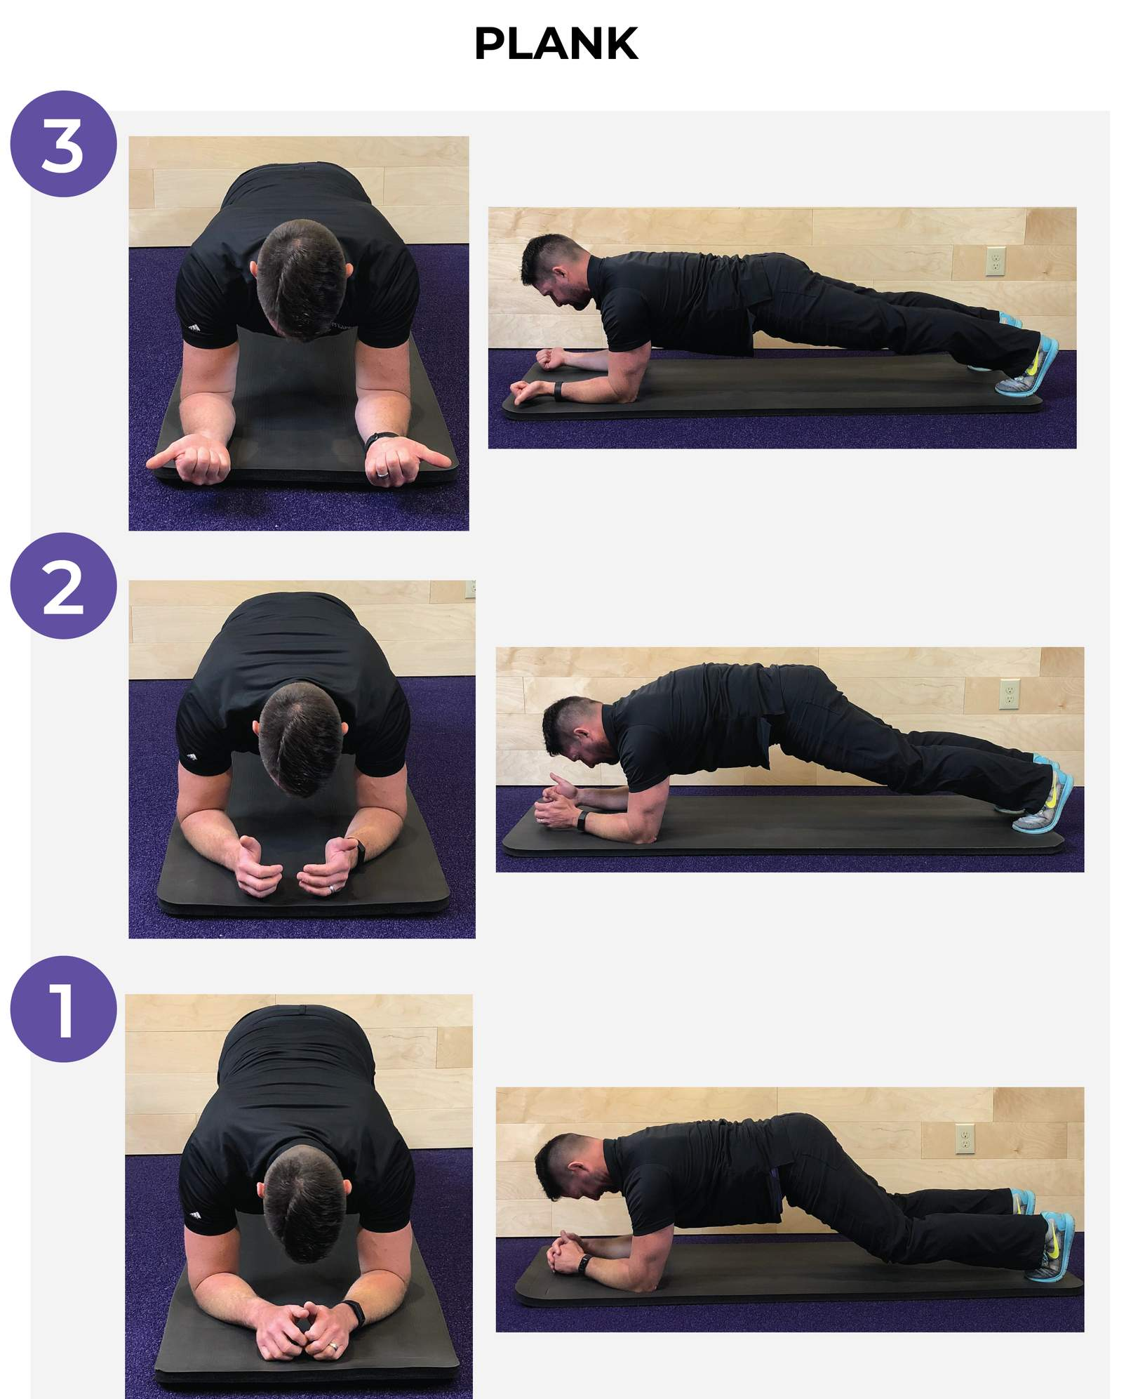
Low Plank
Evaluates thoracic and shoulder mobility along with core control under load.
Low Scores indicate difficulty maintaining a neutral spine in hinge-based lifts.
Recommended adjustments:
Start with supported or lower-depth variations to reinforce stability before progressing.
Notes:
Efficient Evaluations
Screens multiple planes, upper/lower-body strength, stability, and core control in under 10 minutes.
Immediate Feedback
Clients quickly identify movement limitations, such as: "I can’t hold my plank past 20 seconds without sagging.”
"My left knee collapses during a split squat.”
Real-Life Application
These tests reflect essential movement patterns used in daily life, including squatting, stepping, bracing, and coordinating limbs effectively.

Slide 11
High Five example
Movement | Pain (Y/N) Y=1 | R Score | L Score | Lowest Score | Notes
Overhead Squat | N | – | – | 3 | Good depth, stable spine
Split Squat | N | 2 | 1 | 1 | Left knee valgus/collapse during reps
Single-Leg Balance Reach | N | 1 | 2 | 1 | Right hip drops under fatigue
Plank | N | – | – | 2 | Hips begin to drop at 20s
Bird Dog | N | 2 | 2 | 2 | Slight rotation in torso
Sum | – |  |  | 9
Overall Score (Sum/5) | -- |  |  | 1.8 avg
A result like this indicates a need to regress or refine unilateral leg work (Split Squat, Single-Leg Balance Reach) and address some core stability issues (Plank, Bird Dog).

Slide 12
High Five example
Movement | Pain (Y/N) Y=1 | R Score | L Score | Lowest Score | Notes
Overhead Squat | N | – | – | 3 | Good depth, stable spine
Split Squat | N | 2 | 1 | 1 | Left knee valgus/collapse during reps
Single-Leg Balance Reach | N | 1 | 2 | 1 | Right hip drops under fatigue
Plank | N | – | – | 2 | Hips begin to drop at 20s
Bird Dog | N | 2 | 2 | 2 | Slight rotation in torso
Sum | – |  |  | 9
Overall Score (Sum/5) | -- |  |  | 1.8 avg
A result like this indicates a need to regress or refine unilateral leg work (Split Squat, Single-Leg Balance Reach) and address some core stability issues (Plank, Bird Dog).

Slide 13
Programming Post High Five
Identify Patterns in Scores
Actionable Takeaways
Unilateral Stability → Prioritize regressions and gradual progressions for lunges.
Adjust Programming
Unstable Patterns:
Overhead Squat (3) → Good mobility & posture.
Split Squat (1) → Left knee collapse indicates hip/knee instability.
Single-Leg Reach (1) → Right hip drop under fatigue shows lateral instability.
Plank (2) → Hips sagging at 20s reflect limited core endurance.
Bird Dog (2) → Torso rotation indicates weak anti-rotation control.
Core Stability → Improve trunk endurance and anti-rotation strength.
Strength Balance → Maintain overhead squat mobility while addressing targeted stability issues.
Split Squat → Use assisted or box-supported variations.
Single-Leg Reach → Add hand support or reduce range.
Core Stability:
Plank → Shorter holds, emphasize tension cues.
Bird Dog → Integrate band resistance for anti-rotation.
Load & Complexity:
Build bilateral strength while progressively adding unilateral challenges.
Notes:
The first step will be to choose the appropriate workout for the member based on the information you received while collecting their story as well as their overall score on the High Five Assessment.

Slide 14
Progression Continuum: Interpreting Scores & Immediate Actions
0 | 1 | 2 | 3
Scores of 0 (Pain)
Action: This is a clear sign to refer out to a medical or rehab professional. Training should not proceed until the client has been cleared to continue.
Example: Inability to complete the Overhead Squat and expressed pain during the movement.
Why It Matters: If the member has pain, this doesn’t necessarily mean they can't train. In many cases, having a coach is the ideal scenario for them. The coach just needs the appropriate guidance from a healthcare professional to move forward.

Slide 15
Progression Continuum: Interpreting Scores & Immediate Actions
0 | 1 | 2 | 3
Scores of 1 (Dysfunction)
Action: Use a regression or limited ROM for that pattern.
Example: If an Overhead Squat scores a 1, modify to a Box Squat or Goblet Squat to a higher box to reduce strain.
Why It Matters: Pain or an inability to complete the movement means focusing on range, stability, and motor control before adding complexity.

Slide 16
Progression Continuum: Interpreting Scores & Immediate Actions
0 | 1 | 2 | 3
Scores of 2 (Functional with Compensation)
Action: Use a baseline variation, but monitor form and adjust with minor tweaks.
Example: A heel lift for squats can assist someone struggling with ankle mobility.
Why It Matters: A 2 suggests the movement is possible but includes compensations (e.g., knee valgus, slight torso collapse). A mindful warm-up and corrective work can refine mechanics.

Slide 17
Progression Continuum: Interpreting Scores & Immediate Actions
0 | 1 | 2 | 3
Scores of 3 (Functional without Compensation)
Action: Introduce a progression if it fits their goals, or stay at baseline based on mesocycle planning.
Example: Moving from a Goblet Squat to a Front Squat or from an Incline Push-Up to a Standard/Weighted Push-Up.
Why It Matters: A 3 indicates readiness for increased load or complexity while maintaining movement integrity.

Slide 18
Progression Continuum: Interpreting Scores & Immediate Actions
0 | 1 | 2 | 3
Blending Progressions & Regressions in a Single Session
Clients may have different scores across movement patterns.
Example: A client scores a 3 on Bird Dog (strong trunk control) but a 1 on Overhead Squat.
Solution: Progress their core work while using a more conservative squat variation.
Why This Matters: Progressions and regressions are not fixed categories—they adapt day-to-day based on movement readiness, ensuring safe, scalable improvements for every client.

Slide 19
Multiple Clients, 1 Movement Pattern
Coach Demonstrates the Baseline Variation
Start by demonstrating a moderate-intensity movement (e.g., Goblet or Landmine Squat).
A single progression continuum allows every client to train at the right level while keeping the group on the same page.
“Our goal is 10 Front Squats with a low box. If you struggled with the racked Front Squat position or would like to swap to a more stable position and heavier load, try a goblet or back squat with a 3-1-1 tempo. If you feel strong and stable with your front squats, remember that weight and lets use the 3-1-1 tempo for those 10 reps.”
This approach maintains class flow, reduces confusion, and allows coaches to correct individuals effectively without disrupting the session.
 |  |  | Single Leg Squat
 |  |  | Smith Pause Squats
 |  |  | High/Low Bar Tempo
 |  |  | Barbell Back Squat
 |  | Unilateral Load | 1.5 Stance Squat
 |  | Landmine | Zercher Squat
 | Suspension/Assisted Squat | Goblet/Landmine | Front Squat
 | Bodyweight/ Box Squat | BW Squat Brace Squat | Brace Squat(Tempo)
0 | 1 | 2 | 3
Although participants may perform different squat variations (Box vs. Goblet vs. Front Squat vs Tempo Front Box Squat), they are united by the same movement pattern

Slide 20
BRINGING IT ALL TOGETHER

Slide 21



ALIGNING THE MESOCYCLE to the PROGRESSION CONTINUUM
WEEKS 1-2 BUILD THE FOUNDATION | WEEKS 3-4 PROGRESS STRENGTH AND STABILITY | WEEKS 5-6 PROGRESS STRENGTH AND POWER + REASSESSMENT
Each foundational movement (Squat, Hinge, Lunge, Push, Pull, Rotation) follows a progression ladder that aligns with the mesocycle. Prioritize technique, control, and stability High Five: Clients scoring 1s & 2s should reinforce foundational patterns. | Increase range, load, or tempo while refining movement efficiency. If technique is solid, invite them to try the next level High Five: Clients improving to 2s & 3s can advance to goblet squats, hinges, or split squats. | Cycle Reset & Reassessment Re-test using High Five and or In App Strength Assessment. Improved scores → progress movement options. If movement remains limited, adjust reps, tempo, or exercise selection to reinforce control.
Notes:
1. One Continuum Per Pattern
Each foundational movement (Squat, Hinge, Lunge, Push, Pull, Rotation) follows a progression ladder.
In AFT settings, demonstrate 1–2 baseline variations, then direct individuals to their appropriate level.

Slide 22
DRIVING LONG-TERM SUCCESS THROUGH PROGRAMMING
1. Micro-Progressions: Adjusting Acute Variables
Load: Increase resistance (kettlebell, dumbbell, barbell) without altering movement.
Volume: Add reps or sets while maintaining movement quality.
Tempo: Slow eccentrics or add pauses to build strength at the current level.
Range of Motion: Gradually deepen squats or extend lunge/hinge distance as mobility improves.
2. Communication & Coaching
Empower Clients: Teach self-assessment (e.g., adjusting movements based on how they feel).
Coach Oversight: Ensure strict form before progressing; hold borderline cases at their level.
Celebrate Small Wins: Progress isn’t just new exercises—it’s mastery of existing ones.
3. Scaling in a Group Setting
One Theme, Multiple Levels: Everyone is “squatting,” but one person may be at a Box Squat (Level 2) while another is at a Back Squat (Level 3).
Simple Flow: Demo a baseline movement, a regression, and a progression, then guide choices based on daily readiness and High Five scores.
Micro-Progressions: Adjusting Acute Variables
Communication & Coaching
Scaling in a Group Setting

Slide 23
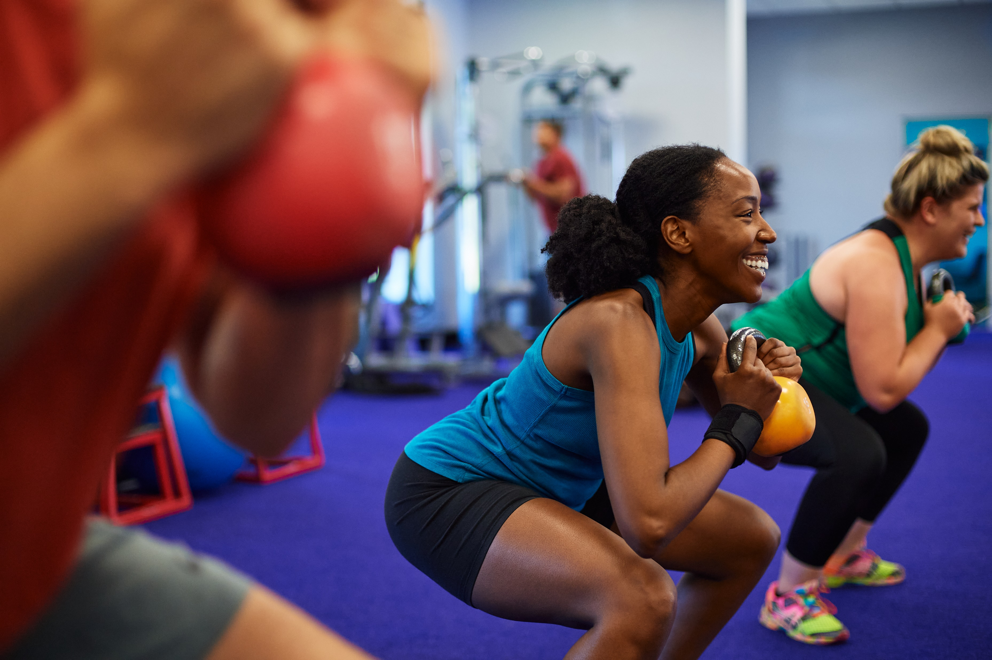
COMPLEXITY OF MOVEMENT
LOAD
TEMPO
RANGE OF MOTION
BODY POSITION
Notes:
Understanding the complexity of movement means recognizing that no two days feel exactly the same. Fatigue, stress, injuries, or external demands can impact how well we move, making it crucial to adjust movement difficulty dynamically—not just for performance goals, but to maintain functional independence and prevent injury as life throws new demands our way. By strategically progressing or regressing movements through load, tempo, range of motion, and body position, we create a training framework that helps individuals build strength where they need it, reinforce stability where they lack it, and develop movement confidence for both training and daily life. The ability to scale exercises ensures that everyone—regardless of age, experience, or ability—can train safely, make progress, and stay prepared for whatever life requires.

Slide 24
DRIVING LONG TERM SUCCESS
Communication & Coaching
Load: Increase resistance (kettlebell, dumbbell, barbell) without altering movement.
Volume: Add reps or sets while maintaining movement quality.
Tempo/Rest: Slow eccentrics or add pauses to build strength at the current level. Increase or decrease rest periods to manipulate cardiovascular effort.
Range of Motion: Gradually deepen squats or extend lunge/hinge distance as mobility improves. Add in partial/full/deficit reps for added intensity.
Micro-Progressions: Adjusting Acute Variables
Scaling in a Group Setting

Slide 25
DRIVING LONG TERM SUCCESS
Micro-Progressions: Adjusting Acute Variables
Communication & Coaching
Empower Clients: Teach self-assessment (e.g., adjusting movements based on how they feel).
Coach Oversight: Ensure strict form before progressing
Celebrate Small Wins: Progress isn’t just new exercises—it’s mastery of existing ones.
Scaling in a Group Setting

Slide 26
DRIVING LONG TERM SUCCESS
Micro-Progressions: Adjusting Acute Variables
Scaling in a Group Setting
One Pattern, Multiple Levels: Everyone is “squatting,” but one person may be at a Box Squat while another is at a Back Squat.
Simple Flow: Demo a baseline movement, a regression, and a progression, then guide choices based on daily readiness and High Five scores.
Communication & Coaching

Slide 27
One Continuum, Multiple Entry Points
High Five Assessment as Your Compass
Tracking Progress on the Continuum
Sustainable Growth & Long-Term Success

Slide 28
One Continuum, Multiple Entry Points
High Five Assessment as Your Compass
Each movement pattern has a structured progression/regression ladder, making on-the-fly adjustments seamless.
Clients can move up or down the ladder based on readiness, ensuring appropriate challenge levels.
Tracking Progress on the Continuum
Sustainable Growth & Long-Term Success

Slide 29
One Continuum, Multiple Entry Points
High Five Assessment as Your Compass
Tracking Progress on the Continuum
Establish Baseline: Overhead Squat, Split Squat, Single-Leg Balance, Push-Up, Plank/Bird Dog guide daily movement capacity.
Immediate Adjustments: Real-time feedback determines the best movement variation without rewriting workouts.
Sustainable Growth & Long-Term Success

Slide 30
One Continuum, Multiple Entry Points
Tracking Progress on the Continuum
High Five Assessment as Your Compass
Celebrate Milestones: Guide clients to recognize progress—e.g., moving from assisted to full push-ups or from a KB hinge to a barbell deadlift.
Adjust Acute Variables: Volume, load, and tempo tweaks enhance progression even within the same movement.
Sustainable Growth & Long-Term Success

Slide 31
One Continuum, Multiple Entry Points
Sustainable Growth & Long-Term Success
High Five Assessment as Your Compass
Tracking Progress on the Continuum
Autoregulation: A client excelling in Week 3 might need a deload in Week 5—adjusting regressions isn’t a setback; it’s smart coaching.
Peak Safely: As the mesocycle progresses, keep clients engaged, safe, and progressing without burnout.

Slide 33
AFT Movement Pattern Continuum

Slide 34
Horizontal Push
 |  |  | Resistance (Chaos) Unilateral Load (Unstable) Add Rotation
 |  |  | Unilateral Load (Stable)
 |  | Unilateral Load (Stable) | Ring/Suspension Push Up
 |  | Barbell Bench Press | Barbell Floor Press
 | DB Chest Press Kneeling Push Up | Dumbbell Chest Press | SA Dumbbell Chest Press
 | Wall Push Up Incline Push Up | Push Up Resistance Push Up | Resistance Push Up Suspension Push Up (Tempo)
0 | 1 | 2 | 3
Notes:
BENEFITS:
Develops upper-body pushing strength Improves shoulder and chest musculature Enhances core stability when performed with proper bracing (e.g., push-ups). Upper-body pushing strength is critical for daily activities like pushing doors, lifting objects, or maintaining shoulder health and posture. Stability in pressing movements prevents compensations that can lead to shoulder strain.
PRIME MOVERS:
Pectoralis major, anterior deltoids, triceps brachii

Slide 35
HORIZONTAL PUSH BENEFITS
objects onto shelves, stabilizing loads overhead, and maintaining strong, mobile shoulders. Proper execution prevents compensations that stress the lower back or rotator cuff.
PRIME MOVERS:
Deltoids (especially anterior/lateral), upper trapezius (stabilizer), triceps brachii
Builds overhead strength
IN REAL LIFE:
Putting objects onto shelves
Stabilizing loads overhead
Maintaining strong, mobile shoulders
Builds should stability
Improves scapular upward rotation
Reinforces core engagement

Slide 36
HORIZONTAL PUSH PRIME MOVERS
DELTOIDS – anterior/lateral trapezius
UPPER TRAPEZIUS - stabilizer
TRICEPS BRACHII

Slide 37
VERTICAL PUSH
 |  |  | Unilateral Load (Unstable) Add Rotation
 |  |  | Unilateral Load (Stable)
 |  |  | Handstand Push Up
 |  | Unilateral Load (Stable) | BB Strict Press
 |  | Standing SA OHP | Barbell Push Press
 | Seated DB Press | Unilateral Load SS or CL) | Landmine
 | Banded Overhead Press Wall Overhead Press | HK/TK SA DB Press | DBL DB OHP
0 | 1 | 2 | 3
Notes:
BENEFITS:
Builds overhead strength and shoulder stability Improves scapular upward rotation (healthy overhead mechanics) Reinforces core engagement under a vertical load. Overhead pressing is essential for real-world tasks like lifting objects onto shelves, stabilizing loads overhead, and maintaining strong, mobile shoulders. Proper execution prevents compensations that stress the lower back or rotator cuff.
PRIME MOVERS:
Deltoids (especially anterior/lateral), upper trapezius (stabilizer), triceps brachii

Slide 38
VERTICAL PUSH BENEFITS
objects onto shelves, stabilizing loads overhead, and maintaining strong, mobile shoulders. Proper execution prevents compensations that stress the lower back or rotator cuff.
PRIME MOVERS:
Deltoids (especially anterior/lateral), upper trapezius (stabilizer), triceps brachii
Upper Body Strength and Muscle Mass
IN REAL LIFE:
Putting objects onto shelves
Stabilizing loads overhead
Maintaining strong, mobile shoulders
Improved Shoulder Stability and Health
Improves scapular upward rotation
Reinforces core engagement

Slide 39
VERTICAL PUSH PRIME MOVERS
DELTOIDS – anterior/lateral trapezius
UPPER TRAPEZIUS - stabilizer
TRICEPS BRACHII

Slide 40
HINGE
 |  |  | Add Rotation
 |  |  | Barbell Deadlift
 |  | Banded Hip Thrust | Unilateral (Single Leg DL/Bridge)
 |  | KB Swing | Goodmorning(Heavy)
 | Banded Pull Through | Deadlift from Box | Trap Bar Sumo
 | Glute Bridge (Supine on Floor) | Goat Belly Banded Hip Thrust | RDL Conventional
0 | 1 | 2 | 3

Slide 41
HINGE BENEFITS
objects onto shelves, stabilizing loads overhead, and maintaining strong, mobile shoulders. Proper execution prevents compensations that stress the lower back or rotator cuff.
PRIME MOVERS:
Deltoids (especially anterior/lateral), upper trapezius (stabilizer), triceps brachii
Strengthens Posterior Chain
IN REAL LIFE:
Lifting objects off the ground
Jumping, sprinting, explosiveness
Enhances proper spinal alignment
Prevents low-back injuries
Improved Functional Movement
Better Athletic Performance
Notes:
BENEFITS:
Strengthens the posterior chain to prevent low-back injuries Trains safe hip-dominant movement patterns for lifting objects off the ground Builds powerful glutes and hamstrings, enhancing athletic performance. A strong hinge pattern is essential for real-life tasks like picking up heavy objects, jumping explosively, or preventing low-back injuries by training hip-driven movement instead of lumbar compensation.
PRIME MOVERS:

Slide 42
HINGE PRIME MOVERS
GLUTEUS MAXIMUS
HAMSTRINGS
ERECTOR SPINAE- Core Stabilizer

Slide 43
Squat
 |  |  | Barbell Back Squat (High/Low Bar)
 |  |  | Safety Bar (Tempo)
 |  |  | Smith Machine Pause
 |  | Unilateral Load | 1.5 Stance
 |  | Landmine | Zercher/Trap Bar
 | Suspension/Assisted Squat | Goblet/Landmine | Front Squat
 | Bodyweight/ Box Squat | Brace Bodyweight | Brace Squat(Tempo)
0 | 1 | 2 | 3
Notes:
BENEFITS:
Enhances lower-body strength and hypertrophy Boosts functional mobility (e.g., getting up from a chair) Strengthens knee and hip extensors for daily tasks and athletic performance. Squatting is one of the most fundamental human movement patterns, essential for daily tasks like sitting, standing, lifting, and athletic performance. Strengthening the squat improves lower-body power, joint health, and injury resilience.
PRIME MOVERS:

Slide 44
SQUAT BENEFITS
objects onto shelves, stabilizing loads overhead, and maintaining strong, mobile shoulders. Proper execution prevents compensations that stress the lower back or rotator cuff.
PRIME MOVERS:
Deltoids (especially anterior/lateral), upper trapezius (stabilizer), triceps brachii
Enhanced Lower Body Strength
IN REAL LIFE:
Sitting and Standing
Lifting and Carrying Objects
Enhances athletic performance
Improved Mobility and Joint Function
Increased Bone Density
Core Strength and Stability

Slide 45
SQUAT PRIME MOVERS
QUADRICEPS
GLUTEUS MAXIMUS
ADDUCTORS
Notes:
Quadriceps, gluteus maximus, adductors; core stabilizers support the spine

Slide 46
Horizontal Pull
 |  |  | Pendlay Row
 |  |  | Barbell Bent Over Row
 |  |  | SA/SL Row
 |  | 2/3 Pt Row | Seal Row (Supported)
 |  | Low/ Mid- Angle Row | Landmine Row
 | Cable/ Banded Face Pulls | Sandbag Bent Over Row (Multiplanar) | Inverted Row (Tempo)
 | Machine Seated Row (Back Support) | Seated/ Suspension Row | Unilateral DB/KB Bent Over Row (Unsupported)
0 | 1 | 2 | 3

Slide 47
HORIZONTAL PULL BENEFITS
objects onto shelves, stabilizing loads overhead, and maintaining strong, mobile shoulders. Proper execution prevents compensations that stress the lower back or rotator cuff.
PRIME MOVERS:
Deltoids (especially anterior/lateral), upper trapezius (stabilizer), triceps brachii
Improved Posture
IN REAL LIFE:
Pulling/Opening heavy doors
Lifting and moving heavy objects
Increased comfort and postural endurance
Prevents Muscle Imbalances
Increased Shoulder Stability
Enhanced Grip Strength
Notes:
BENEFITS:
Strengthens the upper back for better posture Improves scapular retraction and shoulder stability Balances out pressing movements to reduce injury risk. Pulling movements are essential for maintaining posture, shoulder stability, and spinal alignment. Strengthening the upper back counteracts pressing movements, preventing imbalances and reducing injury risk.

Slide 48
HORIZONTAL PULL PRIME MOVERS
LATISSIMUS DORSI
RHOMBOIDS
TRAPEZIUS & POSTERIOR DELTOID
Notes:
PRIME MOVERS:
Latissimus dorsi, rhomboids, trapezius (mid/low), posterior deltoids, biceps

Slide 49
Vertical Pull
 |  |  | Unassisted Pull Up
 |  |  | Chin Up/ Assisted Pull Up
 |  |  | Negative Chin Up
 |  |  | Upright Row
 |  | Assisted Pull Ups | Pull Overs (Tempo)
 | Pull Downs (Tempo) | Pull Overs | Lat Pull Downs (Heavy + Tempo)
 | High Angle Cable Row | Lat Pull Down | Scapular Pull Up
0 | 1 | 2 | 3

Slide 50
VERTICAL PULL BENEFITS
objects onto shelves, stabilizing loads overhead, and maintaining strong, mobile shoulders. Proper execution prevents compensations that stress the lower back or rotator cuff.
PRIME MOVERS:
Deltoids (especially anterior/lateral), upper trapezius (stabilizer), triceps brachii
Enhanced Posture and Spinal Alignment
IN REAL LIFE:
Pulling yourself up
Carrying heavy objects
Stability when lifting overhead
Better Shoulder Mobility
Increased Back/Arm Strength
Enhanced Forearm Strength
Notes:
BENEFITS:
Increases upper-back strength for better posture and shoulder health Develops grip strength and core stability (especially in pull-ups/chin-ups) Complements pressing movements by maintaining balance in the shoulder girdle. Vertical pulling is essential for real-world tasks like climbing, carrying, and overhead lifting. Developing grip strength and core control enhances total-body stability and pulling power.

Slide 51
VERTICAL PULL PRIME MOVERS
LATISSIMUS DORSI
BICEPS BRACHII
RHOMBOIDS & LOWER TRAPS
Notes:
PRIME MOVERS:
Latissimus dorsi, biceps brachii, forearms, scapular downward rotators (rhomboids, lower traps)

Slide 52
Lunge
 |  |  | Assisted SL Squat/ Pistol Squat
 |  |  | Single Leg Box Squat (Loaded)
 |  |  | BW Single Leg Squat
 |  | Forward/ Walking Lunge | Goblet SS/ Reverse Lunge (Heavy)
 |  | Goblet SS/ Reverse Lunge (Light + Tempo) | Front Foot Elevated SS
 | Assisted Reverse Lunge | BW Reverse Lunge | Goblet SS/ Reverse Lunge (Heavy)
 | Assisted Split Squat | BW Split Squat | Bulgarian SS
0 | 1 | 2 | 3

Slide 53
LUNGE BENEFITS
objects onto shelves, stabilizing loads overhead, and maintaining strong, mobile shoulders. Proper execution prevents compensations that stress the lower back or rotator cuff.
PRIME MOVERS:
Deltoids (especially anterior/lateral), upper trapezius (stabilizer), triceps brachii
Improved Lower-Body Strength and Stability
IN REAL LIFE:
Walking up and down stairs
Getting up from the floor
Tying Shoes, gardening, reduced joint stress
Enhanced Balance and Coordination
Increased Mobility and Flexibility
Reduced Injury Risk
Notes:
BENEFITS:
Develops unilateral strength and corrects side-to-side imbalances Improves hip stability, knee tracking, and balance Great for daily activities like climbing stairs or picking items off the ground. Unilateral strength is critical for everyday movements like climbing stairs, stepping onto curbs, or navigating uneven terrain. Training lunges improves knee stability, hip strength, and balance for long-term mobility and injury prevention.

Slide 54
LUNGE PRIME MOVERS
QUADRICEPS
GLUTEUS MAXIMUS
HAMSTRINGS & CALVES
Notes:
PRIME MOVERS:
Quadriceps, gluteus maximus, hamstrings (stabilization), calves; core aids balance

Slide 55
Rotation
 |  |  | Zercher Rotations
 |  |  | KB Rotations (Single Leg)
 |  |  | KB Rotation (TK/HK)
 |  | Med Ball Rotational Throws | Thoracic Pull Through (Loaded)
 |  | Standing Cable Rotation | Windmill (Top/Bottom)
 | HK Pallof Press | Standing Pallof Press | Landmine Rotation/ Russian Twist
 | TK Pallof Press | TK Cable Rotation (Light) | SL/SA Cable Rotation
0 | 1 | 2 | 3

Slide 56
ROTATION BENEFITS
objects onto shelves, stabilizing loads overhead, and maintaining strong, mobile shoulders. Proper execution prevents compensations that stress the lower back or rotator cuff.
PRIME MOVERS:
Deltoids (especially anterior/lateral), upper trapezius (stabilizer), triceps brachii
Improved Core Strength and Stability
IN REAL LIFE:
Grabbing objects behind you, reaching across the car seat
Golfing, baseball, tennis, raking leaves
Maintaining strong, mobile shoulders
Enhanced Mobility and Flexibility
Increased Power and Athleticism
Reduced Risk of Injury
Notes:
BENEFITS:
Develops core stability and rotational strength (essential for many sports and daily twisting movements) Improves trunk control, reducing spinal stress in rotational tasks Enhances overall athleticism and injury resilience. Rotational strength is essential for daily life (twisting to grab objects, sports movements, and core bracing under load). Training rotation improves power transfer, injury resilience, and overall functional strength.

Slide 57
ROTATION PRIME MOVERS
OBLIQUES
TRANSVERSE ABDOMINIS
TRANSVERSOSPINALIS MUSCLE GROUP- Multifidus, rotators, semispinalis
Notes:
PRIME MOVERS:
Obliques (internal/external), transverse abdominis, spinal rotators; hips often assist

