Slide 1
Data management Data Management Plans Data Formats Metadata Repositories
Acknowledgements: Raymond Roman (UCT-SEA)

Slide 2
IOC Guide 73:
Guidelines for a Data Management Plan
A data management plan should address the questions:
• What data will be generated by the activity?
• What procedures will be used to manage the data?
• Which file format(s) will be used for the data?
• How will changes in the data files be tracked?
• Where will the data be stored?
• Who will have access to the data?
• How will the data be documented (metadata)?
• Will the data be available in a repository?
• What archive and long-term retention solutions are planned?

Slide 3
File organization: Naming conventions (Active research phase)
Make life easier
Naming conventions should be:
Descriptive
Consistent
Consider including:
• Unique identifier (ie. Project Name or Grant # in folder name)
• Project or research data name
• Conditions (Lab instrument, Solvent, Temperature, etc.)
• Run of experiment (sequential) • Date (in file properties too)
• Version # 29
Eg. A2003135.L2_LAC_SST.data
2004052712703-NCEI-L3C_GHRSST-SSTskin-AVHRR_Pathfinder-PFV5.3_NOAA17_G_2004148_day-v02.0-fv01.0.nc

Slide 4
File organization: Naming conventions
Make life easier
Naming conventions should be:
Descriptive
Consistent
Eg.
YYYYMMDD
MMDDYYYY
YYMMDD
Use date format ISO 8601: YYYYMMDD

Slide 5
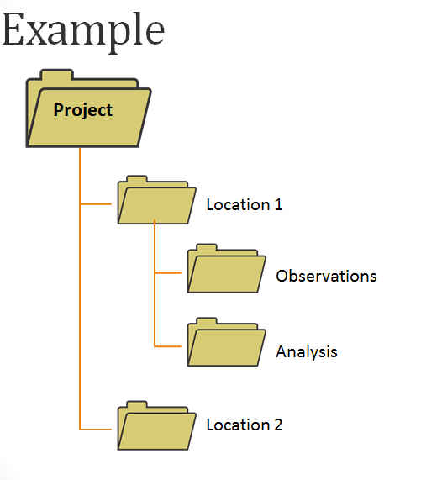
File organization: File structure
Hierarchical file structures can add additional organization to your files.
Some considerations are:
Project
Date
Analysis
Location

Slide 6
File organization: versioning
Track versions of:
Analysis/program/scripts while keeping the original version of the data file the same or
Data files themselves
Things to document:
What was changed?
Who is responsible?
When did it happen?
Why?

Slide 7
IOC Guide 73:
Guidelines for a Data Management Plan
A data management plan should address the questions:
• What data will be generated by the activity?
• What procedures will be used to manage the data?
• Which file format(s) will be used for the data?
• How will changes in the data files be tracked?
• Where will the data be stored?
• Who will have access to the data?
• How will the data be documented (metadata)?
• Will the data be available in a repository?
• What archive and long-term retention solutions are planned?

Slide 8
Storage (Active phase backup)
Ideally keep 3 copies:
local/working copy e.g. on your workstation or in shared workspace
remote copy e.g. on a managed backup system (cloud)
other copy in another remote location, or local/external e.g., external hard drive

Slide 9
IOC Guide 73:
Guidelines for a Data Management Plan
A data management plan should address the questions:
• What data will be generated by the activity?
• What procedures will be used to manage the data?
• Which file format(s) will be used for the data?
• How will changes in the data files be tracked?
• Where will the data be stored?
• Who will have access to the data?
• How will the data be documented (metadata)?
• Will the data be available in a repository?
• What archive and long-term retention solutions are planned?

Slide 10
What do we mean by data?
General
Images
Videos
Numerical measurements
Social Sciences
survey responses
focus group and individual interview transcripts
opinion polling
Natural Sciences
measurements generated by sensors/laboratory instruments
computer modelling
Simulations
observations and/or field studies
specimen

Slide 11
File formats
Best case is using non-proprietary (open) formats
Preferred formats
Containers: TAR, GZIP, ZIP
Databases: XML, CSV
Geospatial: SHP, DBF, GeoTIFF, NetCDF
Moving images: MOV, MPEG, AVI, MXF
Sounds: WAVE, AIFF, MP3, MXF
Statistics: ASCII, DTA, POR, SAS, SAV
Still images: TIFF, JPEG 2000, PDF, PNG, GIF, BMP
Tabular data: CSV
Text: XML, PDF/A, HTML, ASCII, UTF-8
Web archive: WARC

Slide 12
File formats: ASCII
ASCII
American Standard character for Information Interchange
PROS: ASCII files is easily exchangeable and human readable. ASCII files make it simple to quickly open files written from acquisitions and view data immediately as well as to easily share the data.
CONS:
ASCII files, however, have several drawbacks, including a large disk footprint, which can be an issue when storage space is limited
Reading and writing data from an ASCII file can be significantly slower compared to other formats

Slide 13
File formats: Binary
Binary
PROS:
In contrast to ASCII files, binary files have a significantly smaller disk footprint
It can be streamed to disk at extremely high speeds, making them ideal for high-channel-count and real-time applications
CONS:
It is not human-readable and therefore difficult to exchange between users
To share the files with colleagues, you must provide them with an application that interprets your specific binary file correctly

Slide 14
File formats : xml
XML
PROS: XML format has been gaining in popularity due to its ability to store complex data structures
With XML files, you can store data and formatting along with the raw measurement values
Using the flexibility of the XML format, you can store additional information with the data in a structured manner
XML is also relatively human-readable and exchangeable
CONS: in its raw form, XML includes tags within the file that describe the structures which somewhat limits the readability
The weakness of the XML file format is that it has an extremely large disk footprint compared to other files and cannot be used to stream data directly to disk
a downside to being able to store these complex structures is that they may require considerable planning when you design the layout, or schema, of the XML structures

Slide 15
File formats: NetCDF
NetCDF (Network Common Data Format)
NetCDF is a set of software libraries and self-describing, machine-independent data formats that support the creation, access, and sharing of array-oriented scientific data.
The classic NetCDF data model consists of variables, dimensions, and attributes.
NetCDF is a subset of the Hierarchical Data Format HDF5
NetCDF data is:
Self-Describing. A NetCDF file includes information about the data it contains.
Portable. A NetCDF file can be accessed by computers with different ways of storing integers, characters, and floating-point numbers.
Scalable. A small subset of a large dataset may be accessed efficiently.
Appendable. Data may be appended to a properly structured NetCDF file without copying the dataset or redefining its structure.
Sharable. One writer and multiple readers may simultaneously access the same NetCDF file.
Archivable. Access to all earlier forms of NetCDF data will be supported by current and future versions of the software.

Slide 16
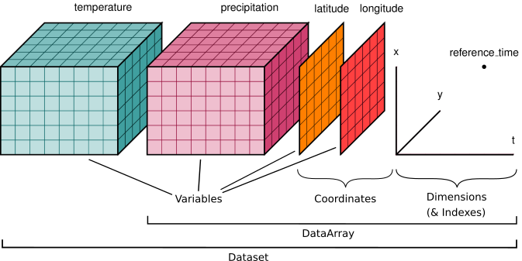
The NetCDF data model (and xarray’s)

Slide 17
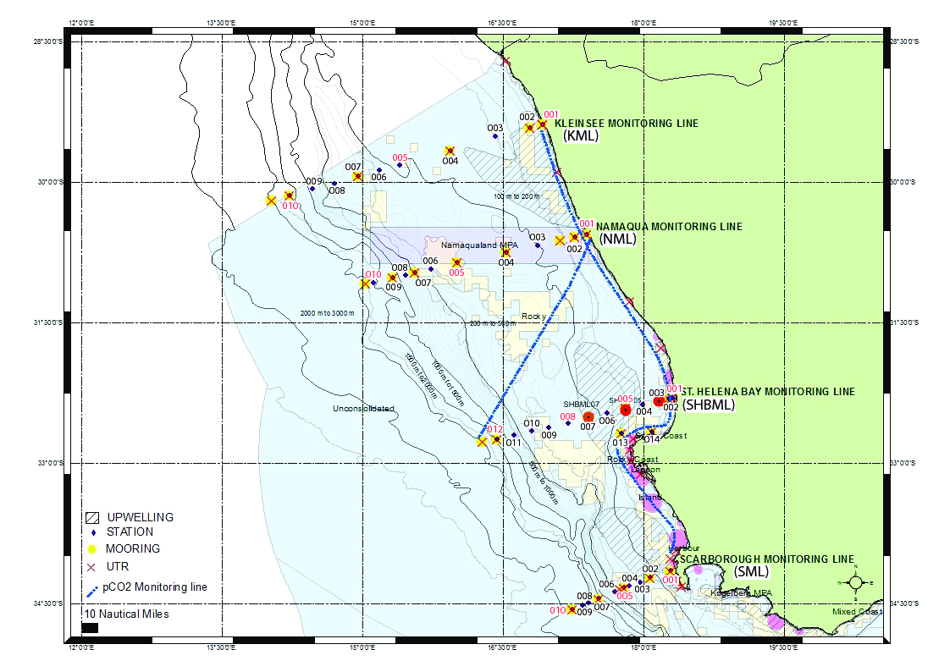



Lat
Lon
Temperature
…
Integrated Ecosystem Program
DFFE, South Africa
SML-001
…
SML-010
SHBML-001
…
SHBML-012
Tabular representation of station data
This is a 2D array, with a give ordering of the stations
Essential raw data, but:
require consistent structure (time, vertical levels)
difficult to slice and group (but we have pandas)
NML-001
…

Slide 18














Latitude (or location along Y)
GRIDDING
Sea Surface Temperature (SST)
Land
masking
Longitude (or location along X)
Lat-1
Land grid point
= missing value

Slide 19
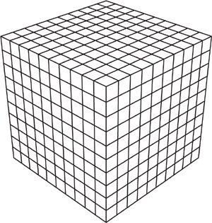




Multidimensional arrays
SST
Time
SST
t
j
i
lon
lat

Slide 20




Understanding grids and pseudocolor mesh
Note: in matlab, the uppermost row and rightmost column are not shown when showing a pseudocolor mesh
Pseudocolor grid (python, matlab, etc.)
Numerical grid

Slide 21
File formats: PDF-A
PDF-A
ISO-standardized version of the Portable Document Format (PDF) specialized for use in the archiving and long-term preservation of electronic documents
PDF/A differs from PDF by prohibiting features ill-suited to long-term archiving, such as font linking (as opposed to font embedding) and encryption
The ISO requirements for PDF/A file viewers include color management guidelines, support for embedded fonts, and a user interface for reading embedded annotations
A PDF/A document must embed all fonts in use; accordingly, a PDF/A file will often be larger than an equivalent PDF file that does not include embedded fonts

Slide 22
IOC Guide 73:
Guidelines for a Data Management Plan
A data management plan should address the questions:
• What data will be generated by the activity?
• What procedures will be used to manage the data?
• Which file format(s) will be used for the data?
• How will changes in the data files be tracked?
• Where will the data be stored?
• Who will have access to the data?
• How will the data be documented (metadata)?
• Will the data be available in a repository?
• What archive and long-term retention solutions are planned?

Slide 23
Applied Ocean Science
Importance of Metadata

Slide 24
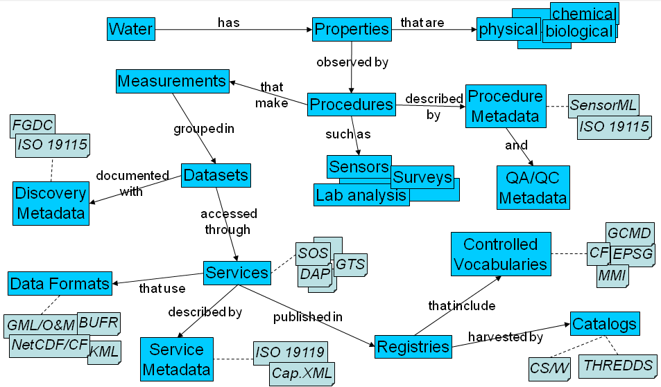
Notes:
This metadata/data management thing is awash with acronyms and interlocking parts and pieces that can be difficult to conceptualize into how they fit together and what is associated with what. Read this diagram like a paragraph: “Water has Properties that are …. The Properties are observed by Procedures described by Procedure Metadata (described by standards SensorML and ISO 19115) and QA/QC Metadata. The Procedures make Measurements …, etc.2

Slide 25
Data, finally…
_, _, _, _, _, _, _, _, _, _, _, _, _, _,
-179, -180, -180, -180, -180, -180, -180, -179, -179, -179, -179, -179,
-180, -180, -180, -180, -180, -180, -180, -179, -179, -179, -179, -179,
-179, -179, -179, -179, -179, -179, -180, -180, -180, -180, -180, -180,
-180, -180, -180, -180, -180, -180, -180, -180, -180, -180, -180, -180,
-180, -180, -180, -180, -180, -180, -180, -180, -180, -180, -180, -180,
-180, -180, -180, -180, -180, -180, -180, -180, -179, -179, -179, -179,
-178, -177, -176, -176, -175, -174, -173, -174, -175, -176, -175, -174,
-173, -172, -171, -169, -166, -165, -165, -166, -168, -169, -170, -171,
-171, -171, -171, -171, -169, -167, -165, -164, -163, -163, -162, -160,
-159, -160, -162, -162, -162, -160, -157, -154, -153, -153, -158, -163,
-165, -165, -165, -166, -170, -171, -172, -171, -167, -163, -161, -160,
-158, -158, -158, -158, -157, -158, -161, -161, -156, -153, -154, -157,
-159, -158, -161, _, _, _, _, _, _, _, _, _, _, _, _, _, _, _, -168,
-169, -170, -170, -169, -168, -167, _, _, _, _, _, _, _, _, _, _, _, _,
WHAT IS IT ?!?!

Slide 26
Data with Metadata
int time(time) ;
time:long_name = "reference time of sst field" ;
time:standard_name = "time" ;
time:axis = "T" ;
time:units = "seconds since 1981-01-01" ;
time:calendar = "proleptic_gregorian" ;
short analysed_sst(time, lat, lon) ;
analysed_sst:_FillValue = -32768s ;
analysed_sst:long_name = "analysed sea surface temperature" ;
analysed_sst:standard_name = "sea_surface_temperature" ;
analysed_sst:units = "kelvin" ;
analysed_sst:valid_min = -300s ;
analysed_sst:valid_max = 4500s ;
analysed_sst:add_offset = 273.15f ;
analysed_sst:scale_factor = 0.01f ;
byte mask(time, lat, lon) ;
mask:_FillValue = -128b ;
mask:long_name = "sea/land field composite mask" ;
mask:flag_values = 1b ;
mask:flag_meanings = "sea land lake ice" ;
mask:comment = "b0:1=grid cell is open sea water b1:1=land is present in this grid cell b2:1=lake surface is present in this grid cell b3:1=sea ice is present in this grid cell b4-b7:reserve for future grid mask data" ;
byte sea_ice_fraction(time, lat, lon) ;
sea_ice_fraction:_FillValue = -128b ;
sea_ice_fraction:long_name = "sea ice area fraction" ;
sea_ice_fraction:standard_name = "sea ice area fraction" ;
sea_ice_fraction:units = "percent" ;
sea_ice_fraction:valid_min = 0b ;
sea_ice_fraction:valid_max = 100b ;
sea_ice_fraction:add_offset = 0.f ;
sea_ice_fraction:scale_factor = 0.01f ;
netcdf \20131010-NCDC-L4LRblend-GLOB-v01-fv02_0-AVHRR_OI {
dimensions:
lat = 320 ;
lon = 320 ;
time = 1 ;
variables:
float lat(lat) ;
lat:_FillValue = NaNf ;
lat:long_name = "latitude" ;
lat:standard_name = "latitude" ;
lat:axis = "Y" ;
lat:units = "degrees_north" ;
lat:comment = "uniform grid from -89.875 to 89.875 by 0.25" ;
float lon(lon) ;
lon:_FillValue = NaNf ;
lon:long_name = "longitude" ;
lon:standard_name = "longitude" ;
lon:axis = "X" ;
lon:units = "degrees_east" ;
lon:comment = "uniform grid from -179.875 to 179.875 by 0.25" ;

Slide 27
// global attributes:
:Conventions = "CF-1.0" ;
:title = "Daily-OI-V2, Final, Data (Ship, Buoy, AVHRR: NOAA19, METOP, NCEP-ice)" ;
:DSD_entry_id = "NCDC-L4LRblend-GLOB-AVHRR_OI" ;
:references = "Reynolds, et al.(2007) Daily High-resolution Blended Analyses. Available at ftp://eclipse.ncdc.noaa.gov/pub/OI-daily/daily-sst.pdf" ;
:institution = "NOAA/NESDIS/NCDC" ;
:contact = "Richard.W.Reynolds@noaa.gov & Chunying.liu@noaa.gov" ;
:GDS_version_id = "v1.0-rev1.7" ;
:netcdf_version_id = "3.6.0-p1 of Jul 4 2005 16:41:16 $" ;
:creation_date = "2013-10-25" ;
:product_version = "Version 2.0" ;
:history = "Version 2.0" ;
:spatial_resolution = "0.25 degree" ;
:start_date = "2013-10-10 UTC" ;
:start_time = "00:00:00 UTC" ;
:stop_date = "2013-10-11 UTC" ;
:stop_time = "00:00:00 UTC" ;
:westernmost_longitude = -179.875f ;
:easternmost_longitude = 179.875f ;
:southernmost_latitude = -89.875f ;
:northernmost_latitude = 89.875f ;
:file_quality_index = "0" ;
:source_data = "NCEP GTS, AVHRR19, METOP, NCEP ice" ;
:comment = "WARNING Some applications are unable to properly handle signed byte values. If values are encountered > 127, please subtract 256 from this reported value" ;

Slide 28
data:
analysed_sst =
_, _, _, _, _, _, _, _, _, _, _, _, _, _, _, _, _, _, _, _, _, _, _, _, _,
_, _, _, _, _, _, _, _, _, _, _, _, _, _, _, _, _, _, _, _, _, _, _, _,
_, _, _, _, _, _, _, _, _, _, _, _, _, _, _, _, _, _, _, _, _, _, _, _,
_, _, _, _, _, _, _, _, _, _, _, _, _, _, _, _, _, _, _, _, _, _, _, _,
_, _, _, _, _, _, _, _, _, _, _, _, _, _, _, _, _, _, _, _, _, _, _, _,
_, _, _, _, _, _, _, _, _, _, _, _, _, _, _, _, _, _, _, _, _, _, _, _,
_, _, _, _, _, _, _, _, _, _, _, _, _, _, _, _, _, _, _, _, _, _, _, _,
_, _, _, _, _, _, _, _, _, _, _, _, _, _, _, _, _, _, _, _, _, _, _, _,
_, _, _, _, _, _, _, _, _, _, _, _, _, _,
-179, -180, -180, -180, -180, -180, -180, -179, -179, -179, -179, -179,
-180, -180, -180, -180, -180, -180, -180, -179, -179, -179, -179, -179,
-179, -179, -179, -179, -179, -179, -180, -180, -180, -180, -180, -180,
-180, -180, -180, -180, -180, -180, -180, -180, -180, -180, -180, -180,
-180, -180, -180, -180, -180, -180, -180, -180, -180, -180, -180, -180,
-180, -180, -180, -180, -180, -180, -180, -180, -179, -179, -179, -179,
-178, -177, -176, -176, -175, -174, -173, -174, -175, -176, -175, -174,
-173, -172, -171, -169, -166, -165, -165, -166, -168, -169, -170, -171,
-171, -171, -171, -171, -169, -167, -165, -164, -163, -163, -162, -160,
-159, -160, -162, -162, -162, -160, -157, -154, -153, -153, -158, -163,
-165, -165, -165, -166, -170, -171, -172, -171, -167, -163, -161, -160,
-158, -158, -158, -158, -157, -158, -161, -161, -156, -153, -154, -157,
-159, -158, -161, _, _, _, _, _, _, _, _, _, _, _, _, _, _, _, -168,
-169, -170, -170, -169, -168, -167, _, _, _, _, _, _, _, _, _, _, _, _,

Slide 29
Metadata
Definition – Data about data (structured information that tells us who, what, when, where and how)
Why?
Make data understandable (through keywords and attributes)
Enables data sharing now and in the future
Facilitates long-term archival preservation of data
Helps others discover, access, use, repurpose and cite your data in the long term
Various metadata standards tailored to specific disciplines

Slide 30
Metadata (cont.)
Metadata standards:
Dublin Core- https://www.dublincore.org
Darwin Core- https://www.tdwg.org/standards/dwc
ABCD (Access to Biological Collection Data) https://abcd.tdwg.org
AVMS (Astronomy Visualization Metadata Standard)
CSDGM (Content Standard for Digital Geospatial Metadata)
CF (Climate and Forecasting) Metadata Conventions http://cfconventions.org
Advantage of using these standards:
Ensure you have a complete, standard set of information about each part of your data
Enable your dataset to be organized with other datasets
Notes:
Dublin [General metadata standard • Widely applicable • Used in many different repositories ]
Darwin [For biological diversity • Emphasizes taxonomy • Frequently used in biodiversity databases ]

Slide 31
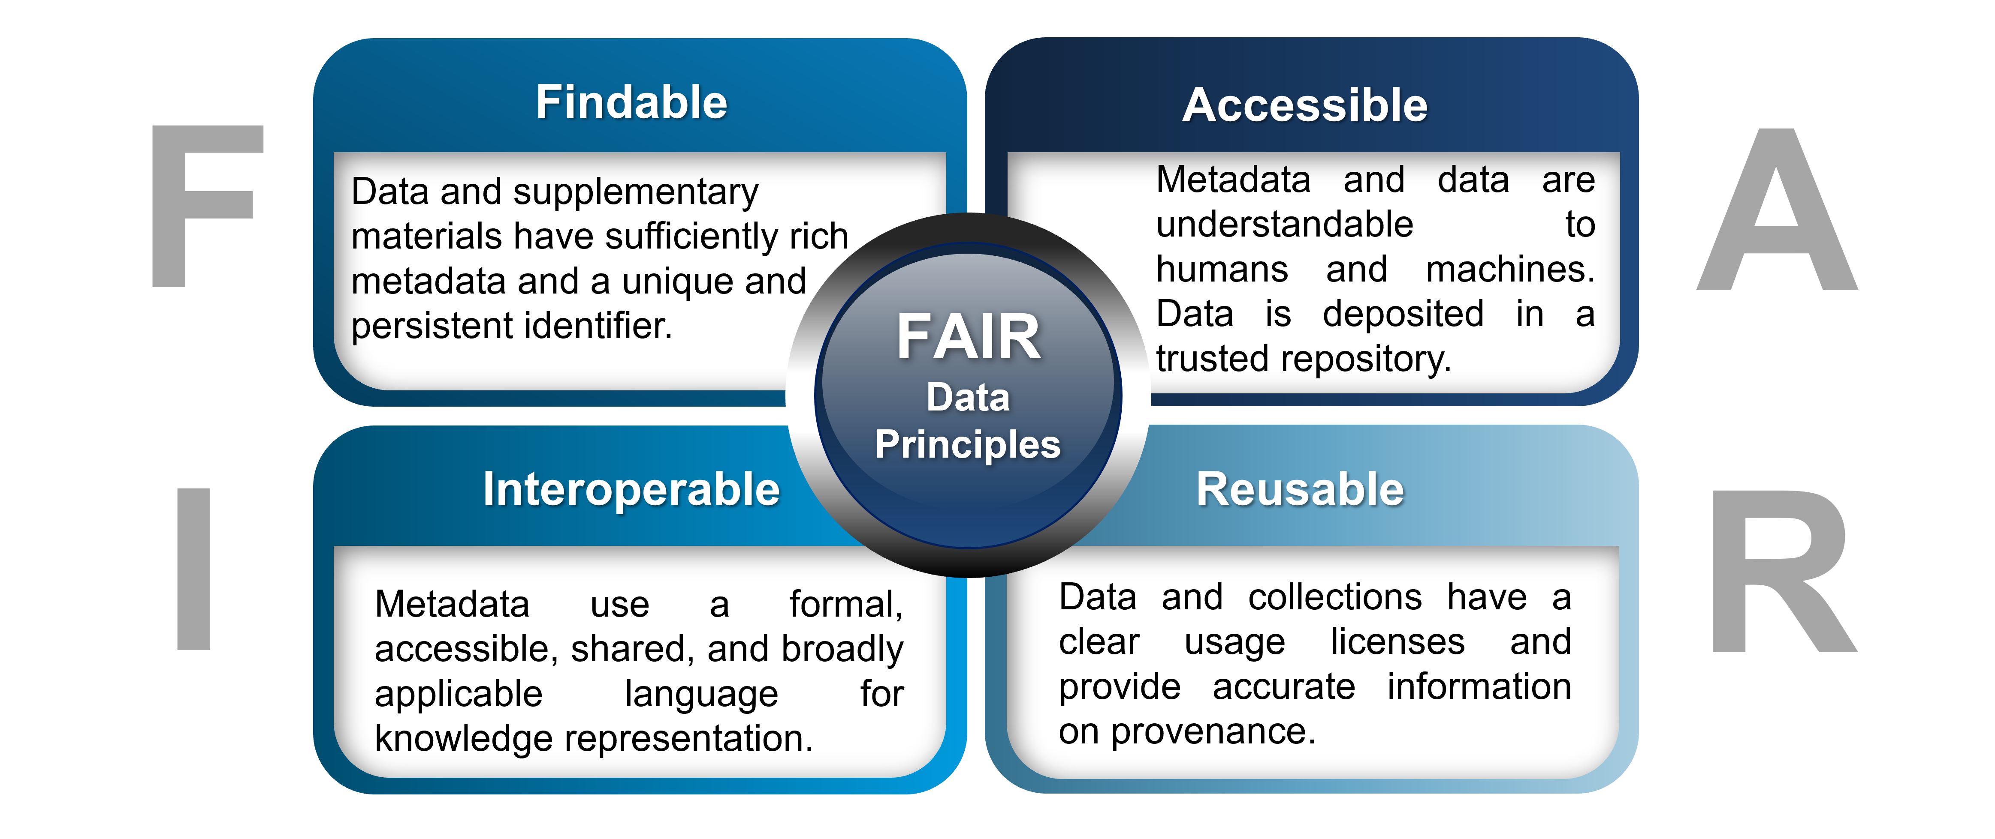
https://www.go-fair.org/fair-principles/

Slide 32
IOC Guide 73:
Guidelines for a Data Management Plan
A data management plan should address the questions:
• What data will be generated by the activity?
• What procedures will be used to manage the data?
• Which file format(s) will be used for the data?
• How will changes in the data files be tracked?
• Where will the data be stored?
• Who will have access to the data?
• How will the data be documented (metadata)?
• Will the data be available in a repository?
• What archive and long-term retention solutions are planned?

Slide 33
Data sharing: Copyright and Licensing, DOIs
Copyright is a legal right created by the law of a country that grants the creator of an original work exclusive rights for its use and distribution.
Copyright implications, intellectual property and other legal restrictions on use: An Archive will honor all applicable legal restrictions. These issues occur when the OAIS acts as a custodian. An OAIS should understand the intellectual property rights concepts, such as copyrights and any other applicable laws prior to accepting copyrighted materials into the OAIS. It can establish guidelines for ingestion of information and rules for dissemination and duplication of the information when necessary.
A licence is an official permission or permit to do, use, or own something (as well as the document of that permission or permit).
A Digital Object Identifier or DOI is a persistent identifier or handle used to uniquely identify objects, standardized by ISO-26324. DOIs are in wide use mainly to identify academic, professional, and government information, such as journal articles, research reports and data sets, and official publications.
https://www.doi.org/
Extracts from Wikipedia

Slide 34
Regularly Used Licenses
Freeing content globally without restrictions CC0
Attribution + ShareAlike BY-SA
Attribution + NoDerivatives BY-ND
Attribution + Noncommercial + ShareAlike BY-NC-SA
Attribution + Noncommercial + NoDerivatives BY-NC-ND
Attribution + Noncommercial BY-NC
Attribution alone BY
Wikipedia

Slide 35




Licensing
SAEON recommends Creative Commons Licenses
Choice may be subject to DEA / National policy
Attribution (BY) Licensees may copy, distribute, display and perform the work and make derivative works and remixes based on it only if they give the author or licensor the credits (attribution) in the manner specified by these.
Share-alike (SA) Licensees may distribute derivative works only under a license identical ("not more restrictive") to the license that governs the original work. (See also copyleft.) Without share-alike, derivative works might be sublicensed with compatible but more restrictive license clauses, e.g. CC BY to CC BY-NC.)
Non-commercial (NC)
Licensees may copy, distribute, display, and perform the work and make derivative works and remixes based on it only for non-commercial purposes.
No Derivative Works (ND)
Licensees may copy, distribute, display and perform only verbatim copies of the work, not derivative works and remixes based on it.

Slide 36
IOC Guide 73:
Guidelines for a Data Management Plan
A data management plan should address the questions:
• What data will be generated by the activity?
• What procedures will be used to manage the data?
• Which file format(s) will be used for the data?
• How will changes in the data files be tracked?
• Where will the data be stored?
• Who will have access to the data?
• How will the data be documented (metadata)?
• Will the data be available in a repository?
• What archive and long-term retention solutions are planned?

Slide 37
DOIs: Digital Object Identifiers
https://doi.org/10.7289/V5WD3XHB
https://www.datacite.org
https://geo-ide.noaa.gov/wiki/index.php?title=DOI_Minting_Procedure
https://zenodo.org/communities/scale_south_africa
Example: http://www.digitalservices.lib.uct.ac.za/dls/rdm-policy

Slide 38
Data publication sites and DOIs
https://www.pangaea.de/
https://www.datacite.org
https://data.aad.gov.au/
https://www.bodc.ac.uk/
https://zenodo.org
https://www.epfl.ch/campus/library/services-researchers/data-publication/data-code-journals/

