Slide 1
Project Overview
Blackwell Electronics - Customer Buying Patterns
Find out the following:
Do customers in different regions spend more per transaction?
Which regions spend the most/least?
Is there a relationship between number of items purchased and amount spent?

Slide 2
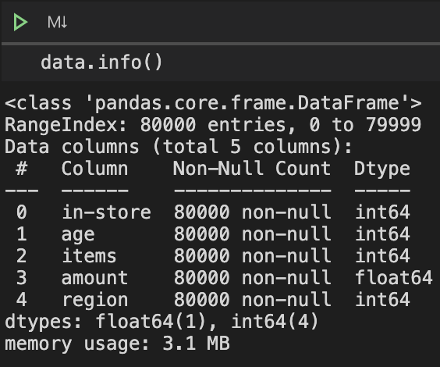
Data Overview
in-store
Where the transaction took place
0: Online Transaction
1: In-Store Transaction
age
Age of person making the transaction
items
Number of items purchased for transaction
amount
total amount paid for transaction
region
Which region the transaction took place
1: North - 2: South
3: East - 4: West

Slide 3
Analysis:
Consumers patterns in each region
Histograms: Amount in transaction for each region
Box Plots: Amounts of transactions for each region
Line Plots: Avg Amount spent for each Age for each region
Scatter Plots: Amount vs Age for each region

Slide 4
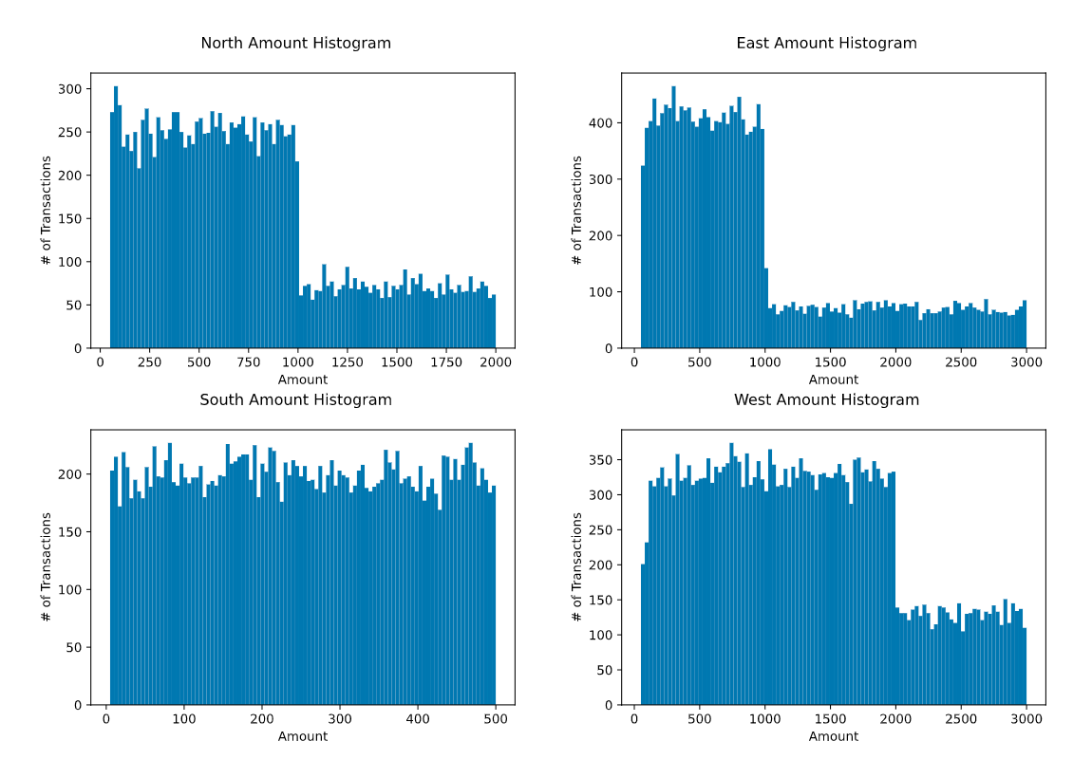
Histogram: Amounts for each region

Slide 5
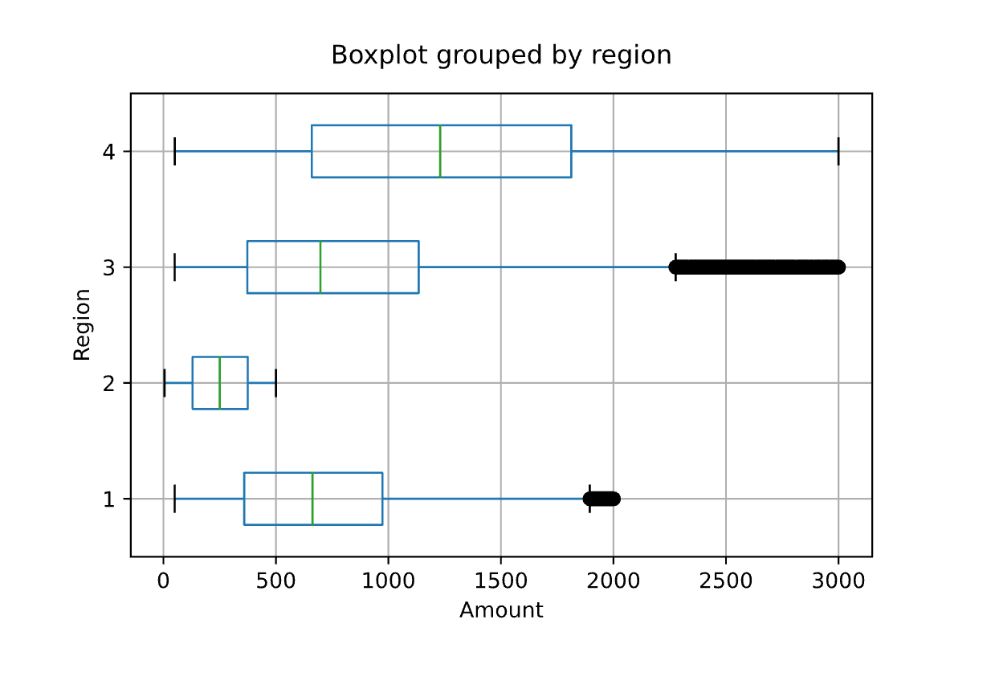
Histogram: Amounts for each region

Slide 6
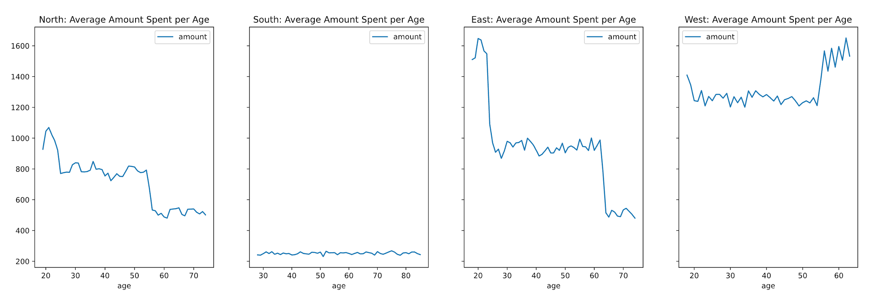
Line Plot: Average Amount Spent per Age

Slide 7
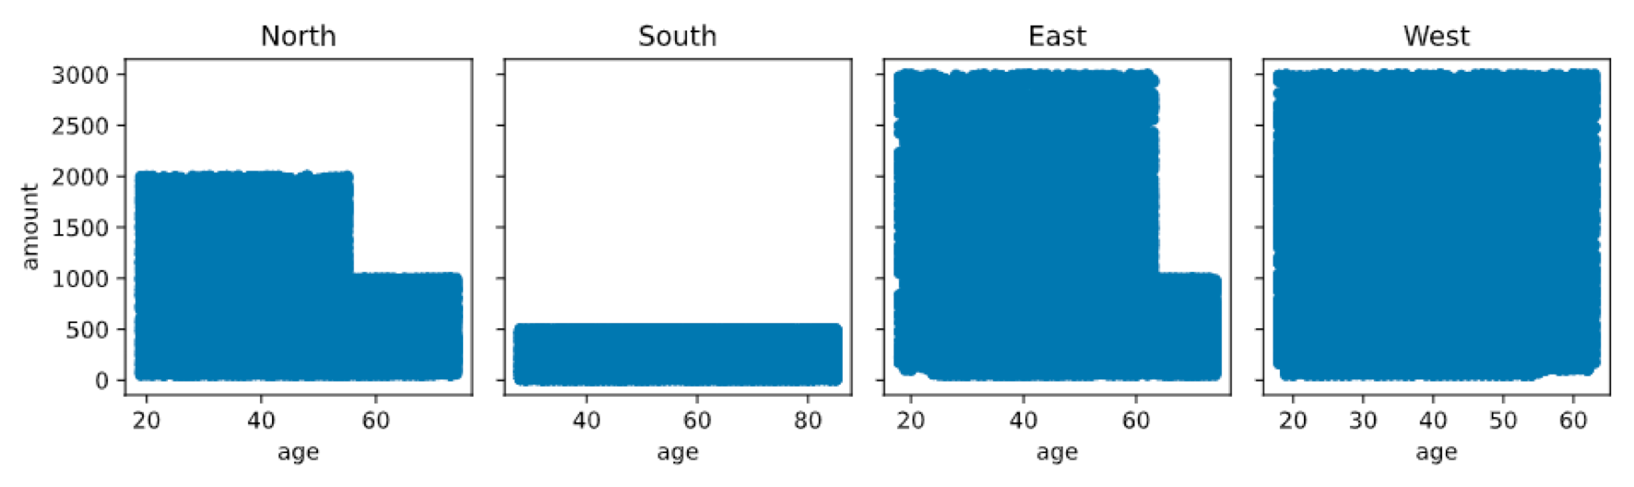
Scatter Plots: Amount vs. Age for each Region

Slide 8
Implications
Regions show to have a pattern in how much they spend
Ages in each regions seem to have a pattern on how they individually spend
West spends the most overall on the average transaction
South does seems to have very spread out transactions
North and East have a sharp cliff of transactions after the amounts are greater than 1000
Most likely due to the 60+ years old customers do not make transactions > 1000 in these regions
West has a similar cliff of transaction after the amounts are greater than 2000
Does not have a spending pattern with age or amount

Slide 9
Analysis:
Relationship between # of items and amount
Bar Graph: Average Amount Cost for Transaction with X items
Box Plot: Amount per Transaction with X Items

Slide 10
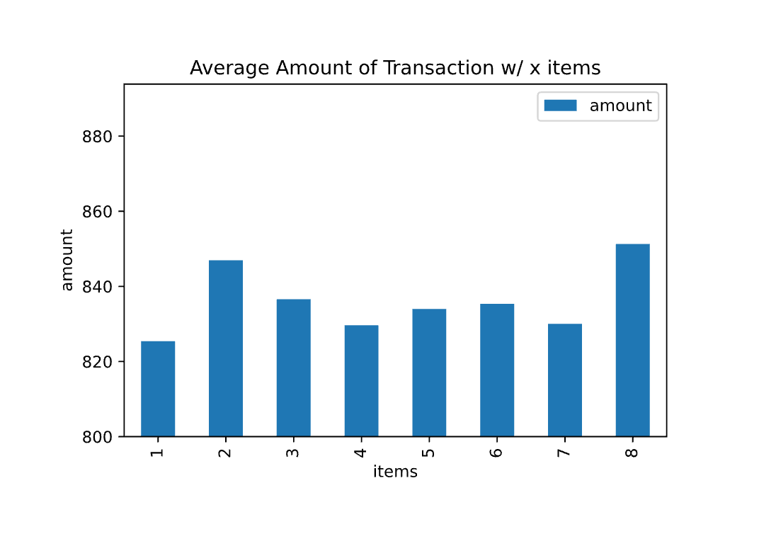
Bar Graph: Average Amount for Transaction w/ X Items

Slide 11
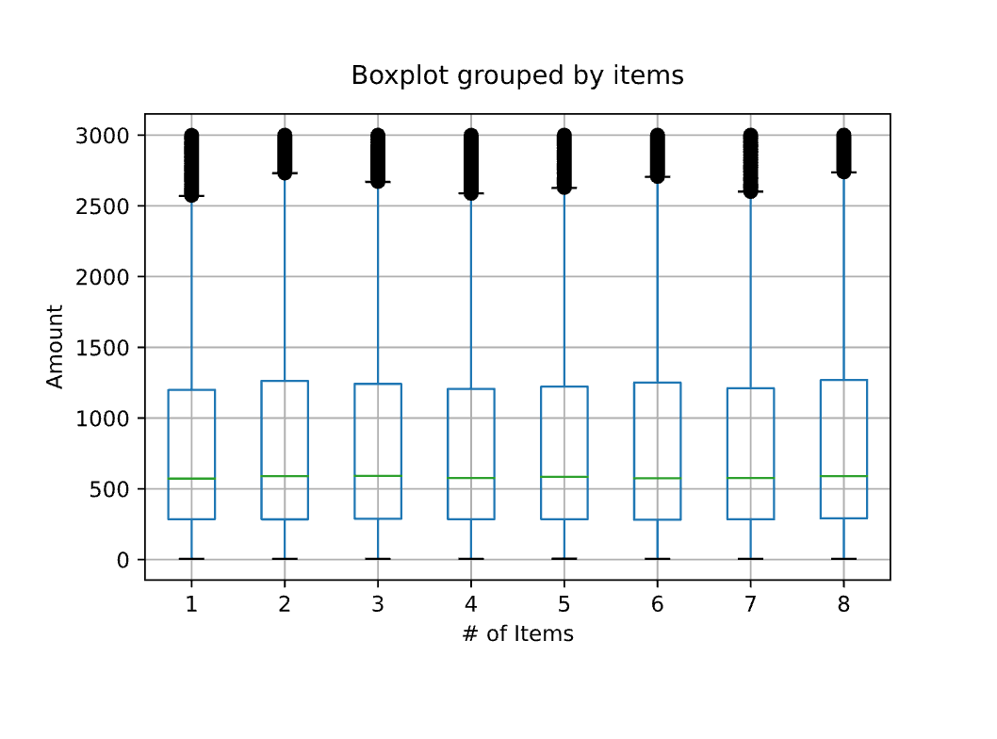
Box Plots: Amounts for Transactions w/ X Items

Slide 12
Implications
Items seems to have no correlation to amount spent on a transactions

