Slide 1
Project Overview
Blackwell Electronics - Customer Buying Patterns
Find out the following:
Do customers in different regions spend more per transaction?
Which regions spend the most/least?
Is there a relationship between number of items purchased and amount spent?

Slide 2
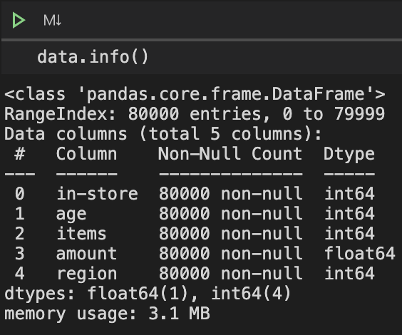
Data Overview
in-store
Where the transaction took place
0: Online Transaction
1: In-Store Transaction
age
Age of person making the transaction
items
Number of items purchased for transaction
amount
total amount paid for transaction
region
Which region the transaction took place
1: North - 2: South
3: East - 4: West

Slide 3
Analysis:
Consumers patterns in each region
Scatter Plot: Transaction Amounts for each region
Histograms: Amount in transaction for each region
Box Plots: Amounts of transactions for each region
Line Plots: Avg Amount spent for each Age for each region
Scatter Plots: Amount vs Age for each region

Slide 4
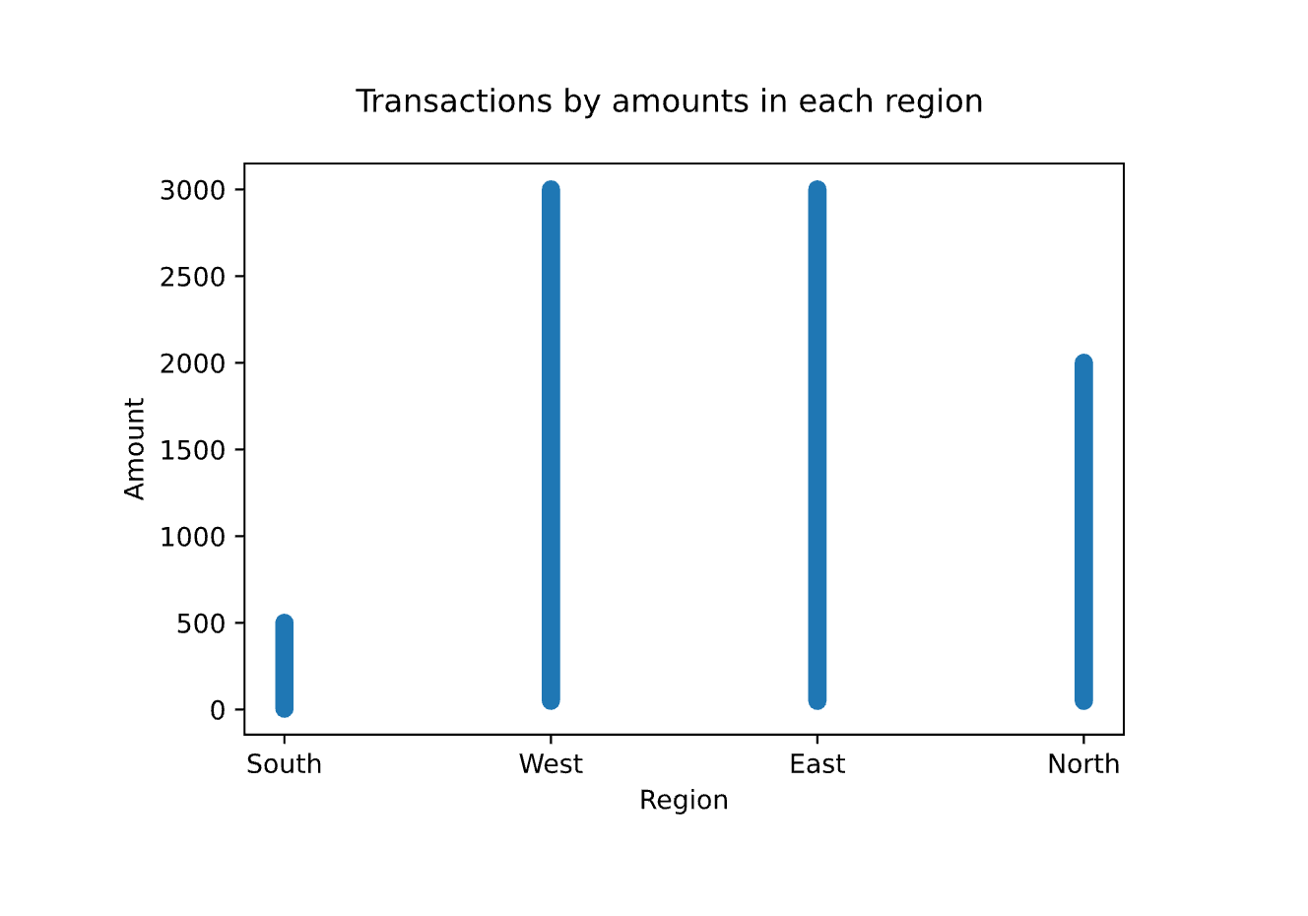
Scatter Plot: Transaction Amounts for each region
Regions show a range in which all their transaction amounts reside
South: 0-500
West: 0-3000
East: 0-3000
North: 0-2000

Slide 5
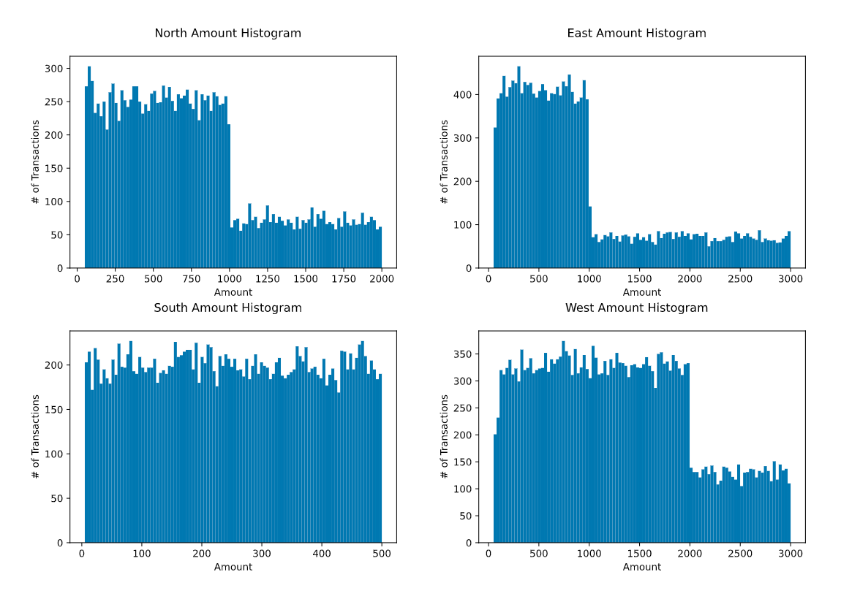
Histogram: Amounts for each region
Regions show to have a pattern in how much they spend
East and North regions have a sharp decrease in transaction when the transaction amount is 1000+
West have a sharp decrease in transactions when the amount is 2000+
South does not have any transactions above 500
Western consumers spend the most on the average transaction
Southern consumers spend the least on the average transaction

Slide 6
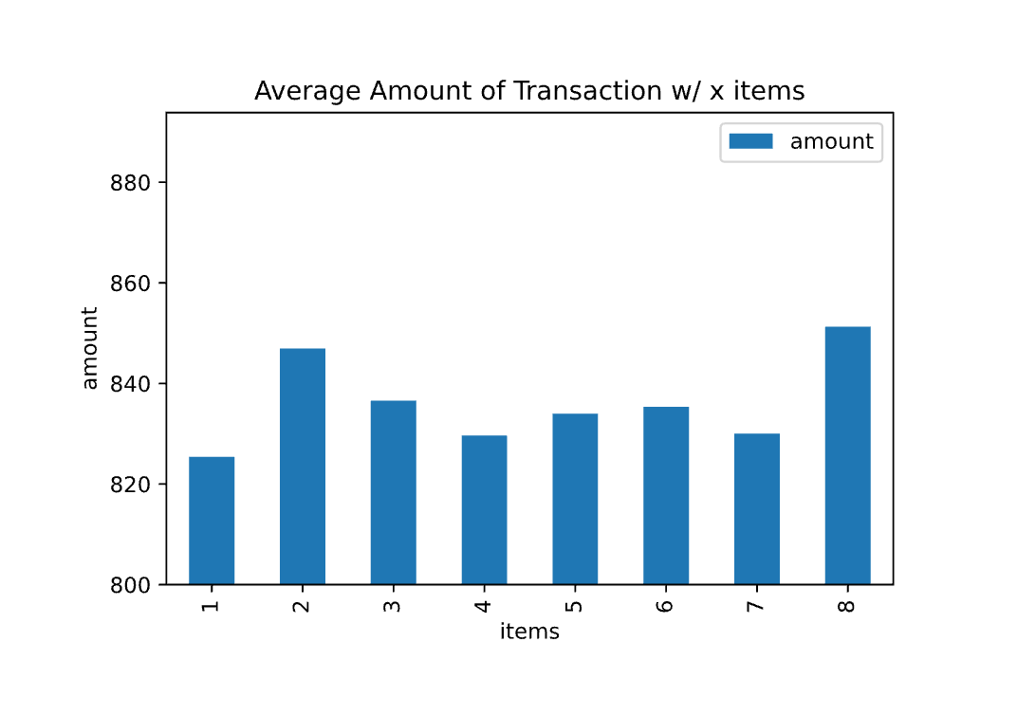
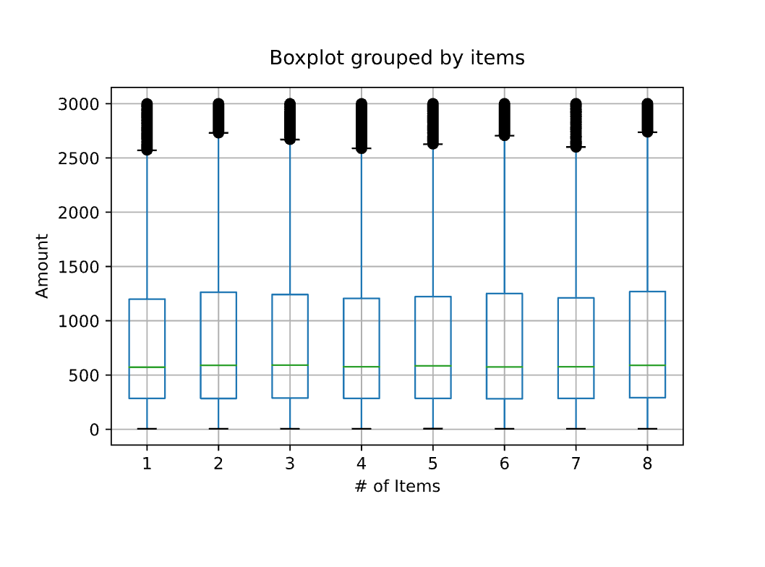
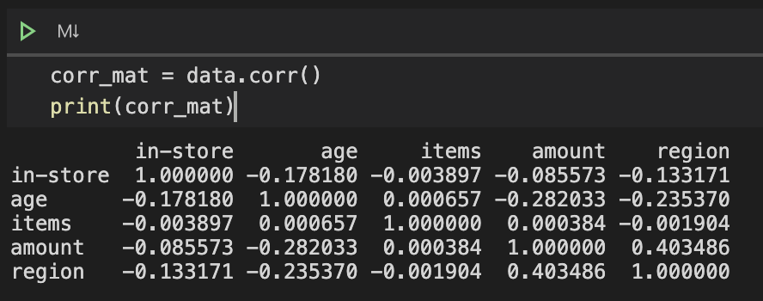
Transactions w/ X Items
Average of amounts in transactions with different items are very close together and do not show a positive or negative relationship with the # of items in the transaction
In the box plot, their quadrants are very similar and does not have a correlation between # of items and amount.

Slide 7
Other Findings
Age vs. Amount in each region

Slide 8
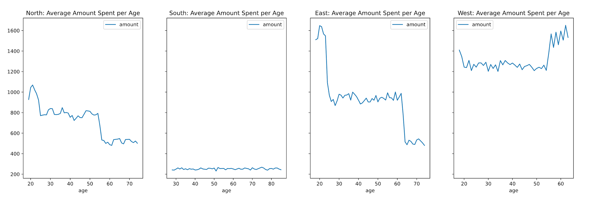
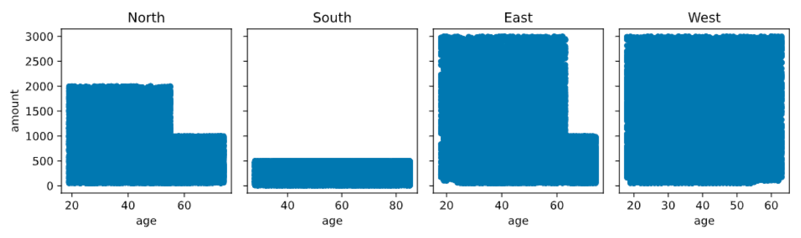
Amount Spent per Age
Regions show to have a pattern the transactions and their age
Northern 55yrs.+ consumers do not spend more than 1000 in a transaction
Eastern 60yrs.+ consumers do not spend more than 1000 in a transaction

