Slide 1
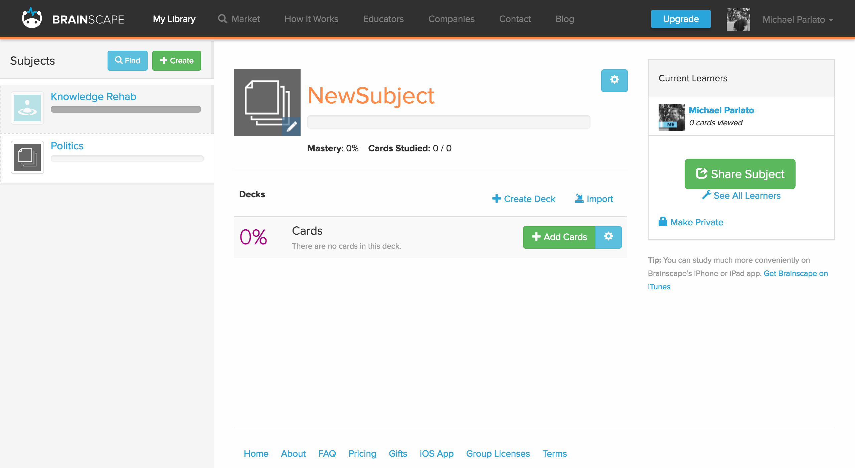
Sidebar
SideBarHeader
SidebarRows
SubjectIndexItem
SubjectIndexItem

Slide 2
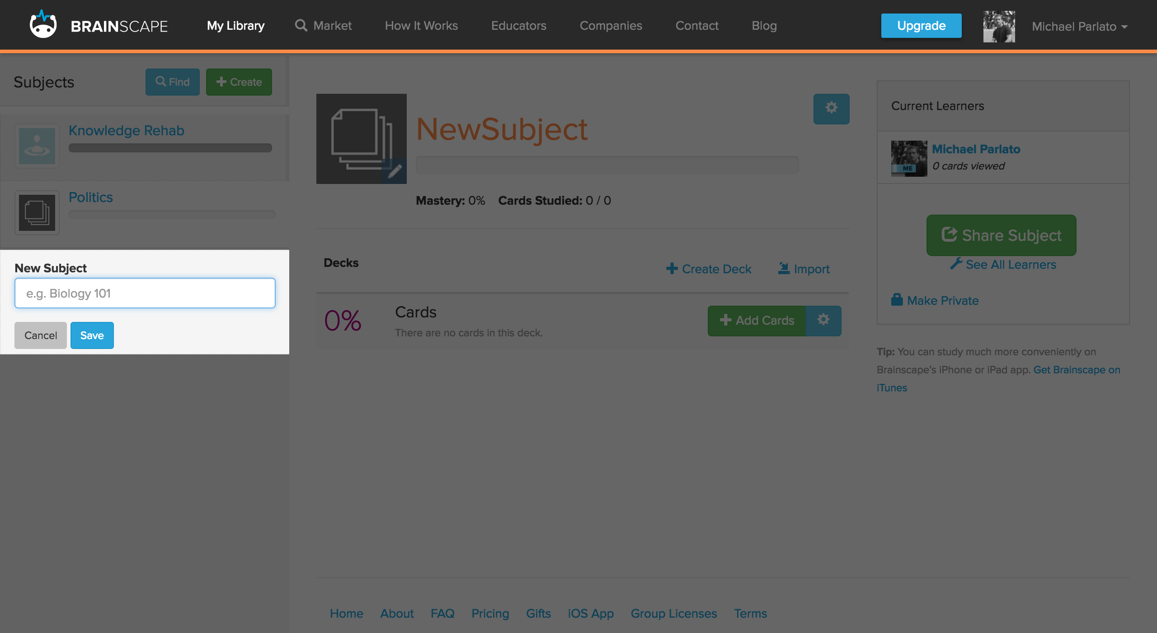
SubjectForm

Slide 3




iRETAIN.IO
ABOUT
HOW IT WORKS
PLUGIN
CONTACT
LOGIN
SIGN UP
GUEST
Create your own decks from scratch
iRETAIN.IO
[Ī-ri-teyn] application:
Study and create flash card decks on a variety of subjects
Transform everyday browsing into an educational experience with the iRETAIN Chrome Extension
Search for topical study decks
Create flash cards while browsing. Just point and click
Download the Chrome Extension

Slide 4
iRETAIN.IO
ABOUT
HOW IT WORKS
PLUGIN
CONTACT
LOGIN
SIGN UP
GUEST
Username
Password
Create your own decks from scratch
Login
iRETAIN.IO
[Ī-ri-teyn] application:
Study and create flash card decks on a variety of subjects
Transform everyday browsing into an educational experience with the iRETAIN Chrome Extension
Search for topical study decks
Create flash cards while browsing. Just point and click
Download the Chrome Extension

Slide 5
iRETAIN.IO
ABOUT
HOW IT WORKS
PLUGIN
CONTACT
LOGIN
SIGN UP
GUEST
Sign Up with Gmail
Sign Up with Facebook
Create your own decks from scratch
…or...
iRETAIN.IO
[Ī-ri-teyn] application:
Username
Password
Sign Up
Study and create flash card decks on a variety of subjects
Transform everyday browsing into an educational experience with the iRETAIN Chrome Extension
Search for topical study decks
Create flash cards while browsing. Just point and click
Download the Chrome Extension

Slide 6
iRETAIN.IO
ABOUT
HOW IT WORKS
PLUGIN
CONTACT
STUDY
MY LIBRARY
Michael
SUBJECTS
GENERAL KNOWLEDGE
iR
FIND
+ CREATE
Cards Studied: 0 / 1024
iR
GENERAL KNOWLEDGE
Decks
+ ADD
EDIT
REMOVE
Politics
STUDY
EDIT
REMOVE
Pop Culture
iR
SCIENCE
STUDY
EDIT
REMOVE
Technology
REMOVE
STUDY
EDIT
Employability
iR
MUSIC
STUDY
EDIT
REMOVE
iR
PLUG IN

Slide 7
iRETAIN.IO
ABOUT
HOW IT WORKS
PLUGIN
CONTACT
STUDY
MY LIBRARY
Michael
SUBJECTS
Logout
iR
GENERAL KNOWLEDGE
Account Settings
FIND
+ CREATE
Cards Studied: 0 / 1048
iR
GENERAL KNOWLEDGE
Decks
+ ADD
EDIT
REMOVE
Politics
QUIZ
EDIT
REMOVE
Pop Culture
iR
SCIENCE
QUIZ
EDIT
REMOVE
Technology
REMOVE
QUIZ
EDIT
Employability
iR
MUSIC
QUIZ
EDIT
REMOVE
iR
PLUG IN

Slide 8
iRETAIN.IO
ABOUT
HOW IT WORKS
PLUGIN
CONTACT
STUDY
MY LIBRARY
Michael
SUBJECTS
GENERAL KNOWLEDGE
iR
FIND
+ CREATE
Cards Studied: 0 / 1024
iR
GENERAL KNOWLEDGE
Decks
+ ADD
NB: Red Arrows indicate next slide
EDIT
REMOVE
Politics
QUIZ
EDIT
REMOVE
Pop Culture
iR
SCIENCE
QUIZ
EDIT
REMOVE
Technology
REMOVE
QUIZ
EDIT
Employability
iR
MUSIC
QUIZ
EDIT
REMOVE
iR
PLUG IN

Slide 9
iRETAIN.IO
ABOUT
HOW IT WORKS
PLUGIN
CONTACT
STUDY
MY LIBRARY
Michael
SUBJECTS
POLITICS
iR
FIND
+ CREATE
Cards Studied: 0 / 100
iR
GENERAL KNOWLEDGE
CARDS
STUDY
EDIT
REMOVE
Card 1
Card 2
Selected
Card
iR
SCIENCE
MOVE
EDIT
REMOVE
Card body would be displayed here
iR
MUSIC
Card 3
Card 4
iR
PLUG IN
Card 5
more
iR
NEW SUBJECT NAME

Slide 10
iRETAIN.IO
ABOUT
HOW IT WORKS
PLUGIN
CONTACT
STUDY
MY LIBRARY
Michael
SUBJECTS
SCIENCE
iR
FIND
+ CREATE
Cards Studied: 0 / 2048
iR
GENERAL KNOWLEDGE
Decks
+ ADD
Biology
STUDY
EDIT
REMOVE
Medicine
iR
SCIENCE
STUDY
EDIT
REMOVE
Geology
REMOVE
EDIT
REMOVE
STUDY
EDIT
Engineering
iR
MUSIC
STUDY
EDIT
REMOVE
iR
PLUG IN

Slide 11
iRETAIN.IO
ABOUT
HOW IT WORKS
PLUGIN
CONTACT
STUDY
MY LIBRARY
Michael
SUBJECTS
SCIENCE
iR
FIND
+ CREATE
Cards Studied: 0 / 2048
iR
GENERAL KNOWLEDGE
Decks
+ ADD
Next Slide
Biology
STUDY
EDIT
REMOVE
Medicine
iR
SCIENCE
STUDY
EDIT
REMOVE
Geology
REMOVE
EDIT
REMOVE
STUDY
EDIT
Engineering
iR
MUSIC
STUDY
EDIT
REMOVE
iR
PLUG IN

Slide 12
iRETAIN.IO
ABOUT
HOW IT WORKS
PLUGIN
CONTACT
STUDY
MY LIBRARY
Michael
SUBJECTS
SCIENCE
iR
FIND
+ CREATE
NewDeck
iR
GENERAL KNOWLEDGE
Deck Name
Astrology
iR
SCIENCE
X
Public Private
EDIT
REMOVE
Syntax Highlighting
Tags
iR
MUSIC
STARS
ASTEROIDS
NERD
+
CANCEL
SAVE
Next Slide
iR
PLUG IN

Slide 13
iRETAIN.IO
ABOUT
HOW IT WORKS
PLUGIN
CONTACT
STUDY
MY LIBRARY
Michael
SUBJECTS
SCIENCE
iR
Tags
Bonus Feature:
Filter decks in index by tag
FIND
+ CREATE
STARS
ASTEROIDS
Cards Studied: 0 / 2048
NERD
PHARMACOLOGY
iR
GENERAL KNOWLEDGE
Decks
+ ADD
Biology
STUDY
EDIT
REMOVE
Medicine
iR
SCIENCE
STUDY
EDIT
REMOVE
Geology
REMOVE
EDIT
REMOVE
STUDY
EDIT
Engineering
iR
MUSIC
STUDY
EDIT
REMOVE
Astrology
STUDY
EDIT
REMOVE
iR
PLUG IN
Next Slide

Slide 14
iRETAIN.IO
ABOUT
HOW IT WORKS
PLUGIN
CONTACT
STUDY
MY LIBRARY
Michael
SUBJECTS
SCIENCE
iR
Tags
FIND
+ CREATE
STARS
ASTEROIDS
ASTROLOGY
0 Cards Public
NERD
+
iR
GENERAL KNOWLEDGE
Syntax Highlighting
Cards
+ ADD
X
Chrome Extension:
With syntax highlighting, words in this deck (and their synonyms) will be highlighted when browsing on other websites. Hovering over, for synonyms, will show the original word looked up. For original words, definition will be shown.
iR
SCIENCE
EDIT
REMOVE
iR
MUSIC
iR
PLUG IN

Slide 15
iRETAIN.IO
ABOUT
HOW IT WORKS
PLUGIN
CONTACT
STUDY
MY LIBRARY
Michael
SUBJECTS
SCIENCE
iR
Tags
FIND
+ CREATE
STARS
ASTEROIDS
ASTROLOGY
0 Cards Public
NERD
+
iR
GENERAL KNOWLEDGE
Syntax Highlighting
New Card
+ ADD
X
Title
Black hole
iR
SCIENCE
Body
LOOKUP
Fill body with default definition/explanation from dictionary API (or create your own)
EDIT
REMOVE
iR
MUSIC
CANCEL
SAVE
iR
PLUG IN

Slide 16
iRETAIN.IO
ABOUT
HOW IT WORKS
PLUGIN
CONTACT
STUDY
MY LIBRARY
Michael
SUBJECTS
SCIENCE
iR
Tags
FIND
+ CREATE
STARS
ASTEROIDS
ASTROLOGY
0 Cards Public
NERD
+
iR
GENERAL KNOWLEDGE
Syntax Highlighting
New Card
+ ADD
X
Title
Black hole
Body
LOOKUP
iR
SCIENCE
a region of space having a gravitational field so intense that no matter or radiation can escape.
EDIT
REMOVE
iR
MUSIC
CANCEL
SAVE
iR
PLUG IN

Slide 17
iRETAIN.IO
ABOUT
HOW IT WORKS
PLUGIN
CONTACT
STUDY
MY LIBRARY
Michael
SUBJECTS
SCIENCE
iR
Tags
FIND
+ CREATE
STARS
ASTEROIDS
ASTROLOGY
1 Card Public
NERD
+
iR
GENERAL KNOWLEDGE
Syntax Highlighting
Cards
+ ADD
X
Black hole
EDIT
REMOVE
iR
SCIENCE
EDIT
REMOVE
iR
MUSIC
iR
PLUG IN

Slide 18
iRETAIN.IO
ABOUT
HOW IT WORKS
PLUGIN
CONTACT
STUDY
MY LIBRARY
Michael
SUBJECTS
Name
iR
Science
FIND
+ CREATE
Public Private
X
iR
GENERAL KNOWLEDGE
Next Slide
Syntax Highlighting
What is syntax highlighting? This is the app’s twist – When enabled, the Chrome extension will highlight concepts and any synonyms or related concepts on other web pages. Reminding a user of a word they’ve previously looked up or relating it to a word they know will help to maximize retention.
CANCEL
SAVE
iR
SCIENCE
EDIT
REMOVE
iR
MUSIC
iR
PLUG IN

Slide 19
iRETAIN.IO
ABOUT
HOW IT WORKS
PLUGIN
CONTACT
STUDY
MY LIBRARY
Michael
SUBJECTS
Name
iR
New Subject Name
FIND
+ CREATE
Public Private
X
iR
GENERAL KNOWLEDGE
Syntax Highlighting
CANCEL
SAVE
iR
SCIENCE
iR
MUSIC
iR
PLUG IN

Slide 20
iRETAIN.IO
ABOUT
HOW IT WORKS
PLUGIN
CONTACT
STUDY
MY LIBRARY
Michael
SUBJECTS
NEW SUBJECT NAME
iR
FIND
+ CREATE
Cards Studied: 0 / 0 Private
iR
GENERAL KNOWLEDGE
Decks
+ ADD
iR
SCIENCE
iR
MUSIC
iR
PLUG IN
iR
NEW SUBJECT NAME
EDIT
REMOVE

Slide 21
iRETAIN.IO
ABOUT
HOW IT WORKS
PLUGIN
CONTACT
STUDY
MY LIBRARY
Michael
SUBJECTS
Name
iR
New Subject Name
FIND
+ CREATE
Public Private
X
iR
GENERAL KNOWLEDGE
Syntax Highlighting
CANCEL
SAVE
iR
SCIENCE
iR
MUSIC
iR
PLUG IN
iR
NEW SUBJECT NAME
EDIT
REMOVE

Slide 22
iRETAIN.IO
ABOUT
HOW IT WORKS
PLUGIN
CONTACT
STUDY
MY LIBRARY
Michael
SUBJECTS
Name
iR
New Subject Name
FIND
+ CREATE
Public Private
X
iR
GENERAL KNOWLEDGE
Syntax Highlighting
CANCEL
SAVE
iR
SCIENCE
iR
MUSIC
iR
PLUG IN
iR
NEW SUBJECT NAME
EDIT
REMOVE

Slide 23
iRETAIN.IO
ABOUT
HOW IT WORKS
PLUGIN
CONTACT
STUDY
MY LIBRARY
Michael
SUBJECTS
Enter subject or keyword…
FIND
+ CREATE
iR
GENERAL KNOWLEDGE
Subjects
No Matches
Decks
iR
SCIENCE
No Matches
iR
MUSIC
iR
PLUG IN
iR
NEW SUBJECT NAME

Slide 24
iRETAIN.IO
ABOUT
HOW IT WORKS
PLUGIN
CONTACT
STUDY
MY LIBRARY
Michael
SUBJECTS
Literature
FIND
+ CREATE
iR
GENERAL KNOWLEDGE
Subjects
Literature
+ ADD
Adding a subject will automatically add, while adding a deck will list some options…
Decks
iR
SCIENCE
18th Century English Authors
+ ADD
Modern Science Fiction
+ ADD
iR
MUSIC
iR
PLUG IN
iR
NEW SUBJECT NAME

Slide 25
iRETAIN.IO
ABOUT
HOW IT WORKS
PLUGIN
CONTACT
STUDY
MY LIBRARY
Michael
SUBJECTS
Literature
FIND
+ CREATE
iR
GENERAL KNOWLEDGE
Subjects
Literature
+ ADD
Decks
iR
SCIENCE
18th Century English Authors
+ ADD
Modern Science Fiction
Choose deck…
iR
MUSIC
iR
PLUG IN
iR
NEW SUBJECT NAME

Slide 26
iRETAIN.IO
ABOUT
HOW IT WORKS
PLUGIN
CONTACT
STUDY
MY LIBRARY
Michael
SUBJECTS
Literature
FIND
+ CREATE
iR
GENERAL KNOWLEDGE
Subjects
Literature
+ ADD
Decks
iR
SCIENCE
18th Century English Authors
+ ADD
Modern Science Fiction
General Knowledge
iR
MUSIC
Science
Music
New Subject Name
iR
PLUG IN
CREATE NEW
iR
NEW SUBJECT NAME

Slide 27
iRETAIN.IO
ABOUT
HOW IT WORKS
PLUGIN
CONTACT
STUDY
MY LIBRARY
Michael
SUBJECTS
Literature
FIND
+ CREATE
iR
GENERAL KNOWLEDGE
Subjects
Literature
+ ADD
Decks
iR
SCIENCE
18th Century English Authors
+ ADD
Modern Science Fiction
VIEW
iR
MUSIC
Deck added to user’s
subject, “New Subject name”
iR
PLUG IN
iR
NEW SUBJECT NAME
+1

Slide 28
iRETAIN.IO
ABOUT
HOW IT WORKS
PLUGIN
CONTACT
STUDY
MY LIBRARY
Michael
SUBJECTS
PLUG IN
iR
DOWNLOAD THE CHROME EXTENSION
FIND
+ CREATE
Cards Studied: 0 / 2
Concepts added from Plugin default to this Subject.
iR
GENERAL KNOWLEDGE
CARDS
STUDY
Apostate
Syncopated
iR
SCIENCE
MOVE
EDIT
REMOVE
Card body would be displayed here
General Knowledge
Science
iR
MUSIC
Cards in this subject were added using the Chrome Extension. They can be moved to pre-existing decks, or form the basis of creating new ones.
Music
Deck 1
New Subject Name
Deck 2
CREATE NEW
CREATE NEW
iR
PLUG IN
EDIT
iR
NEW SUBJECT NAME

Slide 29
iRETAIN.IO
ABOUT
HOW IT WORKS
PLUGIN
CONTACT
STUDY
MY LIBRARY
Michael
SUBJECTS
NEW STUDY SESSION
iR
FIND
+ CREATE
iR
GENERAL KNOWLEDGE
Choose deck…
OR
STUDY ALL
iR
SCIENCE
iR
MUSIC
iR
PLUG IN
iR
NEW SUBJECT NAME

Slide 30
iRETAIN.IO
ABOUT
HOW IT WORKS
PLUGIN
CONTACT
STUDY
MY LIBRARY
Michael
SUBJECTS
NEW STUDY SESSION
iR
FIND
+ CREATE
iR
GENERAL KNOWLEDGE
Choose deck…
OR
General Knowledge
STUDY ALL
iR
SCIENCE
Science
Music
New Subject Name
iR
MUSIC
Plug In
iR
PLUG IN
iR
NEW SUBJECT NAME

Slide 31
iRETAIN.IO
ABOUT
HOW IT WORKS
PLUGIN
CONTACT
STUDY
MY LIBRARY
Michael
SUBJECTS
MUSIC STUDY SESSION
iR
FIND
+ CREATE
Questions Completed: 0 / 5
Questions Correct: 0 / 0
iR
GENERAL KNOWLEDGE
Instructions
After you click start, you will be shown a word or concept, along with a definition or explanation. Just click TRUE if the word and explanation are associated, and FALSE if not. You will have 5 seconds to respond (change this in your settings). Ready to go?
iR
SCIENCE
iR
MUSIC
START
iR
PLUG IN
iR
NEW SUBJECT NAME

Slide 32
iRETAIN.IO
ABOUT
HOW IT WORKS
PLUGIN
CONTACT
STUDY
MY LIBRARY
Michael
SUBJECTS
MUSIC STUDY SESSION
iR
FIND
+ CREATE
Questions Completed: 4 / 5
Questions Correct: 3 / 4
iR
GENERAL KNOWLEDGE
Question 5
00:03:47
Dorian mode
A minor mode of the major scale, beginning on the 2nd note.
iR
SCIENCE
TRUE
FALSE
iR
MUSIC
iR
PLUG IN
iR
NEW SUBJECT NAME

Slide 33


iRETAIN.IO
ABOUT
HOW IT WORKS
PLUGIN
CONTACT
STUDY
MY LIBRARY
Michael
SUBJECTS
Logout
iR
END OF MUSIC STUDY SESSION
Account Settings
FIND
+ CREATE
Questions Completed: 5 / 5
Questions Correct: 4 / 5
iR
GENERAL KNOWLEDGE
Congratulations!
Average Time: 00:03:25
Number Correct: 4 / 5
Score: 82
iR
SCIENCE
iR
MUSIC
STUDY AGAIN
CHOOSE ANOTHER SUBJECT
iR
PLUG IN
Share your results:
iR
NEW SUBJECT NAME

Slide 34
iRETAIN.IO
ABOUT
HOW IT WORKS
PLUGIN
CONTACT
STUDY
MY LIBRARY
Michael
SUBJECTS
iRETAIN.IO
iR
FIND
+ CREATE
Signed in as Michael
RESET PASSWORD
iR
GENERAL KNOWLEDGE
Account Settings
Study Session Timer
5 Seconds
Number of Questions
iR
SCIENCE
5
Default Deck What’s This?
Plug In (Default)
Email Address
None Listed
iR
When using the Chrome Extension, concepts you look up will default to the selected deck.
MUSIC
Username
mvincent7891
First Name
Michael
Last Name
iR
PLUG IN
Parlato
iR
NEW SUBJECT NAME

Slide 35
LibraryContainer (Example Content Container)
iRETAIN.IO
NavHeader
ABOUT
HOW IT WORKS
PLUGIN
CONTACT
STUDY
MY LIBRARY
Michael
SidebarContainer
SUBJECTS
SubjectHeader
SidebarHeader
iR
SCIENCE
FIND
+ CREATE
Cards Studied: 0 / 2048
GENERAL KNOWLEDGE
SubjectsIndex
iR
Decks
+ ADD
Biology
DecksIndex
STUDY
EDIT
REMOVE
DeckIndexItem
Medicine
iR
SCIENCE
STUDY
EDIT
REMOVE
Geology
REMOVE
EDIT
REMOVE
STUDY
EDIT
Engineering
iR
MUSIC
STUDY
EDIT
REMOVE
iR
PLUG IN

