Slide 1

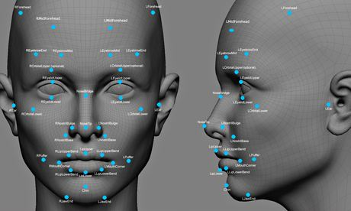
Face Dataset Compression & Recognition using Principal Component Analysis & Support Vector Machine Algorithms
CHE 765 & SEP 767
Multivariate Statistical Methods for Big Data Analysis and Process Improvement
Vipin Chandran Muthirikkaparambil
Student Number: 400547437
Professor: Dr. Brandon Corbett
Project instructor: Dr. Hesam Hassanpour
Notes:
Brief Intro
The effectiveness of this project is tested and implemented by using Python programming lang.
The moment u see a persons face its actually a 2D image that gets stored in ur brain and u are able to recollect it→recognize later.
FR is just implementation of this in computers.
Since face is a 2D image we ll brief a bit of image data.

Slide 2

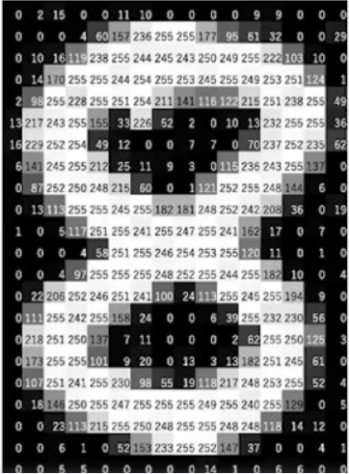
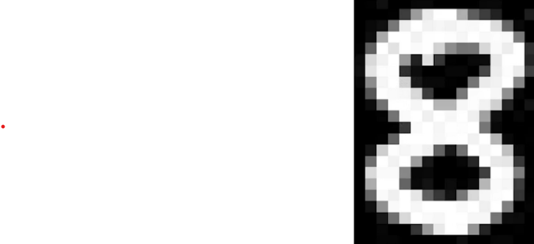

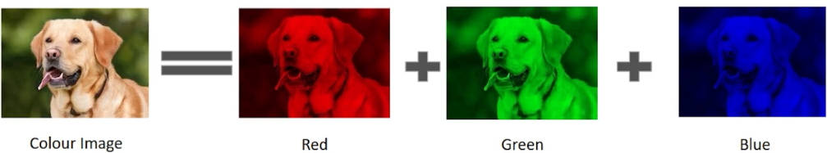
How Do Computers Store Images?
0 → Black
255 → White
Matrix → Channel
Gray-scale images
RGB images

Slide 3
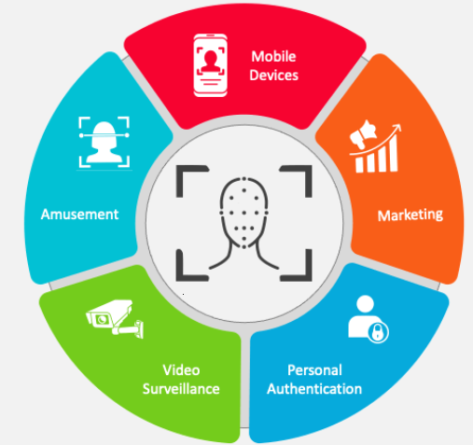
Introduction – LITERATURE REVIEW
MOTIVATION
Requires no physical interaction on behalf of user, showed its importance during COVID times.
PROBLEM STATEMENT
With advancement in camera modules, more and more pixel density quality images gets captured.
EDGE-Computing; For Autonomous vehicle for faster processing of image datasets.
(IMAGE STORAGE & PROCESSING SPEEDS)
MOTIVATION
Passive Identification in one-to-many environments (e.g. Figuring out terrorist in a busy airport).
Notes:
With rapid growth of AI, FR technology has developed rapidly in recent years.
Why we chose Face Re Facial recognition technology has found various applications across different industries, Smartphones, Attendance Tracking, Payment Systems:
In the process of face recognition, firstly, check whether the image has face information from the collected image. If there is face information, extract the face feature information.
like PCA

Slide 4
Introduction – LITERATURE REVIEW
BASIC FRAMEWORK OF FACE RECOGNITION [1]
FACE CLASSIFICATION & RECOGNITION
IMAGE ACQUISITION
FACE DETECTION
FEATURE EXTRACTION
Web Crawler [1]
Camera Lens
Geometric feature-based methods
Template matching and neural methods
Notes:
In geometric feature-based methods [3], (Nodal points) facial features measured such as distance btw eyes, width of nose, length of jaw line etc. Properties. In contrast, template matching and neural methods [1] generally operate directly on an imagebased representation of faces, i.e. pixel intensity array. Because the detection and measurement of geometric facial features are not required, these classes of methods have been more practical and easy to implement as compared to geometric feature based methods.

Slide 5
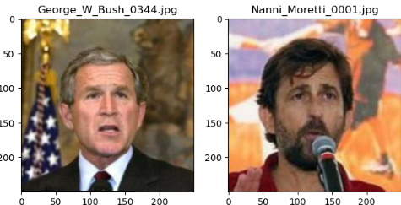
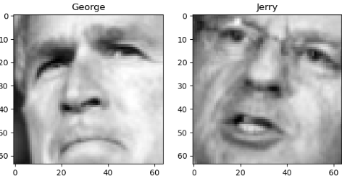
Data Source (Face Database Description)
1329 image samples
8 distinct target labels
min_faces_per_person = 50 & resize = 0.4
StandardScaler, scaled to [0, 1]
50 x 37
64 x 64
13,233 face images
Pixel range [0-255]
gray level
Cropped
COMPRESSION
Labelled Faces in the Wild
(LFW)
RECOGNITION
Notes:
Labeled Faces in the Wild, a database of face photographs compiled by the Computer Vision Laboratory of Amherst University of Massachusetts designed for studying the problem of face recognition under unrestricted conditions.
13,000 images of faces collected from the web
1680 of the people pictured have two or more distinct photos in the data set.
Original LFW dataset we see above, where face matching accuracy can be unrealistically boosted through the use of background parts of images (i.e. by using possible correlations between faces and backgrounds). LFWcrop Face Dataset -- cropped gray version of the Labeled Faces in the Wild (LFW) dataset, keeping only the center portion of each image (i.e. the face) where background is omitted.

Slide 6
Objectives
1
Discuss the framework of face detection, including image acquisition, feature extraction, and face classification, and employ image processing techniques, respectively.
2
Discuss how PCA can be used to compress a large-scale face dataset consisting, achieving a great compression percentage, thereby reduce the amount of calculation and storage space of data
3
4
parameter adjuster named GridSearchCV is used to adjust the parameters to further improve the precision and
recall of face recognition of Support Vector Machine Algorithm
Create a pipeline, to concatenate multiple consecutive steps which includes PCA to reduce the dimensionality and train the SVM classifier on the resulting data. Compare the classification report and confusion metrics obtained in either cases.

Slide 7
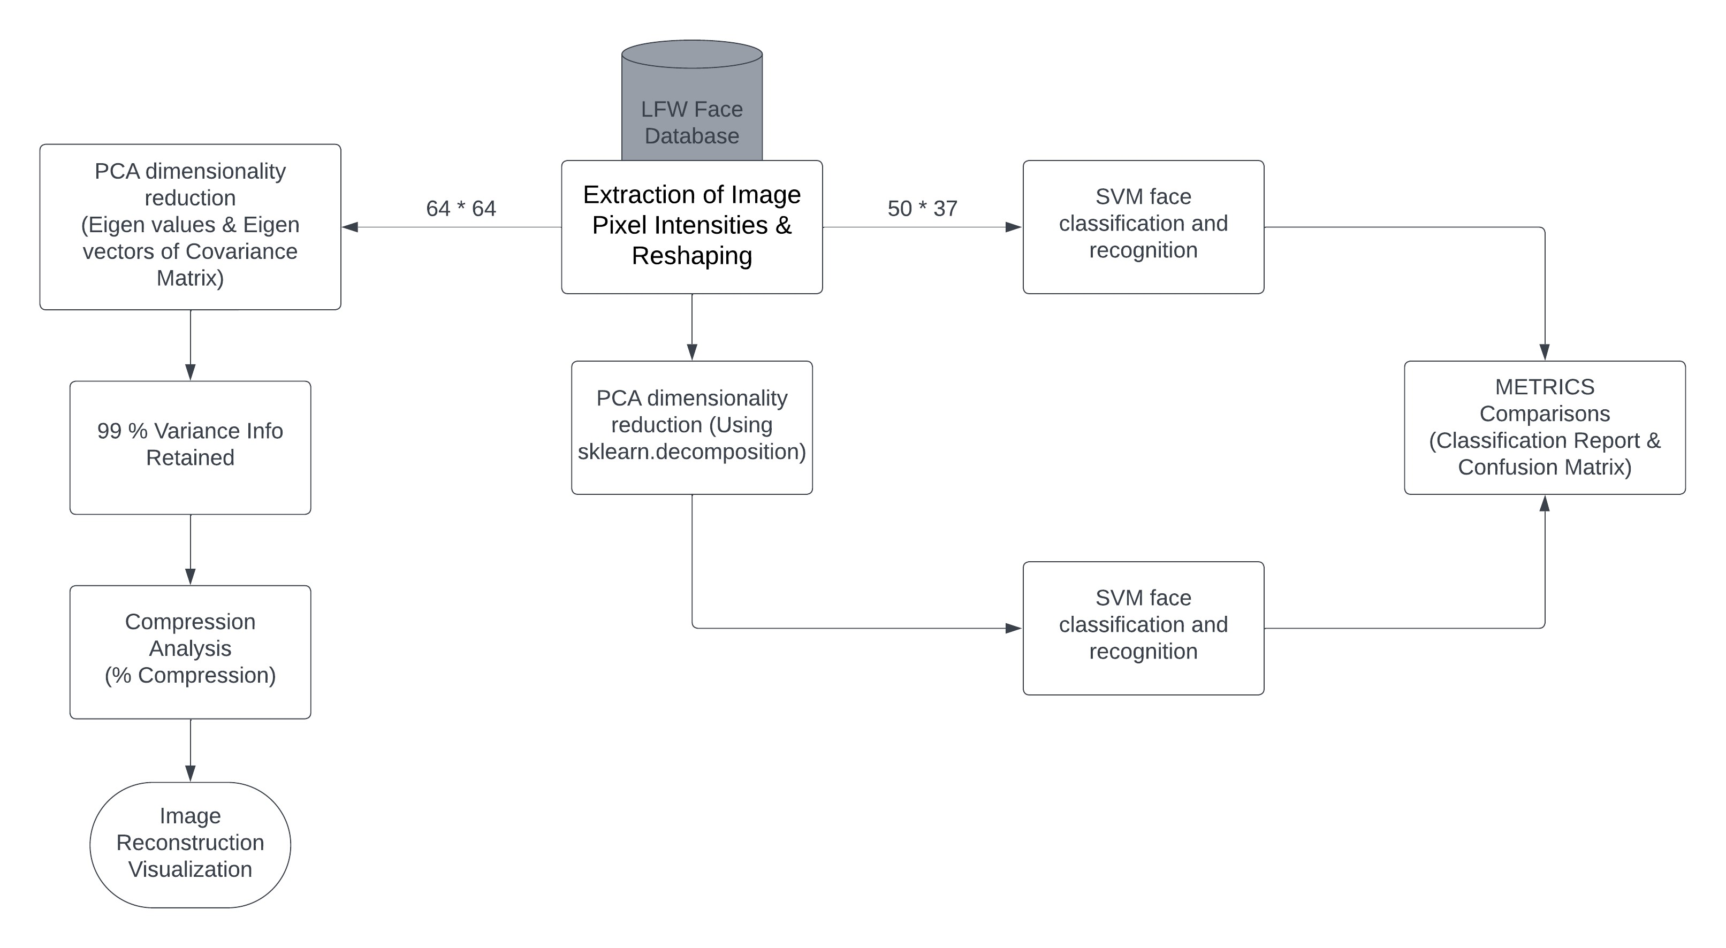
Block Diagram

Slide 8
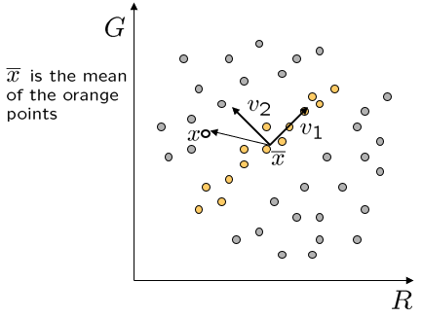
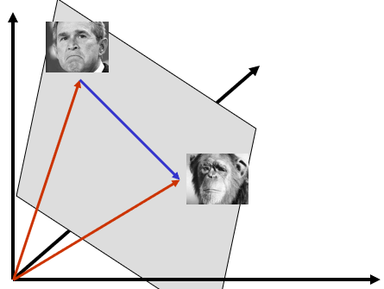
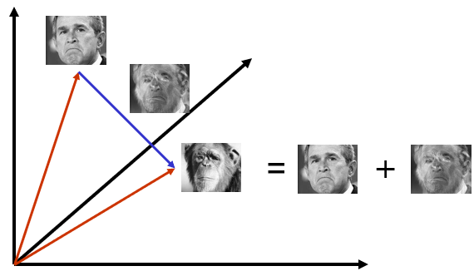
Methodology: PCA (Principal Component Analysis)
2D Space
v₁ is eigenvector with largest eigenvalue
v₂ is eigenvector with smallest eigenvalue
(Dimensionality Reduction)
Space of face: Eigen faces
The set of faces is a “subspace” of the set of images
We can find the best subspace using PCA
This is like fitting a “hyper-plane” to the set of faces
Notes:
Face feature extraction
methods are divided into knowledge-based representation
methods and statistics based representation methods.
reduce data Redundancy
For instance, in a dataset consisting of face photographs, each photograph will have facial features like eyes, nose, mouth. Instead of encoding this information pixel by pixel, we could make a template of each type of these features and then just combine these templates to generate any face in the dataset
Its core idea is to project the data along the direction of maximum variance to retain the characteristics of the original data as much as possible.
Lets see how (PCA) is used to play a key role in feature extractor
PCA – Different ways it can be calculated
Eigenvalue decomposition eigendecomposition of X′X, eigenvectors are linearly independent (orthogonal
Singular value decomposition
Non-linear iterative partial least-squares (NIPALS) algorithm
An image is a point in a high dimensional space
An N x M image is a point in R^{NM}
We can define vectors in this space as we did in the 2D case
The set of faces is a “subspace” of the set of images
We can find the best subspace using PCA
This is like fitting a “hyper-plane” to the set of faces

Slide 9
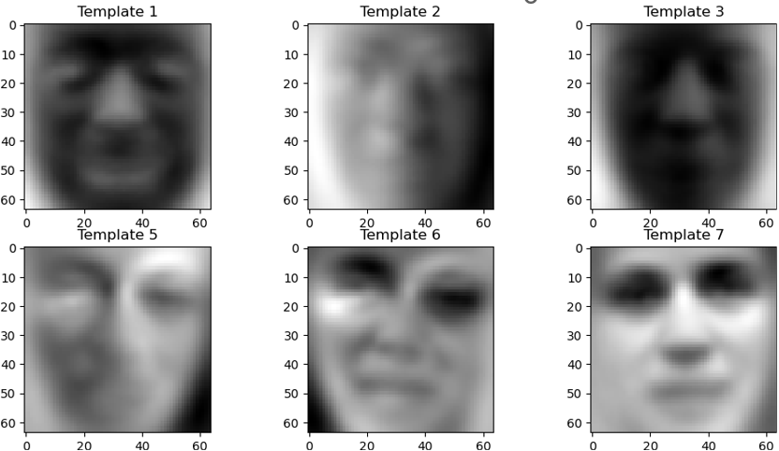
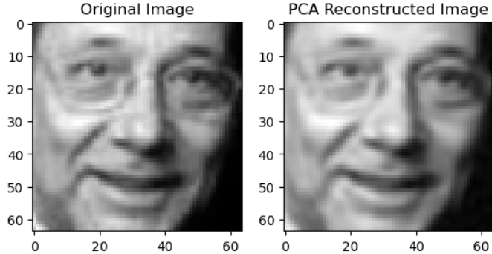
Results & Discussion: Case1
Eigen faces
Retains 99% Variance:
Hence 577 components

Slide 10
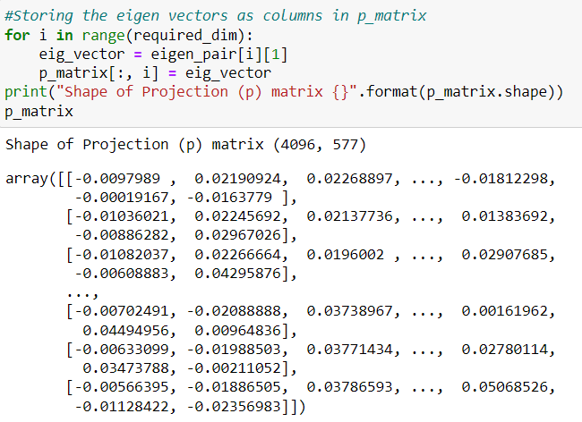
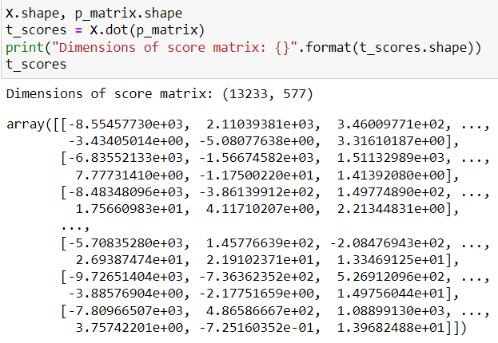
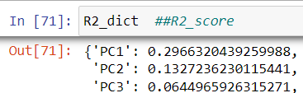
Results & Discussion: Case1
Loadings
Scores

Slide 11

Results & Discussion: Case1
Original Dataset
13233 x 64 x 64
54,202,368
unique values
Scores
13233 x 577
7,635,441
unique values
Loadings
577 X 64 x 64
2,363,392
unique
values
Compressed Dataset Total Unique Values
7,635,441 + 2,363,392 = 9,998,883 unique values.

Slide 12
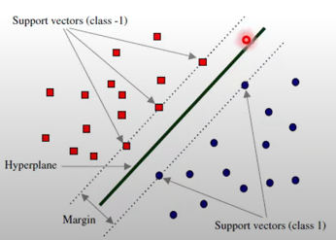
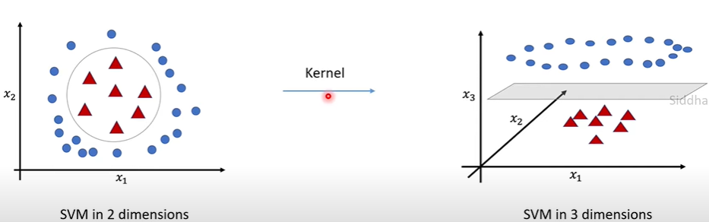
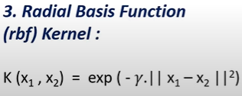
Methodology: (SVM) Support Vector Machine
SVM face classification and recognition
In an N-dimensional space, a hyperplane is a flat affine subspace of hyperplane dimension N − 1..
The classification is done by substituting value of a new point in the hyperplane and then determining the sign of the value.
Number of dimensions is greater than the number of samples. This is a classification case that SVM is effective at solving [2]
(1) Linear separable SVM algorithm
(2) Nonlinear SVM algorithm
Notes:
(1) Linear separable SVM algorithm
SVM – 2 feature example, scatter plot. SVM tries to fit a hyperplane that differentiates these 2 classes. Support vectors
(2) Nonlinear SVM algorithm
Kernels: mathematical functions that Increase the dimensional space.
Different types are linear, polynomial, Radial basis function (rbf)/gaussian kernels and Sigmoid
In our solution, we will tune the hyperparameters, including the penalty C, the kernel (linear or RBF), and 𝛾𝛾 (for the RBF kernel) through cross-validation.
The dataset is imbalanced, so we set class_weight='balanced' to emphasize the underrepresented classes.

Slide 13
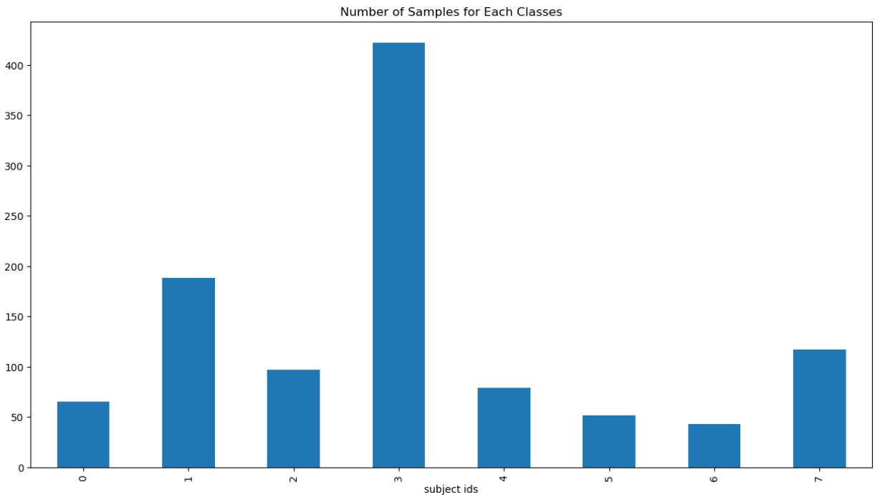
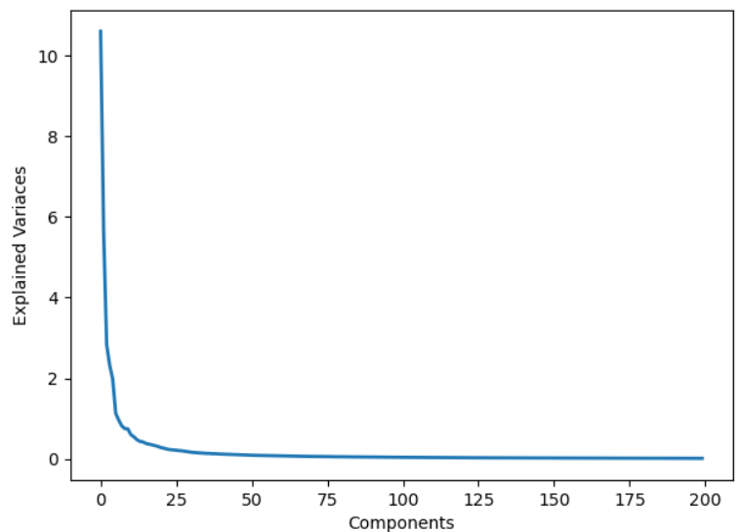
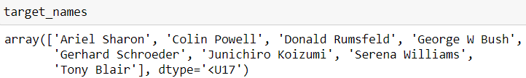
Results & Discussion: Case2
George W Bush has the greatest number of samples in our dataset
Plot to determine the number of components
Decided -- 80

Slide 14
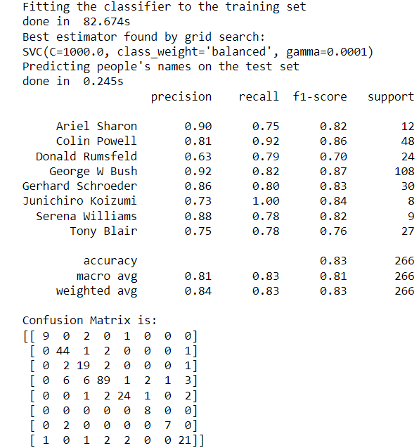
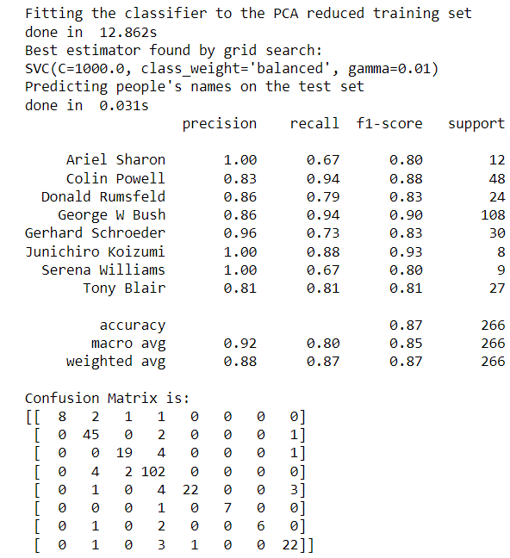








Results & Discussion: Case2
After PCA
PCA can prevent overfitting.
Notes:
By comparing the two experimental results, it is found that the precision and recall performance indexes of face recognition have been significantly improved after PCA dimensionality reduction. The reason is that the dimensionality reduction not only reduces the computational complexity, but also removes some noise data, which is conducive to machine learning, and then improves the accuracy of face recognition.

Slide 15
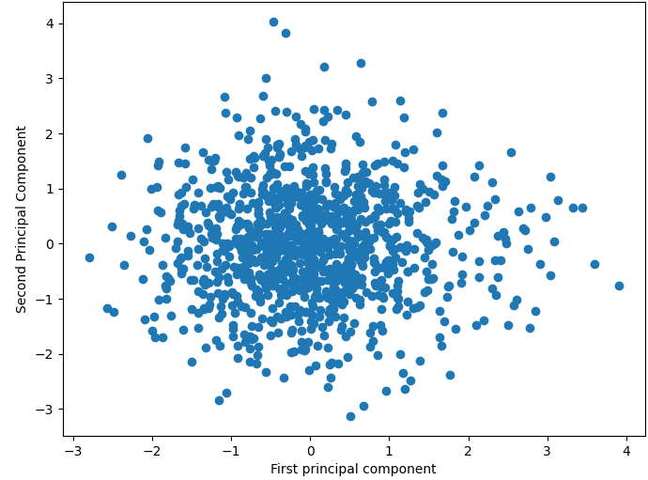
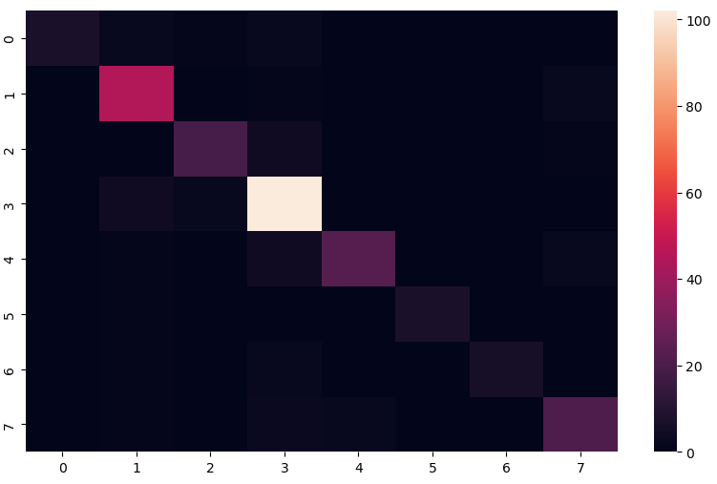








Results & Discussion: Case2
Scatter Plot PC1 vs PC2
Confusion Metrics Plot
Notes:
By comparing the two experimental results, it is found that the precision and recall performance indexes of face recognition have been significantly improved after PCA dimensionality reduction. The reason is that the dimensionality reduction not only reduces the computational complexity, but also removes some noise data, which is conducive to machine learning, and then improves the accuracy of face recognition.

Slide 16
Conclusion & Future work
Face recognition is one of the key research fields of artificial intelligence and pattern recognition. This project discusses the problem of face recognition by combining SVM and PCA algorithm, and optimizes the important parameters, which not only reduces the amount of calculation and storage space of data processing, but also increases the accuracy of recognition.
We can employ deep learning techniques like CNN- Convolutional Neural Network as Classification algorithms, just to see metrics difference. But it is a research fact that it always “Better to use SVM if Number of dimensions is greater than the number of samples”
Use cross-validation techniques, explicitly splitting data into folds and repetitively write a for loop to consecutively examine each hyperparameter, thereby reducing overfitting.

Slide 17
References
IEEEXPLORE
[1] Y. Wang and Q. Wu, "Research on Face Recognition Technology Based on PCA and SVM," 2022 7th International Conference on Big Data Analytics (ICBDA), Guangzhou, China, 2022, pp. 248-252, doi: 10.1109/ICBDA55095.2022.9760320.
[2] M. O. Faruqe and M. A. M. Hasan, "Face recognition using PCA and SVM," 2009 3rd International Conference on Anti-counterfeiting, Security, and Identification in Communication, Hong Kong, China, 2009, pp. 97-101, doi: 10.1109/ICASID.2009.5276938.
[3] Jain N，Kumar S，Kumar A，et al. Hybrid deep neural networks for face emotion recognition[J].Pattern Recognition Letters，2018，115：101-106.
Others: [4] https://www.kaggle.com/datasets/

Slide 18
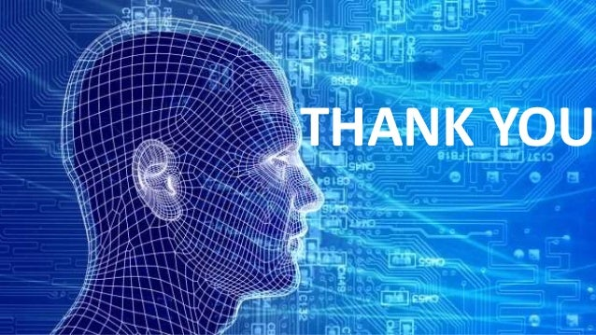
Presented By:
Vipin Chandran Muthirikkaparambil
Student Number: 400547437
Professor: Dr. Brandon Corbett
Project instructor: Dr. Hesam Hassanpour

